Slide 1
How Laradon Developed Affordable Housing in Denver

Slide 2
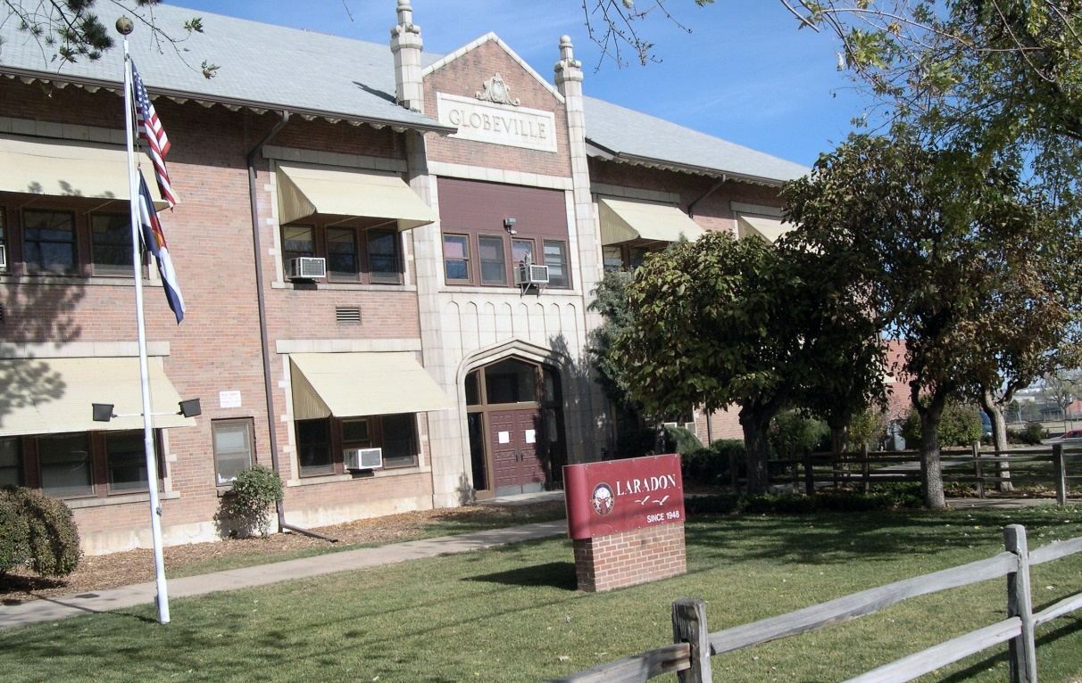
Laradon – c. 1948
Circle of life IDD programming for both children and adults

Slide 3
2016 Survey of IDD Families Reveal Four Social Determinants of Well-Being:
Affordable Housing
Healthcare Access
Workforce Development
Healthy Food Access

Slide 4
Housing
Need key available resources
Land
Developer
Financing Expertise
Political Support

Slide 5
Land
Laradon converted four vacant acres on its 10 acre campus
Elisabetta
Habitat for Humanity Townhouses
Stella

Slide 6
Developer
Interviewed housing experts across Denver
Created housing vision and plan that aligned with Laradon vision and strategies
Selected Gorman and Company

Slide 7
Financing Structure
Low income housing tax credit 4% award for both Elisabetta and Stella
Construction and permanent debt financing
Soft cost funding from the city of Denver and the state of Colorado that helped offset Laradon program space cost
$500K Laradon loan to the project which attributed toward fit out space and be credited toward acquisition of the space at refinancing
Laradon pays $10.00 per year in lease cost due to the financing structure

Slide 8
Political Support
Three city council people, Denver Housing Authority and Habitat for Humanity as key supporters and partners

Slide 9
Three Projects
Elisabetta – 91 units – 1,2,3 bedroom apartments
Habitat for Humanity – 7 townhouses – 3 bedrooms
Stella – 132 units – 1,2,3,4 bedroom apartments
Gorman developed, owns and manages Elisabetta and Stella buildings; Habitat owns and manages the townhouses

Slide 10
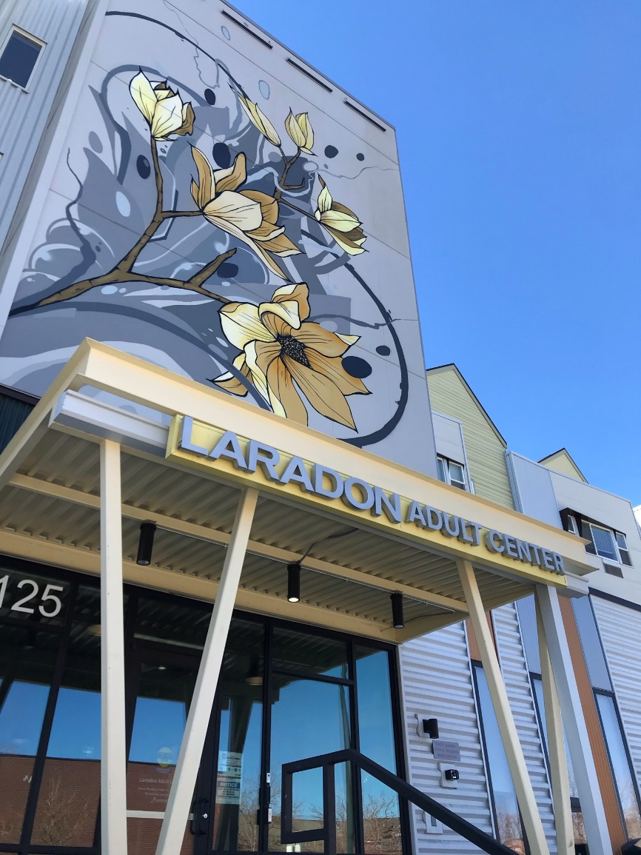
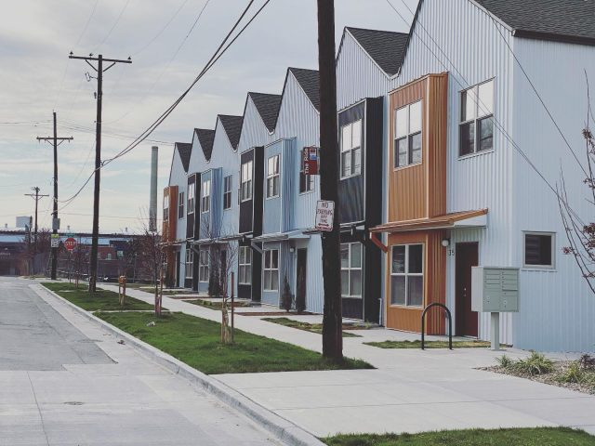
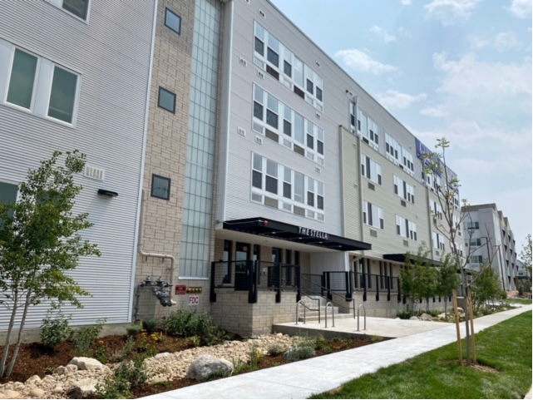
Elisabetta
Habitat for Humanity Townhomes
Stella

Slide 11
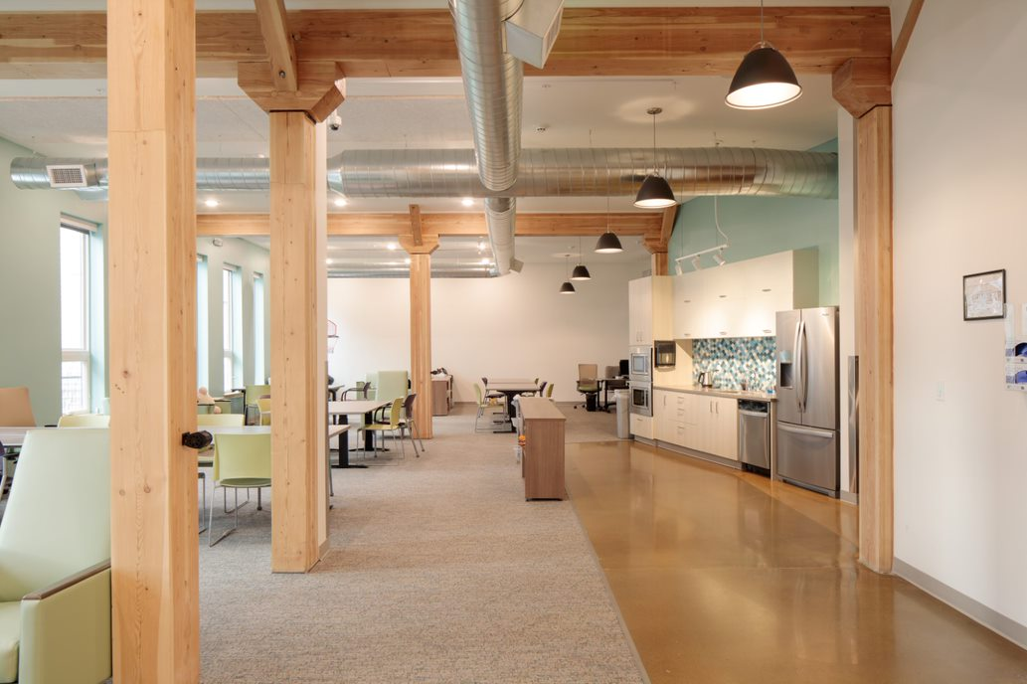
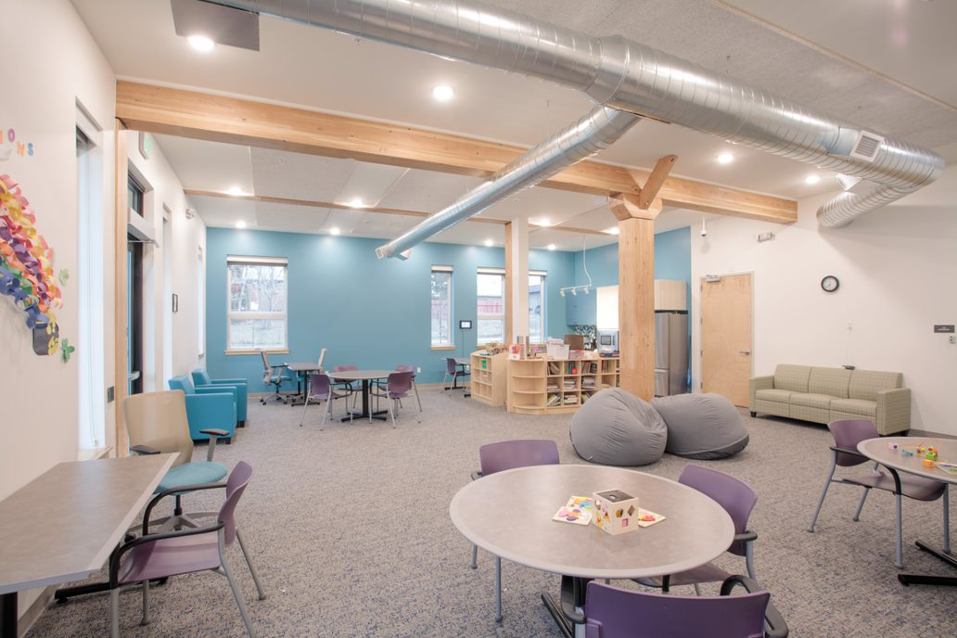
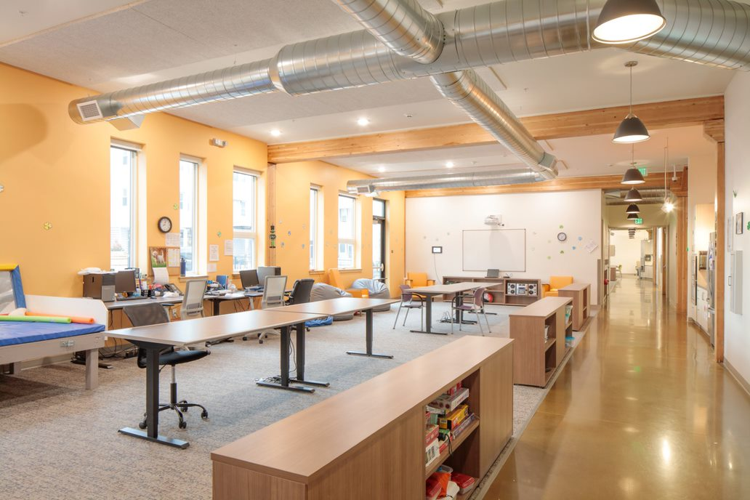
Elisabetta
Interior

Slide 12
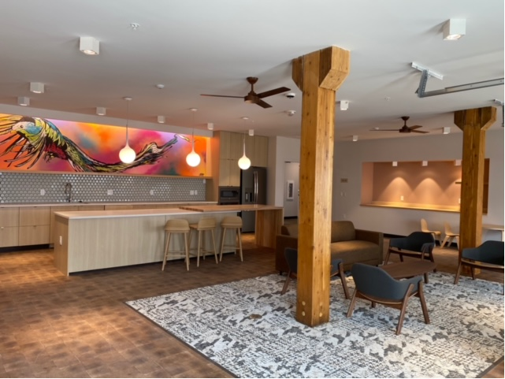
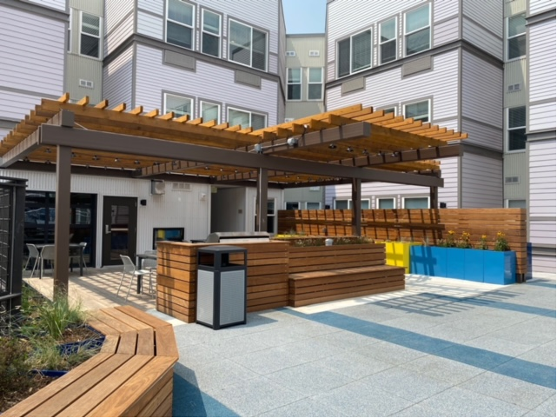
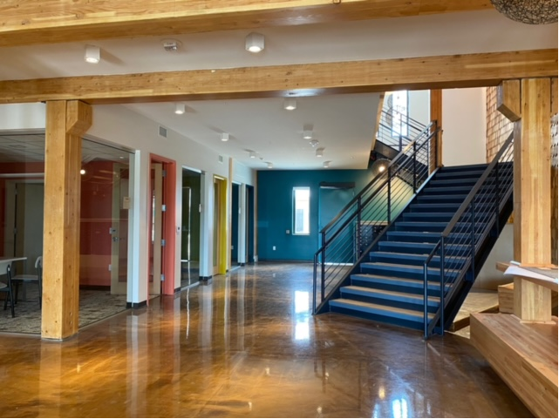
Stella Interior/Exterior

Slide 13
Laradon possesses the entire first floor of Elisabetta and Stella for programming and Elisabetta (Adult Day Services) and Stella (Adult Employment and Child Transition)
Financial structure allows “free” Laradon space which can be purchased at refinancing at fair-market value (likely zero) when project refinanced in 15 years

Slide 14
Entering a Memorandum of Understanding with Denver Housing Authority for a 4th affordable housing project
Laradon spearheaded the first ever IDD affordable housing study in Denver County
Study results will be published this fall and shared broadly

Slide 15
Tangible Results of the Projects
22-811 Vouchers
30 handicap accessible units
Re-developed 3 square city blocks in Globeville
Home to a small number of IDD families and Laradon staff

Slide 16
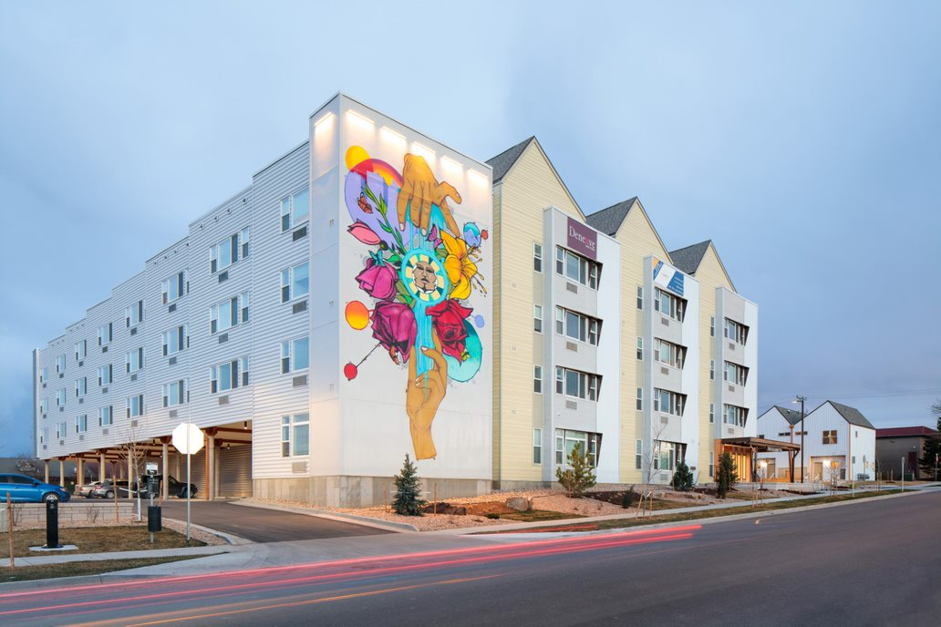

Slide 17
Challenges
Need more IDD families accepted in units
Financing structure, housing regulations and cost are barriers of entry for IDD families – easier for the homeless population than for IDD
Need legislative and regulatory changes to expand eligibility rules for IDD
Incorporate IDD housing study findings into future projects
Insufficient Social Security Income to pay affordable housing rents

Slide 18
Conclusion
Affordable housing projects are doable, but much work remains to get IDD families into these units

