Slide 1
Opportunity to Increase Crisis Prevention/Stabilization for People with IDD and Behavioral Disorders
Alliance 2021
Carol Meredith
Corry Robinson

Slide 2
Overview of Presentation Objectives
Understand history of this project
Understand importance of new opportunity in HB 21-1166
Understand importance of cross-system collaboration for children and adults with IDD and mental health disorders

Slide 3
History
2010--CO Autism Commission identified increased access to MH services for people with Autism and other neuro-developmental disabilities as a critical goal.
2012-Medical-MH committee of CANDO (successor to Autism Commission) identified START model as a possible model to emulate.
CO Legislature funds Gaps Analysis

Slide 4
History
Policy and Funding Barriers and Recommendations report developed.
2015 CO Legislature authorized funding for Pilot
Reports and recommendations
2021- CO Legislature funds training for care coordination

Slide 5
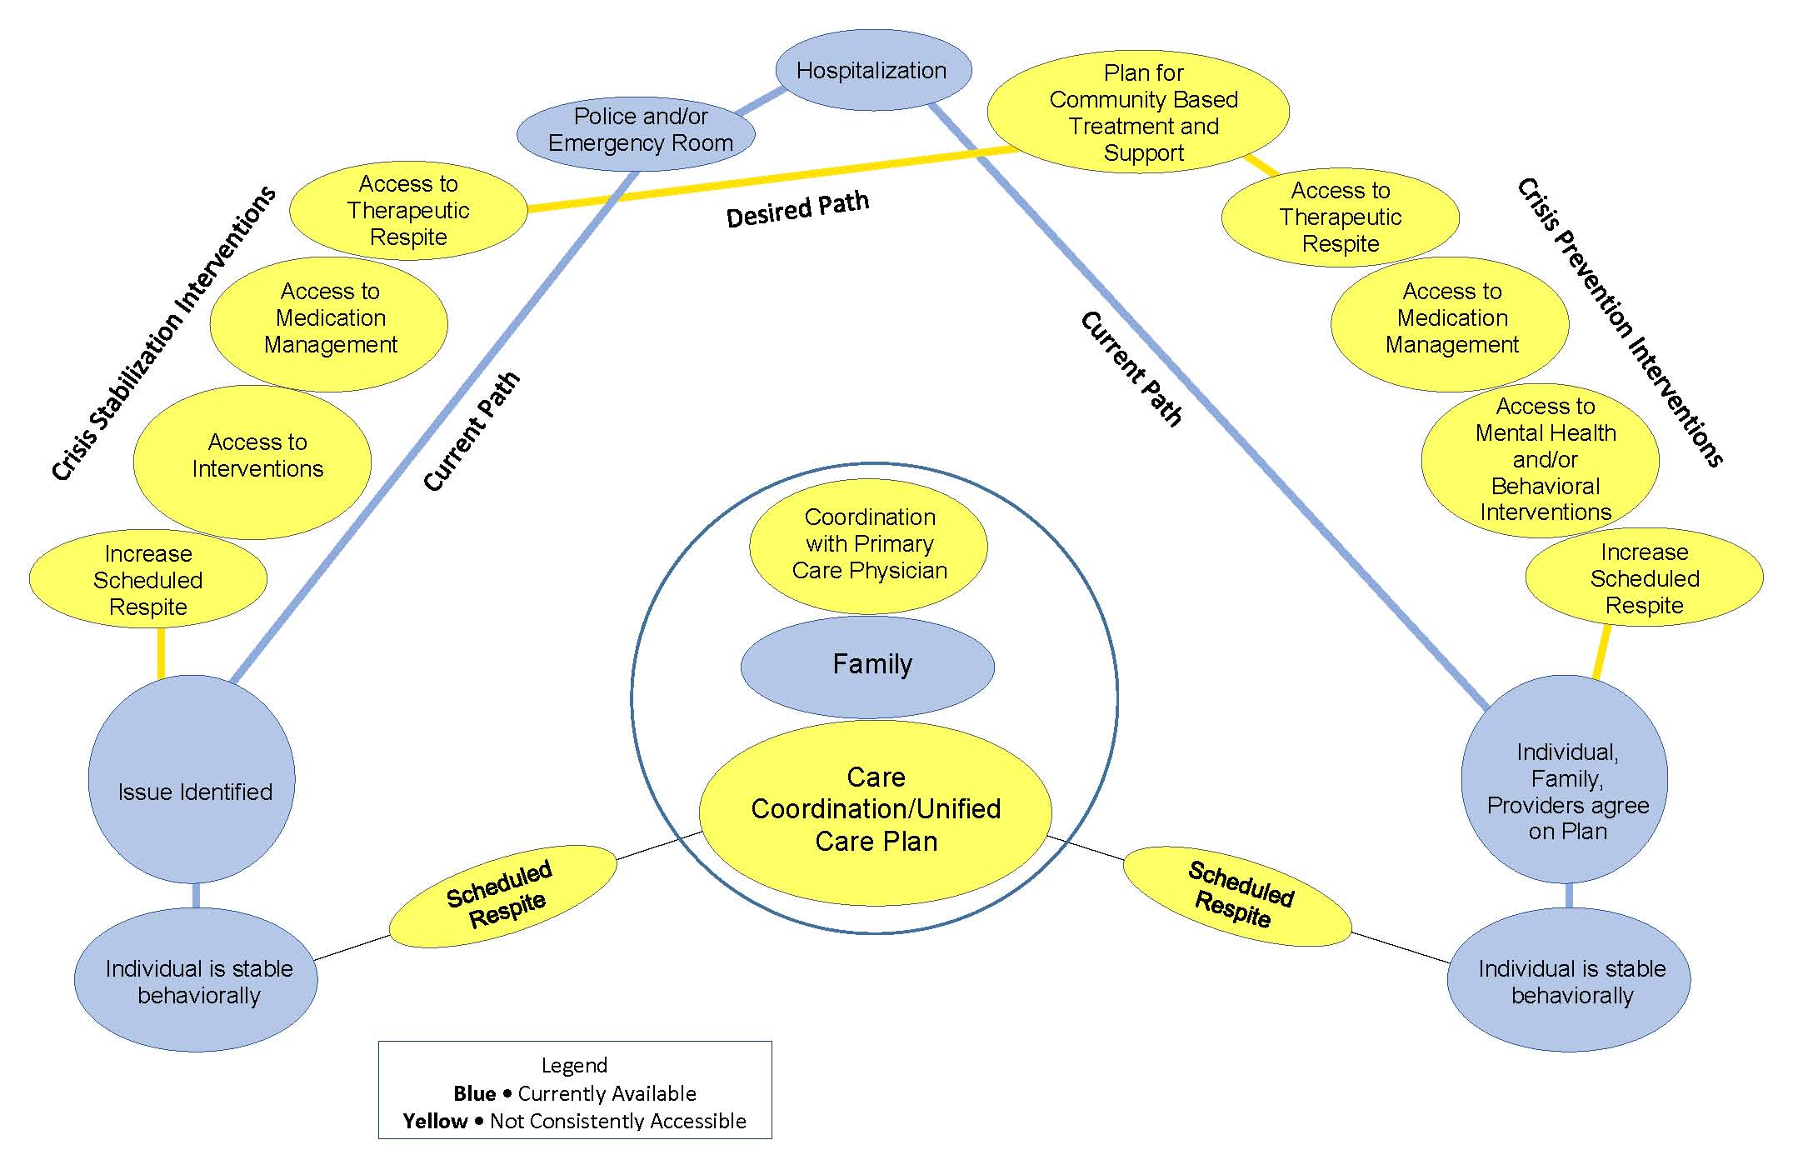
Desired System

Slide 6
Estimate of number of adults with dual diagnosis
Estimate is consistently 30 to 35 percent nationally
3,362-3,923 adults in Colorado on waivers likely in need of mental health services
NCI Core Indicator data shows:
43% of individuals with I/DD need some extensive support to manage self injurious, disruptive and/or destructive behavior
Higher use of psychotropic medication

Slide 7
Recurring Comments for Needed Services
Wrap-around care/support
Many families receiving services/therapies state that any one service meets their child’s needs “a little” or “somewhat”
Access to needed care - regardless of diagnoses or lack thereof
Support for the entire family unit
Need out of home placement options
Day Camp; longer term camps
Respite care with trained staff
Family therapy/classes
Living options for transitioning adults
Living/other supports for higher-functioning individuals
Need for provider training/more options for crises

Slide 8
A Partnership Among Experts

Slide 9
Colorado START Services and Foothills Gateway’s Crisis Response Program

Slide 10
The Values of START:
Capacity building begins with positive engagement- whether it is an individual or a large system. START emphasizes building upon abilities in each individual and their system of support. START has built capacity within systems to provide collaborative treatment planning and crisis intervention plans.
Help begins with providing oxygen- By helping to resolve the immediate destabilizing situation allows for hope and change going forward. START has provided support within 24-hour crisis and inpatient psychiatric facilities so that treatment is appropriate for the unique needs of individuals with dual diagnoses.
Team effort- we work as a team to create opportunities. This includes mutual respect that allows for team input and helping the program to improve and change.
Community- developing and maintaining fellowship with others to share common attitudes, values, interests, and goals, through outreach.
Humanity- Conducting all activities with compassion, understanding and kindness. People are treated with dignity and respect.

Slide 11
CRISIS INTERVENTION
Access to services
Treatment planning
Integrating health and wellness
Service linkages
Identification of stressors
Crisis planning and prevention
Crisis intervention
Respite services
Clarifying diagnoses
Emergency Room
In-patient
Police/legal
PRIMARY
INTERVENTION
SECONDARY
INTERVENTION
Potential impact of intervention
Required intensity of Intervention
TERTIARY
INTERVENTION

Slide 12
FUNDING SOURCES AND LIVING SITUATION
LIVING SITUATION
HOST HOME/FAMILY CARE: 3
FAMILY HOME: 9
INDEPENDENT LIVING: 3
FUNDING SOURCE
HCBS-DD: 6
HCBS-SLS: 4
CES: 1
CHRP: 2
FSSP: 1
WAIT-LIST: 1

Slide 13
PRIMARY REASONS FOR REFERRAL
SERVICES AT TIME OF REFERRAL
Aggression (physical, verbal, property destruction, threats)
Decrease in ability to participate in daily functions
Diagnosis and treatment plan assistance
Family needs assistance
Leaving unexpectedly
Mental health symptoms
Self-injurious
Sexualized Behavior
Suicidal ideation/behavior
Behavioral support services
Case management Services
Day/prevocational services
Enhanced staffing
Mental health outpatient service
Occupational therapy
Physical therapy
Respite services
Vocational/employment services

Slide 14
PSYCHIATRIC DIAGNOSIS
Autism Spectrum Disorder (ASD)
Attention Deficit Hyperactivity Disorder (ADHD)
Anxiety
Depression
Reactive Attachment Disorder (RAD)
Conduct Disorder
Disruptive Mood Dysregulation Disorder (DMDD)
Obsessive Compulsive Disorder (OCD)
Bipolar Disorder
Borderline Personality Disorder
Mood Disorder

Slide 17
Crisis Response and START Moving Forward
Continue to provide Crisis Services, including START Coordination, to adults/children with IDD and mental health support needs.
Continue to contract with The Center for START Services for consultation, training, and oversight.
Work with our community partners to address the needs of adults/children with IDD having a mental health crisis. FGI staff work very closely with SummitStone Health Partners (SHP), law enforcement agencies/co-responders, and hospitals in responding to these urgent situations.
Foothills Gateway’s ongoing Crisis Response Team members are: On-call Case Management staff, START Coordinator/ Crisis Team Supervisor (Reni Moreno) overseeing the specially trained staff who are dispatched to respond to crisis.
Support services through the HCBS-CHRP waiver (children The START Coordinator is able to provide Wrap Around/Intensive from birth to 21 years old). Through CHRP, children can receive intensive support services, which include crisis prevention & intervention, if they meet the Level of Care criteria. The services provided will align with strategies, interventions and supports for the child and the whole family, with the core focus on stabilization and crisis prevention and/or de-escalation.
On-going outreach and training to Healthcare Providers, Mental Health Providers, Schools and Families

Slide 18
Questions?

Slide 19
Denver START Clinical Team
Denver Human Services IDDEAS Program

Slide 20
Local Program Investigation
October 2019
Advisory Council recommendation
March 2020
Public meeting on START model
September 2021 Contracts before City Council for approval
2018
DHS I/DD Needs Assessment
Winter 19/20 Program investigation of START model efficacy
January-August 2021
CSS consultation for RFP to select local provider
Fall 2021
Hiring/ services begin
2
Notes:
In our 2018 Needs Assessment for Residents with I/DD, 65% of respondents indicated adequate mental health services as a “big problem”
In October 2019, the DHS IDDEAS Advisory Council (IAC) recommended DHS explore the START model and potential to implement in Denver.
Winter 2019-20: DHS began investigating the model and met repeatedly with CSS staff, as well as Denver local providers and START program leaders across the nation.
March 2020: DHS hosted a virtual public meeting about START with CSS staff.
January-August 2021: Consultation with CSS to support the City’s competitive selection of a local provider and to develop Denver implementation plans ($25,000 contract).
September 2021: Denver START services launch, contingent on approval of START contracts.

Slide 21
Collaboration & Oversight
Knowledge. Transparency. Accountability. Collaboration.
Denver Human Services and CSS for START Services monitor local program development.
Vendors work together to achieve goals.
Vendors report out to Denver Human Services.
3
Notes:
Talk about relationships, decisions, accountability. All communicating with each other. Just as CSS trains the local provider on the START model, the local provider (RMHS) will be communicating differences/ nuances that are specific to our local community and CSS will work with RMHS to meet Denver’s unique needs as they arise.

Slide 22
New Opportunity HB 21-1166
Telehealth Training of 30 Professionals in Cross System Behavioral Health Crisis Response Training
Each of the 20 CCB geographic areas will have one person selected for training
An additional 10 people to give support to rural areas

Slide 23
New Opportunity HB 21-1166
Masters degree prepared person may come from any agency. Agency will be reimbursed for time spent training
Training won’t start until Spring 2022, but start planning now.
Begin building a Community of Practice across communities

Slide 24
Cross System Work Imperative to HB 21-1166
Reach out to Mental Health Centers
Reach out to Law Enforcement and First Responders
Reach out to Crisis System Personnel

Slide 25
Cross System Work Imperative to HB 21-1166
Reach out to families with individuals with dual diagnosis
Reach out to Legislators
Use selection of HB 21-1166 professional to be trained to establish or further current Cross System work

Slide 26
Knitting Services
Medicaid Home and Community Based Services Waivers
Medicaid State Plan
Behavioral Health Organizations
Colorado Crisis Services
Private Insurers
Other Respite Dollars

Slide 27
Build upon Current and Planned Efforts
Look at Behavioral Health transformation plans https://cdhs.colorado.gov/behavioral-health-reform
Look at IDD focused report; use the recommendations to address issues you face
Look at plans for the ARPA money especially with respect to:
Crisis Intervention
Care Coordination
Workforce Development

Slide 28
Anthem for Next Five Years

Slide 29
Presenters
Carol Meredith - Carol@arc-ad.org
Cordelia Robinson Rosenberg - Cordelia.rosenberg@cuanschutz.edu
https://medschool.cuanschutz.edu/jfk-partners/projects/dual-diagnosis-gap-analysis

