Slide 1

Best Practices:
Individualized Service & Support Plan

Slide 2
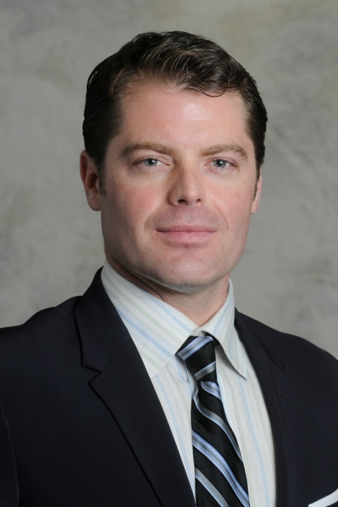
Tom is President of Arlington Heritage Group and joined the firm in 2008, bringing years of investment and financial management experience to the executive team.
Prior experience includes equity analysis and portfolio management at Standard & Poor’s, ING Barings, and American Century.
Tom has a B.S. in Business Administration from Boston University and holds both the Chartered Financial Analyst and Certified Market Technician designations.

Slide 3















Since 1986, Arlington Heritage Group has managed trusts for human service providers and 501(C)3s. The Provider Trust is used by non-profits to better manage funds of individuals in their care.
Some of Our 75+ Clients…

Slide 4
Since 1986, Arlington Heritage Group has managed trusts for residential agencies and 501(C)3s that care for individuals with special needs.
Arlington offers its Provider Trust to non-profits that wish to have their own trust to help better manage the funds of individuals in their care.

Slide 5
Individualized Service & Support Plan (ISSP)
Details what is most important to an individual so team can focus on those areas, derived from Person Centered Planning (PCP) process
Comprehensive in scope, includes the following:
Preferences
Medical
Health & Safety
Functional Information
Financial
Services & Supports

Slide 6
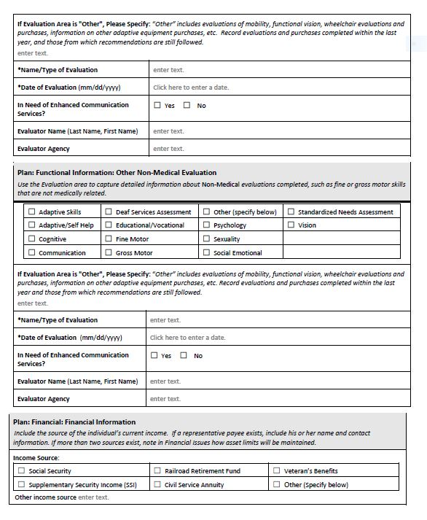
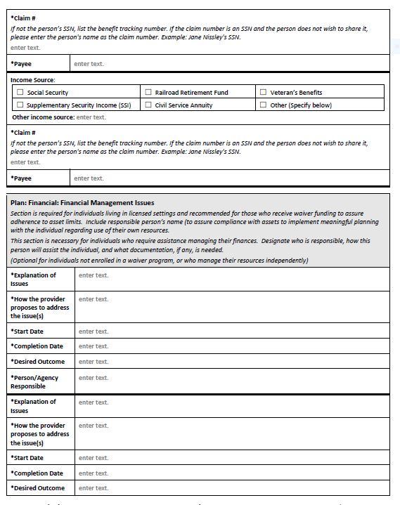
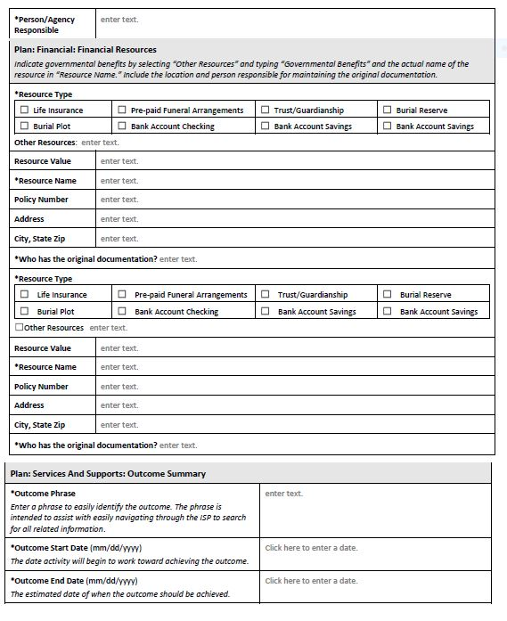
Financial Section

Slide 7


The Essentials
Income Sources
Social Security, SSI, Civil Service Annuity, Veteran’s Benefits, RR Retirement, Other(s)
Financial Management Issues
Section necessary for those requiring assistance in managing their finances.
Key questions are Who is responsible? and How will the individual be assisted?
Financial Resources
Life Insurance, Pre-Paid Funeral, Plot, Trust/Guardianship, Bank Checking, Bank
Savings, Other

Slide 8
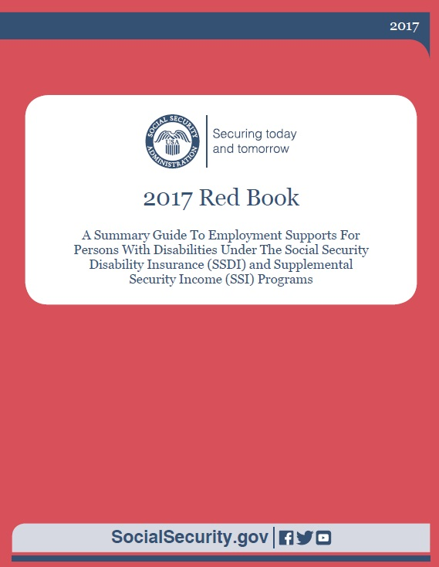
A Note on Income & Jobs
Public Policy (the Community Rule et. al.), technology and state initiatives are moving in the direction of job placement.
Income thresholds and penalties can be confusing.
--Excludes first $65 earned income each month
--Excludes half of amount over $66
A person can make up to $1,550/month before SSI benefit = $0.00

Slide 9
Social Security Resource Limits
$2,000
Personal effects, jewelry, etc.
Burial spaces
Life insurance, up to $1,500
Grants
Burial funds, up to $1,500
(unless an irrevocable trust)

Slide 10
More Exempt Resources
Individual’s Car
Individual’s House
Irrevocable Prepaid Burial Account
Trusts: Pooled Special Needs & SNTs
ABLE Account

Slide 11

Ascertaining Resources
Bank Accounts: checking or savings or certificate of deposit
Life Insurance or Burial Insurance
Pre-paid burial and/or plot
House or car
Trusts: special needs trust, pooled special needs trust, other
ABLE Account
IRA, 401(K), ESOP,
Annuity or Structured Settlement
Future Bequest

Slide 12


Do The Legwork!

Slide 13
Finding Resources
Talk to the individual, family members, guardian, conservator, or POA
?
Is the person a beneficiary, named in will, had a previous job, or has another financial account other than bank checking? Joint accounts?
If yes…CHANGE THEM!
CONDUCT AN ASSET SEARCH
https://colorado.findyourunclaimedproperty.com/
https://www.unclaimed.org/

Slide 14
Exempt vs. Non-Exempt
Bank Accounts $2,000
Life Insurance $1,500
Pre-paid burial Irrevocable
House or car Titled to the Individual
Trusts d(4)a, d(4)c
ABLE Account
IRA, 401(K), ESOP, DRiPs Must be Liquidated
Annuity/Settlement Must be paid into exempt account
Future Bequest

Slide 15
Interacting With Team Constituents
Parents & Family
--The power of Mom
--Siblings
--Extended family
Guardians and POAs
--What kind of partnership does the Guardian want?
--POA or Healthcare POA?
Trustees
--Is the Trustee transparent? Responsive?
Case Workers
--Degree of expertise? Knowledge of the individual?

Slide 16
Recalcitrant Team Members
Parents & Family
--Decisions only parents can make?
Guardians, Conservators, POAs
--Corporate Counsel, Executive involvement
Trustees
--Corporate Counsel
Case Workers
Individual’s Own Decisions Contrary to Interest…a new wrinkle with PCP

Slide 17
Thomas Tirney
Arlington Heritage Group, Inc.
tgtirney@ahgtrusts.com
(215) 672-1184

