Slide 1
Improving health care access and equity for children and youth with special health care needs
Alliance Summit 2024
Megan Bowser, Executive Director
Christy Blakely, Senior Advisor

Slide 2
OUR MISSION:
Making COLORADO a better place for children and youth with special health care needs
www.familyvoicesco.org

Slide 3
OUR WORK:
Provides public awareness of challenges and barriers
Helps families to navigate healthcare systems and understand their rights and resources
Works to improve health equity, access and quality of care
www.familyvoicesco.org

Slide 4
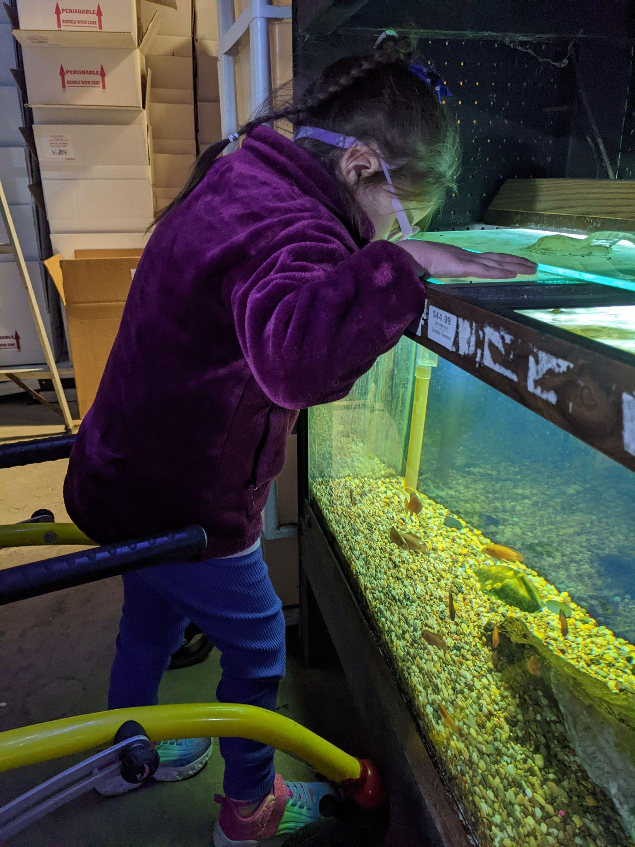
An Example
Community Intervener Pilot

Slide 5
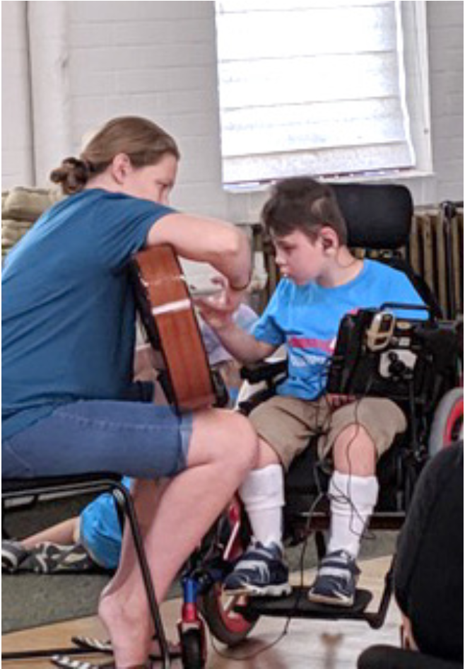
WHAT IS AN INTERVENER?
Works consistently one-to-one with an individual who is deafblind
Has training and specialized skills in deafblindness
Works closely with all team members (i.e. OT, PT, TB/VI, TD/HH, O&M, SLP etc.) to implement the IEP goals on a day to day basis
www.familyvoicesco.org
Notes:
Assigned to work one-to-one with a student who is deafblind to facilitate the process of intervention as opposed to a paraprofessional who usually works with groups of students.
Has skills in deafblind intervention including communication methods, environmental access, sensory loss, deafblind instructional strategies, and how to create independence rather than dependence.

Slide 6
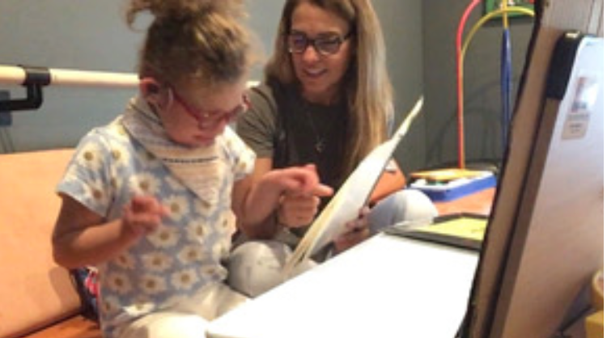
WHAT IS AN INTERVENER?
Facilitates the student’s connection to others by creating a safe and supportive environment that encourages successful communication and interaction
https://intervener.org/
www.familyvoicesco.org
Notes:
Participates as an active member of the student’s team including attendance at IEP meetings in order to contribute valuable day-to-day knowledge of the student
Facilitates the student’s connection to others by explaining and modeling the student’s specific communication system, acting as a bridge to the world, and creating a safe and supportive environment that encourages successful interactions

Slide 7
ROLE OF AN INTERVENER
Facilitate access to the environmental information that is usually gained through vision and hearing, but which is unavailable or incomplete to the child who is DeafBlind.
Facilitate the development and/or use of receptive and expressive communication skills.
Develop and maintain a trusting, interactive relationship that can promote social and emotional well‐being for the child who is deafblind.
www.familyvoicesco.org
Notes:
Assist children to explore activities such as, going to the library, a park, the pool, a store, and more.
The role of the intervener is to provide effective deafblind‐ specific intervention. The intervener facilitates access to the environmental information that is usually gained through vision and hearing, but which is unavailable or incomplete to the child who is deafblind; the intervener facilitates the development and/or use of receptive and expressive communication skills, and the intervener develops and maintains a trusting, interactive relationship that can promote social and emotional well‐being for the child who is deafblind.

Slide 8
Community Intervener Program
2 parents individual school advocacy
Coming together to work with the Department of Education
Widening the vision
Seeking support from an organization

Slide 9
The Intervener Pilot
The Intervener Community Pilot was born
Year one, August 2021:
Grant from Commission of the Deaf and Hard of Hearing and Deaf Blind
Donations
Hired a manager, recruited committee members, contracted for evaluator, created documents, solicited for participants and Interveners
Served 10 families in year 1 starting December 2021

Slide 10
The Intervener Pilot
Year two, August 2022, fully funded:
Grant from Circle Foundation
Grant from Commission of the Deaf and Hard of Hearing and Deaf Blind
Grant from Rose Foundation - Lobbyist
Donations
Continued recruiting families and interveners to the program. Completed pre and post surveys of families and tracked progress on goals.
Served 17 families in years 2 and 3

Slide 11
Other Activities
Collaborated with CDE, Anchor Center for Blind Children, Colorado Hands and Voices, University of Northern Colorado, and more
Created an Advisory Committee and an Oversight & Education Committee
*Each committee met monthly

Slide 12
Fall 2022
Hired a Lobbyist
Initiated a bill for the 2023 legislative session
Worked with bill writer
Lobbyist worked to find a funding source
Worked to find sponsors for the bill
Collected data and success stories from families and interveners

Slide 13
The Legislative Process
HB23-1067 - Family Intervener Program Deafblind Children
Concerning creation of a family and community intervener program to support children experiencing deafblindness, and, in connection therewith, making an appropriation.
The act creates the family and community intervener program (program) to support children who are deafblind and their families. The program provides deafblind children the services of an intervener who is specifically trained in deafblindness, building language and communication skills, and intervention strategies with children who are deafblind and their community, families, and environment. The Colorado commission for the deaf, hard of hearing, and deafblind shall contract with an intervener program manager (manager) who has oversight over the program, the intervener activities, and the outcomes for children who are deafblind.

Slide 14
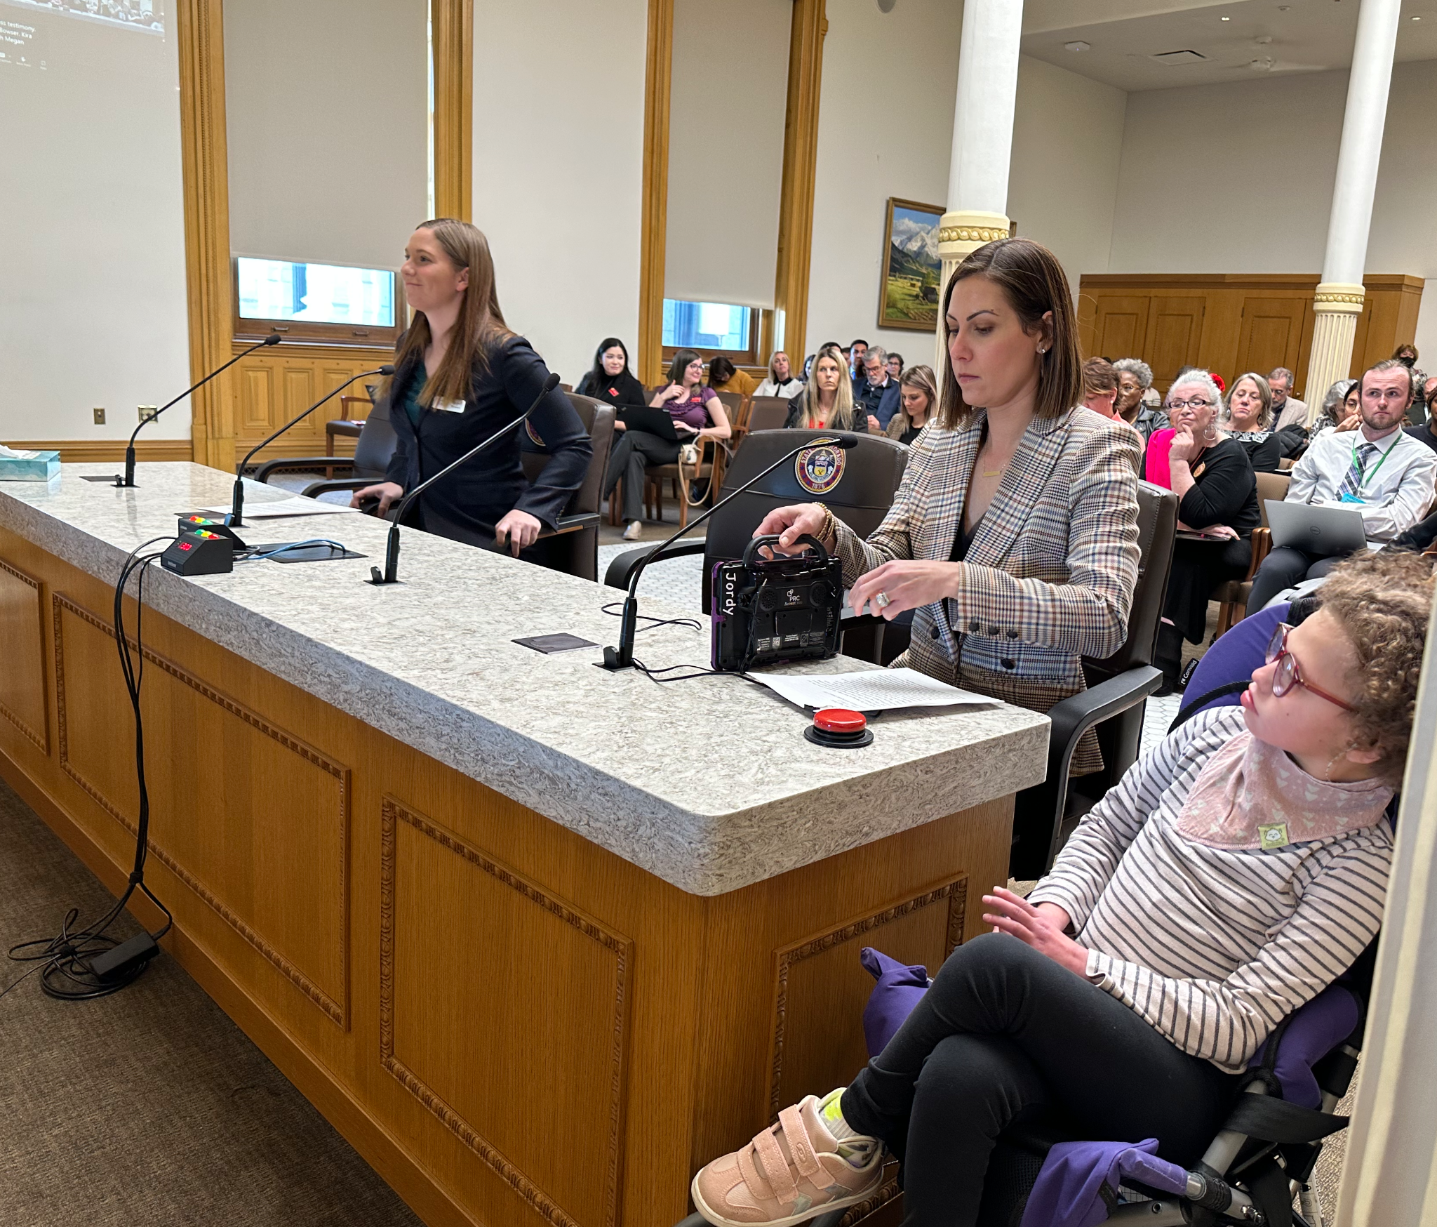
HB 23-1067
Bill introduced in the House by Mary Young, and Mary Bradford in the Senate
Helped families craft their stories
Parents and participants testified at committee hearings at the capitol

Slide 15
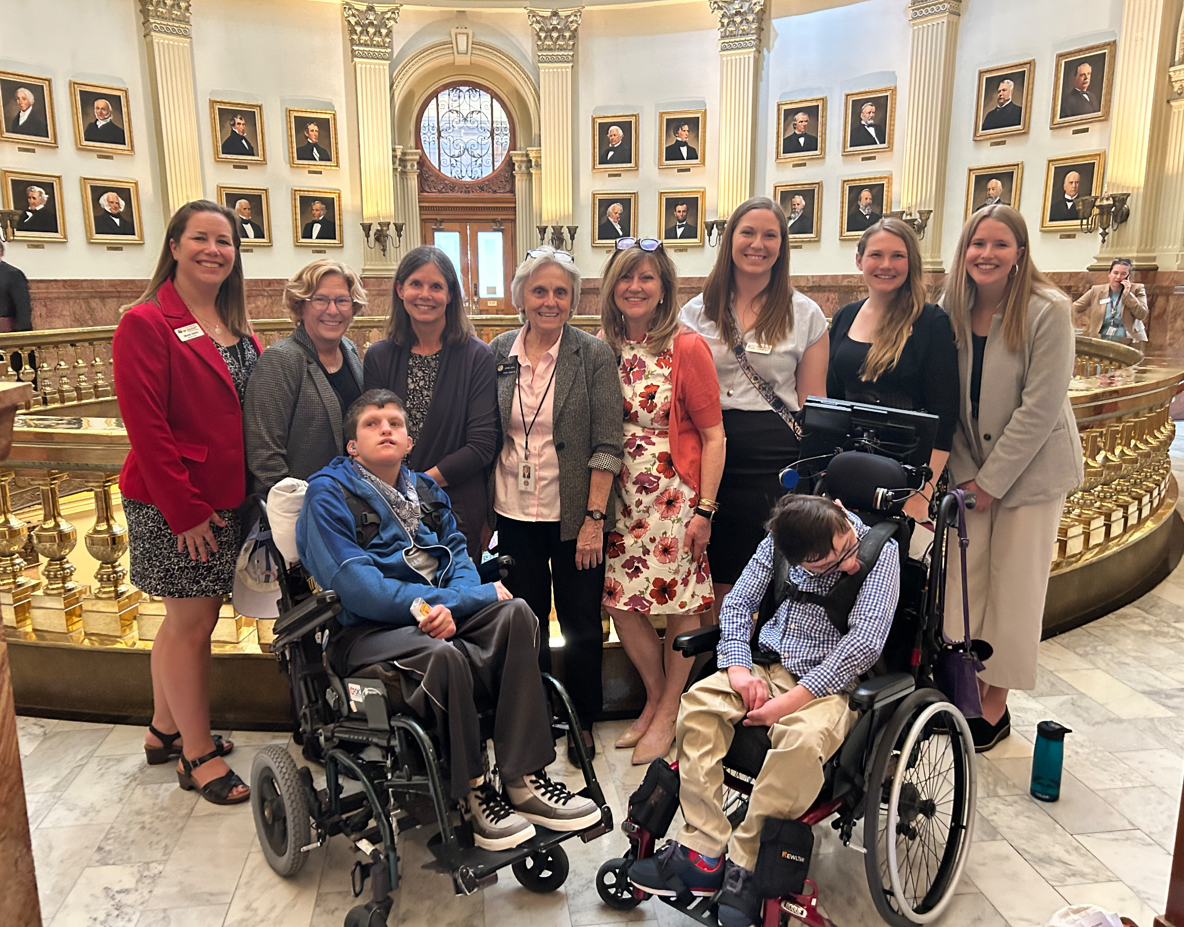
Gathered Momentum

Slide 16
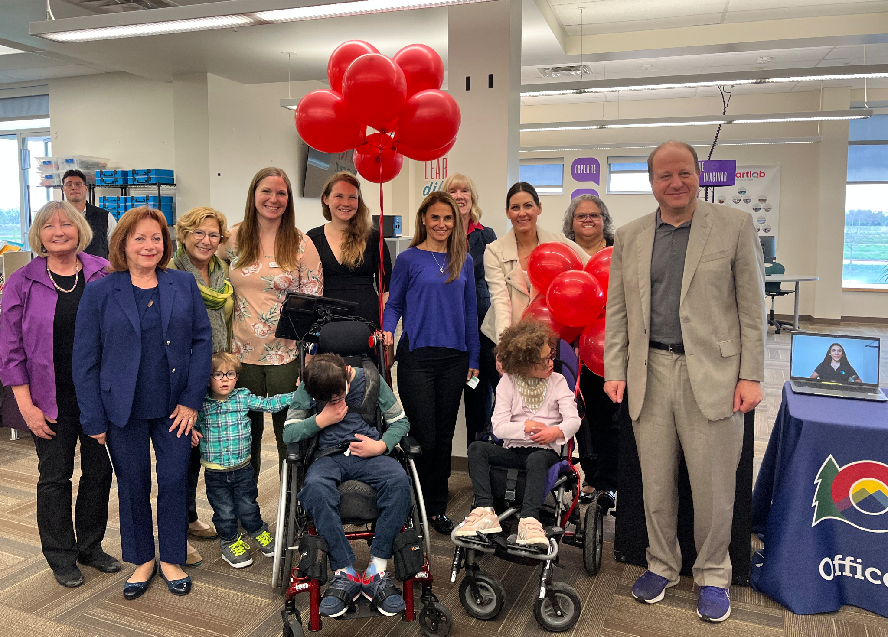
Signed into Law
May 15, 2023

Slide 17
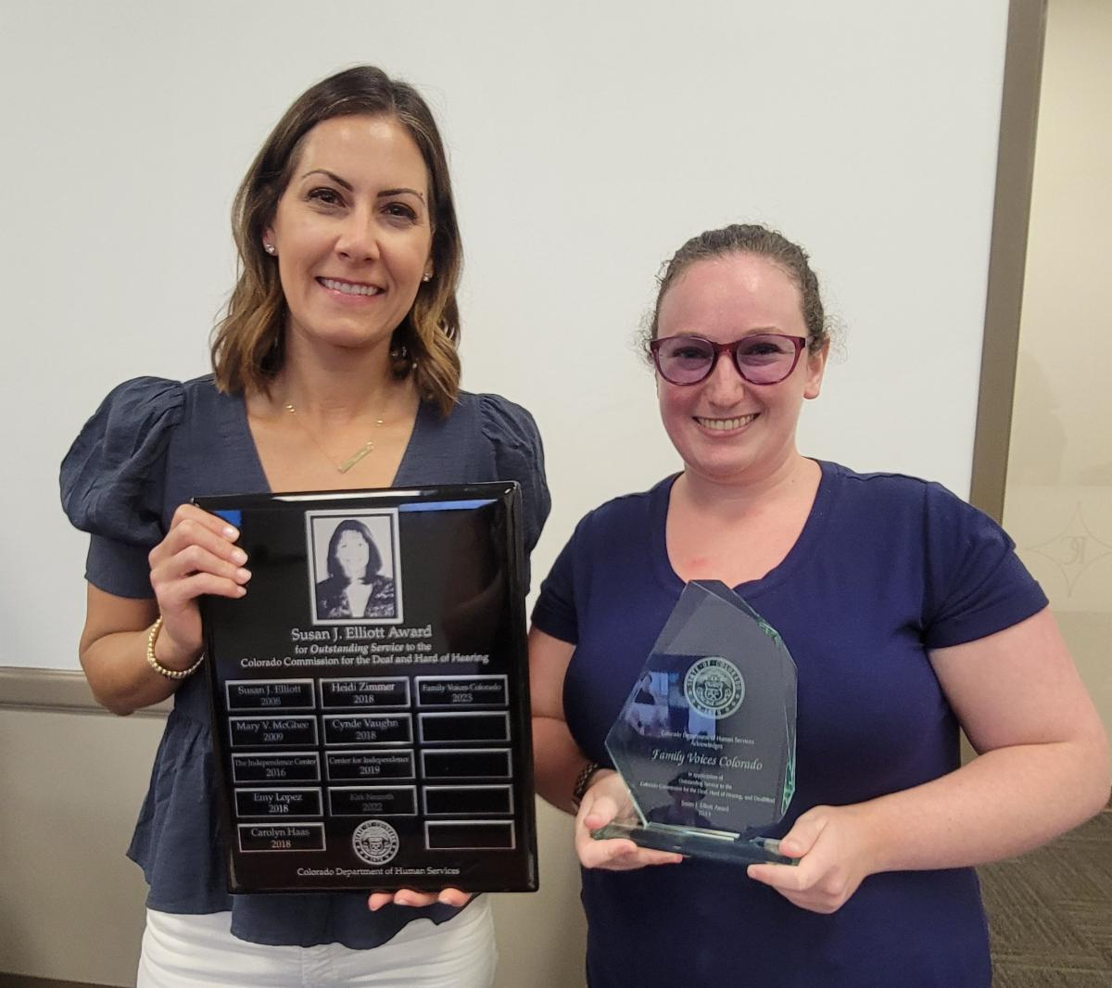
Won an Award!
2023 Susan J. Elliot Award
Kiera Zink &
Elli Streifer
accept the award on behalf of Family Voices CO

Slide 18
Data
11 Interveners - 8 newly recruited to the field
20 children served - ages 18 months to 24 years
Overall, how satisfied are you with the Intervener services your child and family received?

Slide 19
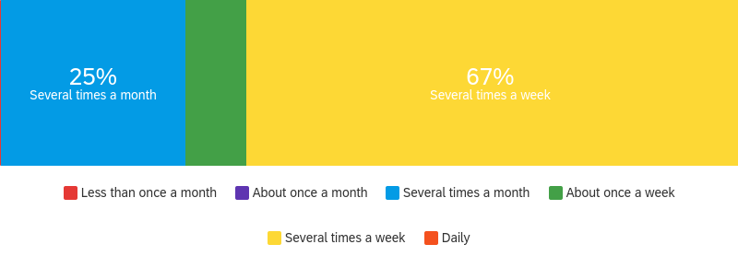
How often does your child engage in community activities (not including school or therapy)?
Pre
8.3%
8.3%
Post
8.3%
Notes:
Pre & Post updated again

Slide 20
How would you best describe your child's communication skills?
Pre
Post
8%
and which are difficult for an unfamiliar person to understand
most people can understand
present basic needs
, picture symbols, etc.
ell about day and communicate
Notes:
Pre & Post updated

Slide 21
Challenges
Creating the many documents for both families and interveners
The time to onboard for both families and Interveners took much longer than expected
Families wanted most of the hours in summer, rather than throughout the year making budgeting difficult
Moving a Program to the a state agency takes TIME!
www.familyvoicesco.org

Slide 22
GOALS
Provide children and youth with deafblindness meaningful access to their community comparable to their peers without sensory impairments
Provide systems navigation specifically for this population
Secure funding for and place this program in a Colorado state agency to continue in perpetuity
www.familyvoicesco.org

Slide 23
Intervener Program Today
As of August 1st, 2024, the Intervener Program is managed by The Commission for the Deaf Hard of Hearing and Deaf/Blind.
Elli Striefer is the manager of this program
The program receives ongoing funding through the Colorado telephone users with disabilities fund

Slide 24
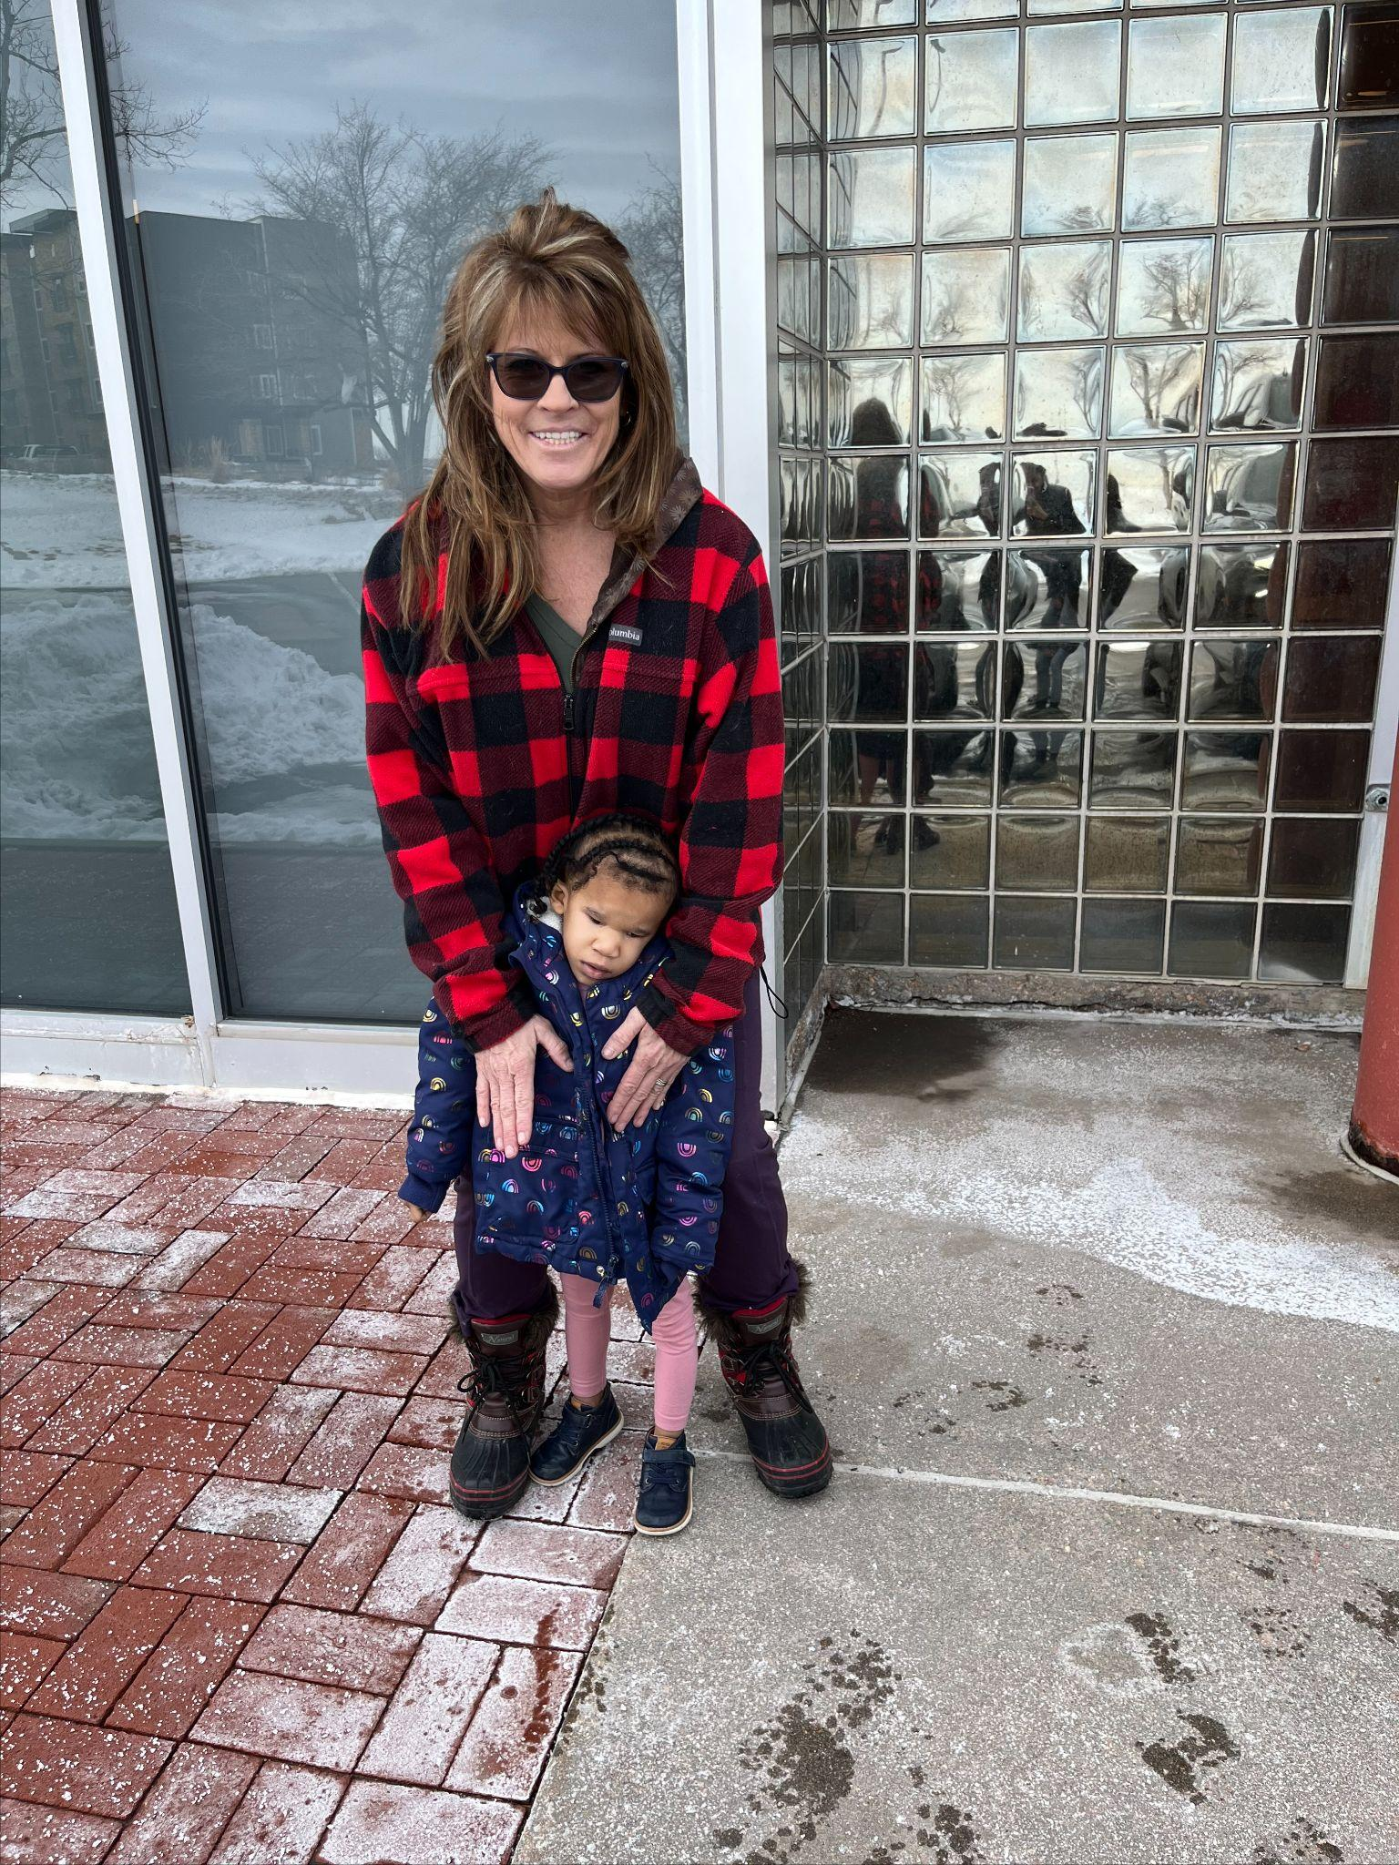
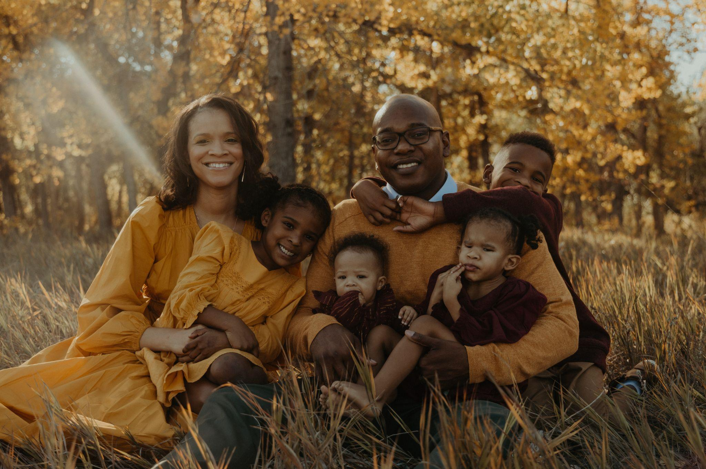
TESTIMONIAL
www.familyvoicesco.org
Notes:
Some weeks ago, Emerie attended a family community day that was held at Anchor Center. When her mom saw the slide, she suggested that I try it with her. She went on to state that the last time Emerie had been on a slide she did not like it: she’d cried. I brought Emerie to the slide, telling her where we were going. We stood next to the slide, and I signed the motion of a slide on her body. I described the slide to her and allowed her to touch it before getting on. Then I brought her to the top of the slide, sat on it and placed her to sit on me. Then I said “ready, set, go!” and slid down. To my surprise, she did not cry, but seemed to have liked the experience (though she did not smile either). When I asked, “should we do it again?” she said “again”! We went down on it a second time. After this, she was comfortable enough to leave my lap and sit on the slide, exploring it on her own.
-Shama, Intervener to Emerie, Denver

Slide 25
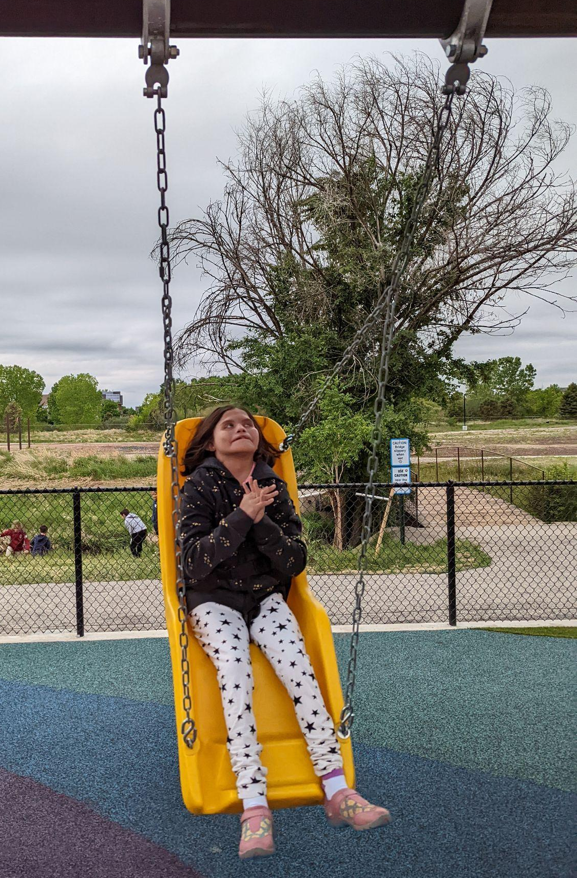
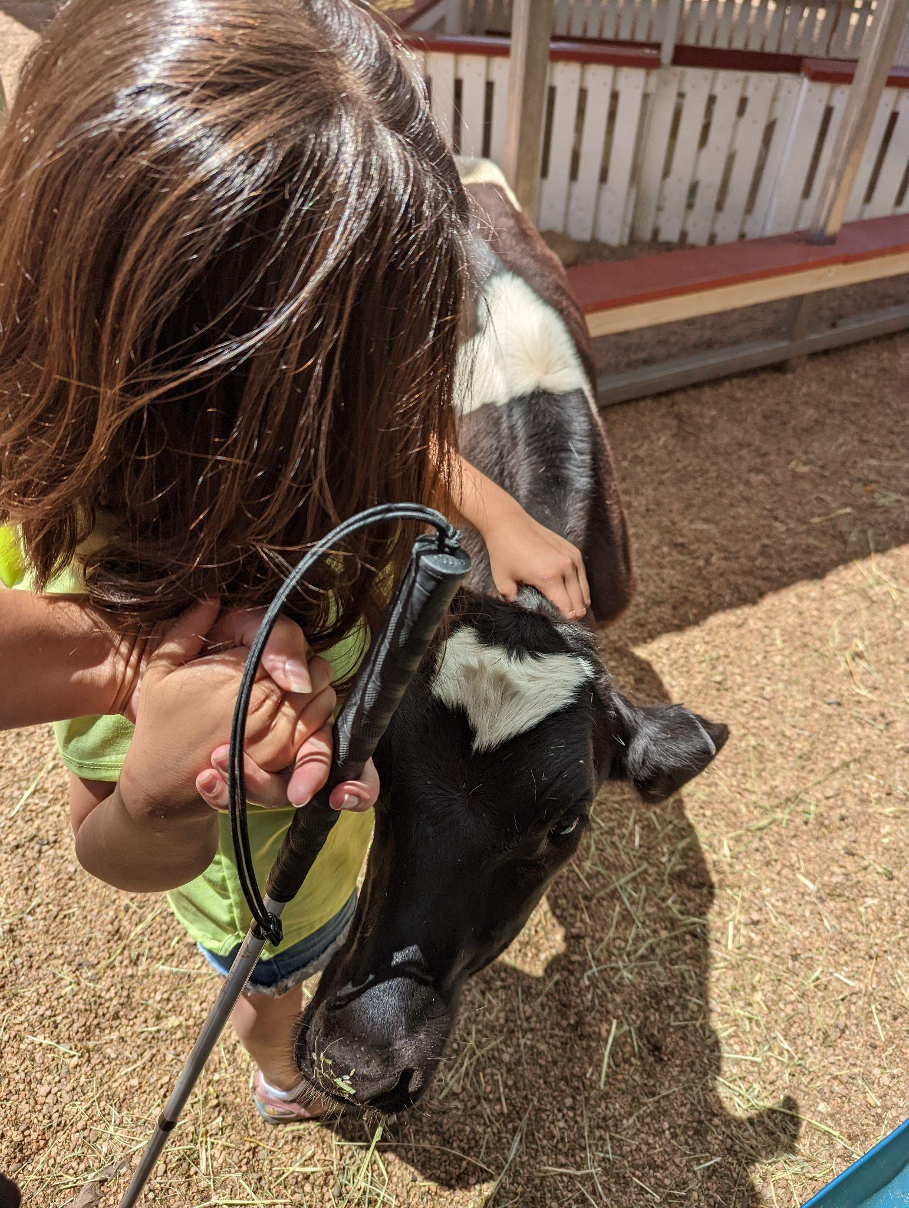
TESTIMONIAL
www.familyvoicesco.org
Notes:
Daisy is an incredibly smart middle schooler with CHARGE syndrome and Dandy Walker syndrome. She is deaf and has only a small window of vision. She uses American Sign Language at school however, there has been very little access to Sign Language at home and no access to Sign Language in the community. Having an intervener in the home and community has given her the opportunity to communicate outside of school. Her parents do not speak English therefore finding Sign Language classes and other resources has been very difficult for them. For the first time in Daisy’s life, they have an opportunity to really communicate with their daughter. It has been amazing for her parents to witness Daisy using her signs to ask to swing at the park or ask for her favorite toy without getting frustrated. Her parents have finally been given a way to learn her language and how to communicate with their daughter. They are even seeing a decrease in behaviors such as scratching herself and pulling out her g-tube due to frustration. Both Daisy and her family are so thankful to have the opportunity to be part of the intervener pilot and hope community interveners will be a service available to more kids like Daisy in the years to come.
-Cassandra, Intervener to Daisy, Denver

Slide 26
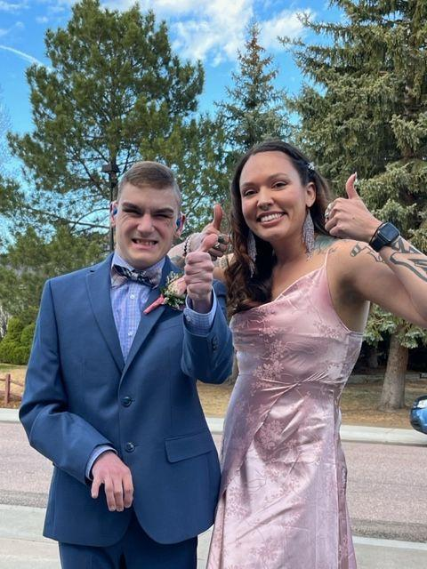
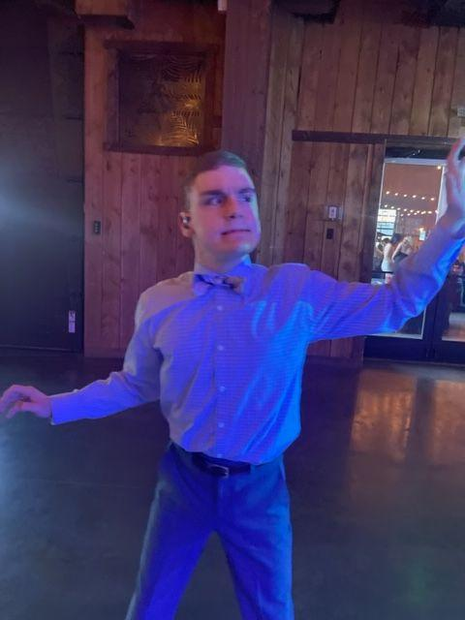
TESTIMONIAL
www.familyvoicesco.org
Notes:
Beck was able to take a date and enjoy his senior prom, thanks to Family Voices! His intervener, Zoë, picked him up at home and took pictures with Beck and his family before heading off to the prom. Once at the prom, Beck introduced Zoë to all his teachers and friends. Then, right away, Beck and Zoë initiated the party on the dance floor. They spent almost the whole night, dancing together and with some of his classmates. After all the dancing, they headed to after prom at Top Golf. Beck was expecting there to be an arcade there but came to find out that they only had console games; which he was not interested in. So, Beck was asking to leave and go to an arcade. With encouragement from Zoë and his teacher, Beck tried golfing with his classmates. Beck’s first attempt to golf was independent, but Zoë could tell he didn’t quite understand how to play from just the verbal instructions of his teacher. After letting him try on his own, Zoë asked Beck if she could show him how to stand and swing the golf club, he nodded. Zoë used hand-under-hand to show Beck where to grip the club as well as how to have an athletic stance, with feet wide and bent knees. Directly after this, Beck hit a golf ball out onto the green! Zoë, his teacher and his classmates all applauded him and Beck continued to play several more rounds through the night.
The next morning, Beck’s mother informed Zoë that Beck slept in late (from all the partying 🥳) and when he woke up he was in high spirits from the night before and told his parents all about the fun he had.
It was truly a fun night!

Slide 27
Application
The Table

Slide 28
Listen to customers and you will hear them. Look carefully at customers and you will see them. Do both and you will understand them.
-Ron Kaufman
Bring families to the table
The table belongs to the families we serve, seek to find what value you can bring!

Slide 29
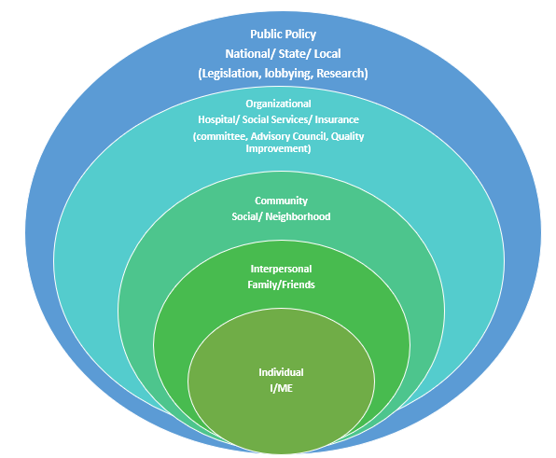
Circles of Engagement
1. Individual (I/Me, Immediate Family)
2. Interpersonal (Extended Family/Friends)
3. Community (Social/Neighborhood)
4. Organizational - Hospital/Social Services/Insurance (Committee, Advisory Council, Quality Improvement)
5. Public Policy - National/State/Local (Legislation, Lobbying, Research)
5
4
3
2
1

Slide 30
Our Role
Meet families where they are
Presume good intentions
Encourage them to dream
Empower them to thrive
Uplift their stories
Notes:
Dream = HOPE
Get out of survival mode

Slide 31
QUESTIONS?
Family Voices Colorado
megan@familyvoicesco.org
(303)877-1747
www.familyvoicesco.org

Slide 32
THANK YOU FOR YOUR TIME!
www.familyvoicesco.org

