Slide 1
WELCOME! The Meeting will begin momentarily
“Reinventing Direct Care Administration to Create a Sustainable Future”
Dcisoftware.com

Slide 2
Agenda for Today’s Webinar
Who is DCI
How can a Business Management Platform really help?
Discussion of Training and Employee Management
How does this fit into DCI
DCI Demonstration
Discussion on how to manage remote employees w our Time and Attendance, Training, and messaging
Q&A

Slide 3
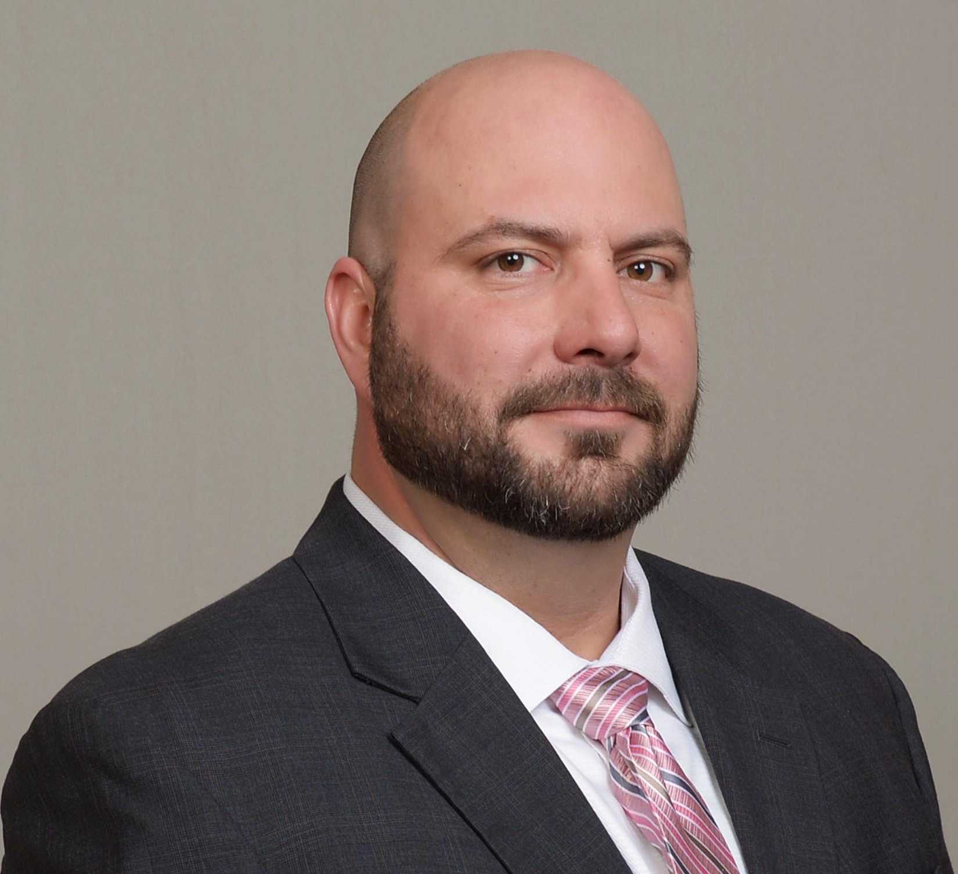
Who We Are
Mindi Mitchell, COO (Portland, OR)
19 years of industry experience working at and leading multi-state agencies: I/DD, residential, supported living, day programs, employment, foster care, HCBS, etc.
Brian Perry, VP of Sales (Austin, TX)
15 years of sales and sales management experience and 9 years healthcare IT experience managing teams of sales executives and project managers.
Marisa Balbo, Innovation Assoc. (Scottsdale, AZ)
17 years of industry experience: Provider Relations and Contracting Supervisor, Manager and Director Behavioral Health/IDD/MCO

Slide 4
What We Believe
OUR MISSION
OUR VISION
OUR VALUES
OUR GOAL
“Reinventing direct care administration to create a sustainable future.”
“Design state of the art systems that streamline administration and direct more resources to caregiving.”
“Pioneering innovations for compliance, quality of care, and higher direct care wages.”
“To become your trusted technology partner.”

Slide 5
How can a Business Management Platform really help?
Track and record Time and Attendance remotely and accurately.
Easily track mileage and client transportation
Manage Authorizations seamlessly and have the ability to track utilization in real time
Capture all the data that you need to pay your employees and bill your funding sources easily and with great accuracy

Slide 6
Training and Employee Management
Training remote employees, how do I even?
How do I keep up with all of the compliance items?
How do we make sure our staff is trained
How do we easily chat about clients, and other sensitive issues without having too many calls each day?

Slide 7
Integrating Business Processes...
Authorization Management
Time and Attendance
Electronic Visit Verification
Payroll Processing
Billing
Real Time Reporting
Alerts and Notifications
Scheduling and Shift Trading
Training and Compliance
Rating Direct Care Quality
Making Employment Management Easy
4. EVV, Time Entry & Transportation Tracking
3. Scheduling
2. Training & Compliance
5. Client Rating
1. Authorizations
6. Business Rules & Approvals
Billing & Payroll
Quality of Care Analytics
Alerts & Notifications

Slide 8
The Authorization Module
Stores and manages authorizations from any funding source
Receives automated authorization updates from select funding source systems
Capable of receiving imports to add or update authorizations from all other funding sources
Enforces daily, weekly, and monthly authorization limits
Manages start dates, end dates, and expiration dates
Reports authorization balances in real time
Is the system of record for all care management and billing transactions
Integrates with all other DCI modules to ensure compliance and optimize usage of care

Slide 9
The Training Module
Allows agencies to:
Configure training compliance at multiple levels:
Corporate, funding source, employee, client, and service code level
Tracks required trainings and proactively alerts employees and supervisors to increase compliance
Prevents any caregivers without proper training, background check, or certifications, from providing care
The training module can also provide links to live training calendars or other online training systems

Slide 10
DCI Above and Beyond
Additional Training Options Available:
Provides a Learning Management System (LMS) for delivering online training, testing, and certification:
Online HD Video training content from the DCI library
Load your own video training
DCI can film custom online training for you
Closed captioned and multiple languages available
https://awardco.wistia.com/medias/giduts2nhz
PRICING UPON REQUEST

Slide 11
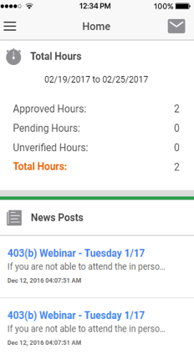
Proactive, Real-Time Alerts & Notifications
HIPAA Secure Text Messages, Emails, User Portals, and Dashboards
Helps your agency stay ahead on compliance and care
Allows your caregivers to manage themselves
Makes employee oversight simple

Slide 12
Mobile App Demonstration

Slide 13
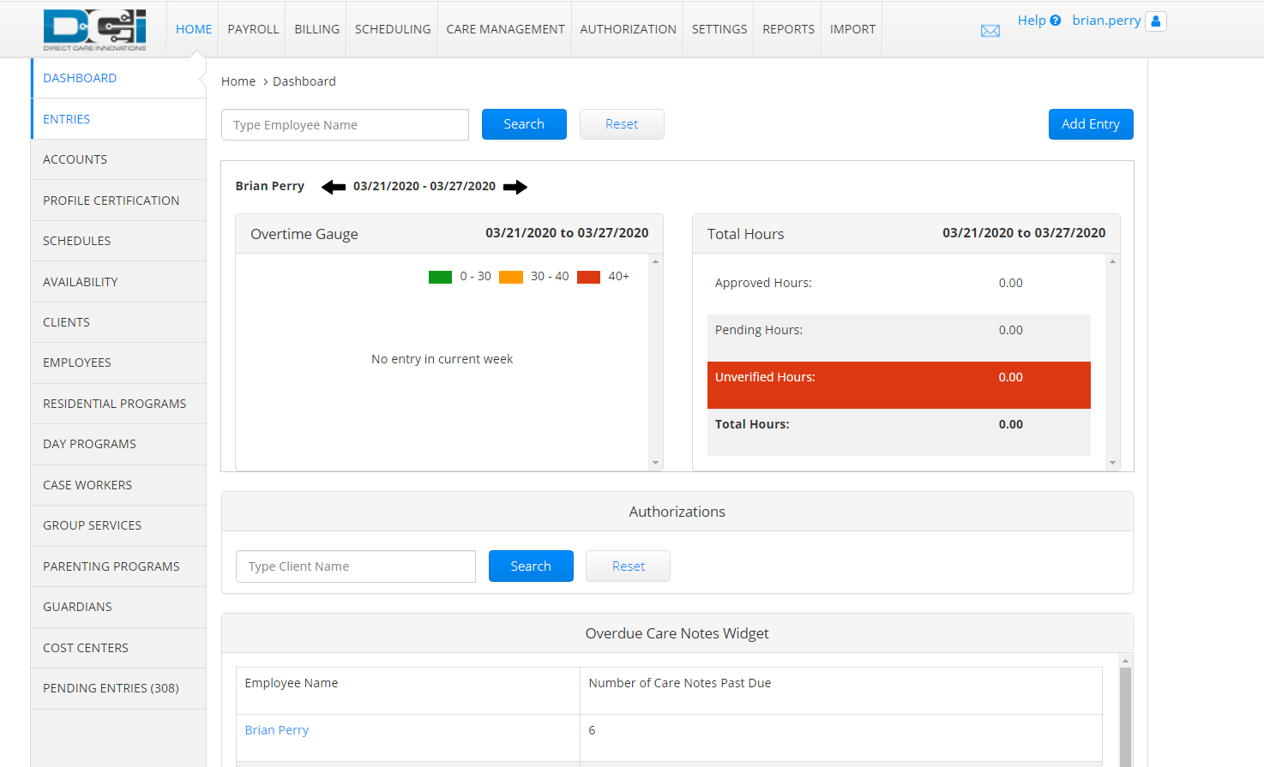
DCI Dashboard
DCI’s Super user Dashboard puts everything within easy reach for ease of use

Slide 14
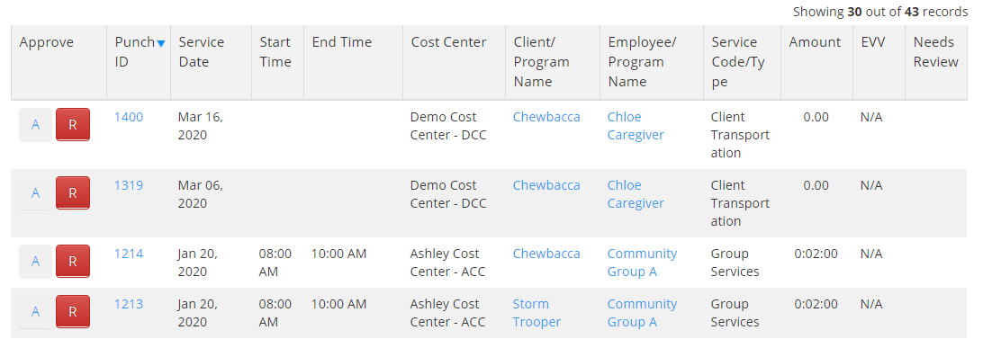
Auto Approval DCI will automatically approve entries that meet the following criteria:
Does not put the employee over 40 hours in the work week
Has valid and complete EVV (if EVV is required)
Does not put the client over any authorization limits
Entries that fail auto approve move to a pending status for Employer action:

Slide 15
When you’re with DCI back office is easy!!
Payroll
DCI uses the EVV and time entry data to process payroll
DCI payroll handles all payroll functions
PTO, Vacation, Multiple pay rates
Batch processes
The payroll module can integrate with other payroll providers
Billing
DCI uses the Authorization Module and the time entry and EVV information to generate billing
Identifies potential billing issues in real time to make sure you get paid for the services you are providing
Auto approval for compliant claims
Daily billing to optimize cash flow
DCI helps you optimize revenue by tracking and reporting utilization

Slide 16
How to manage remote employees and best practices
As we demonstrated, DCI can help your organization manage remote employees during the pandemic but also after, setting up your agency to thrive and grow in the future.
Our Training and Compliance Module allows for easy tracking and education of staff whether onsite or remote, automating all of the tracking and training requirements for an organization saving time and money!
Automation allows users to get back to caregiving and reduce the amount of time spent on Administrative tasks
If you would like to learn More about DCI and how we can help feel free to reach out to us at sales@dcisoftware.com or call us at (480)295-3307

Slide 17
Questions... Thoughts... Feedback... After the presentation we will randomly choose an attendee to win our $100 Amazon Gift Card

