Slide 1
Using Data to Measure Quality
Christy Scott, Early Intervention Program Director
Ashley Furney, Early Intervention Evaluation Coordinator

Slide 2
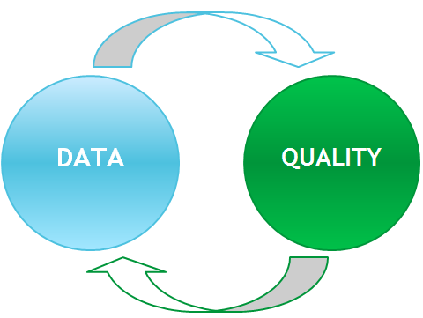
Is Quality Measureable?
Measureable: (adj) capable of being measured http://www.dictionary.com/
Quality: (noun) General excellence of standard or level https://en.oxforddictionaries.com/

Slide 3
Where to Start
What is the desired end result?
What are barriers to achieving the goal? What is in place to support the goal?
Select activities to focus on
Implement improvement activities strategically
Notes:
Pause - answer activity question 1 (3 mins)

Slide 4
Consider
Using theory of action/logic model
Analyzing data and infrastructure to guide decisions
Choosing activities that are doable with current resources
Selecting manageable timelines
Activity #1
Notes:
Pause - answer activity question 1 (3 mins)

Slide 5
Make Quality Subject Measurable
Determine quality criteria (subject matter experts)
Determine what you wish to learn from the data
Choose a method for quantifying quality
Notes:
3 common scoring methods:
Holistic Rating Scale, Analytic Rating Scale, Single-Point Rating Scale

Slide 6
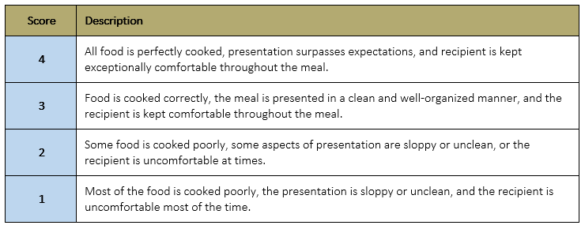
Holistic Rating Scale
Lists 3-5 levels of performance along with a broad description of the characteristics that define each level. Levels are labeled with numbers, letters, or words.
https://www.cultofpedagogy.com

Slide 7
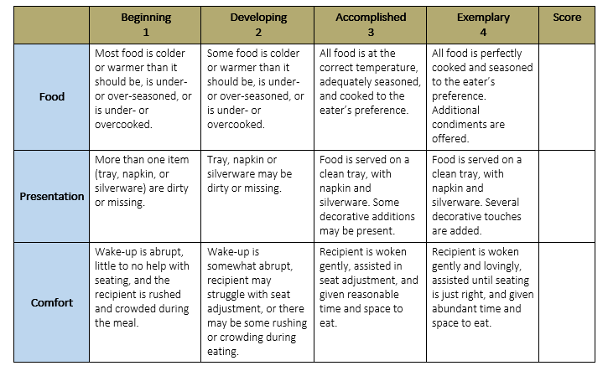
Analytic Rating Scale
Breaks down the characteristics into parts allowing the scorer to itemize and define exactly what aspects are strong and which ones need improvement
https://www.cultofpedagogy.com

Slide 8
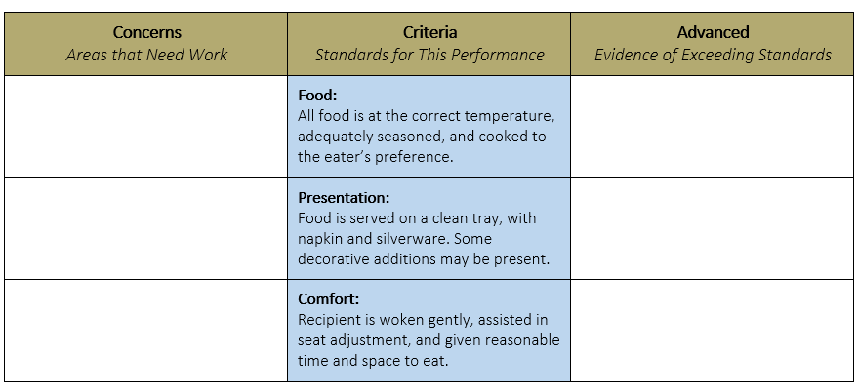
Single-Point Rubric
Breaks down components into different criteria (similar to analytic rating scale), but only describes the criteria for proficiency. It does not list criteria for falling short of or exceeding expectations.
Activity #2-4
https://www.cultofpedagogy.com
Notes:
Pause- answer activity question 2-4

Slide 9
WH Questions
Activity #5-7
Notes:
Pause: Answer questions 5-7

Slide 10
How EI Colorado is Using Quality Assessment Tool Data
Baseline data vs post-implementation
Has quality improved since new expectations were implemented?
Month to month (within programs)
Does quality continue to improve over time?
Month to month (between programs)
Are programs showing similar trends in quality improvement?
Inter-rater reliability
Are assessors using the tool and ratings similarly
Anecdotal Findings
Casual trends in rating scale criteria identified

Slide 11
Questions?

