Slide 1
We need to talk about lack of representation in disability services
Jeff Newman
Autistic Activist
Director of Community Integration at Community Connections

Slide 2
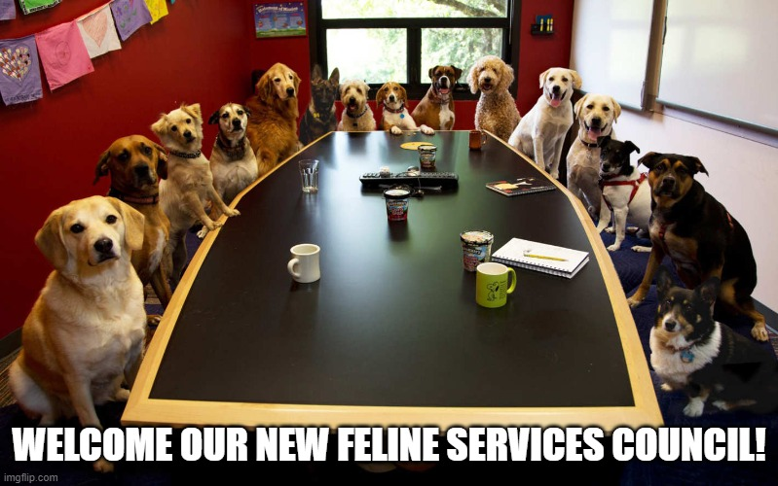

Slide 3

But that representation fail is not a joke. It is the typical state of affairs.

Slide 4

Autism Conferences open to my parents and not me

Slide 5
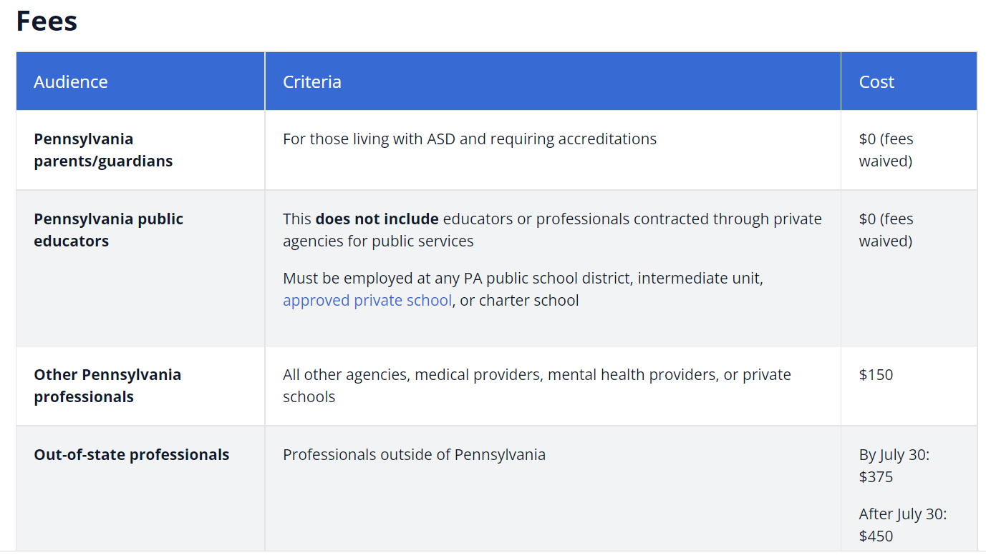

Slide 6
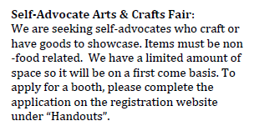
NOT REPRESENTATION and certainly not “advocacy.”

Slide 7
Who is most qualified to speak on stuff like this?!?
Notes:
I’m a dude. Most of you aren’t, not many cis dudes in this line of work. When you are a guy working in this field, you have to be really careful you never leave the office toilet seat up or god forbid ANYTHING on that seat- no plausible deniability.
So anyways, this is a crowd I am sure is well-acquainted with Mansplaining.
Let me introduce to you- Ablesplaining.
All from AAIDD conference..

Slide 8
So why am I picking on conferences here?
I enjoy making my hosts squirm.
Conferences advertise what voices our system is truly interested in listening to and platforming.
Notes:
Yeah, sometimes I enjoy letting conference organizers wonder how badly I am going to nuke the room.

Slide 9
What do disabled people have to say about this lack of representation?

Slide 10



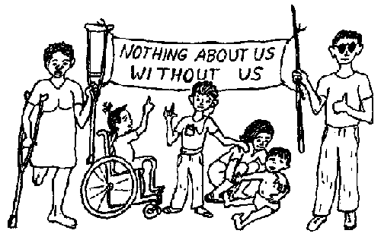


Slide 11

Train your eye to this. In your organization and in our system:
Are the right people in the room?
Who chose who is in the room? Were they chosen because they will tell us pleasant things?
Do they have accommodations to be heard?
Are we prepared to listen?
Are they leading or are they rubber stamping?
Do they have critical mass or are they tokens?
Do we see this same representation in employment? In management? In Leadership?
Notes:
Accommodations to be heard definitely includes accommodations to ensure access and understanding of the issues being discussed

Slide 12

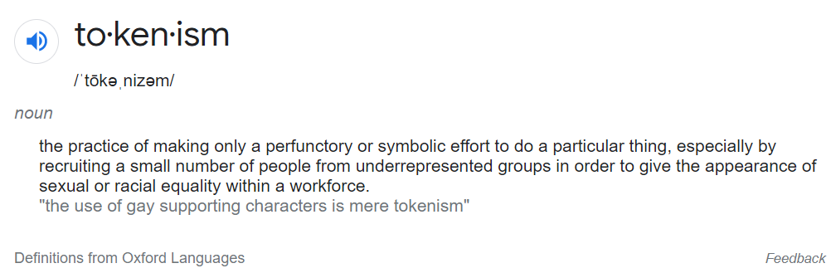
Tokenism is not representation

Slide 13

Tokenism creates this kind of labor:
The burden of representing an entire community.
Near impossible opportunities to drive real change.
Exhaustion from having to educate everyone- yourself.
Being constantly put in positions of debating your own humanity.
Getting used as a mascot to improve the perception of the organization

Slide 14

“Us vs. Them” culture at service agencies
Widespread assumption that employees are not disabled
Workplace culture established and maintained by non-disabled employees
“Those people” get services, while “we” care for them
Enables setting up services for “them” in ways you would never tolerate for yourself.
Lots of closeted, unaccommodated, disabled people as employees.
“Not like us” attitudes about the disabled permeate society and implicitly and explicitly enter our organizations.
Notes:
For every disabled person you are aware of in your organization, there are multiples more that you don’t know. We are drawn to this work. We feel the injustice built into this system and our services, and the impact to people just like us- our friends, our peers, or in some cases, just us as people enrolled in these services. It keeps us up at night. I switched careers and took a huge pay cut to come do this work.
I am, um, “out” as a disabled person, so, they disclose to me. We exchange our secret signs in the hallway. But organizationally they do not out themselves. They don’t believe it is safe to disclose. They don’t think they will be considered for promotions if they disclose. They have to believe that every single employee you bring on from now until the end of time will accept them as a disabled person, and you know you can’t promise that.

Slide 15

Building a critical mass

Slide 16
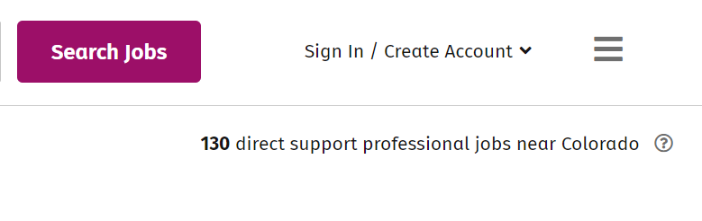
Our embarrassment of Riches of Job Applicants…

Slide 17
We know this state of affairs, right?
DSP turnover averages of 43%.
18% of DSPs have been employed less than 6 months
33% leave in the first 6 months
THESE FIGURES ARE FROM PRE-COVID DATA!!!
Source: National Core Indicators 2019 Staff Stability Survey

Slide 18
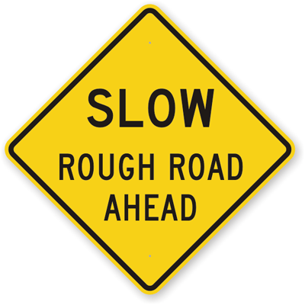
And it is only going to get harder..

Slide 19
“Women aged 25 to 64 are the main group of people who enter the DSP profession and similar occupations. However, while in the next decade demand for DSPs will increase by 48 percent, only 2 million additional women aged 25 to 64 will enter the whole labor force in that time, down from 6.3 million in the early 2000s. This means that unless the field of applicants is broadened and diversified, the shortfall of staff will be a persistent challenge. This has long-term consequences for preserving individuals with IDD’s ability to make choices about their lives.”
American Network of Community Options and Resources. (2017). Addressing the Disability Services Workforce Crisis of the 21st Century.

Slide 20

What is the roadmap out of crisis?
Most proposed solutions to this workforce crisis center around pay and benefits
  Not in our control, dictated by reimbursement rates
  Pay doesn’t address future demographic shifts
  Ableist stigma is not going away, and until it does we will have people “afraid” of doing this job.

Slide 21
Meanwhile…
33% labor participation rate for disabled people ages 16-64,
76% for non-disabled people of same age source: August 2021 data from the Bureau of Labor Statistics Current Population Survey
32% of disabled people work part time vs 17% of the general working population source- National Council of State Legislature, “Employing People With Disabilities”
Disabled people, specifically people with intellectual and developmental disabilities, often have less access to meaningful work
  Most jobs center on physical and menial labor

Slide 22
YOU CANNOT TRAIN LIVED EXPERIENCE
Disabled people:
  Used to navigating and “hacking” benefits systems
  No “Us vs. Them.” We’ve been there and gotten the T shirt (terrible service plan/IEP, talked over and ignored, active discrimination)
  Invaluable mentors
  Know the disabled community
  CARE DEEPLY ABOUT THIS WORK
  The other statistics you are more familiar with (stay on job longer, loyal to employer, less sick days, safer employees)

Slide 23

So, you’ve decided to make a concerted effort to hire disabled people…

Slide 24
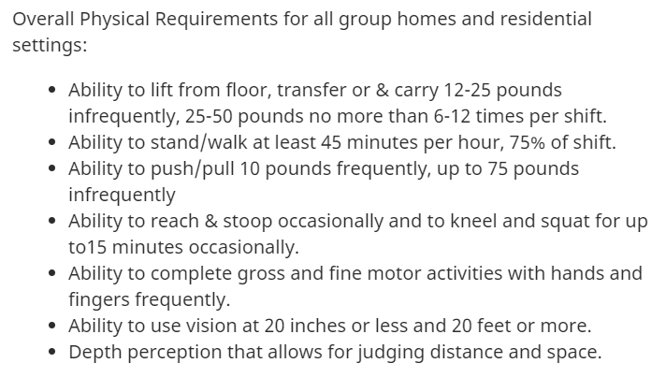
A chilly welcome right from the start…
These kind of clauses are recognized by disabled people as discriminatory “weed outs” of disabled people.
This language does not specify the task that needs to be completed (and allow for reasonable accommodation), it specifies disabilities that need not apply…
Notes:
This is from a current ad in Colorado. I don’t need to name names as a lot of you have a “physical requirements” section.

Slide 25
Disabled People have a rough entry into your organization.
Official and informal training centered on how to “manage” and “handle” disabled people like them.
Exposure to “behind the scenes” talk
Lots of ableism not understood as ableism.
Lots of ugly speech and ugly words
People like them denied autonomy
Inability to really discuss any of this
Placed in “token/mascot” positions instead of real work for real pay.
Erosion of mental health
Notes:
Here is what happens when a disabled person brings up issues of bias, ableism, or unjust treatment? Pointing out ableism to somebody working in disability services? You might as well be accusing them of having a white hood in the closet. You are well intentioned and care too, so respond with ANGER and OUTRAGE when somebody points out the warts.

Slide 26
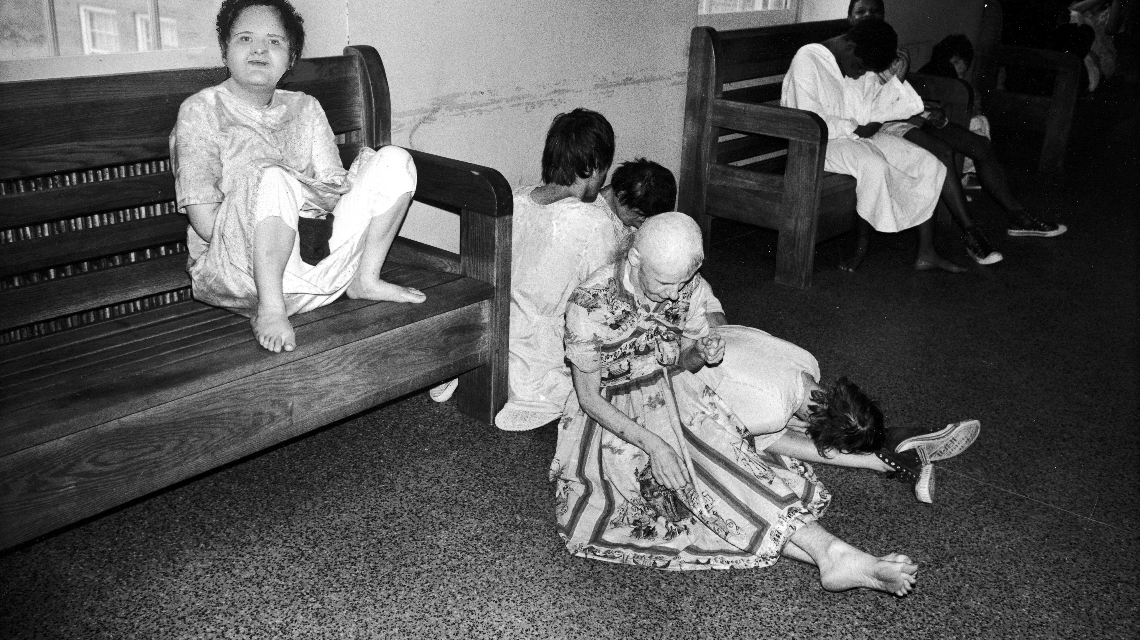
Disabled people Supporting disabled people- the wrong way
In institutions, disabled people were made to support other disabled people.
Disabled people were commonly used to carry out acts of violence against their peers, dehumanize their peers, “handle” their peers
When you put disabled workers in a position of doing things to their peers that they would not do to themselves, you are putting them into situations like this!

Slide 27
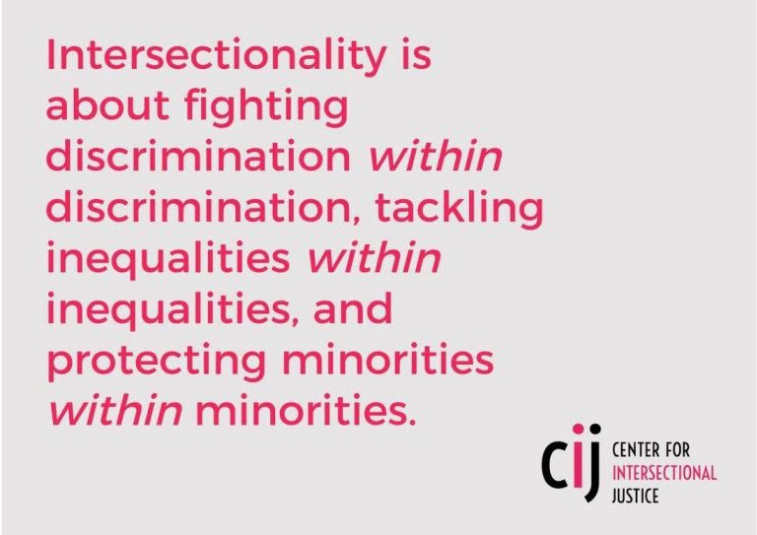
Notes:
Intersectionality matters. It is a really uncomfortable truth in my own life that I got a lot of breaks my way to end up in front of you, and an uncomfortable reality that if at the end of the day, I’m a white dude and that caused many of the things that break my way.
It also greases the skids for me to be an autistic white dude- I match your expectations of what an autistic person looks like, you’ve seen plenty of autistic white dudes in tv and media and that makes you more comfortable with me in ways that A black trans autistic person cannot access.
When we solve problems without looking to intersectionality, we end up solving problems for white people

Slide 28
So What do we do?
Work on getting your house in order FIRST. Consider hiring consultants
Recognize this is a continual improvement process, not a “fixed it” process.
Disabled people didn’t create this mess, it isn’t our responsibility to fix it. The entire organization needs to work to address issues of ableism and create just services. THIS IS NOT JUST THE LABOR OF THE DISABLED MEMBERS OF YOUR TEAM
Disabled people need open lines of communication up the chain
Disabled people need to be valued and need to have opportunities to share their expertise!
Disabled people need to be included at all levels of your organization. Need a career ladder for DSPs!
Being disabled in our society means TRAUMA. You need to be trauma informed and trauma accommodating

Slide 29
Lets talk accommodations
If people aren’t using your accommodations process, you have a broken one.
Take disability out of it. Wouldn’t everybody work more effectively with reasonable accommodations? This flexibility also makes it way less scary for disabled people.

Slide 30
How do we get these disabled workers?
Hiring people already enrolled in your services.
Connecting with your local centers for independent living
Connecting with the local and online advocacy communities (people will actually move for the right opportunity)
Disabled hiring preference
Demonstrate you are a place where people can drive change, disabled people will be your ambassadors.
If you don’t take this seriously, you will get the opposite reputation.

Slide 31
What do we do next?
Grow your advocacy and activism.
1
Build on what you have. Start with a nucleus of advocates/activists, build disability representation to a critical mass and beyond.
2
Create, improve, and hone a DSP training program for disabled people and people receiving services. Create a career path for people interested in it.
3

Slide 32

What can you do?

