Slide 1
COEF Updates Alliance State Forum May 19, 2022

Slide 2
Agenda
Introductions
Benefits Counseling Updates
COEF Employment First Data System (CO-DESOS)
Rate Study Updates
COEF Sustainability

Slide 3
Benefits Counseling Updates

Slide 4
Benefits Counseling In Colorado
Colorado Disability Benefits 101 Utilization
Utilization Data for February – April 2022
Total Users of English / Spanish Site: 4,291 (New Users 4,143)
Colorado Cities represented: Denver, Fort Collins, Boulder, Aurora, Lakewood, Colorado Springs, Longmont, Greeley, Westminster, Arvada, Englewood, Grand Junction, Pueblo, Thornton, Parker, Centennial, Highlands Ranch, Littleton, Bailey, Berthoud, Craig, Golden, La Junta, Loveland, Sterling.
Notes:
Cohorts
COEF with the support of the Colorado Dept of Labor and Employment Division of Voc Rehab offered the opportunity for individuals to earn their benefits counseling certification through the Cornell University Institute on Disability and Employment. Through the partnership between DVR and COEF, this training was able to be offered at a discounted rate for all participants. Cost was $500/participant. 2 Cohorts offered. Cohort One just finished in person classes, independent study period, and a review session. Cohort One Testing will take place next week. Cohort Two started classes this week (Tuesday, May 17th). Cohort Two will finish classes on June 16th, and testing on July 1st. All individuals passing the written exam will then complete a practicum – working with a "live" beneficiary from start to finish, providing benefits counseling.
Cohorts are a mix of self employed employment providers working with DVR, employees of PASA's, non-profits, School to Work Alliance school staff, mental health agencies, and independent living centers. Some plan to provide benefits counseling within their agencies for their constituents, some will provide benefits counseling under DVR authorization, and some plan to become DVR vendors to provide benefits counseling.
To participate in the Cohorts, individuals or agencies needed to attend informational sessions, complete an Introductory Training, and had to complete an application. Out of 51 applicants, there were 20 that completed all classes of Cohort One and they will need to pass the testing and practicum. There are 17 that started and are projected to complete the requirements in Cohort Two.
Those achieving provisional certification (pass the written exam) and pursuing practicum completion will be invited to participate in the Benefits Collaborative – a monthly meeting (Community of Practice) of all certified benefits counselors in Colorado. Purpose of the group is continued training opportunities specific to Colorado, technical assistance on case work, and sharing of information and resources.
HCPF Report
Subject Matter Experts represent WIPA, PASA, DVR Provider / Multiple State Provider
Colorado DB101
Colorado DB101 is a web based employment resource and benefit estimator tool. This means a place any user (pwd, job seekers, service providers, support teams, etc) can go 24/7/365 and explore the world of work, the world of benefits, and the merge of the two.
**Can play the video from the front page of the DB101 website (is 2 mins) if you want to do a "refresher" of what it is** (Have it keyed up in another tab from presentation.)
DB101 Utilization
Feb-April Data Compilation for Alliance:
https://docs.google.com/document/d/1dOFeRN2j8CbIx-sckYmJbjlGfVNTEqvW/edit
Q3 2022 Data Report:
https://docs.google.com/document/d/1axZSXjmWC9a3BcLVcUOnX1ioFc9bz6Q3/edit

Slide 5
Benefits Counseling In Colorado
Benefits Counseling Certification Cohorts
COEF / DVR partnership – offering Cornell WIP-C Certification at a reduced rate
Cohort One finished classes with 20; Cohort Two projected to finish with 17
COEF Statewide Benefits Collaborative Support upon completion
Benefits Counseling in DD and SLS Waivers
HCPF has partnering with COEF to collect data from other states, and Colorado Subject Matter Experts to learn potential successes and challenges in implementing benefits counseling in DD and SLS Waivers
COEF will be making recommendations to HCPF about what to consider when adding Benefits Counseling as a waiver service.

Slide 6
Colorado Employment First Data System (CO-DESOS)

Slide 7
Employment First Data Timeline
2017
April 2021
January 2022
Summer 2022
EFAP Strategic Recommendations
Indiana University UCEDD
COEF Launch of CO DESOS
COEF Procures DESOS
1.-A Develop a system to track employment outcomes and day service participation for Coloradans with significant disabilities and produce an annual report to the Colorado General Assembly consistent with CRS 25.5-10-204 (1) (g) (III).
Presents DESOS to EFAP, COEF responds to feedback and questions. Continued engagement occurs during the HCPF SB18-145 Data Committee
CO website build begins
Stakeholder engagement, project plan and initial provider data entry

Slide 8
Goals of CO Employment First Data System
Create an annual “point in time” style data collection process in Colorado
CO-DESOS is accessible, user friendly and accepted by provider organizations as valuable.
Produces an annual data report on key Employment First outcomes that can be used by a wide variety of stakeholders.
CO-DESOS establishes a collaborative Employment First data culture with increased provider response rates each year and the opportunity to compare data longitudinally.

Slide 9
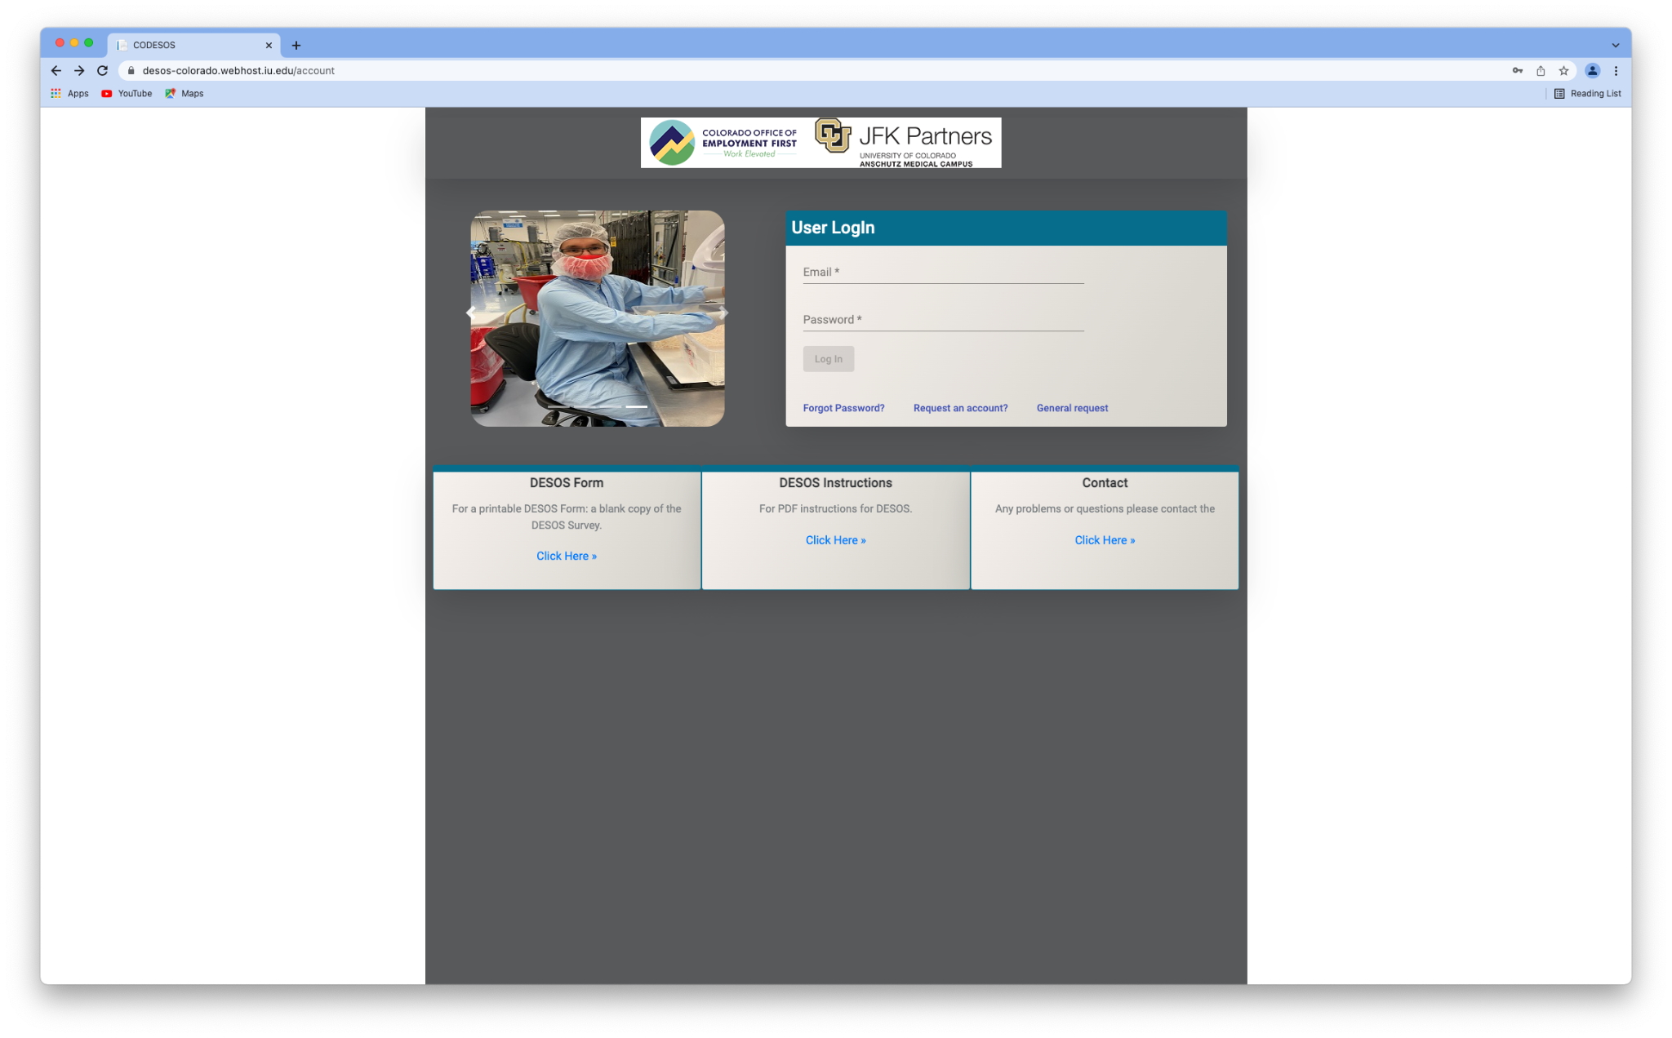
CO DESOS Demo Site

Slide 10
What’s Next?
Ongoing stakeholder engagement with EFAP, providers, other advocacy organizations and state agencies to build buy-in and launch CO-DESOS in 2022.
COEF led CO-DESOS workgroup
Technical Assistance from Indiana University for provider support, data collection/analysis, and report building
Alignment with SB18-145 data requirements

Slide 11
Rate Structure and Rate Methodology Report Can be found at our website: RSRM Report

Slide 12
Job Development/Job Placement Specialist
Job Coach/Employment Facilitator
Employment Specialist
Average Salary
$43,680 per year
Average salary
$39,520 per year
Average Salary
$47,840 per year
Intake
Determining preferences, strengths, interests, skills
Discovery
Planning
Resume development
Supporting the employee to learn job tasks
Facilitate a relationship between the employee and their co-workers/supervisors
Assist with fading to co-worker and natural supports
Employer negotiations, including accommodations
Accompanying the job seeker to an interview (where appropriate)
Assisting in job description development

Slide 14
Recommended Issues for Discussion
Benefits Counseling
EFAP should review the data on the differences in availability and access to certified benefits planners for persons with disabilities prior to beginning employment and early in the employment planning process
Assistive Technology
There should be a timely availability of certified assistive technology specialists to meet the person, review their support needs and make additions to the person’s plan, including sources for funding and training to use the device.
Individual Supported Employment Rates v. Group Employment and Segregated Day Program Rates
The recommendations and proposed rates for services do not address the rates that a variety of state agencies pay for non-vocational, facility-based day services for individuals with disabilities
Data Collection and Sharing
EFAP should consider the development of a comprehensive, interagency collaborative evaluation system to track and document the short- and long-term benefits and return on investments of public funding.

Slide 15
COEF Sustainability

Slide 16
Commitments from EFAP Partners - FY23
Colorado University / JFK Partners
Employment First Data Project, Children’s Hospital Pilot
Development Disabilities Planning Council
Youth and Family curriculum with Employment First Focus, DB101 maintenance
Office of Behavioral Health
IPS Employment Specialist Training, Fidelity Reviews, Learning Communities

Slide 17
Commitments from EFAP Partners - FY23
Division of Vocational Rehabilitation
Training & Learning Communities
Employment First
Benefits Counseling & DB101
Supported Employment
Customized Employment
Systematic Instruction
Children’s Hospital Employment First Transition Pilot
DVR Parent Advisory Group
DVR Referrals
DVR & EFAP Communications

Slide 18
COEFs Pathway Forward – FY24 and Beyond
Join COEFs Sustainability Workgroup
Kick off meeting being scheduled
June 2022

Slide 19
Questions / Discussion

Slide 20
THANK YOU.

