Slide 1

Shaping policy, sharing solutions, strengthening communities

Slide 2


What’s Happening on the Federal Front?
Presenter:
Katherine Berland, Director of Public Policy
American Network of Community Options and Resources
Alliance Summit
June 22, 2017

Slide 3

ANCOR is…
A national nonprofit trade association advocating and supporting
Over 1,200 private providers of services and supports to
Over 800,000 people with disabilities and their families
And employing a workforce of over 600,000 direct support professionals (DSPs) and other staff
Membership benefits include robust government relations representation at federal level and access to exclusive ANCOR content, as well as exclusive discounts on technology and I/DD products through the ANCOR marketplace.

Slide 4

Inside the Beltway: What’s Going on in DC?

Slide 5
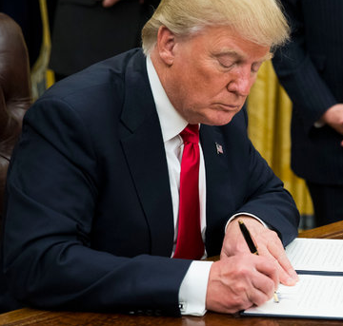
Inside the Beltway: What’s Going on in DC?
Affordable Care Act on Day 1
On January 20, President Trump issued his first Executive Order, directing government agencies to scale back as many aspects of the ACA as possible.
This permits agencies to delay, waive, or refuse to enforce provisions of the ACA prior to repeal by Congress.

Slide 6
Inside the Beltway: What’s Going on in DC?
Other Notable Executive Orders
January 20: Freeze on pending and recently-enacted regulations
January 23: Federal hiring freeze (lifted April 12, but agencies are required to look for ways to reduce staff)
January 30: Directs executive agencies to identify regulations for elimination – at least two for every one new regulation planned, and new regs must be budget neutral
March 13: Directs OMB to spearhead effort to eliminate or reorganize unnecessary or redundant federal agencies

Slide 7
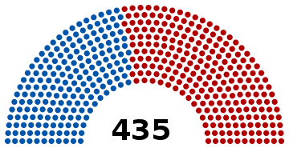


Inside the Beltway: What’s Going on in DC?
The 115th Congress Takes Hold: House of Representatives
Speaker of the House – Paul Ryan (R-WI)
Minority Leader – Nancy Pelosi (D-CA)
194 (+7) 241 (-5)

Slide 8

Inside the Beltway: What’s Going on in DC?
The 115th Congress Takes Hold: Senate
Majority Leader – Mitch McConnell (R-KY)
Minority Leader – Chuck Schumer (D-NY)
46 (+2) 52 (-2)
(2 independents)

Slide 9
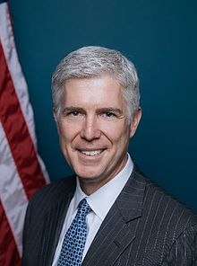
Inside the Beltway: What’s Going on in DC?
Appointment: Supreme Court
Neil Gorsuch
Served as judge of the U.S. Court of Appeals for the 10th Circuit
Private practice attorney for 10 years
Former Supreme Court clerk
Constitutional originalist (often compared to Scalia)
IDEA Act decision overturned by Supreme Court during confirmation
Sworn in on April 10, 2017, after “nuclear” rules change

Slide 10
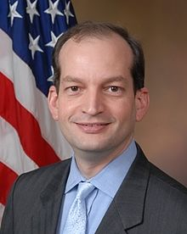
Inside the Beltway: What’s Going on in DC?
Cabinet Appointments: Labor Department
Alexander Acosta
Dean of Florida International University College of Law
Former U.S. Attorney for the Southern District of Florida
Appointed to NLRB, DOJ by President George W. Bush
Sided against unions in several cases
Pledges to streamline DOL per President Trump’s budget plan
Sworn in on April 28, 2017

Slide 11
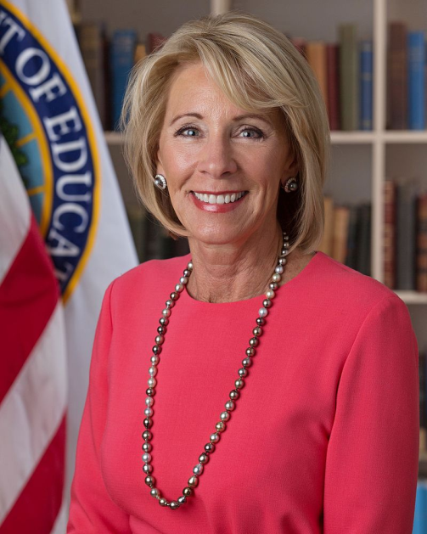
Inside the Beltway: What’s Going on in DC?
Cabinet Appointments: Education Department
Betsy DeVos
Former Chair of Michigan Republican Party
Supports school choice, school vouchers, charter schools
Serves on boards of Windquest Group, Neurocore
Concerns over commitment to Federal enforcement of Individuals with Disabilities Education Act (IDEA)
Sworn in on February 7, 2017

Slide 12
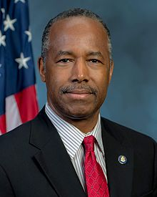
Inside the Beltway: What’s Going on in DC?
Cabinet Appointments: Housing and Urban Development
Ben Carson
Former Director of Pediatric Neurosurgery at Johns Hopkins Hospital
Elected into the National Academy of Sciences Institute of Medicine
Has said that fair housing laws, housing subsidies are priorities
Sworn in on March 2, 2017

Slide 13
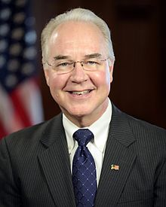
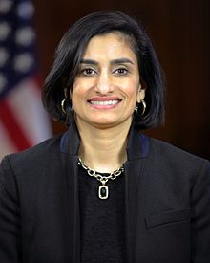
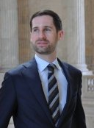
Inside the Beltway: What’s Going on in DC?
Appointments: Health and Human Services
Tom Price – Secretary, HHS
Served as U.S. Representative for GA’s 6th District
Former Chair of House Budget Committee
Sworn in on February 10, 2017
Seema Verma – Administrator, CMS
Founder/CEO of SVC Inc., health policy consulting
Instrumental in crafting Healthy Indiana Plan, other state Medicaid plans
Sworn in on March 14, 2017
Brian Neale – Director, CMCS
Former healthcare policy director for Mike Pence
Worked with Pence, Verma on Healthy Indiana Plan

Slide 14

Inside the Beltway: What’s Going on in DC?
Trump Introduces FY2018 Budget Proposal (May 23, 2017)
Proposes deep cuts for many agencies, including Agriculture, Labor, State, EPA, Commerce, Education, HHS, HUD, and DOT
Increases defense spending by $54B
Medicaid – Cuts $610B (in addition to $834B in AHCA)
CHIP – Cuts $16.7B
Social Security – Cuts $74B, including SSI/SSDI benefits
ODEP – Refocuses department away from TA grants and towards state demos to help individuals with disabilities get or stay in labor market
SNAP – Cuts $200B
HUD – Cuts $6.2B, including $1B cut from rental assistance programs

Slide 15
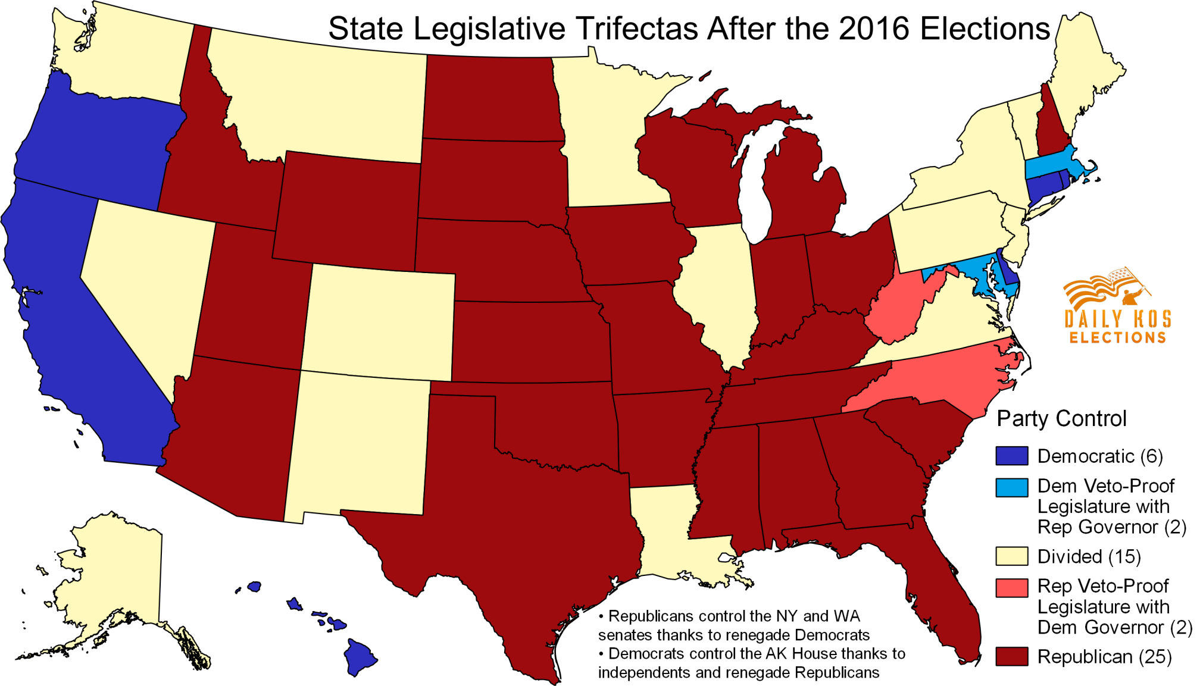
Outside the Beltway: What’s Going on in the States?

Slide 16


CMS Home and Community Based Settings Rule
Price/Verma Letter
A letter sent on March 14 to Governors:
Characterizes current Medicaid program as “outdated”, “rigid” and full of burdensome federal rules
Asserts HHS’ commitment to streamlined approval of 1115 demonstrations that innovate around training, employment, and independence
Suggests state-led reforms that could made including cost-sharing, HSA-like programs, and premium payments
Suggests extension of HCBS implementation deadline
Suggests states may get more flexibility in making heightened scrutiny determinations

Slide 17

CMS Home and Community Based Settings Rule
Guidance issued on May 9:
Extends compliance deadline for HCBS rule by three years, to March 17, 2022
Does not extend planning period, saying: “[S]tates should continue progress in assessing existing operations and identifying milestones for compliance that result in final Statewide Transition Plan approval by March 17, 2019.”
Does not change requirement that new settings must come into the HCBS program already in compliance

Slide 18

FINAL RULE: DOL Overtime Exemption
Finalized: May 23, 2016.
Purpose: To update the “white collar” exemptions threshold which had not been updated since 2004
Key Provisions:
$47,476/year ($913/wk) salary threshold for “white collar” exemptions (40th percentile of lowest-wage Census region salary data)
$134,004/year salary threshold for highly compensated employees (90th percentile of national salary data)
Update every 3 years, beginning January 1, 2020
No changes to the duties test
Time-limited non-enforcement policy for certain Medicaid IDD providers

Slide 19
FINAL RULE: DOL Overtime Exemption
Legal challenge: On September 20, 2016 twenty-one states, chambers of commerce, and other industry groups filed suit challenging the rule.
District Court: On November 22, 2016, a federal judge issued a preliminary injunction against the rule, effectively suspending it nationwide. DOL asked that the injunction be suspended pending appeal, but was denied.
Future of the Rule: As the legal challenge continues to play out, the Trump administration and Congress majority party have indicated that they intend to roll back the rule. It is likely that the rule will be resolved through the legislative process before the legal process ends.

Slide 20
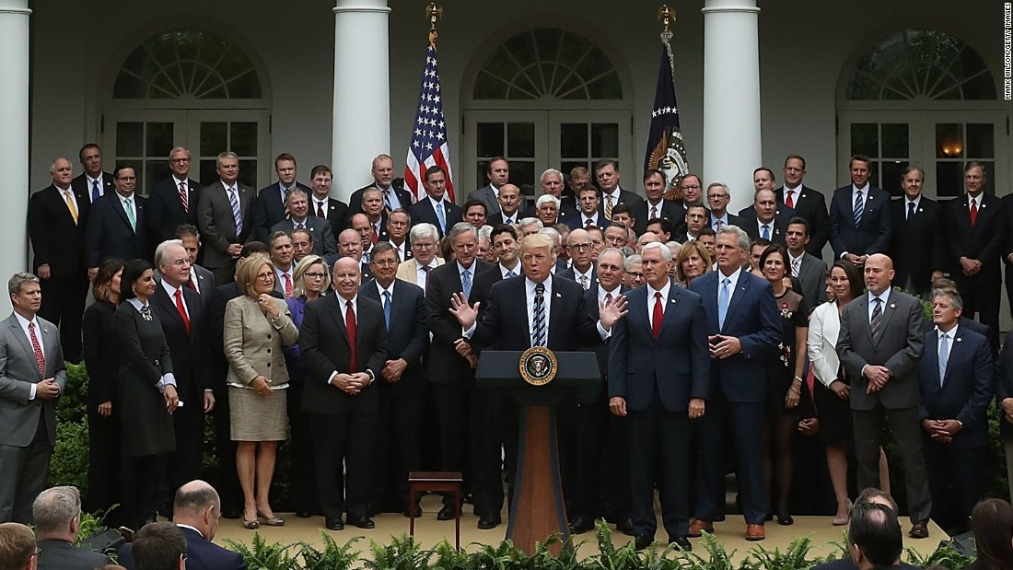
Affordable Care Act Repeal and Replace: What the heck is happening?

Slide 21

ACA Repeal & Replace
A Timeline (2017)
January 4: Senate resolution to repeal the ACA through budget reconciliation
January 20: President Trump signs Executive Orders on ACA enforcement
March 6: House introduces American Health Care Act (AHCA)
March 8: House committees hold AHCA markups
March 9: House Energy & Commerce/Ways & Means vote to advance AHCA
March 13: CBO releases AHCA score
March 15: House Budget committee votes to advance AHCA
March 21: House Rules committee releases Manager’s Amendment
March 23: House Rules committee releases revised Manager’s Amendment
March 24: AHCA withdrawn from House floor
April 25: MacArthur amendment introduced
May 4: House passes AHCA
May 24: Revised CBO score released
June 22: Draft text released (TBD)
June 29: Senate vote expected

Slide 22
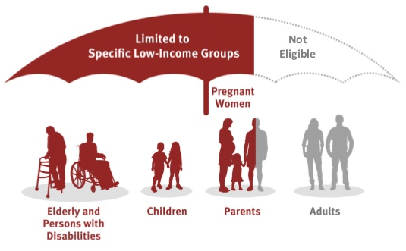
ACA Repeal & Replace
American Health Care Act (H.R. 1628)
Repeal Medicaid Expansion
Would end states’ ability to expand by 2020
Enhanced match would continue for those already enrolled unless break in coverage
Graphic by Kaiser Family Foundation

Slide 23
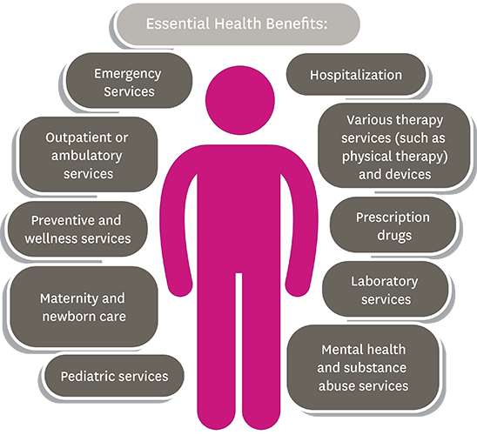
ACA Repeal & Replace
American Health Care Act (H.R. 1628)
Remove EHB Requirements
Starting in 2020 remove requirement that Medicaid Alternative Benefit Plans (ABPs) include EHBs
States would define EHB for purposes of premium tax credit
MacArthur amendment would give states an option to define EHBS

Slide 24

ACA Repeal & Replace
American Health Care Act (H.R. 1628)
Continuous Coverage
Impose 30% penalty for individuals who have a coverage lapse of 63 days
Individual Mandate
Individual tax penalty eliminated as of January 1, 2016

Slide 25

ACA Repeal & Replace
American Health Care Act (H.R. 1628)
Replace Subsidies with Tax Credits
Starting in 2020, replace ACA income-based tax credits with age-adjusted tax credits.
  Up to age 29 - $2,000
  Age 30-39 - $2,500
  Age 40-49 - $3,000
  Age 50-59 - $3,500
  Age 60 and older - $4,000
  Families can claim credits for up to 5 oldest members, up to limit of $14,000 per year

Slide 26

ACA Repeal & Replace
American Health Care Act (H.R. 1628)
Impose Per Capita Caps
Eligibility categories (beginning in FY 2020):
  Seniors
  Blind and disabled
  Children ineligible for CHIP
  Medicaid expansion population
  Other adults
Use FY 2016 spending to determine initial baseline
Inflation rate of CPI-M/CPI-M + 1
States could chose block grant option for certain populations

Slide 27








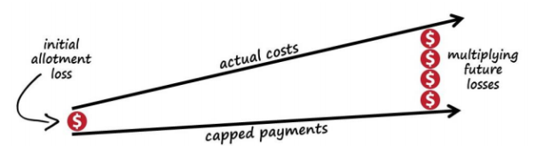
Medicaid Reform
Block Grants and Per Capita Caps
Current System | Block Grants | Per Capita Caps
Open-ended entitlement, federal match of state funds (50 – 73%). | Set dollar amount allocated to states based on as-of-yet undetermined criteria. | Fixed dollar amount allocated per person eligible for Medicaid.
Medicaid program must cover certain populations and meet certain requirements to qualify for funding. | Regardless of the level of state spending, states receive a fixed pot of money. Any shortages are the responsibility of the state. | Most capitated proposals do not tie payment increases to actual cost increases.
Federal contribution
Fewer enrollees
Less federal funding
More enrollees
More federal funding
State spending
Lower state spending
Fixed level of federal funding
Higher state spending

Slide 28
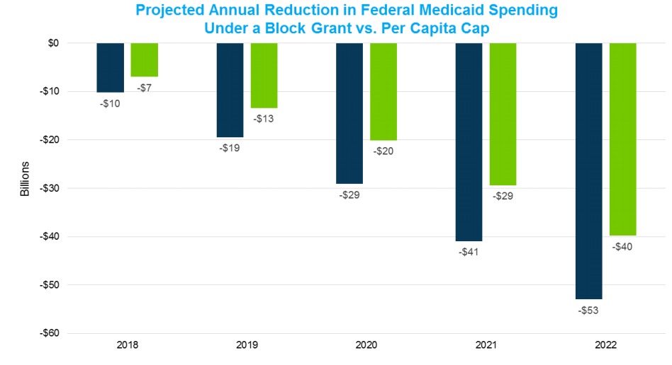
Medicaid Reform
Block Grants and Per Capita Caps
Source: Avalere Health

Slide 29
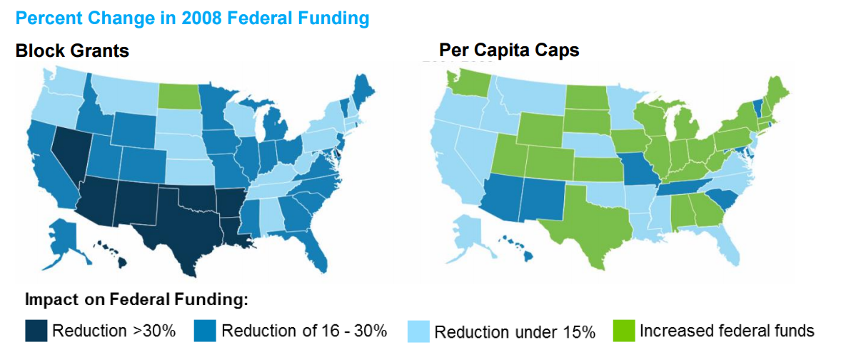
Medicaid Reform
Block Grants and Per Capita Caps
Hypothetically…
Source: Avalere Health

Slide 30
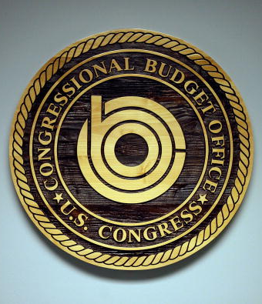
ACA Repeal & Replace
American Health Care Act (H.R. 1628)
So How Do We Pay for This?
Cut approximately $834B from Medicaid over 10 years (in addition to $610B proposed in budget)
Eliminate 1915(k) 6% FMAP enhanced funding
Defund Planned Parenthood
Cap employer tax benefits
CBO estimates 23 million fewer people covered (or 13 million?)

Slide 31
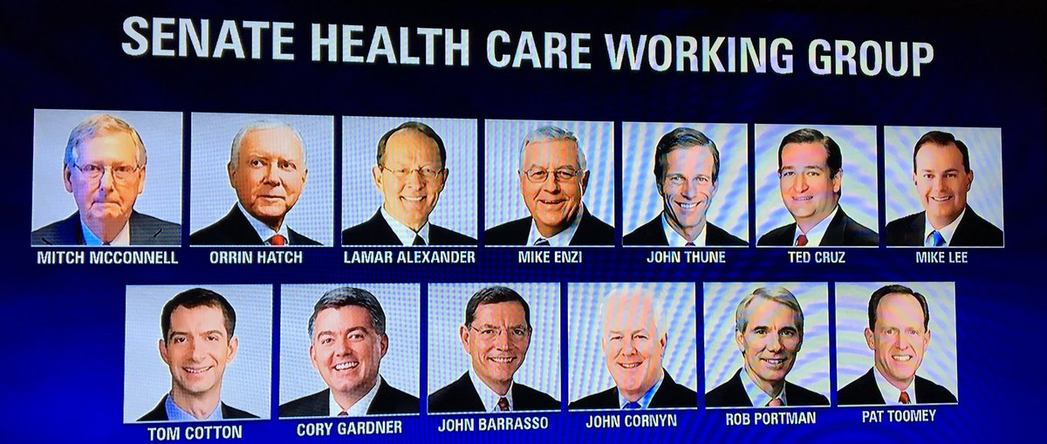
ACA Repeal & Replace
American Health Care Act (H.R. 1628)
What’s Next?
The Senate is now working on their own version, which will likely include many of the same harmful provisions in the House-passed version
ACA repeal is seen by many as a “must win” issue

Slide 32

ACA Repeal & Replace
American Health Care Act (H.R. 1628)
What’s Next?
Pressure is on to resolve any technical details and challenges to get the bill to a vote before the July 4 recess
The Byrd Rule challenges appear to be mostly resolved, with some exceptions

Slide 33
ACA Repeal & Replace
American Health Care Act (H.R. 1628)
What’s at Stake?
Permanent change to the structure of Medicaid funding
  Locked in base rate at 2016 spending levels reduces state flexibility and creates unfair disparities
  Growth rate that will fall short of actual costs
  No guarantee that money brought in under disability rate will be required to be spent on disability services
HCBS waivers and state plans, along with many other services that people with disabilities depend on, are optional services within Medicaid; states may be forced to cut them first
As states make hard choices about what to cut and where to find efficiencies, pressure will be on providers to do more with less
All other federal, state, and local laws and rules still must be complied with – with less funding to do so (OIG, Olmstead, HCBS, FLSA), setting up conflicts between what is required, what is desired, and what is possible

Slide 34


ACA Repeal & Replace
American Health Care Act (H.R. 1628)
What’s the Plan?
Keep up the pressure on the Senate!
Demand transparency
Educate about:
  The services we provide
  The way they are funded
  The budget shortfalls that will hit states under a per capita cap model

Slide 35

ANCOR Report: Addressing the Disability Workforce Crisis of the 21st Century
Recommendations:
Continue work at the state level to ensure sufficiency of rates
Need additional visibility for workers and the value they add
Provide tools and training for supervisors
Utilize technology
Think creatively about how to expand workforce
Urge BLS to create new classification for DSPs

Slide 36

Workforce Recommendation: New BLS SOC for DSPs
The Goal: To get the Bureau of Labor Statistics within Department of Labor to create a new Standard Occupational Classification for Direct Support Professionals.
Why We Need It: BLS collects data that is relied on by policymakers nationwide. DSP data is not captured in its own category, and other SOCs (e.g. home health aides, nursing assistants) do not give us a full and accurate picture.
What We’re Doing: Formal request to BLS, testimony at state and federal levels to urge DOL to create SOC, outreach to Congressional offices.
2017 Direct Support Professional Resolution

Slide 37

ENACTED: 21st Century Cures
Comprehensive Funding Package for Medical Research (enacted December 13, 2016)
Research and drug development
$1B in state grants to fight opioid epidemic
Expedited FDA drug approval process
“Informed consent” waivers
$4.8B to NIH for medicine and biomedical research ($1.5B for brain disease, $1.8B for “cancer moonshot”)
Behavioral health
Strengthens mental health parity regulation
Requires insurance companies to cover mental health treatments to same extent as medical treatments
Grants for community mental health resources (suicide prevention, de-escalation training for LEOs)
Electronic Visit Verification (EVV)
Imposes penalty in the form of FMAP reduction for states that do not implement EVV by certain dates
Personal Care Services: .25% in 2019 → 1% after 2023
Home Health Services: .25% in 2023 → 1% after 2027

Slide 38

INTRODUCED: Regulatory Accountability Act
Would change judicial review standard of regulations from “arbitrary and capricious” to “substantial evidence”
Would require agencies to conduct exhaustive review of alternatives, including cost analysis
Would require a reset of process if it takes longer than two years
Would require agencies to prove proposed regulations are the “least costly” way of accomplishing a policy goal
Would override statutes that prohibit agencies from taking costs into account when setting health standards

Slide 39
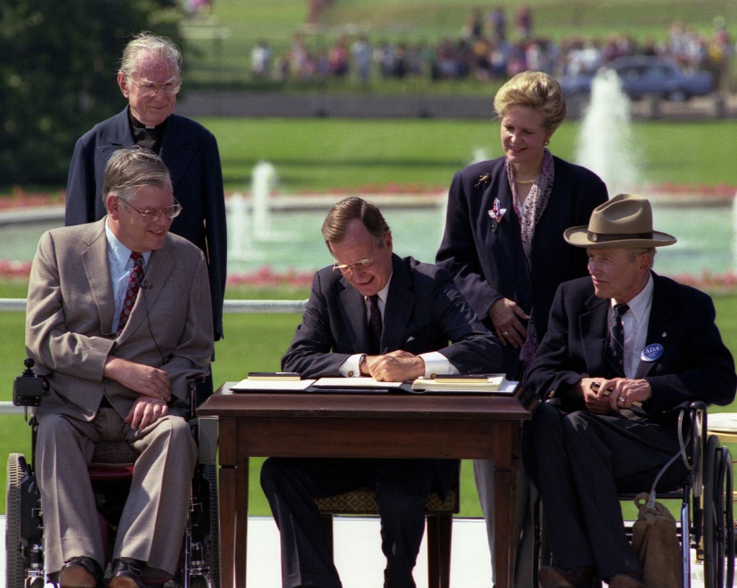
INTRODUCED: ADA Education and Reform Act
Introduced by Rep. Ted Poe (R-TX) on January 24, 2017
Requires notification of ADA violation to be sent to a business prior to initiating lawsuit
Places burden on individual encountering access barrier rather than on business
Gives business owner 60 days to respond, then additional 120 days to remedy
Does not change damages allowed by states; the ADA currently does not allow damages
Disability groups are overwhelmingly opposed to this bill!
President Bush signs Americans with
Disabilities Act into law in 1990

Slide 40

INTRODUCED: TIME Act
“Transitioning to Integrated and Meaningful Employment Act”, introduced March 7, 2017
Introduced by Rep. Gregg Harper (R-MS) March 7, 2017
Would limit and eventually phase out the use of 14(c) Special Wage Certificates over six years
Certificate holders would have to identify barriers preventing individual from transitioning to CIE and resources that have been provided; report to DOL
Harper introduced a similar bill in the past but it has never advanced out of the House

Slide 41

INTRODUCED : ABLE 2.0
A trio of bills to improve upon the “Achieving a Better Life Experience” signed into law in 2014, all introduced in House/Senate April 4, 2017
“ABLE to Work Act” – Would allow working ABLE beneficiary to save additional funds up to FPL
“ABLE Financial Planning Act” – Allows rollovers between 529 college savings accounts to 529A ABLE accounts
“ABLE Age Adjustment Act” – Would raise the age limit for eligibility from 25 (when disability acquired) to 45

Slide 42
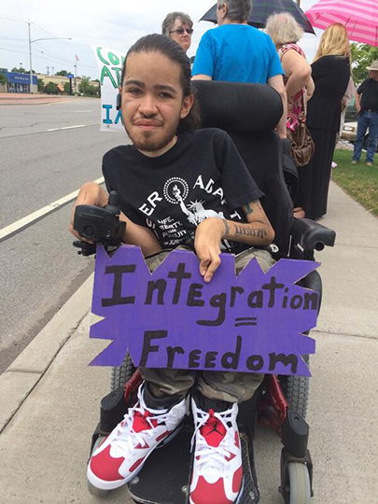
INTRODUCED: Disability Integration Act
Introduced by Sen. Chuck Schumer (D-NY) on April 7, 2017, Rep. James Sensenbrenner on May 16, 2017.
Clarifies that every individual eligible LTSS has a federally protected right to a real choice in how they receive services and supports;
Assures that states and other LTSS funders provide services and supports in a manner that allows individuals with disabilities to live in the most integrated setting (including their own home), have maximum control over their services and supports, and lead an independent life;
Requires adequate rates to maintain sufficient workforce;
Requires states to address the need for affordable, accessible, integrated housing that is independent of service delivery; and
Establishes stronger, targeted enforcement mechanisms.

Slide 43
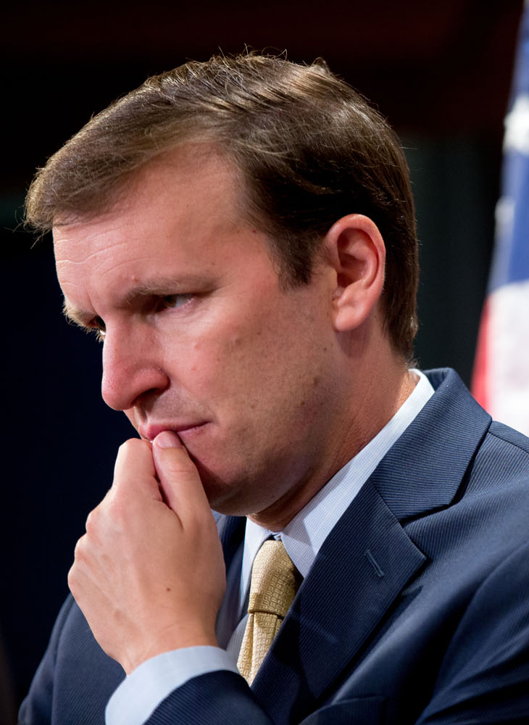
PENDING: DD Improvement Act
Currently being developed by Sen. Chris Murphy (D-CT)
ANCOR continues to work with office to provide input
In response to OIG reports showing incidents of death/abuse of individuals with IDD
Would create uniform definition of “critical incident” that must be reported
Would create federal law for who is a “mandatory reporter” of critical incidents
Would create mandatory online training curriculum on abuse and neglect

Slide 44

Questions?

Slide 45


Upcoming Events
                2017 ANCOR Leadership Summit
                September 18-19, 2017
                The Dupont Circle Hotel
                Washington DC
2018 ANCOR Annual Conference
April 15-17, 2018
Sheraton New Orleans
New Orleans, LA

Slide 46
Contact Information
Katherine Berland, Esq.
Director of Public Policy
kberland@ancor.org
(703) 535-7850, ext. 104

