Slide 1
Brown Ranch
Neuro-Inclusive Community
Steamboat Springs, CO

Slide 2
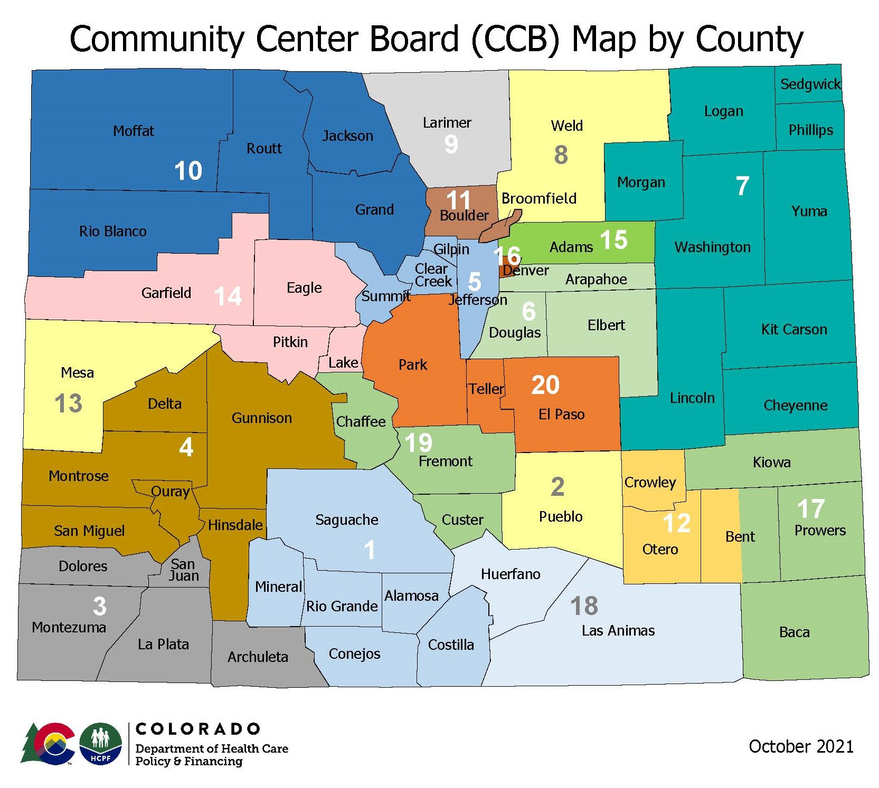
Horizons
Community Centered Board – 10
Only willing and qualified provider & CMA
Equivalent in size to Switzerland
Not “rural” but “frontier” in terms of available Medicaid services
Workforce crisis operating at 35% vacancy
Despite raising wages by 45% in the last 4 years; starting wage is $20/hour
Diversifying service delivery model toward more HHP and FG
No one is coming through the door
And now, the median house cost last quarter in Steamboat was $2.2 million dollars

Slide 4
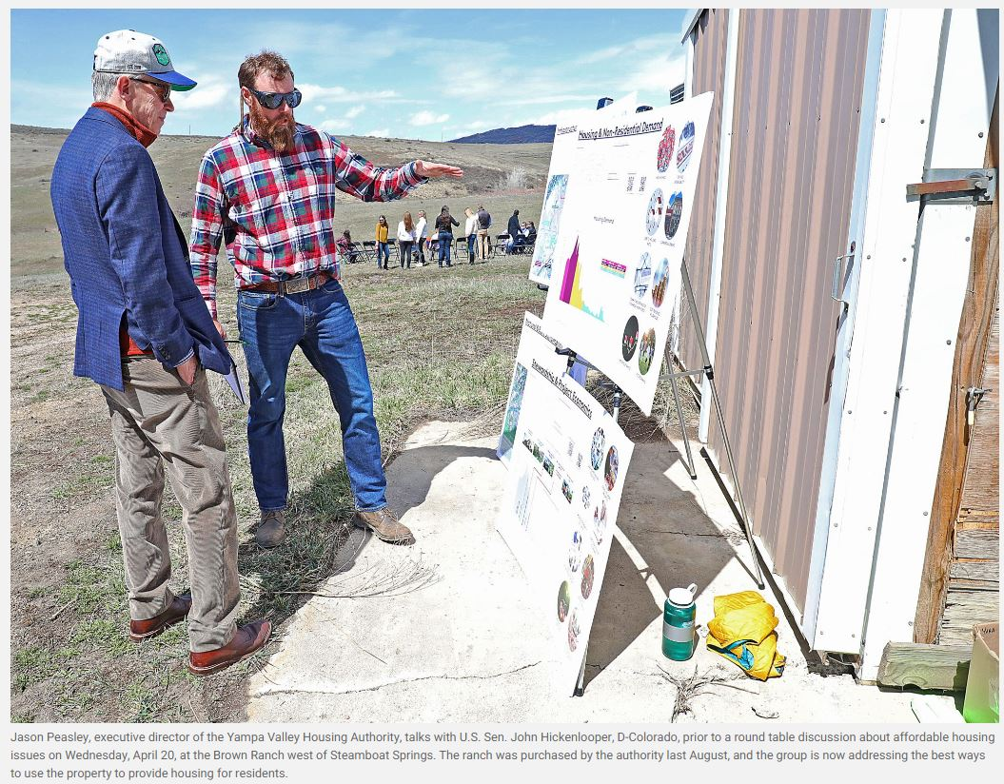
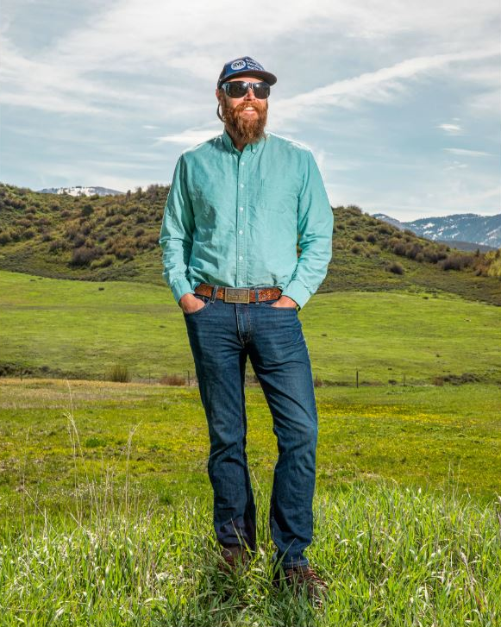
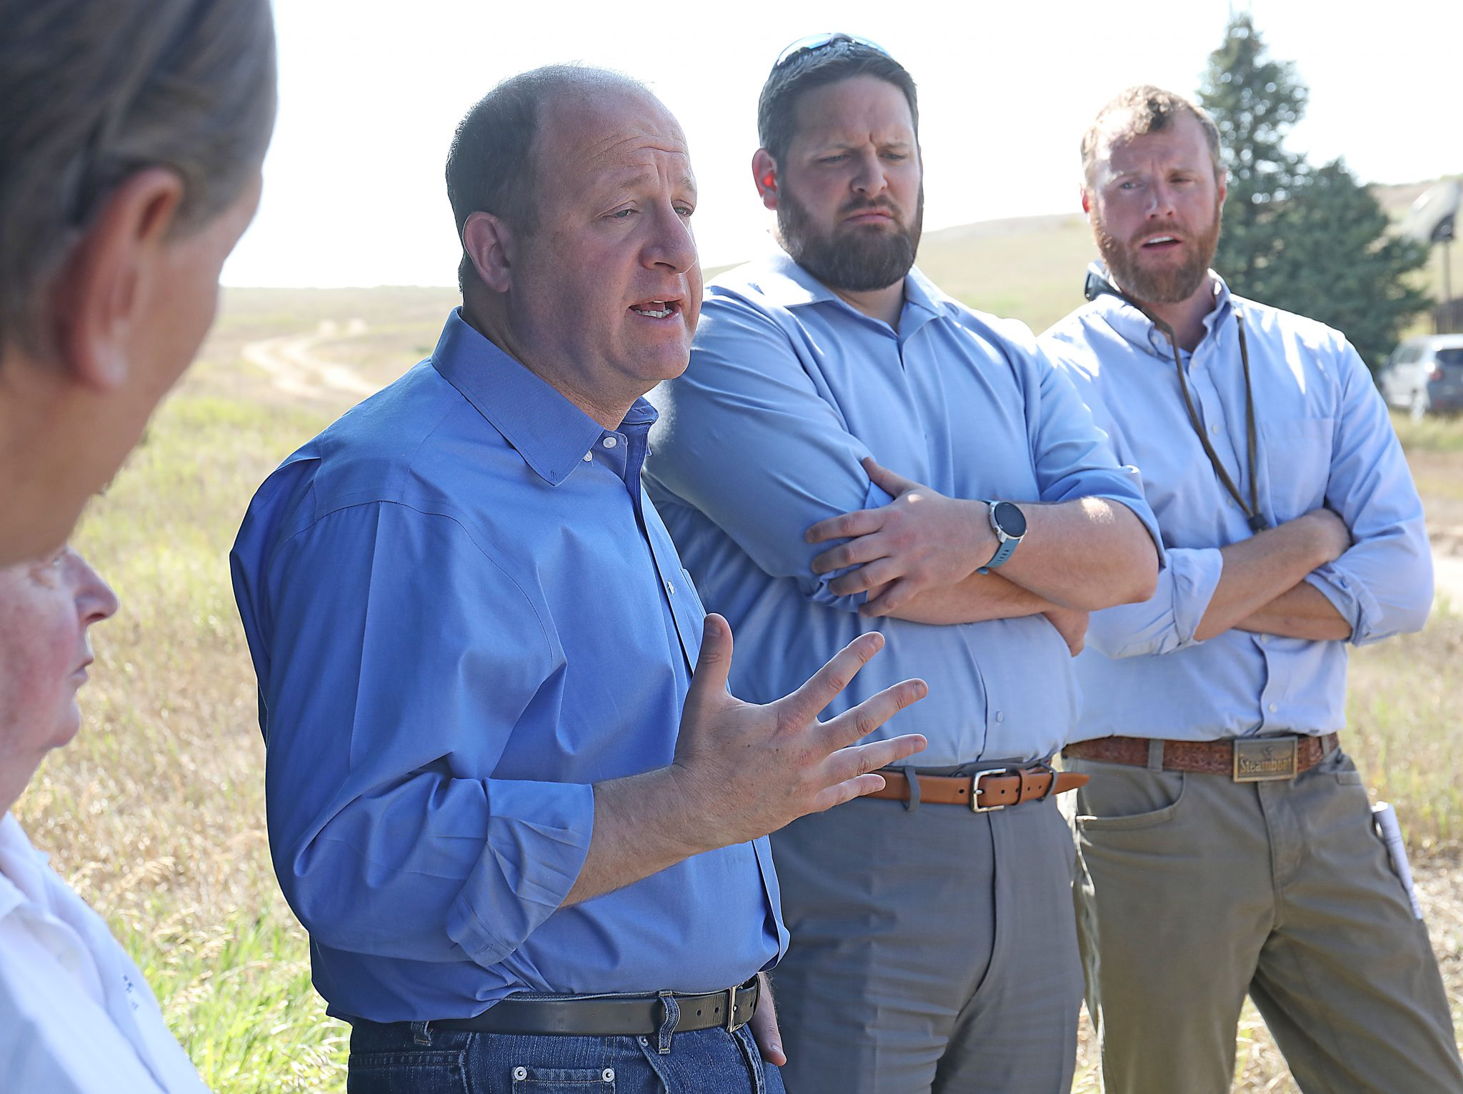
TIME MAGAZINE COVER PHOTO JUNE, 2022
SENATOR JOHN
HICKENLOOPER
GOVERNOR
JARED POLIS
Jason Peasley, Executive Director of the Yampa Valley Housing Authority stands on Brown Ranch just west of Steamboat Springs, CO on May 16, 2022 David Williams for TIME

Slide 5
STEERING COMMITTEE
VISION:
“The Brown Ranch residents will live and connect in a vibrant, resilient, diverse, and welcoming neighborhood that provides a wide variety of housing options and services designed by and for the Yampa Valley community.”
The Steering Committee is a diverse group of 20
community members tasked with creating an overall vision for the Brown Ranch, and creating a set of priorities that will guide the development through the coming decades.
COMMITTEE MEMBERS
The following Community Members met weekly in the fall of 2021 to create the framework
for the Development Plan contained within this document. More information about the Steering Committee including member bios can be found on the project website, at:
GUIDING PRINCIPLES:
1.
The Brown Ranch will provide affordable and attainable housing options for the Routt County workforce in a timely and efficient manner that meets both the urgent and long-term need.
2.
The Brown Ranch will provide quality housing that is sustainable yet flexible, modern, efficient, safe, healthy, environmentally responsible, and in harmony with existing natural systems.
https://brownranchsteamboat.org/steering- committee/
COMMITTEE SELECTION
Within a day of closing on the property, the Housing Authority initiated a community- led comprehensive planning process for the Brown Ranch, including a call for Steering Committee members. YVHA received
more than 90 applications for the Steering Committee from residents committed to working hard for the future of the community. The twenty who were ratified by the YVHA Board are a true snapshot of the community, representing a variety of skill sets, viewpoints, and lived experiences.
3.
The Brown Ranch will be both physically and emotionally connected to the community, providing opportunity for social cohesion and successful vibrant and healthy lifestyles.
Andrew Beckler
Anne Warhover Cecilia Escobar Ed MacArthur Erin Miller Gates Gooding
Genevieve Kalmes Kimball Crangle Kristin Brown Wilson
Lina Grant
Marsha Daugenbaugh
Megan Moore-Kemp Patrick Phillips
Patrick Staib Roger Ashton Sarah Jones Tatum Heath Tim Wohlgenant Vanessa Avitia
Webster Jones
4.
The community-driven process to design and develop the Brown Ranch will be inclusive, fact-based, honest, cost efficient and collaborative with all relevant stakeholders.

Slide 6
HEALTH EQUITY
FINDINGS
This summary of findings reflects research and data from Health Equity Group meetings along with research and reports from multiple community organizations such as the Colorado Futures Center (CFC), and the Northwest Colorado Health Aging Coalition Report 2020.
This summary of findings reflects input from Health Equity Group meetings and survey findings, targeted outreach, and research and reports from multiple community organizations including Northwest Latinx Alliance, LiftUp Client Survey 2021 and Integrated Community based on their day to day experience with traditionally unrepresented voices within the community.
LACK OF HOUSING IMPACTS AVAILABLE WORKFORCE
NEED FOR SAFE PEDESTRIAN SYSTEMS
Safe sidewalks, trails and walkable access to essential services are needed.
COVID INEQUITY
Latinx community members suffered more than 2x the COVID-19 death rate, compared to white community members.
HIGH HOUSING COSTS
There is a staff shortage among teachers, nurses and social service workers due to lack of affordable housing options.
Routt County’s working-age population (16-65), both in absolute numbers and as a
share of the total population, hit a decade’s low in 2021. The downward trend is strongest in the 24-44 age cohort.
About 30% of households are cost burdened in Steamboat Springs and Colorado state. In Routt County 28% of households are cost burdened.¹
INEQUITABLE LIFE EXPECTANCY
In Craig, where much of the Steamboat Springs workforce lives, average life expectancy is 75.4 to 79.7 years, compared to 77.7 to 82.2 years in Steamboat Springs itself.⁴
TRAFFIC SAFETY CONCERNS
Traffic safety is a significant concern, and most collisions in the county happen in Steamboat Springs.
CHANGING CLIMATE INEQUITIES
Many people don’t have access to cooling during summer heat and smoke waves and there are high rates of ER visits due to heat.
OVERCROWDED HOUSING
Doubled-up households are becoming more common due to high costs and lack of supply. Overcrowding can exacerbate stress.
Steamboat has a doubled-up household rate of 18.6% compared to Colorado at 15.5%.³
HIGHER WORKFORCE DISABILITY
Steamboat Spring has a disability rate of 4.7% of the total population.²
FOOD ACCESS CHALLENGES
Food prices are among the highest in the state, well over the state average.
CHILDCARE CHALLENGES
Routt County has a very low rate of childcare attendance due to lack of affordability, which affects people’s ability to keep a job.

Slide 7
MOBILITY
GUIDING PRINCIPLES
PEOPLE FIRST
Design for people before cars by prioritizing safe and comfortable pedestrian, bike, and transit infrastructure.
Locate a transit stop or hub within a 1/2 mile of all homes
Implement a gridded street network to reduce street widths and improve walkability.
Provide designated bike lanes throughout the neighborhoods, connected to the multimodal trail.
Provide a network of pedestrian-focused spaces (greenways) that connect to the multimodal trail.
ACCESS
Ensure safe and clear access throughout the neighborhood for people with a range of physical, visual, and auditory abilities.
Minimize street slopes where possible to accommodate a range of physical abilities.
Prioritize 5% maximum slope in neighborhood centers, especially areas adjacent to transit stops.
Provide accessible pedestrian signals at intersections within neighborhood centers.
Provide a multi-modal trail that is a maximum of 5% slope and provide way- finding maps to identify routes through the community that are 5% or less, to the greatest extent possible.
CONNECTIVITY
Provide easy and intuitive connections from all homes to the neighborhood centers, school site, transit stops, multi-modal trail, and parks and open spaces.
Use a grid network to facilitate easy connections from all homes, and create
EDGES
Create a trail network along the perimeter of development areas to navigate wildland- urban interfaces.
Provide a fire-break between undeveloped areas and housing for fire fighting management.
Create a space for people to visually connect to nature while protecting wildlife habitat.
Provide a gradual, flexible transition from the grid of the developed portion of the site to the undeveloped, natural portion of the site.
multiple options for routes.
Distribute neighborhood centers, transit stops, and parks to allow access within 1/4
mile from all homes.
Create shared streets, or woonerfs,* along key edges that front community park space.
*woonerf: a Dutch term which means a circulation area shared by pedestrians, wheeled users, and vehicles, and accessible to surrounding uses

Slide 8
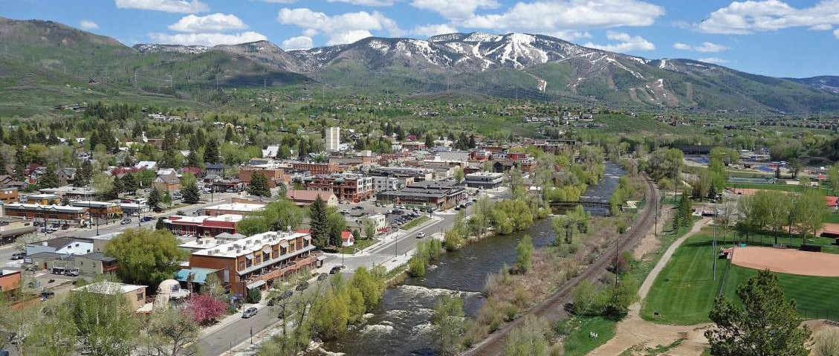
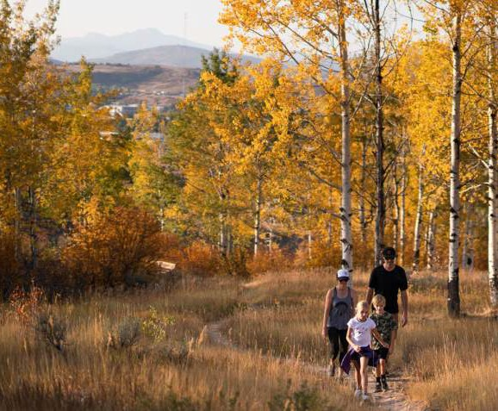
SUSTAINABLE DESIGN GUIDEPOSTS AND STRATEGIES
Bringing together what we heard from the entire community—Steering Committee vision and guiding principles, Focus Team principles, targeted outreach to traditionally unheard voices, and consultant team research
and recommendation—these guideposts and strategies directly shape the physical design of the project.
INCLUSIVE AND EQUITABLE COMMUNITY
Supporting housing choices for all, serving the highest need, and creating accessible community resources and gathering places:
WALKABLE, BIKEABLE, AND TRANSIT FIRST COMMUNITY
Supporting healthy, active lifestyles, connected communities, and a low carbon future:
SAFE AND RESILIENT COMMUNITY
Responding to climate, safety, and health:
Orient blocks north/south to maximize solar exposure and opportunity for solar energy generation.
Use open space and greenway network to capture and manage stormwater and create and restore habitats.
Edge open spaces with service- accessible trails and roads to maximize fire resilience.
Design blocks with lot size flexibility to accommodate multiple types of housing.
Locate highest density blocks with active ground floor uses in greatest proximity to amenities and transit.
Provide direct access to resources and open space amenities through greenway and trail network.
Distribute housing types equitably throughout the neighborhoods, with a mix of Multi-Family, Single-Family
Attached, and Single-Family Detached with Accessory Dwelling Units (ADUs) on every block.
Create a redundant, gridded mobility network with multiple options.
Minimize parking and create alley- accessed parking with ADUs above.
Minimize vehicle lane widths for slower speeds and include bike lanes on all minor streets.
Limit through traffic to a single road.
Aggregate surface parking into parcels that can transition to housing in the future.
Design greenways for north-south connections to the core trail and community resources.
CONTEXT CONNECTED
Rooted in the site, surrounding nature and the greater Steamboat Springs community:
Villages respond to special places on the site – Slate Creek, key viewsheds, and drainages.
Prioritize the multimodal trail connections throughout the site.
Create visual connections to the landscape beyond the site.
Use alleys to support old town character and maximize efficiency.
Promote arts and culture integration throughout the community.

Slide 9
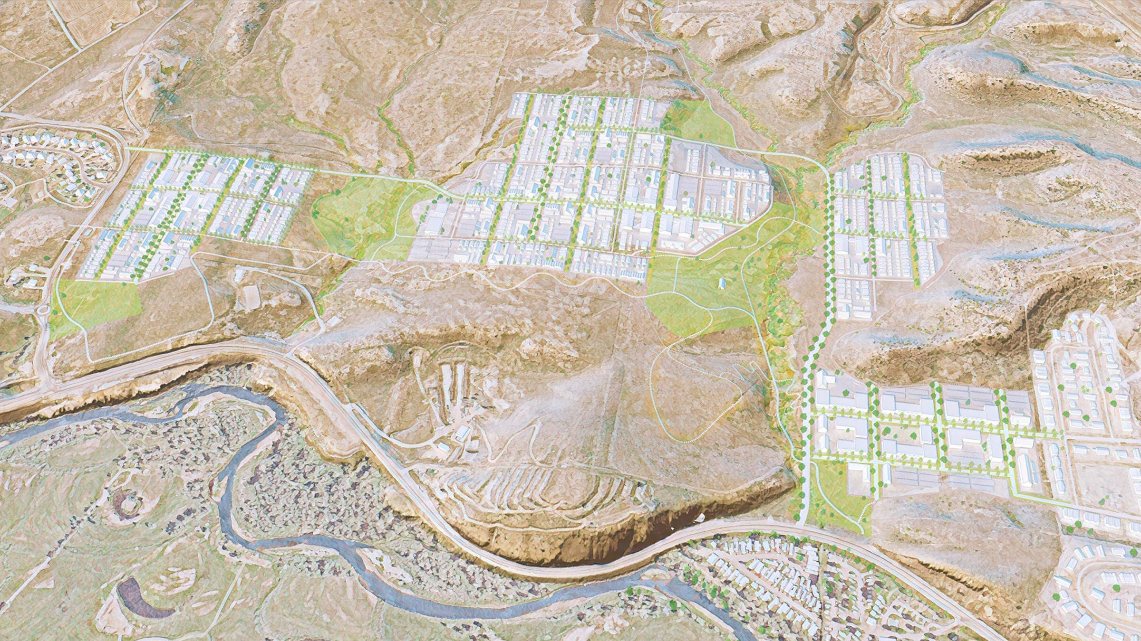
AERIAL VIEW
AIRPORT
OPEN SPACE
NEIGHBORHOOD C
PARK
SILVER SPUR
NEIGHBORHOOD D
NEIGHBORHOOD B
COMMUNITY PARK
CR-42
COMMUNITY PARK
PARK
OPEN SPACE
MULTIMODAL TRAIL
LOG BARN
SLATE CREEK
US-40
NEIGHBORHOOD A
OPEN SPACE
FORMER M&M AUTO PARCEL
SQUARE
OVERLOOK PARK SUBDIVISION
PARK
US-40
SLEEPYBEARMOBILE HOMEPARK
YAMPA RIVER

Slide 10
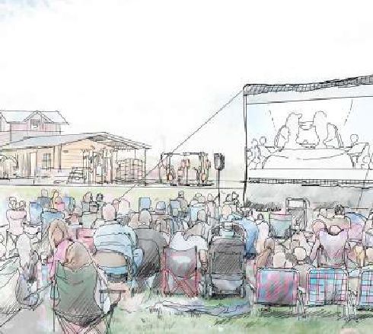
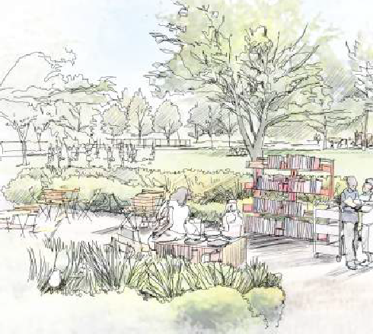
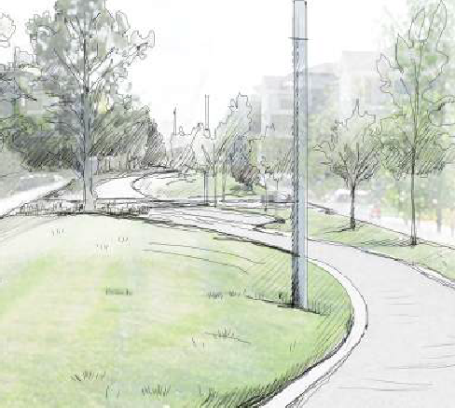
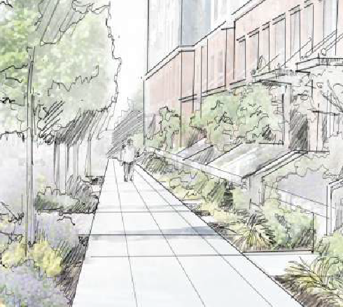
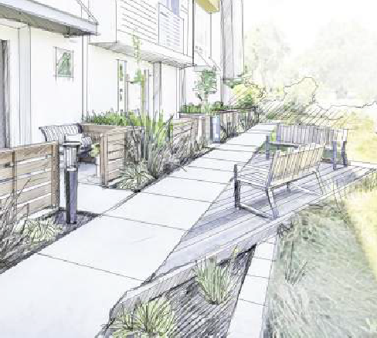
LANDSCAPE TYPOLOGIES
PARKS & PUBLIC REALM
COMMUNITY PARKS RECREATION AND ACTIVITY NODES
Large parks designed to serve recreation needs, provide community activities and programs, address stormwater, and enhance the landscape with native and low-water use plants.
NEIGHBORHOOD PARKS
GATHERING AND PLAY NODES
GREENWAYS & PLAZAS SOCIAL CENTERS FOR GATHERING
Small green spaces designed for social activities, play, and smaller gatherings.
STREETSCAPE
LIFE WITHIN THE PUBLIC REALM
PRIVATE LANDSCAPE
RESIDENTIAL LIFE
Parks designed for play and community gathering with greater amounts of manicured landscape.
Streets designed to function as places to walk and meet neighbors.
Spaces designed for private and semi-private gathering.
WILDLIFE
PEOPLE
WILDLIFE
PEOPLE
WILDLIFE
PEOPLE
WILDLIFE
PEOPLE
WILDLIFE
PEOPLE
NO SUPPLEMENTAL | WATER FROM | NO SUPPLEMENTAL | WATER FROM | NO SUPPLEMENTAL | WATER FROM | NO SUPPLEMENTAL | WATER FROM | NO SUPPLEMENTAL | WATER FROM
WATER | IRRIGATION | WATER | IRRIGATION | WATER | IRRIGATION | WATER | IRRIGATION | WATER | IRRIGATION
Recreational areas
Playgrounds
Trails and paths
Community event space
Picnic and gathering
Native trees and plants
Water quality and infiltration
Stormwater detention
Flexible recreational areas
Playgrounds
Seasonal activities
Picnic and gathering
Community gardens
Low-water use trees and plants
Flexible multi-use lawn
Playgrounds
Trails and paths
Picnic and gathering
Community gardens
Low-water use trees and plants
Water quality and infiltration
Low-water use trees and plants
Low-water use trees and plants

Slide 11
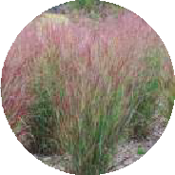
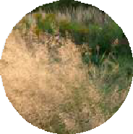
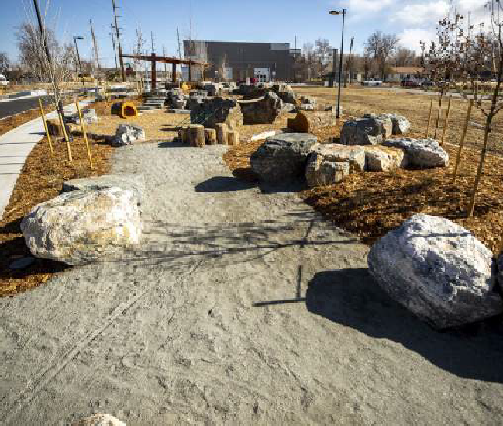
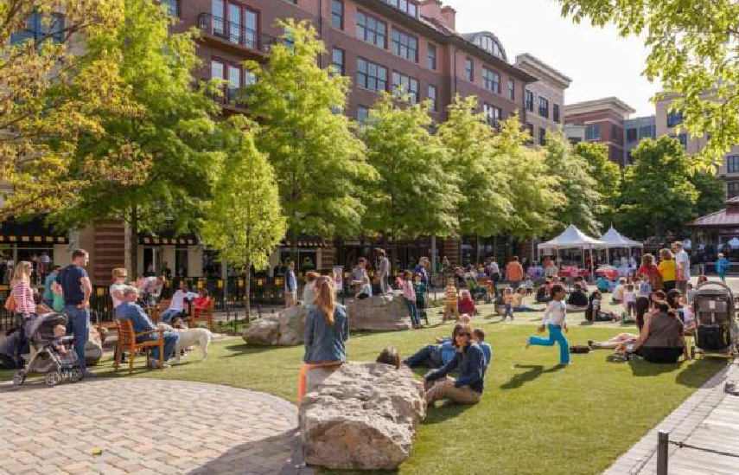
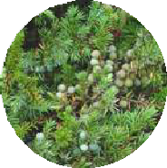
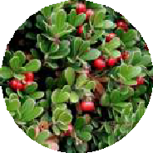
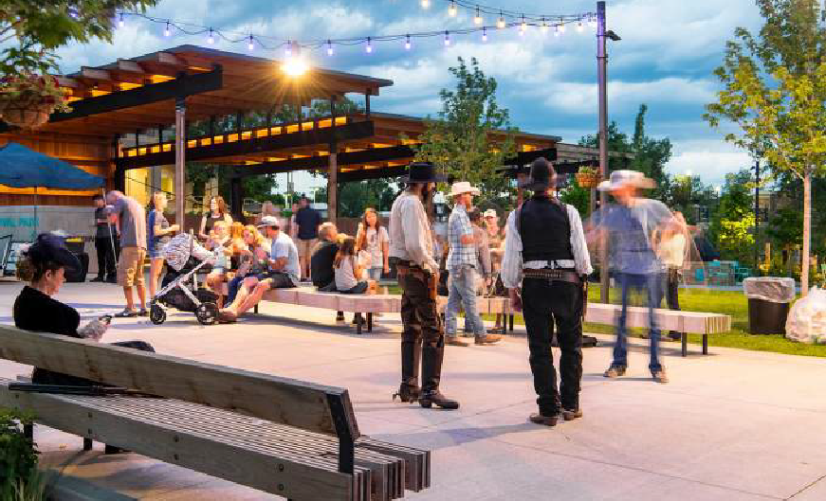
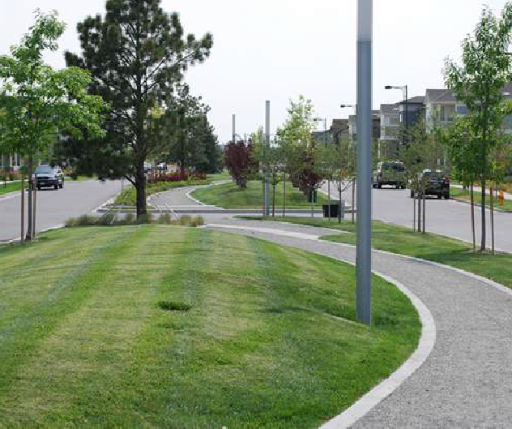
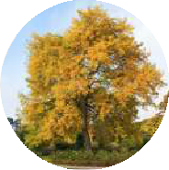
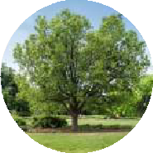
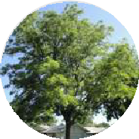
GREENWAYS & PLAZA
SOCIAL CENTERS FOR GATHERING
Greenways and plazas are small green spaces designed for social activities, play, and small gatherings.
The greenways are oriented north-south to connect people to the multimodal trail to the south. These spaces are located between neighborhood streets to provide better access to green space such that all residents are within three blocks of green space.
The greenways are designed to support gatherings, play spaces, and community gardens. Plazas should be located in places with greater housing density and accommodate small community events.
WATER USE LANDSCAPE & IRRIGATION DEMAND
20%
GRASSES
30% 25% 25%
Low
High
Native Plants
Turf
Planting Hardscape Bed
Switchgrass
Panicum virgatum
Large Blue Fescue
Festuca amethystine
CHARACTER IMAGES
Side-oats Grama Prairie Dropseed
Bouteloua curtipendula Sporobolus heterolepis
SHRUBS
Common Juniper
Juniperus communis
Kinnikinnick
Arctostaphylos uva-ursi
Provides pockets of program along greenways
Flexible lawns for various forms of gathering and events gathering
Twinberry Honeysuckle
Lonicera involucrata
Red-osier Dogwood
Cornus sericea
TREES
Honeylocust
Gleditsia triacanthos
Hackberry
Celtis occidentalis
Kentucky Coffeetree
Gymnocladus dioicus
Sugar Maple
Acer saccharum
Provide adequate seating and lighting for gathering
Greenway with path and amenities

Slide 12
Horizons’ Action Plan
Hold in-services for staff and people in services to become financially eligible before the waitlist opens to the public
Encourage people in services to purchase their own 2 bedroom apartment with the intent of each client being the landlord for their own Host Home Provider
Build a day program and office site near the nonprofit center
Facilitate people in services as active community members thereby creating work opportunities and natural supports. Horizons is already a prominent community partner with a mill levy and a client employment rate of over 70%

Slide 13
Takeaways:
Contact your local housing authority and get involved. Share your expertise regarding environmental components for people with physical and intellectual disabilities. YOU ARE THE EXPERTS!
Educate and involve interested staff, people in services, and provide opportunities for them to become eligible.
Historically, community centered boards administered the homeless vouchers through HUD. Find out who manages those vouchers locally and take advantage of them. We save thousands of dollars as a provider every year by ensuring our folks are on that waitlist.
Become more familiar with what health equity and neuro-inclusive housing really means for our folks – because housing is the cornerstone in determining positive health outcomes for EVERYONE.
Be like Doug McNeill from Laradon – continue to advocate for safe, accessible, and affordable housing for people on Medicaid waivers. Make no mistake, the future will be marked by a fight for resources. And if housing is not part of that fight for people with IDD, then health outcomes will never be what we want them to be.

Slide 14
Tatum Heath
Executive Director
Horizons Specialized Services
https://brownranchsteamboat.org
theath@horizonsnwc.org
970-879-4466 ext 108

