Slide 1
Making Health & Nutrition a Priority for the IDD Community
Presentation by:
Cassandra Bursma, RD
Karlene Martin

Slide 2
Objectives:
Discuss challenges the IDD population faces
Address polypharmacy and drug-nutrient interactions
Discuss obesity and those at a higher risk
Address importance of physical activity and how to increase involvement
Discuss how to provide mealtime support and engagement

Slide 3
“The number of adults with IDD ages 60 and older is projected to nearly double from 641,8860 in 2000 to 1.2 million by 2030.”
Notes:
In addition, to growth of the population, the life expectancy of these individuals is also increase. Lifespan has grown from 66 years in 1950 to 78 years in 2007.
- d/t growing numbers, changes in public policy and technological and medicinal advancements

Slide 4
What do you think some of the barriers are for the IDD population regarding health care?

Slide 5
Challenges
Lack of access to primary care providers experienced with IDD
Communication issues
Behavioral issues
Physical limitations and/or challenges
Sensory issues
Time limitations

Slide 6
Nutrition and Health Issues
Adults have higher rates of obesity, sedentary behaviors, and poor nutritional habits
Polypharmacy impacting nutrient absorption
Higher incidence of dental disease
Increased gastrointestinal disorders
Increase in musculoskeletal disorders
Notes:
More than 75% of people w/ IDD live with their families, but inly about 5% of IDD funding is directed for family support 1
Making the family the advocates, fighting the system to help their child develop healthfully
Until the age of 21 years, persons w/ IDD are eligible to receive support services (education, training, health promotion) through the Individuals with Disabilities Education Act 1
Task becomes more challenges when eligibility ends – impacting both the individual with IDD and the caregiver 1

Slide 7
Nutrition and disability are intimately linked.
Malnutrition can directly cause or contribute to disability, and disability can lead to malnutrition.

Slide 8
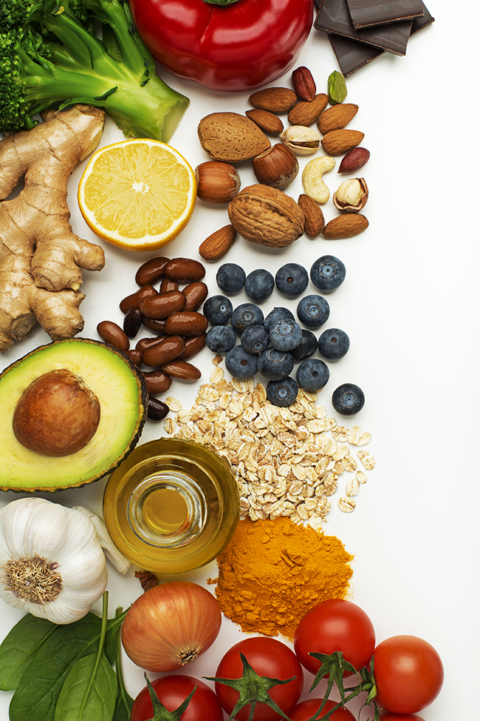
Without proper nutrition and supplementation, we can introduce and/or exacerbate problems.

Slide 9
Potential Consequences Of Poor Nutrition
Decreased brain growth
Osteopenia
Decreased immunity
Irritability
Skin breakdown
Increased incidence of adult problems:
Obesity
Hypertension
Type 2 diabetes
Notes:
Decreased brain growth and lead to reduced learning potential
Osteopenia- decreased bone mass leading to increase incidence in fractures and broken bones this could be d/t poor intake of CA or a chronic drug and/or nutrient interaction

Slide 10
Polypharmacy and Drug-Nutrient Interactions

Slide 11
Drug-Nutrient Interactions
A drug-nutrient interaction is a reaction between a medicine and one or more nutrients. Nutrients are the vitamins and minerals that are in the food you eat.
Notes:
Mental illness is common amongst IDD population, estimates of 2.5x higher (3)
Growing evidence suggests therapies are improving mental illness challenges
Cognitive Behavioral Therapy, mindfulness for mood, anxiety disorders, and OCD – however, some may need medication in conjunction

Slide 12
Drug-Nutrient Interactions
Drug Type | Potential Drug-Nutrient Interaction
Anticonvulsants | Decreased levels of folic acid, vitamin K, E, and zinc
Antidiabetics | Impair uptake of release of iodine by the thyroid, and decrease in vitamin b12
Antidepressants | Increase appetite and contribute to weight gain
Antipsychotics | Can cause IBS, low vitamin D and folic acid levels and can cause increased blood lipid levels
Anxiolytics | Decrease appetite
Blood pressure lowering | Diuretics can deplete body of potassium
Cholesterol lowering | Affects absorption of the fat-soluble vitamins K and D and, in addition, may alter water-soluble vitamins, including folic acid *Consumption of antioxidants, foods high in vitamins A,C, E, B and folic acid) may interact with drug and reverse results
Notes:
54% of people with IDD receive medications for at least 1 of these conditions:
- mood disorders
- Anxiety
- Behavior challenges
- Psychotic disorders
~87 of adults w/ IDD (on Medicaid and Mcaid/Mcare) have one or more prescriptions w/in 7 months
- Aspirin can even decrease levels of vitamin C

Slide 13
Obesity

Slide 14
Obesity
Obesity is the most common comorbidity of the IDD population
Those at higher risk within the IDD population are those diagnosed with:
Down syndrome
Turner syndrome
Angelman syndrome
Prader-Willi syndrome
Notes:
Specifically 38% in IDD population compared to 28% for general (HCBS Dietitian Services article)
Being female, having Down Syndrome, engaging in less physical activity, drinking greater amounts of soda, and taking medication that causes weight gain result in an increased risk of developing obesity.

Slide 15
Obesity (cont’d)
Health consequences that are commonly associated with being overweight or obese include:
Coronary heart disease
Type 2 diabetes
High blood pressure
Stroke
Liver/gallbladder disease
Respiratory problems
Cancers (particularly breast and colon)
… How can we prevent this, and what exactly are their calorie needs so we can better manage their weight?
Notes:
Specifically 38% in IDD population compared to 28% for general (HCBS Dietitian Services article)
Being female, having Down Syndrome, engaging in less physical activity, drinking greater amounts of soda, and taking medication that causes weight gain result in an increased risk of developing obesity.

Slide 16
Calorie Requirements
Clinical Condition | Calorie Requirements
Cerebral Palsy Athetoid Cerebral Palsy | 13.9 kcal/cm height with mild to moderate activity 11.1 kcal with physical restrictions Can be up to 6000kcal/day in adolescence
Down Syndrome Boys (age 5-12 years) Girls (age 5-12 years) | 16.1 kcal/cm height 14.3 kcal/cm height
Prader Willi | 10-11 kcal/cm for maintenance 8.5 kcal/cm for weight loss
Turner Syndrome | Lower calorie needs, need an individualized approach

Slide 17
The Importance of Physical Activity and How to Increase Involvement

Slide 18
Let’s Get Physical
Encourage light stretching or modified yoga practices
Gauge their interest in participating in the Special Olympics
Offer rewards after involvement
Checkout dance clips on Youtube– don’t be afraid to make it fun and get silly!
Notes:
Sedentary behaviors are another factor that contributes to obesity
If person is able to partake in yoga or light stretching, this will help stimulate the circulation of blood flow. Yoga also increases mindfulness and helps those fall into a deeper sense of relaxation, which helps them combat stress. Yoga has also been proven to help with IBS with improved blood flow and enhancing the brain-gut function.
Also, with MI and high incidence of depression, getting active and moving the body increase the the production of endorphins, those “feel good” chemicals
Provides 32 options for both individual and team sports
Offer rewards after partaking in a walk, jog, or stationary bike ride. Play one of their favorite games afterwards, or join in one of their favorite activities (maybe painting) or give them a prize, just avoid food (specifically deserts or highly sweetened foods)
Music encourages the body to move

Slide 19
How to Provide Mealtime Support and Engagement

Slide 20
Mealtime Support
Have structured mealtimes
Create a positive and social environment
Plan and arrange meals that are best suited for the IDD person
If tube fed, try to have the feeds coincide with family meals or scheduled group home mealtimes
Notes:
-Structure regulates hunger and creates routine. IDD persons can look forward to health, delicious foods and interacting with family members or members in their group home
Positive and stress-free environments allow IDD persons to relax when eating, reducing anxiety, which can trigger gastrointestinal issues like IBS
Positive and stress-free environments also allow you to encourage the consumption of new foods. For the general population, it takes a person at least 14 tries to accept and develop a taste for a new food. It is also extremely important to not get upset or frustrated if a new food is not excepted. Continuously presenting a food and allowing small bites and/or tastes will improve long-term acceptance and reduce future disordered eating behaviors. It is also a good idea when presenting a new food to present it with a food that is highly enjoyed.
Plan accordingly and recognize foods that are best for the IDD person keeping in mind preferred consistencies and textures and temperatures.
If weight management is an issue, providing pre-packaged frozen meals assists with calorie and portion control
-

Slide 21
In 2015, a study was conducted and found that dietitian services were not widely provided in HCBS waivers – less than 1% of the approximately 630,000 people with IDD supported by HCBS waivers were projected to receive dietitian services.
Notes:
Dietitian services are grossly underutilized and it’s effecting our IDD community. It’s time to provide proper continuity of care and provide dietary services to those who need it the most.

Slide 22
At Shield HealthCare, we are committed to help you and your family. We provide more than just supplies and aspire to help you every step of the way.
Check out our website at www.shieldhealthcare.com to get connected, stay up to date and connect with your local Registered Dietitian.
Notes:
Get connected with us.
We even provide bedside TF teachings and nutrition consults to make you as successful as possible.

Slide 23
Sources:
Friedman, C., & Spassiani, N. A. (2018). Community‐Based Dietician Services for People With Intellectual and Developmental Disabilities. Journal of Policy and Practice in Intellectual Disabilities, 15(4), 343-349, which has been published in final form at https://doi.org/10.1111/jppi.12253.
Heller, Tamar. “People with Intellectual and Developmental Disabilities Growing Old: An Overview.” Impact Newsletter: People with Intellectual and Developmental Disabilities Growing Old: An Overview, 2010, ici.umn.edu/products/impact/231/2.html.
Tinglin, Carolyn C. Adults With Intellectual and Developmental Disabilities: A Unique Population, 2013, www.todaysgeriatricmedicine.com/archive/050613p22.shtml.
Trollor, Julian N, et al. “Prescribing Psychotropic Drugs to Adults with an Intellectual Disability.” Australian Prescriber, NPS MedicineWise, Aug. 2016, www.ncbi.nlm.nih.gov/pmc/articles/pmc4993707/.
Youdim, Adrienne, et al. “Nutrient-Drug Interactions - Nutritional Disorders.” Merck Manuals Professional Edition, Merck Manuals, 2019, www.merckmanuals.com/professional/nutritional-disorders/nutrition-general-considerations/nutrient-drug-interactions?query=drug-nutrient%2Binteractions%2Bby%2BAdrienne%2Byoudim.

Slide 24
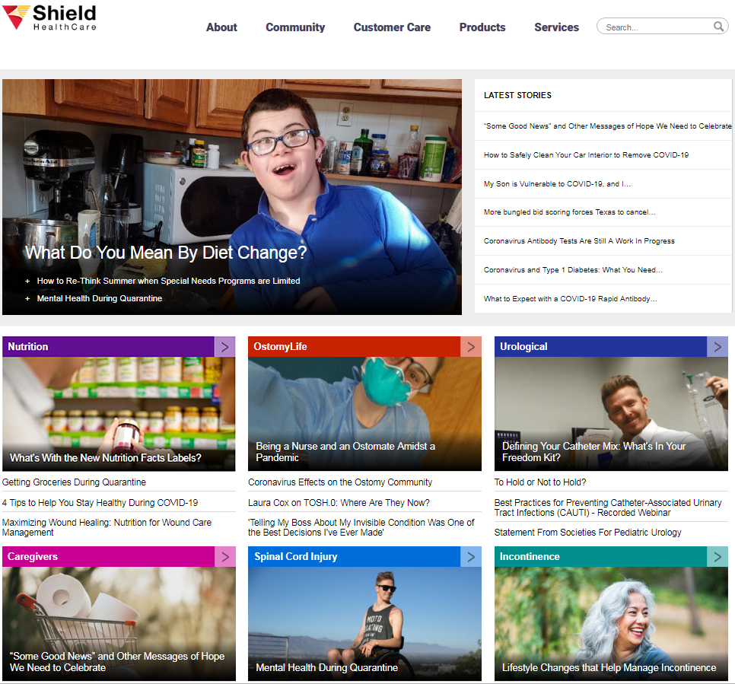
VISIT THE SHIELD HEALTHCARE COMMUNITIES
You can find more useful educational, lifestyle and clinical information
in our online communities at:
shieldhealthcare.com/community
View past and upcoming webinars at:
shieldhealthcare.com/events

Slide 25
FREE EDUCATIONAL BOOKLET GUIDES
Patients, Family & Healthcare Professionals
Can Request Free Guides Online:
SHIELDHEALTHCARE.COM/COMMUNITY
©2020. All rights reserved.

