Slide 1
Emergency Preparedness for Individuals with Access and Functional Needs
Jill Pidcock
Executive Director
Arc of the Central Mountains

Slide 2
Objectives
Build upon existing relationships to create collaboration with project & plan implementation
Design and implement Emergency Preparedness Outreach & Education
Create an Emergency Evacuation Plan and “Go Kit”
Lessons learned in a world of COVID-19

Slide 3
Demographics for the Arc of the Central Mountains
4 – Counties, Human Service Agencies, Emergency Managers, several Fire Departments (Region 13)
Relationships with each County’s Human Service Department
Relationships with other Non-profits in area
Relationships with Case Management and Direct Service Providers
Relationships with 6 School Districts
Relationships with Latino Leadership Groups

Slide 4
Collaboration
Within Counties
Office of Emergency Management (Pitkin County worked on a workbook in Spanish & English)
County Human Service Commissions
School Districts
Create Presentation – accessible format
Take it on the road

Slide 5
Plan, Plan, Plan…
The key to any emergency preparedness is to pre-plan as much as possible. Up until COVID – 19, we had a pretty good idea of how to best accomplish this by creating “systems of support” then we got thrown a curve ball; “Stay at Home” orders and “Social Distancing!” As we begin to reflect on lessons learned, we have added more to our pre-planning to include more self-sufficiency.
Who do you pre-plan with?
Family & neighbors
Direct Care Providers & Case Management
City and County Municipalities
Center for Independent Living
Arc Chapters

Slide 6
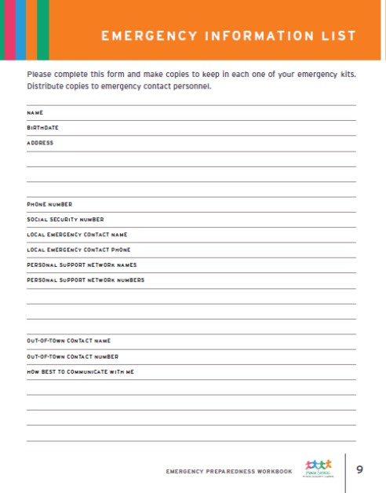
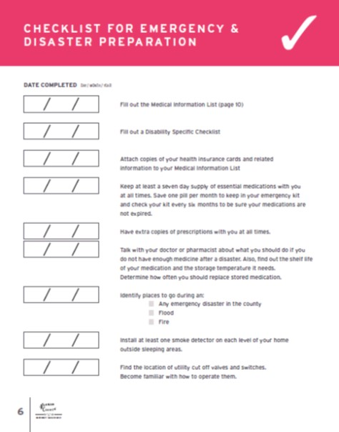
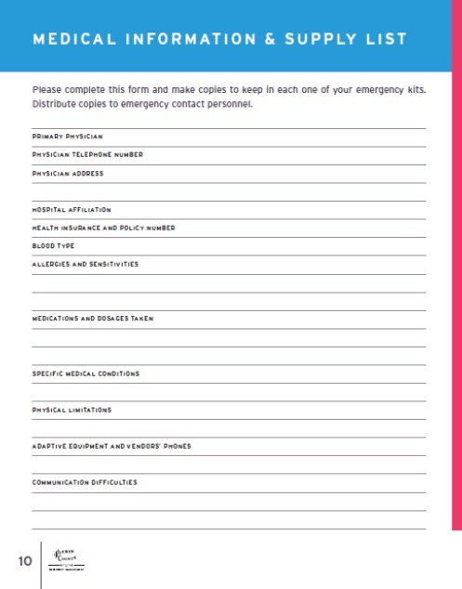
Network of Support and Checklists
Make Lists:
Emergency Contacts
Financial Institutions – Bank, Accountant, Case Manager, Service Providers
Medical Supplies & Equipment
Medications
List of all medications - prescription or over the counter
Directions on dosage

Slide 7
Go (or Stay) Kit:
Medication List
Additional Supply of Medications
Personal Protective Equipment
Gloves
masks
Personal Technology & Power Source (incl. Broadband), batteries
Hearing Devices
Glasses
Oxygen Needs
Disability Specific
Service/Support Animal Supplies
Sensory Items

Slide 8
Other Agencies
It is so important to get involved with other agencies and organizations who have already created systems which work. It is our job to educate those agencies about persons with Intellectual and Developmental Disabilities. Not all persons with I/DD have access and functional needs; but when they do, we are the experts in the field. Be at the table!
Who are some of the agencies in your area?
Fire Departments
School Districts
Red Cross
Public Health
Health & Human Services
Center for Independent Living
Arc Chapters

Slide 9
Emergency Support Functions (ESF)
15 Emergency Support Functions
ESF 6 includes
Mass Care, Emergency Assistance, Temporary Housing
ESF 8 includes
Public Health and Medical Services
Red Cross
Voluntary Organizations Active in Disaster (VOAD)

Slide 10
Evolution of Emergency Response
Joint Budget Committee passed a resolution to create a department of Access and Functional Needs within the Colorado Division of Homeland Security and Emergency Management
Arc Central Mountains has participated in Community Inclusion Engagement Forum as a Community Partner both locally and at the state level

Slide 11
Evolution of Emergency Response
Arc Central Mountains participated in the Regional Emergency Management and Functional Needs Conference in November
The office of Access and Functional Needs has solicited the Arc of the Central Mountains to engage in ongoing coordination to ensure the continuation of inclusion on all emergency planning
COVID 19 – Ongoing collaboration with State level ESF 6 & ESF 8

Slide 12
Evolution of Emergency Response
COVID 19 – This has been an unprecedented time for all of us. Our preparation for emergency response has expanded. Once we had to “shelter in place” the priorities shifted.
Food Insecurities
Personal Protective Equipment
Health – physical and mental
Economic decline
Distance Learning – related services

Slide 13
Thanks to...
Pitkin, Garfield & Eagle County Human Service - Senior Services
Pitkin, Garfield & Eagle County Emergency Management
Aspen Fire Department, Carbondale Fire Rescue, Glenwood Spring
Colorado Department of Homeland Security and the Office of Access and Functional Needs
“How to Prepare for Everything”
author Aaron Titus

Slide 14
Electronic Handouts:
Emergency Preparedness Workbook – English and Spanish
Checklists for Emergency & Disaster Preparation can be found inside the workbooks
Emergency Resources in English and Spanish

Slide 15
J
Jill Pidcock
Jill@arccentralmountains.org

