Slide 1
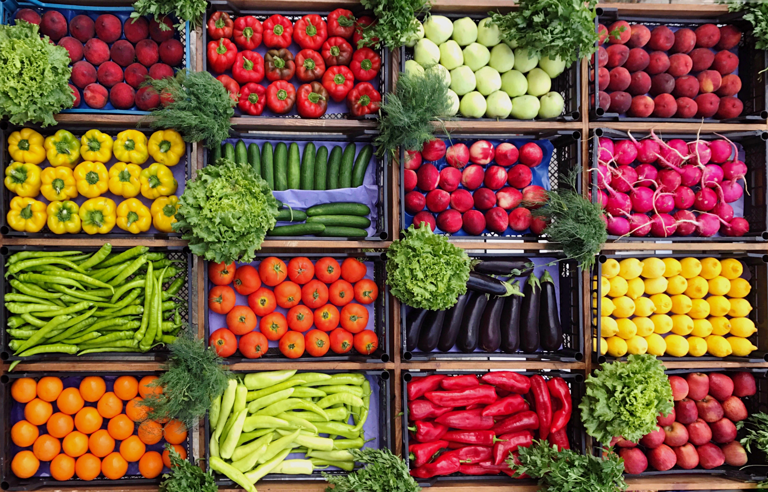
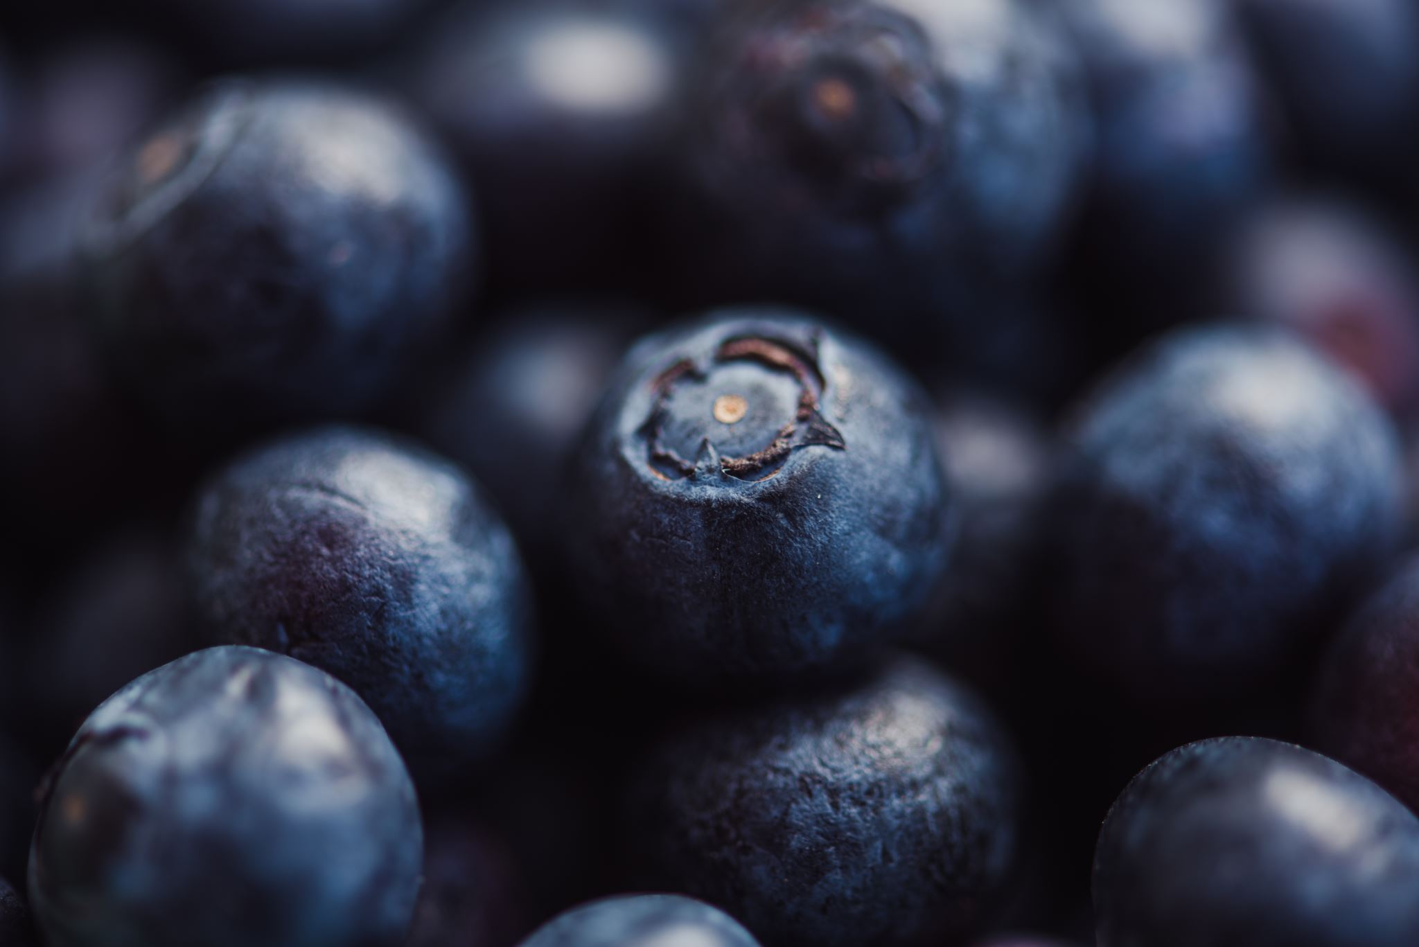
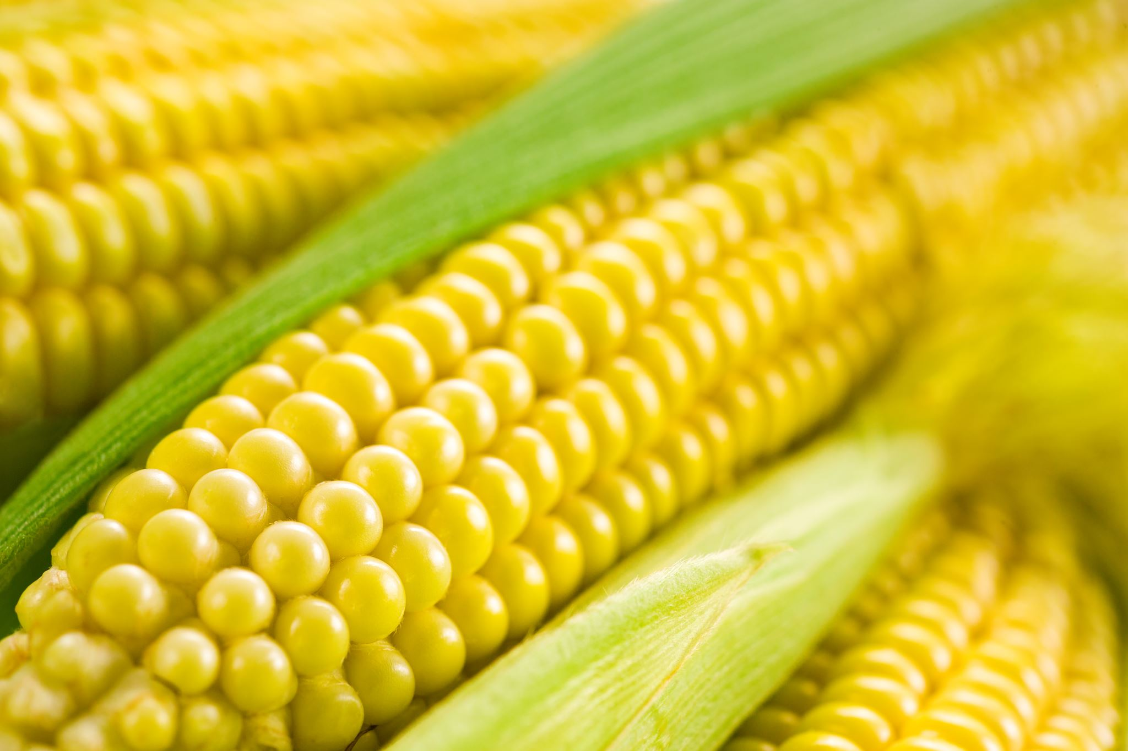
Focus on Fiber
Kristin Koons, RD
Shield Healthcare Registered Dietitian

Slide 2
About Me
Bachelor of Science in Dietetics from The University of Northern Colorado specializing in Medical Nutrition Therapy
Registered Dietitian for 5 years
Previously worked in medical weight loss in nutrition therapy and lifestyle intervention
Extensive experience in Hospital Foodservice Management within Sky Ridge Medical Center

Slide 3
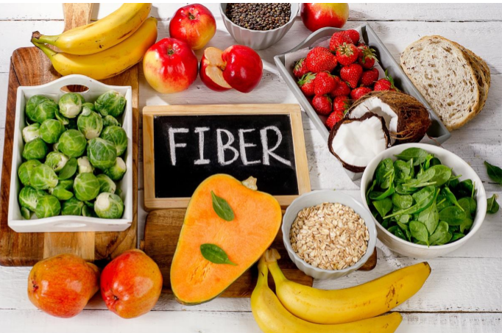
What is Fiber?
Fiber is a type of carbohydrate
Found in the non-digestible part of plant foods
Includes fruits, vegetables, beans, grains, nuts, seeds, legumes
You may see fiber categorized on food label as soluble and insoluble. Both have very important health benefits.
Notes:
We consume protein, fat, and carbohydrates in our daily diet. Fiber falls under the carbohydrate category.
-non-digestible means that it cannot be completely broken down by our GI tract
- The types of fiber vary in different foods so you should aim to consume variety of fiber containing foods.

Slide 4
Types of Fiber
Soluble Fiber
Dissolves in water to form a gel like substance
Can slow down passage of food from stomach to intestine
“Heart healthy”- helps move cholesterol out of body
Examples: Oat bran, nuts, seeds, beans, lentils, peas, some fruits and vegetables

Slide 5
Types of Fiber
Insoluble Fiber
Can be referred to as “roughage”
Does not dissolve in water- holds onto water- creating softer, bulkier stools which can help regulate bowel movements
Supports the good gut bacteria
Wheat bran, vegetables, and whole grains

Slide 6
Benefits Overview
Regularity, fiber adds bulk to our stool which helps with digestion
Most passes through the digestive system without breaking down
Helps prevent constipation (combined with fluid intake)
Satiety, makes you feel full longer
Weight control and maintenance
Blood glucose control

Slide 7
Soluble or Insoluble?
Notes:
Soluble- one cup of black beans = 15 gm of fiber which is the average amount of fiber one consumes per day

Slide 8
Soluble or Insoluble?
Notes:
INSOLUBLE:

Slide 9
Soluble or Insoluble?
Notes:
Insoluble

Slide 10
Soluble or Insoluble?
Notes:
Soluble– the soluble fiber in brussel sprouts can be used to feed beneficial gut bacteria

Slide 11
Soluble or Insoluble?
Notes:
INSOLUBLE- tough outer husk doesn’t break down in your digestive tract making it great source of insoluble fiber

Slide 12
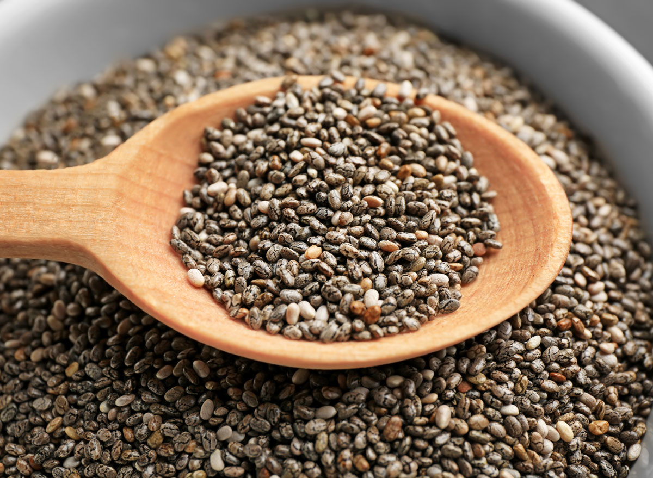
Soluble or Insoluble?
Notes:
Two types of seeds here
Flaxseeds –
Chia seeds-
Forms a gel in water which is great for digestion

Slide 13
How much Fiber Do We Need?
Fiber needs vary from person to person
Women aged 9-50 need >25 grams
Men aged 9-50 need 38 grams
Children:
Age 2-5: 15 grams/day
Age 5-11: 20 grams/day
Age 11-16: 25 grams/day
Age 16-18: 30 grams/day

Slide 14
Fiber in Fruits and Vegetables
Raspberries (1 cup) | 8 grams
Raisins (1 small box 1.5 oz) | 2 grams
Blueberries (1 cup) | 4 grams
Pear (1 medium) | 5.5 grams
Banana (1 medium) | 3 grams
Peas (1 cup cooked) | 9 grams
Baked Potato with the skin (medium) | 4 grams
Baked Sweet Potato with the skin (medium) | 4 grams
Celery (raw-2 stalks) | 2 grams
Broccoli (1 cup cooked) | 5 grams
Carrots (1 cup raw) | 4 grams

Slide 15
Fiber in Beans, Nuts, Grains
Black Beans (1/2 cup) | 7.5 grams
Hummus (2T) | 2 grams
Almond (23 nuts) | 3.5 grams
Peanuts (1/4 cup) | 3 grams
Instant Oatmeal (1 cup instant) | 4 grams
Whole Wheat Spaghetti (1 cup cooked) | 6 grams
Popcorn (3 cups) | 3.5 grams
Brown Rice (1 cup) | 3.5 grams

Slide 16
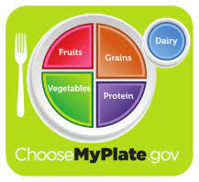
How to Incorporate Fiber
Add to diet slowly
Increase fluid intake, minimum 8-10 cups per day
Incorporating high fiber diet too quickly could result in bloating, cramping, and gas.
Make half your plate whole grains
Fill plate with fruits and vegetables
Look for “whole grain” or “whole wheat” on ingredient list
Swap out white bread for wheat bread
Choose plant protein foods like beans, nuts, seeds more often
Add beans to a meal, add to soups or pasta dishes
Add vegetables to sandwiches or wraps
Blend fruit and vegetables into a smoothie

Slide 17
Fiber and Tube Feeding
It is ideal to get fiber from food sources however when we are unable to consume foods by mouth, we can meet our needs through tube feeding.
Choose formulas that contain fiber
May consider powder fiber additives
Manufactured blended formula options
Home blended tube feeding
Recommend working very close with RD to ensure home blend is meeting nutrient needs.

Slide 18
Constipation in IDD
Can severely impact an individual's quality of life
Many medical contributors
Dehydration
Not enough fiber
Lack of muscle function/tone
Nerve problems or damage
Inactivity/immobility
Medications
“In one review, individuals with intellectual and developmental disabilities (IDD) were 250 times as likely as the general population to receive repeating laxative prescriptions. The same review found that 33 percent to 50 percent of the IDD population experienced constipation.”
Notes:
Constipation can lead to serious health issues

Slide 19
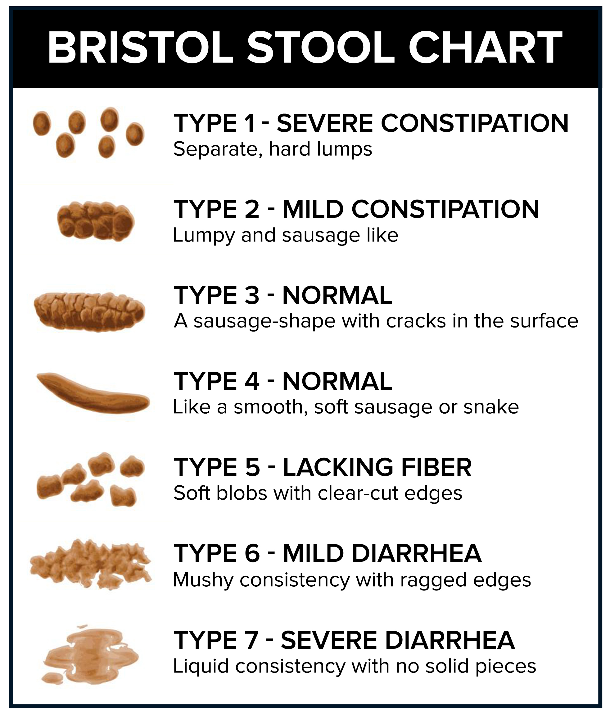
The Signs
Passing stools infrequently
Fewer than 3/week
3 days in between passing stools
Straining on toilet
Hard or lumpy stools
Abdominal bloating or pain
Bristol Stool Chart

Slide 20
Improving Constipation and Quality of Life
Well-balanced diet
Whole grains
Fresh fruits and vegetables
Fiber
Adequate protein intake
Integrate physical activity
Adequate Fluid Intake
See if probiotics are a good option for you!
Notes:
Main management response is to go to laxatives (Miralax
0.8g/kg body weight--- protein
30-35 mL/Kg Body Weight (Adults >30 Years Old) • 40-60mL/Kg (Adolescents) • 35-40 mL/Kg (16-30 Years Old)

Slide 21
THANK YOU from Shield Healthcare

Slide 22
References
Academy of Nutrition and Dietetics https://www.eatright.org/food/vitamins-and-supplements/nutrient-rich-foods/fiber
FDA.gov https://www.accessdata.fda.gov/scripts/interactivenutritionfactslabel/assets/InteractiveNFL_DietaryFiber_March2020.pdf
Kids Health.org https://kidshealth.org/en/parents/fiber.html

