Slide 1
how can i encourage affordable housing for my community?
Tim Dolan, Senior Commercial Loan Officer
Alliance Summit, September 15, 2021

Slide 2
about chfa
financing the places where_ people live and work®
CHFA was established in 1973 by the Colorado General Assembly.
CHFA is not a state agency and does not receive and direct appropriations.
CHFA received authority to use bond proceeds for economic development activities in 1982.
Approximately $25B has been raised and invested in Colorado to date.
Board of Directors: 11 Members
As of December 31, 2020

Slide 3
mission
We strengthen Colorado by
investing in affordable housing and community development.

Slide 4
vision
Everyone in Colorado will have the opportunity for housing stability and economic prosperity.

Slide 5
chfa’s impact in communities
Homeownership
Rental Housing
Business Lending
Single family (SF) mortgage loans
Down payment assistance
Homebuyer education
Multifamily (MF) finance
Housing Credits
Small business lending
Capital-access programs

Slide 6
chfa’s work since 1973
$21.5B
$2.7B
in home finance production with 132,043 customers served with homeownership programs
in multifamily loan production, with 970 developments consisting of 73,769 units created or preserved
71,525
$1.4B
affordable rental housing units supported by housing credits, totaling $562.1M
invested in business lending serving 7,200 businesses and directly supporting 77,745 jobs
Data as of December 31, 2020. Silvercliffs, CHFA rental housing customer, Silver Cliff, Colorado

Slide 7
innovation project background

Slide 8
problem frame
How might CHFA assist with creating housing opportunities for individuals with autism and intellectual and developmental disabilities who could live independently but do not?

Slide 9
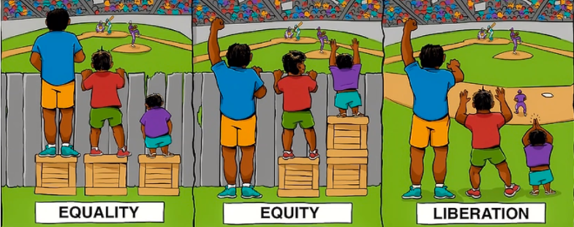
alignment with chfa’s work
Equity:
Creating systems where everyone can thrive.
People don’t get the same things, they get what they need.
Illustration Source: Dr. Nita Mosby Tyler

Slide 10
discovery

Slide 11
research conducted
13 interviews with ND housing and advocacy organizations
Researched existing and under-development example communities
In-depth review of existing literature and data surrounding this issue
86 responses to our voice of customer survey

Slide 12
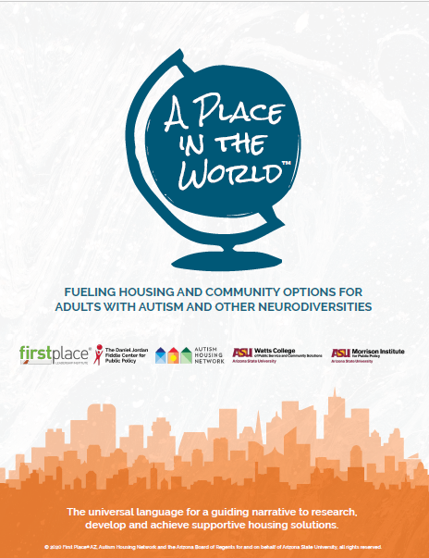
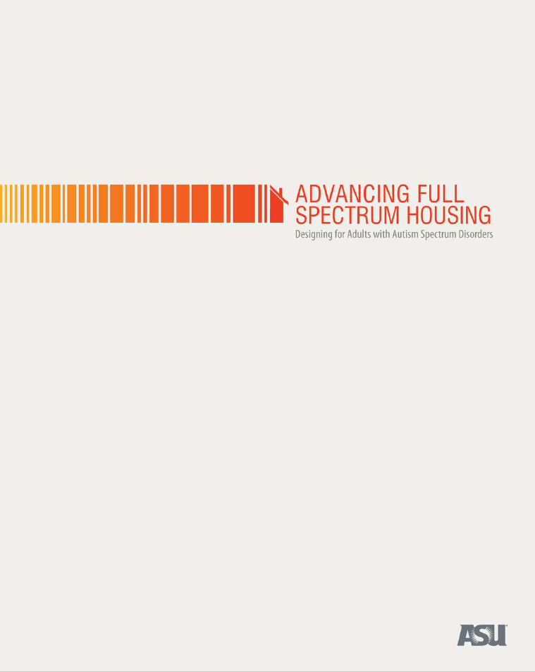
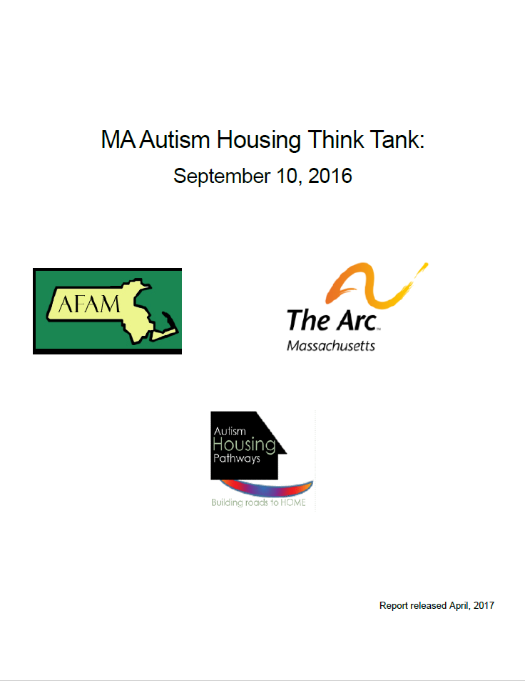
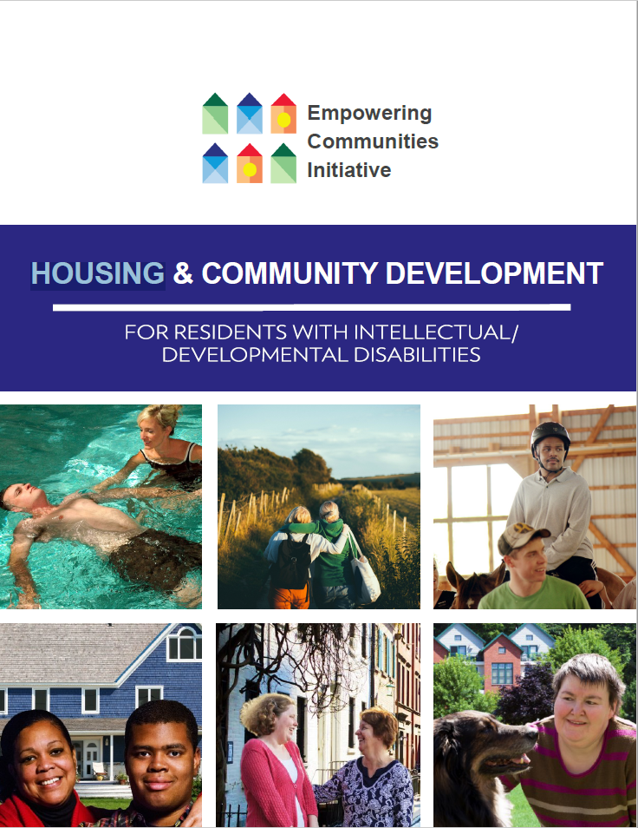
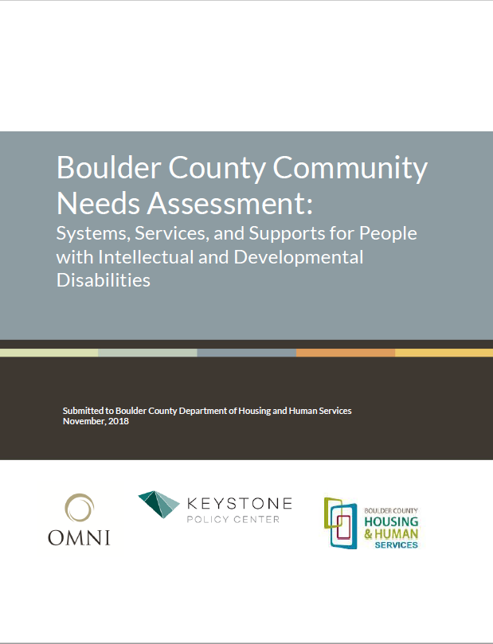

Slide 13
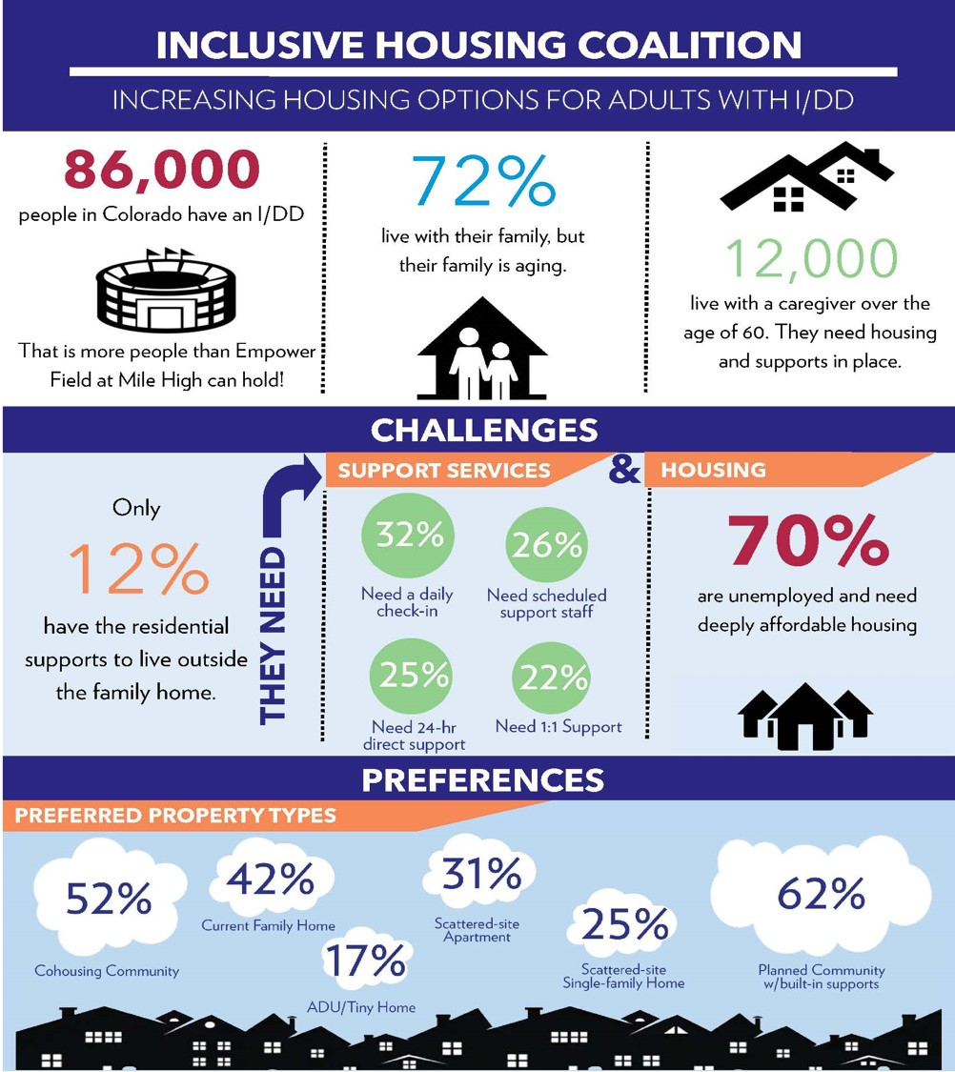
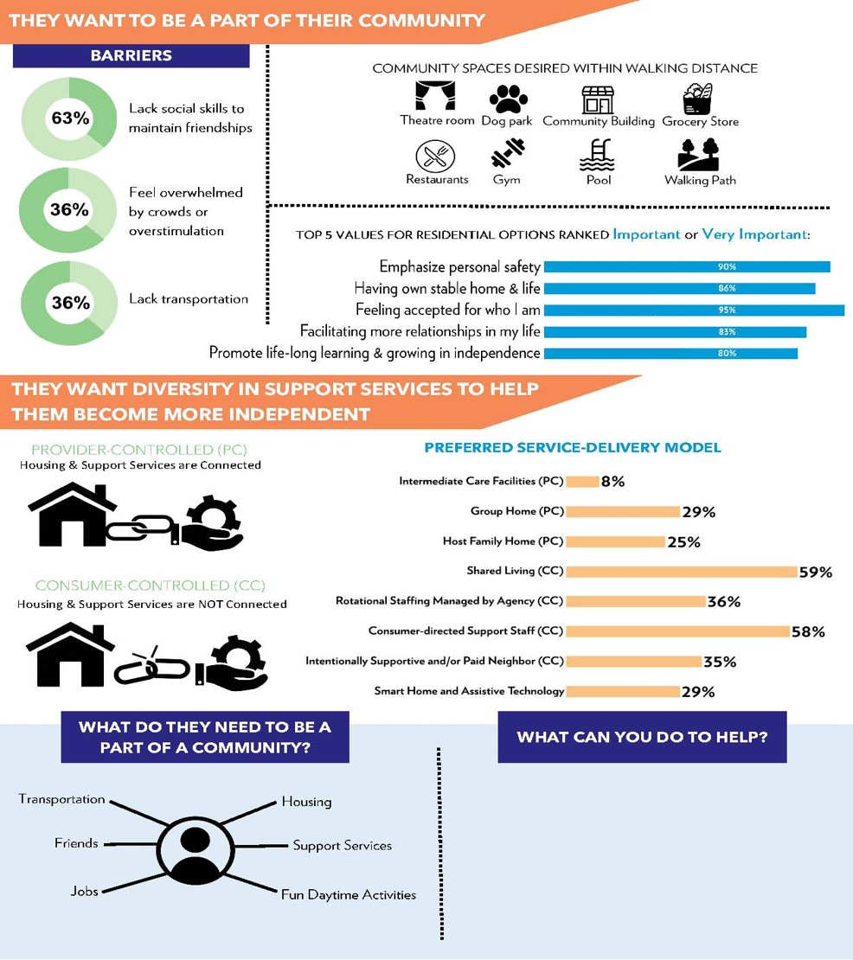

Slide 15
summary of discovery phase findings
Range of housing solutions needed
Significant barriers to housing for neurodivserse individuals
There are specific housing types and design features that help to meet the needs of this population

Slide 16
ideation

Slide 17
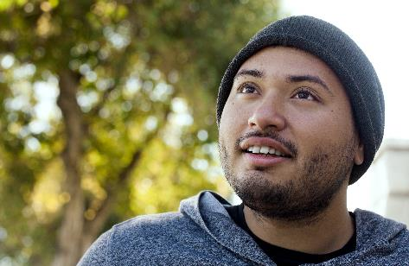
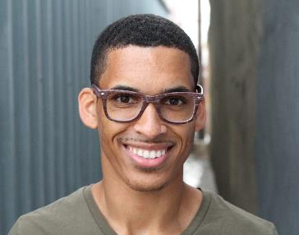

Slide 18
develop

Slide 19
housing continuum
Notes:
Family of Four in Denver: single family ranges from $62,250 to $85,000; multifamily ranges from $47,500 and below (30% = $24,000)
100% AMI = $77,800
115% AMI = $85, 000
80% AMI = $62,250
60% AMI = $47,580
30 % AMI = $24,000
Family of Four in Mesa County: single family ranges from $49,600 to $71, 300; multifamily ranges from $39,120 and below (30% = $19,600)
100% AMI = $62,000
115% AMI = $71, 300
80% AMI = $49,600
60% AMI = $39,120
30 % AMI = $19,560

Slide 20
Notes:
Tim speaking
Design notes: label design as architectural design

Slide 21
housing continuum

Slide 23
types of neuroinclusive housing in progress
Affordable Tax Credit Multi Family – 30 Pearl, Boulder
Non-Tax Credit Multifamily – Trailhead Communities, Littleton
Small Housing Innovation Project
CHFA Home Finance - Access

Slide 24
taking action
The following slides discuss how CHFA will support future activities surrounding neurodiverse housing

Slide 25
focus and expand on currently available resources
Home Ownershipe
Neurodiverse Developer Tool Kit and Guide Supplement
Affordable Rental Housingy
Training
Community Engagement
Research Collaboration
Targeted Fund
Economic Development

Slide 26
expanding our horizons
Funding for Small Housing Loans and Related Uses
Include Staff in the Effort
Catalyze Development of Neurodiverse Communities with Partners

Slide 27
IHC Vision
Colorado residents with I/DD have affordable residential opportunities that enable them to be an integral part of their neighborhood and greater community.
IHC Mission
Address the unique affordable housing crisis experienced by people with I/DD by generating awareness and influencing partnerships towards building diverse opportunities in Colorado.

