Slide 1
So, what is a SOC and Why do we need it?
Donna Martin, Senior Director for State Partnerships & Innovation
Shannon McCracken, VP Government Relations
Alliance 09/01/22

Slide 2
The State of America’s DSP Workforce - 2021
Key Findings:
77% of community providers are turning away new referrals
58% of community providers are discontinuing programs and services. This represents a 70.6% increase since the beginning of the pandemic.
84% of community providers are delaying the launch of new programs and services
81% of community providers are struggling to achieve quality standards

Slide 3
Case for Inclusion - 2022
Key Findings:
The average DSP turnover rate in 2020 increased to 43.6% - about one percentage
Meanwhile vacancy rates for full-time direct support positions increased from 8.5% in 2019 to 12.3% in 2020 – a roughly 45% increase
There were 589,940 people on states’ waiting lists for home and community-based services nationally.
Nearly 4 in 5 (78%) of those waiting were concentrated in just five states.

Slide 4
National Trends in Wage Components
What data source are used to establish DSP wage assumptions?
Which job classifications and wage benchmarks from the BLS are used to estimate DSP wages?
To what extent do states inflate wage data in order to bring the data current and, if they inflate wages, what benchmark is used?
What benefit rate or ERE is incorporated in the rate models?

Slide 5
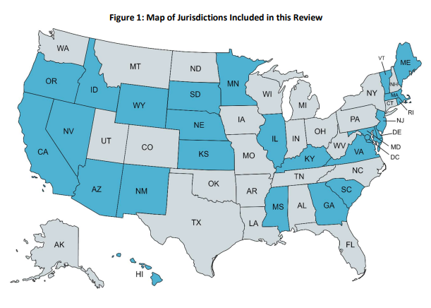

Slide 6
What we learned!
Data sources for wage assumptions:
Bureau of Labor Statistics Standard Occupational Classifications (SOC):
20 states
Benchmarked against minimum wage:
3 states
State’s own determination:
2 states

Slide 7
What is a SOC…
The SOC is one of several standard classification systems established by the Office of Management and Budget (OMB) for use in the Federal statistical system. All Federal agencies that publish occupational data for statistical purposes are required to use the SOC to increase data comparability across Federal programs.
Who is responsible for the SOC?
Responsibility for the SOC is, first and foremost, with the Office of Management and Budget. OMB requires the use of the SOC when publishing Federal statistics about occupations, makes the final decisions about the SOC, publishes the SOC Manual, and charters the SOC Policy Committee.

Slide 8
Why use the SOC?
It is comprehensive. BLS wage data is representative of 1.2 million establishments and about 57 percent of the employment in the United states.
It is regularly produced. BLS wage data is published on an annual basis, allowing rate model assumptions to be regularly reviewed and updated.
It is cross-industry. BLS wage data is not limited to a single industry so estimates for a given occupation are representative of the overall labor market for that occupation; this is particularly important when considering wage levels for traditionally underfunded programs such as Medicaid.
It is state- (and local-) specific. BLS wage data is reported for individual states and substate areas, permitting the evaluation of wage variance across states and within a given state.

Slide 9
Summary
Substantial reliance on wage data from the Bureau of Labor Statistics
Without a specific BLS occupational classification for DSPs, states use a variety of proxy occupations
Most rate studies incorporate wage inflation to trend wages forward
Benefit rate assumptions vary across states

Slide 10
Legislation to Create a Standard Occupational Classification
Recognizing the Role of Direct Support Professionals Act
Would compel OMB to create Standard Occupational Classification (SOC) for DSPs, effective 30 days after passage
Introduced in House (H.R. 4779) and Senate (S. 1437)
Bipartisan legislation
Notes:
Support passage of the Supporting Our Direct Care Workforce and Family Caregivers Act introduced by Senators Kaine and Gillibrand.
$1 billion to direct HHS, through ACL, to award grants to states or other eligible entities for initiatives to build, retain, train, and otherwise promote the direct care workforce and provide grants for states or other eligible entities for educational and training support for both paid and unpaid family caregivers. The bill would also direct ACL to develop a center to offer technical assistance, which would be tasked with making a recommendation to OMB to create a Standard Occupational Classification for DSPs.
Support passage of legislation to create a Standard Occupational Classification for DSPs, including the Recognizing the Role of Direct Support Professionals Act, introduced by Senators Hassan and Collins.
Continue coalition efforts in support of legislation or administrative action that would create a guest worker visa program for DSPs.

Slide 11
SOC Legislation
“The Director of the Office of Management and Budget shall, not later than 30 days after the date of enactment of this Act, revise the Standard Occupational Classification system to establish a separate code (31–1123) for direct support professionals as a healthcare support occupation.
Such code shall be a subset of 31–1120, which includes home health aides and personal care aides.”

Slide 12
Bipartisan Support
Senate Co-Sponsors:
Sen. Maggie Hassan (D-NH)
Sen. Susan Collins (R-ME)
Sen. Bob Casey (D-PA)
Sen. Joni Ernst (R-IA)
Sen. Kirsten Gillibrand (D-NY)
House Co-Sponsors:
Rep. Kathleen Rice (D-NY-04)
Rep. Brendan Boyle (D-PA-02)
Rep. Brian Fitzpatrick (R-PA-01)
Rep. John Katko (R-NY-24)
Rep. Sean Maloney (D-NY-18)
Antonio Delgado (D-NY-19)
Rep. Josh Gottheimer (D-NJ-05)
Rep. Susan Wild (D-PA-07)
Rep. Ann Kuster (D-NH-02)
Rep. Kathy Manning (D-NC-06)
Rep. Deborah Ross (D-NC-02)

Slide 13
ANCOR SOC Advocacy
Administrative Strategy
Provide input to SOC Policy Committee
Last outreach to BLS was in 2018 (Congressional letter)
Legislative Strategy
Increase support for SOC legislation, educate members of Congress on importance of SOC for DSPs
Outreach to House Education and Labor Committee members, Senate Homeland Security and Governmental Affairs Committee members
Outreach to Senate HELP committee members to encourage inclusion of SOC legislation in mental health package/other moving legislation
ANCOR members are critical!
Participate in virtual meetings with members of Congress, advocacy from DSPs, site visits/DSP for a Day campaign, SOCPC input

