Slide 1
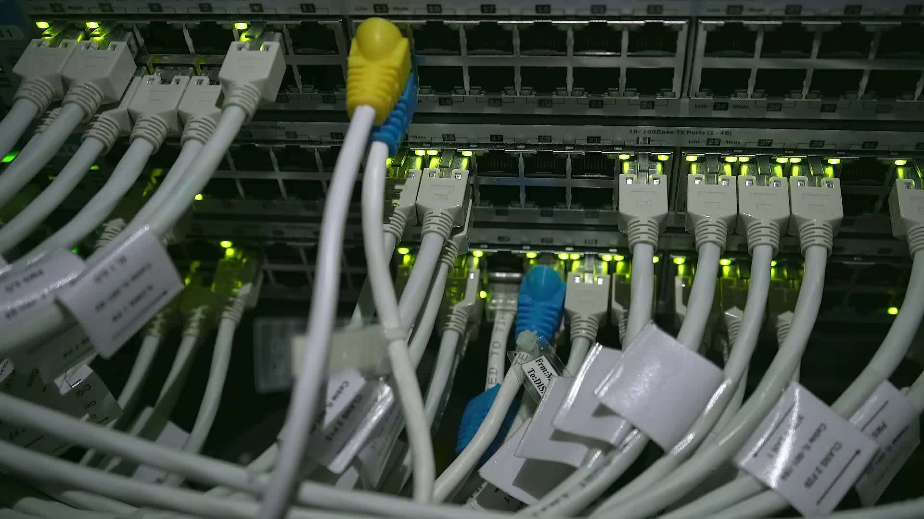
Kyle Corbin Sr Director of State Program Development kcorbin@safeinhome.com (937) 623-5139 Andrea Vincent District Manager avincent@safeinhome.com (703) 586-5037
Unleashing Potential: Elevating Independence with Remote Supports
Notes:
Thank you for having me / attending. My name is ________________ and I’m from a company called SafeinHome who is authorized by your state as a Provider of Remote Supports Services for the people you serve. To learn more about SafeinHome, please go ahead and scan the coupon to learn more - later. I’m excited to talk to you today, As I am presenting, feel free to add your questions to the chat.

Slide 2
WHAT IF…
YOU NEVER GOT TO MAKE AN IMPORTANT LIFE DECISION? (MONEY, CLOTHES, FOOD, LIVING SPACE, BEDTIME)
SOMEONE TOOK ADVANTAGE OF YOU AND NOW YOU HAVE STAFF IN YOUR HOME 24/7
YOU TOOK THE WRONG BUS ONCE, AND NOW YOU ARE NOT ALLOWED TO TAKE ANOTHER ONE?
Notes:
Now I want you think about this… What If,
What if you were always treated like a child? Never got to decide what clothes to wear or how to spend your money?
What if you never got to make a mistake? What if you got on the wrong bus once, and because of that you were never allowed to take the bus ever again?
For most of us, that would never happen -> we live the life of emancipated adults → which includes the ability to make decisions, even if, they are not the best decisions.

Slide 3
What is the difference between Remote Supports and Assistive Technology?

Slide 5
So what is
Remote Supports?
Notes:
Remote Supports is exactly what it sounds like – staff supporting a person from a remote location. Always on – always available. For any reason at any time.
In its simplest form…click a button – connect with staff for a meaningful conversation when YOU want or need support.
STORY?
Why are we passionate about Remote Supports?
The right to lead a self-determined life with the support you need, when you need it.
To live a life of independence, with isolation. A study by Capital Blue Cross conducted in Pennsylvania showed using Remote Supports significantly reduces non-emergency 9-1-1 calls, unnecessary EMS dispatches , frequent calls to family and staff, and helps combat loneliness and depression.
Remote Supports maintains a human-to-human connection not only with the Individual we serve, but with your support circle. Keep in mind, that independence looks different to everyone. For some it might mean a few minutes of time alone, while others could be moving out on their own.
Families
Have the peace of mind, that your loved one is being supported.
Feel confident that someone is there, even when you are not

Slide 8
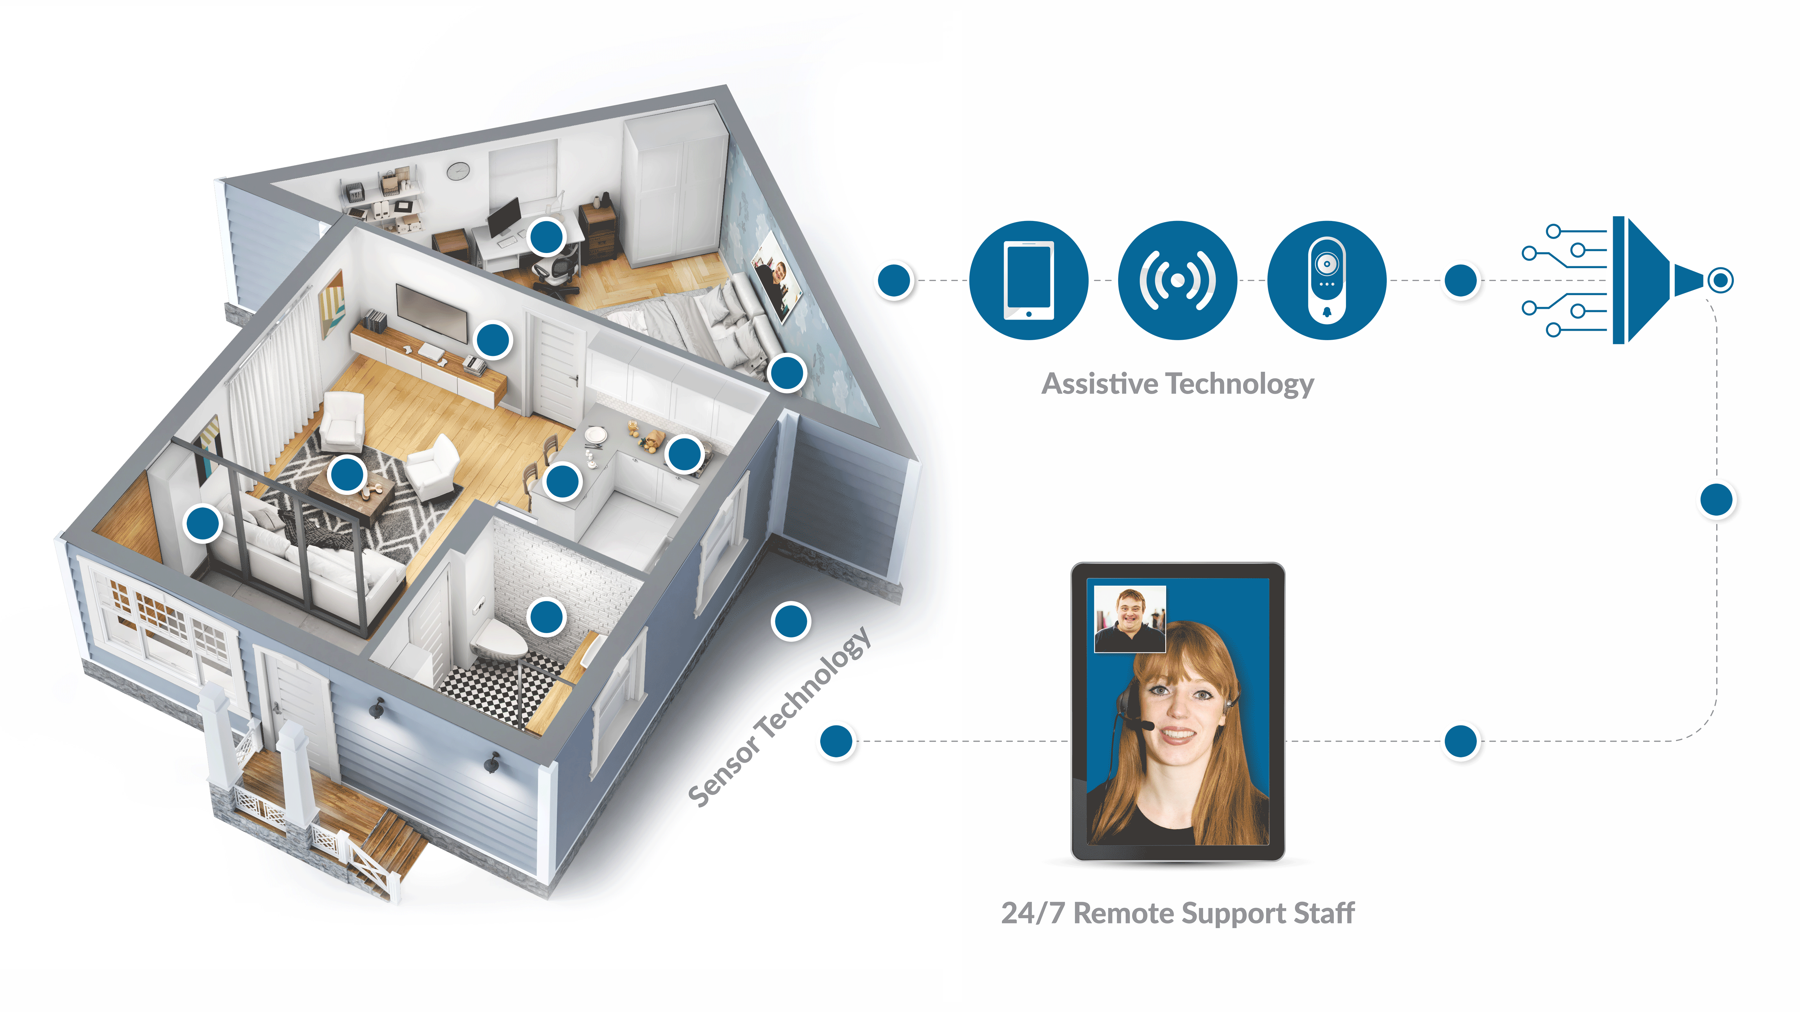
How it Works
Remote Supports integrates multiple technologies and sensors for superior accuracy and real-time 24-hour response
Notes:
This is Visual representation of how our technology services and remote support staff is integrated to provide the support required in the person supported care plan.
Sensors are integrated into the home where needed that provides alerts to the staff and assistive communication devices are provided to respond when needed or check-in when needed. We’ll explain further….

Slide 10
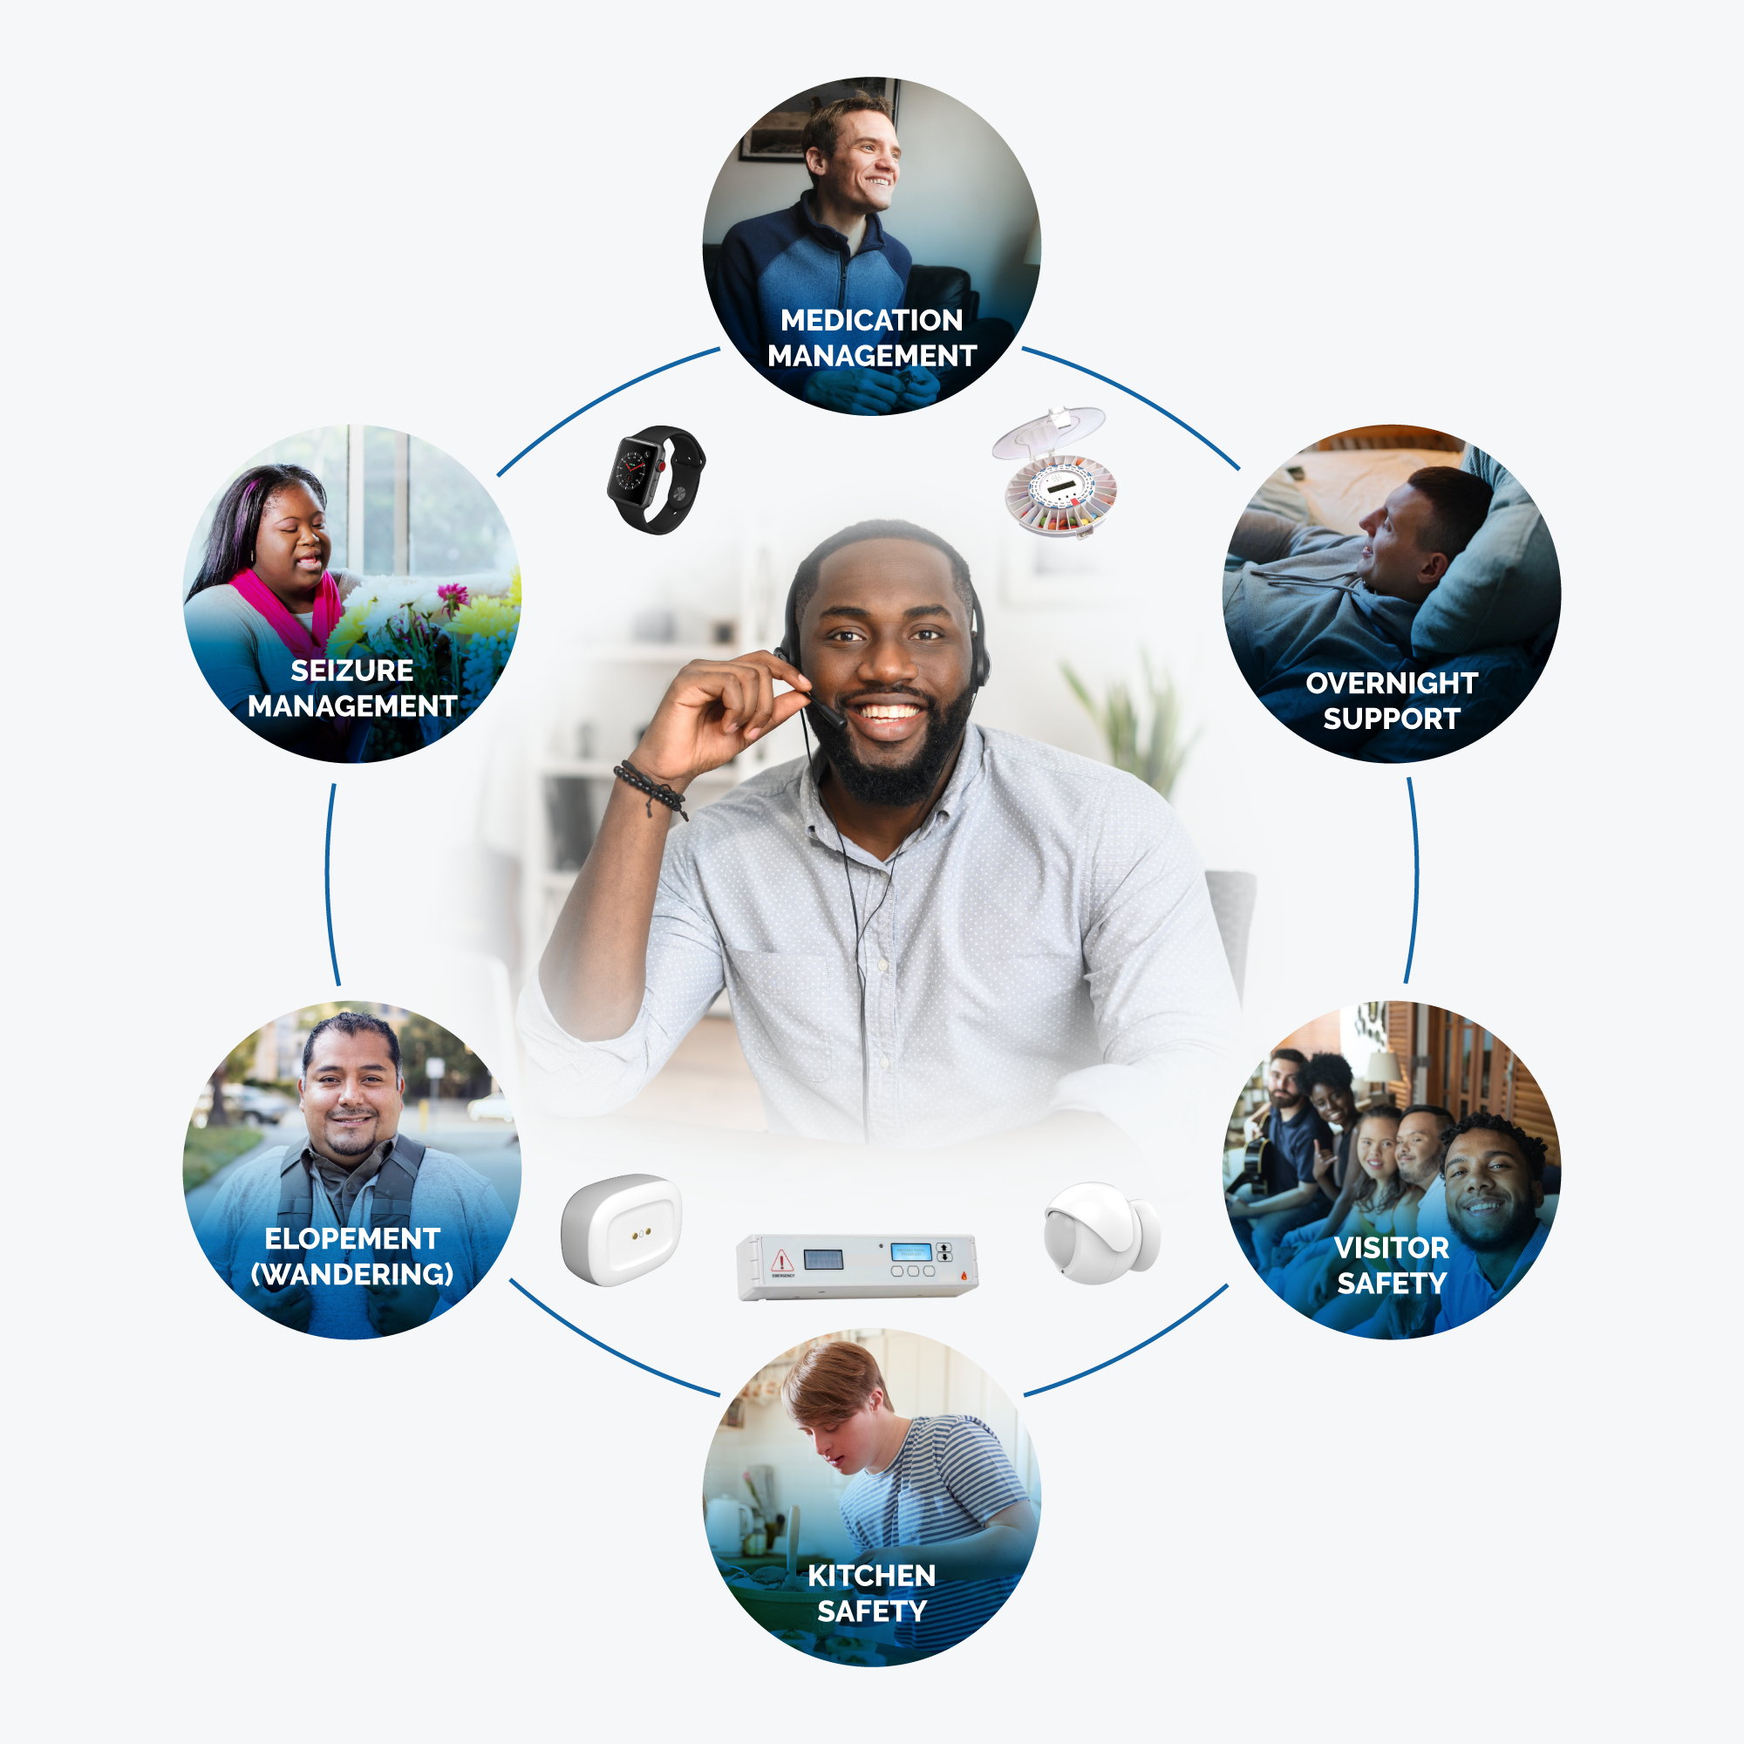
Possible Solutions
Notes:
We build person-centered solutions to help Individuals live their most meaningful lives.
If learning to bake is important – we can provide kitchen safety solutions. If inviting guests over provides comfort and meaning – we can put things in place for visitor safety. If seizures are a concern – we can provie peace of mind with seizure detection solutions to mitigate risks.
Whether for a young adult transitioning to community living or an older adult wanting to age in place – Remote Supports staff will support their unique goals
Remote Supports Solutions are uniquely individualized for each person we serve. Based on the needs, desires and risks, the SafeinHome Support Solutions can assist with medication management, seizure management, kitchen safety, elopement, visitors to the home…
We can offer these solutions whether an individual lives at home with family, at home with or without room mates, and many other environments.
These are a few examples of how we can support an Individual’s goals, wants, and needs.

Slide 11
How is Remote Supports Billed?
Remote Supports are currently on the following waivers:
EBD, CMHS, BI, CIH, & SLS
Bills at $2.51 per 15m unit

Slide 12
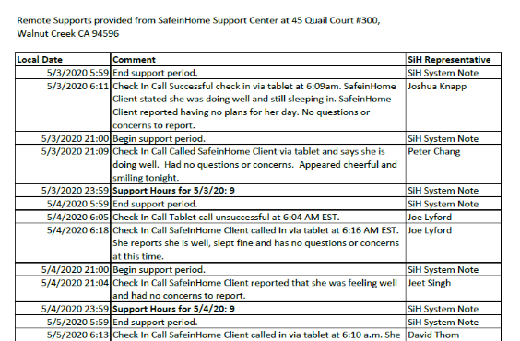
Weekly Reports
AKA: Support Notes:
RSS interactions
HPC/RSS hand-offs
Daily Activities
Kitchen/Bathroom Use
Home Entry/Exit Times
Medication Management
Sleep/Wake Activity
Notes:
SafeinHome Supports Notes documents these types of activities and also all interactions with the person served. This type of data is useful for team decision making and improving and optimizing the care plan - Sam is up 3x night- why? Does he know? Eating? Over/under use of Bathroom?
Also makes it easier for case manager to keep track of what is happening with the people in their case load. It is a SafeinHome Difference.

Slide 13
Steps to Remote Supports
Typically Within 24 HRS
VARIES
Earliest: 48 HRS Standard: 3-5 DAYS
STEP 1
STEP 3
STEP 5
Identify Clients
Consult / Proposal
Approval
Installation / Training
Onboarding
Start of Service
STEP 2
STEP 4
SiH Client Service Team Gets Involved
Notes:
So…How do you get started assisting your individual with Remote Supports services with SafeinHome
The CCS will inform their individuals on remote supports as a waiver service. CCS will add RS to the PCP. Team will schedule a consultation with SafeinHome.
1. Upon a request our response time is within 24 – 72 hours.
2. Then you will get a preliminary proposal – that describes everything that will take place, goals, and the hours of support ( based on a preliminary care plan). We will work with you all to make sure that Remote Supports is in the PCP.
3. We will monitor the LTSS system or communicate with the support broker for self-directed individuals-to make sure everything is accurate on our end. Then, we wait for DDA Approval- Service representative.
4. Once approved, we schedule the installation. Our technicians can install it within 3-5 business days – typically. Install will vary depending on the type of solution. Part of the onboarding process is development of the Care plan with our Client Services representative. Our goal is to have this scheduled and completed the day of installation or within 24 hours after installation.
5. Service start date 2-3 days after installation.
We really are here to take as much off your plate as possible and make this a smooth, easy process.

Slide 14
Next Steps
Identify at least one person on your caseload or in your agency you think might benefit from this service
Reach out to a Remote Supports provider agency for a consultation
Together design an individual specific solution for the future

Slide 15
Kyle Corbin kcorbin@safeinhome.com (937) 623-5139 Andrea Vincent avincent@safeinhome.com (703) 586-5037

