Slide 1
Alliance’s Government Relations Committee of Excellence (GRACE)
2021 Summit Update
Committee Co-Chairs: Randy Brodersen, North Metro Community Services and Shari Repinski, Rocky Mountain Human Services
PASA Members
Tim Cunningham, Cheyenne Village
Alexis Marsh, Easterseals Colorado
Sally Montgomery, Mosaic
Debbie Spencer, Overture
CCB Members
Rob DeHerrera, Developmental Disabilities Resource Center
Tara Kiene, Community Connections, Inc.
Rebecca Novinger, Imagine!
Ksana Oglesby, Mountain Valley Developmental Services, Inc.

Slide 2
In this presentation
The Past Five Years
Colorado’s COVID Response
2021 Legislative Wins
The Next Five Years

Slide 3
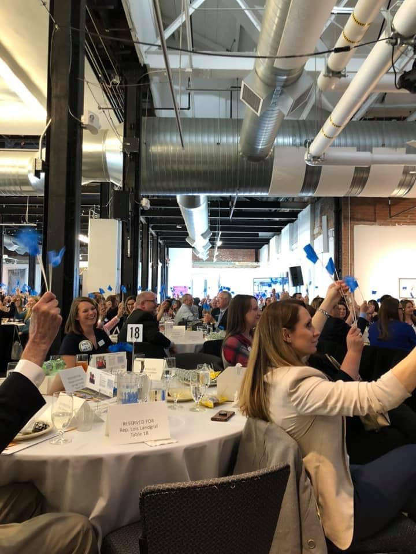
Over the last five years, Alliance and its partners have accomplished a lot! Some notable achievements include:
Increasing annual funding for IDD services by more than $225 million.
Securing an additional $14 million in funding for caseload growth in Early Intervention Services.
Increasing Medicaid reimbursement rates for IDD services by 13% (or more for some services).
Securing funding for an additional 2,185 people to enroll on the DD waiver to receive comprehensive services and supports.
Securing public and private funding to lead a grassroots effort to train more than 2,600 IDD professionals and families in Person Centered Thinking.

Slide 4
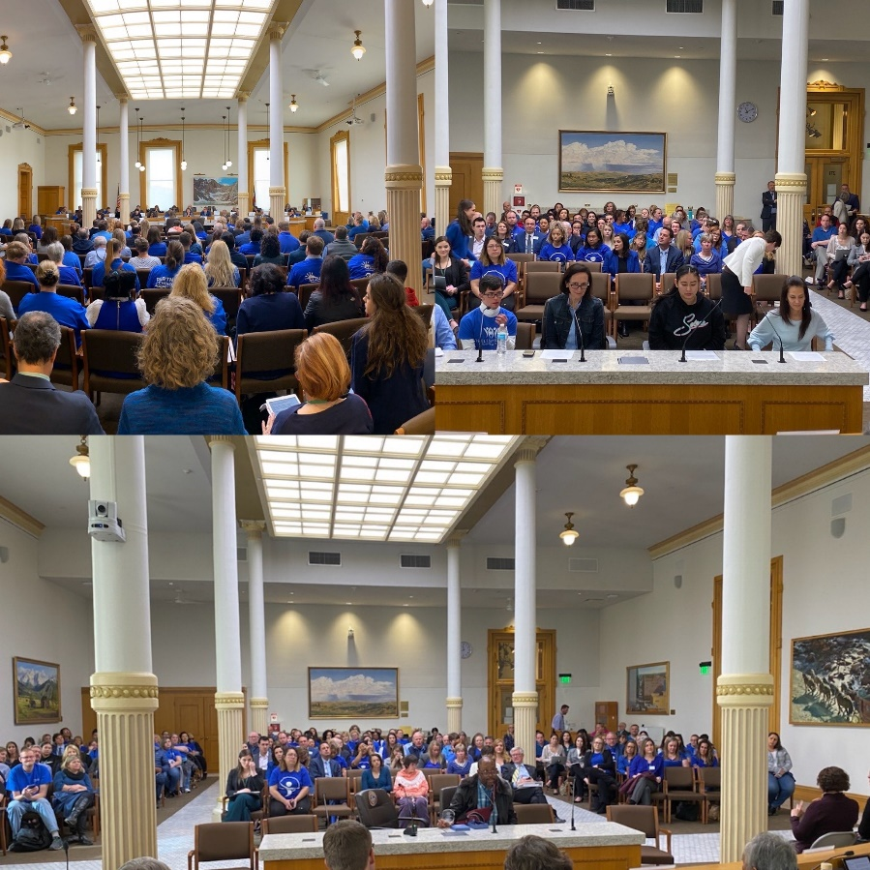
Over the last five years, Alliance and its partners have accomplished a lot! Some notable achievements include:
Organizing IDD-agency site visits and “DSP for a Day” participation by more than 80 legislators from both sides of the aisle.
Supporting the successful passage of more than 60 bills to improve services and supports for people with IDD.
Organizing one of the largest “Day at the Capitol” events each year with 500 people in attendance, including more than half of the General Assembly.
Organizing a 600- person virtual Day at the Capitol Event in 2020.
Protecting all IDD Budget lines during the COVID Pandemic.
Restored the 1% provider rate reduction in 2020.

Slide 5
Alliance’s COVID-19 Response…
State and Federal Work in 2020-21

Slide 6
Overview of COVID Relief in Colorado
Retainer payments to preserve Day Habilitation, Adult Day Services, Supported Employment and Prevocational services, effective March 13th – July 18th (discontinued per federal guidance)
Appendix K amendments to Home and Community-Based Services waivers to include remote services and other flexibilities which preserved access to key services while helping to reduce exposure to the virus among both staff and people supported
Temporary reimbursement rate enhancements to cover: increased staffing, PPE, & other expenses; program losses due to COVID restrictions; and help rebuild capacity for reopening in disproportionately impacted services
New 3-Tier Day Habilitation structure, including 1:1 service option within individual budget that will account for rate increases
COVID-19 training for frontline workers & frequent communication with Disability Community
Notes:
April 1, 2020 – June 30, 2020: 8% for Residential (including family caregiver) & CDASS in SLS, 4% for personal care & homemaker
Jan 1, 2021 – March 31, 2021: 10% for Day Habilitation, Adult Day Services, Supported Employment, & Non-Medical Transportation. 8% for Group Residential Services, ICF-IIDs, and nursing homes.
July 18, 2020 – June 30, 2021: 27.4% for Day Habilitation, Adult Day Services, Supported Employment, & Non-Medical Transportation (on top of the 10% for first quarter)

Slide 7
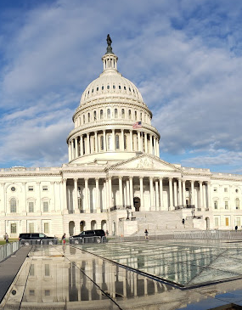
Overview of Federal IDD COVID Relief
Stimulus payments to individuals and families
Protected Medicaid Enrollment throughout Public Health Emergency
Funding for Special Education and safely reopening schools
Expanded small-business loans to help retain, pay staff (Paycheck Protection Program, etc.)
Federal Provider Relief Fund helped cover COVID-related expenses and losses
Expanded paid leave for COVID-related absence, with tax credits to cover related employer expenses
Funding for state and local governments to help fill budget gaps
Temporary Increases in federal Medicaid match
6.2% throughout the Public Health Emergency
10% dedicated to Home and Community-Based Services, effective April 1, 2021 – March 31, 2022

Slide 8
Unprecedented Times, Clear Priorities
Colorado prioritized the needs of people with IDD early in the pandemic
Colorado’s leadership was featured in The Case for Inclusion 2021: A Special Report on the Sustainability of Community Disability Services in America.
Thanks to collaborative efforts, Colorado has seen lower rates of COVID illness and death among people with IDD compared to other states.
www.AllianceColorado.org
Notes:
Over 14,000 people are served on Colorado’s IDD waivers and only about 2% of those people tested positive for covid. Unfortunately, we only had 16 deaths. (That was from March 2020-January 2021.)

Slide 9
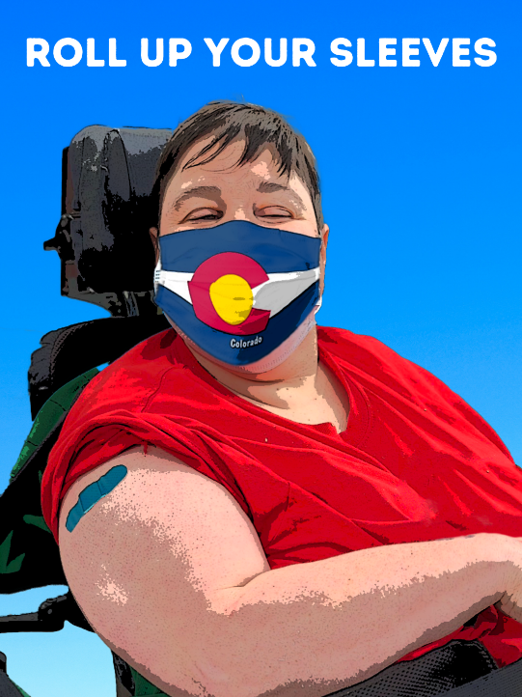
#RollUpYourSleeves Campaign
Resources for the CO IDD Community
Is an effort to help CCBs and PASAs with the tools they need to combat vaccine hesitancy, set up community clinics, access templates for campaign advertisements, share data, and pass on resources.
Thousands of DSPs and people with IDD are now vaccinated!
www.alliancecolorado.org/vaccineresources
www.AllianceColorado.org

Slide 10
Alliance’s Legislative Wins…
2021 Colorado Legislative Session
623 bills, 52 resolutions, and more than 500 bills passed in 116 days!

Slide 11
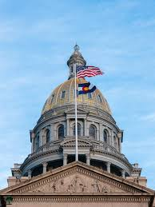
Bills Supported by Alliance - All Became Law!
SB21-039 Elimination Of Subminimum Wage Employment
SB21-039 Talking Points
HB21-1206 Medicaid Transportation Services
HB21-1206 Talking Points
SB21-075 Supported Decision-making Agreement
SB21-075 Talking Points
HB21-1166 Behavioral Health Crisis Response Training
HB21-1166 Talking Points
www.AllianceColorado.org

Slide 12
PASSED: Elimination Of Subminimum Wage Employment
SB21-039 Elimination Of Subminimum Wage Employment
Background:
Federal law allows people with disabilities to be paid below the minimum wage
Approximately 400 people with IDD are earning SMW in Colorado
Colorado is an Employment First state, promoting Competitive Integrated Employment
Bill Summary:
Closes the front door on new SMW programs and hires
Establishes a 4-year transition timeline to help people working in SMW successfully transition to better jobs/services
Requires SMW employers to develop robust plans to transition their programs
Enhances Medicaid services to support transition outcomes
Develops recommendations to address systemic barriers to Competitive Integrated Employment
SB21-039 Talking Points
www.AllianceColorado.org
Notes:
Jodi

Slide 13
PASSED: Medicaid Transportation Services
HB21-1206 Medicaid Transportation Services
Background:
Existing Public Utilities Commission permit requirements will apply to IDD transportation in July 2021
These requirements have financial and administrative costs that will limit transportation options for people with IDD, and therefore limit access to community integration
Bill Summary:
Eliminates PUC permit requirements for Medicaid transportation
Moves oversight of Medicaid transportation services from PUC to Dept. of Health Care Policy & Financing (HCPF)
Requires HCPF to work with stakeholders to establish rules that ensure passenger safety while minimizing financial and administrative burdens on provider agencies, staff, family caregivers, etc.
HB21-1206 Talking Points
www.AllianceColorado.org

Slide 14
Other IDD-Related Bills that PASSED and were Supported by Alliance
HB21-1187 Long-term Services And Support Case Management Redesign
Lays the groundwork for a redesign of Colorado’s case management system for people with disabilities by 2024
HB21-118 Alternative Response Mistreatment At-risk Adults
Creates a pilot program for an alternate response Adult Protective Services can use for low-risk reports of mistreatment of self-neglect of at-risk adults
HB21-1097 Establish Behavioral Health Administration
Creates a Behavioral Health Administration to coordinate behavioral health services across departments
HB21-1122 First Responder Interactions Persons with Disabilities
Creates a commission within the Attorney General’s office to improve first responder interactions with people with disabilities
www.AllianceColorado.org

Slide 15
2021-22 Priorities
What’s next after the COVID-19 Pandemic?

Slide 16
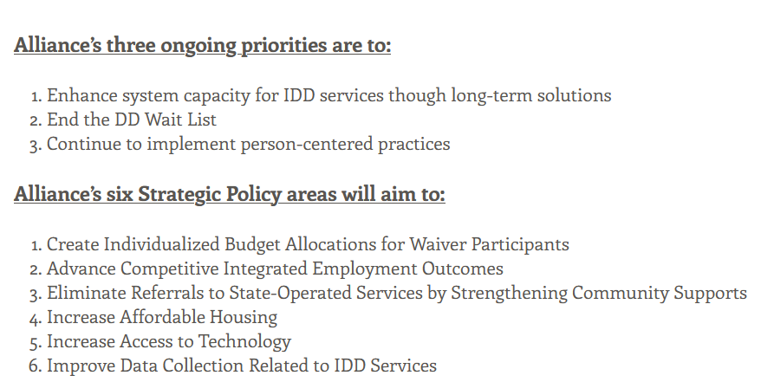
Alliance 2021-25 Policy Agenda
Alliance Planning for Legislative Asks Now (PLAN)
Notes:
End the Wait bill was aimed at (1) phasing out the DD wait list over the course of 5-6 years and (2) creating a sustainable solution to provider rates by tying increases to CPI in future years. Huge fiscal impact which so it couldn't happen this year. Will remain a high priority for Alliance.
Also worked on a bill with The Arc and DLC (and DD Council) to eliminate SMW employment over a 4-year timeline. The bill would have added new services and expanded the Medicaid Buy In program to enhance employment supports for all people with IDD. Bill died due to fiscal note, but looking at bringing back next year.
Our 5-year policy agenda outlines the ongoing priorities as well as 6 strategic policy areas we want to work on in the next 5 years. Ongoing priorities: WL, system sustainability, person-centered practices. Strategic policy areas: Individualized budgets, data collection, technology, housing, employment, and ending referrals to regional centers.
Capitol Chronicles is your insider info about all things happening in the legislature and related to bills/budget.
GRACE committee provides guidance to Alliance on all legislative/policy issues. Final decisions made by executive committee and, if needed, full board.
ANCOR tracks bills and regulatory changes at the federal level. Josh is active in SAE group and Ellen is active on the GR Advisory Committee. Alliance members get many of the benefits of ANCOR membership by virtue of Alliance's participation.

Slide 17
Just some of the issues we are working on…
2021-22
The Workforce Crisis
Case Management Redesign
MCT Rulemaking
Phasing Out Subminimum Wage
Early Intervention Evaluation Transfer
New Department of Early Childhood
ARPA Funding and related programs
Supporting Federal Legislation
Anticipated behavioral health bills in 2022
Notes:
End the Wait bill was aimed at (1) phasing out the DD wait list over the course of 5-6 years and (2) creating a sustainable solution to provider rates by tying increases to CPI in future years. Huge fiscal impact which so it couldn't happen this year. Will remain a high priority for Alliance.
Also worked on a bill with The Arc and DLC (and DD Council) to eliminate SMW employment over a 4-year timeline. The bill would have added new services and expanded the Medicaid Buy In program to enhance employment supports for all people with IDD. Bill died due to fiscal note, but looking at bringing back next year.
Our 5-year policy agenda outlines the ongoing priorities as well as 6 strategic policy areas we want to work on in the next 5 years. Ongoing priorities: WL, system sustainability, person-centered practices. Strategic policy areas: Individualized budgets, data collection, technology, housing, employment, and ending referrals to regional centers.
Capitol Chronicles is your insider info about all things happening in the legislature and related to bills/budget.
GRACE committee provides guidance to Alliance on all legislative/policy issues. Final decisions made by executive committee and, if needed, full board.
ANCOR tracks bills and regulatory changes at the federal level. Josh is active in SAE group and Ellen is active on the GR Advisory Committee. Alliance members get many of the benefits of ANCOR membership by virtue of Alliance's participation.

Slide 18
END THE INVISIBLE WAIT
We have come a long way with this campaign, and might be closer to 2,000 people waiting, as opposed to 3,000!
Alliance’s 2020 bill aimed to eliminate the wait list while ensuring system capacity by:
Funding a 6-year, phased-in elimination of the DD wait list
Tying future rate increases to the Consumer Price Index (aka standard inflation measure) to ensure the availability of providers to serve new and existing enrollees
Unfortunately, this plan was put on hold because of state revenue reductions due to the COVID-19 pandemic
AND NOW… providers are experience a workforce crisis that is causing an invisible waitlist and capacity issues throughout our system.
Even during the pandemic, the Colorado Legislature got 667 people off the wait list!
(FY 21-22 Long Bill)
www.AllianceColorado.org

Slide 19
Strategic Policy Priorities- Work Underway…
Advance Competitive Integrated Employment Outcomes
Legislation: Eliminate Sub-minimum Wage Bill (SB21-039)
Collaborate with the Office of Employment First on training, education, rate study and recommendations
U.S. Office of Disability Employment Policy's National Expansion of Employment Opportunities Network (NEON) Initiative
Collaborate with HCPF on data collection pursuant to SB18-145
Increase Access to Technology
Implement the Colorado Technology First Advisory Committee Recommendations
Create Individualized Budget Allocations for Waiver Participants
Follow the HCPF's Person Centered Budget Algorithm project and new assessment tool
Strengthen Emergency Supports in Communities
Review and implement parts of the Colorado Behavioral Health Task Force IDD Co-Occurring Work Group Recommendations
Increase Affordable, Accessible Housing for People With IDD
Review recommendations from the Aurora and Denver housing studies.
Read the Alliance Five-Year Public Policy Agenda HERE.

Slide 20
Contact us anytime at info@alliancecolorado.org or 303.832.1618
Follow us on social media!
Facebook: @AllianceCOIDD
Twitter: @Alliance_CO
YouTube: Alliance Colorado

