Slide 1
Walk the Talk: Our Experience Building a New Service Organization Centered on Representation and Empowerment
Catherine Sykes
Amanda Turek
Jeff Newman
Notes:
We will all introduce ourselves, about 30-45 seconds each

Slide 2
What is Our Own Lives, Inc?
Notes:
Jeff’s slide, quick explanation of history with community connections

Slide 3
Our Own Lives…
Created as part of the Conflict Free Case Management transition.
Was formerly Community Connection’s services arm spun off into an independent non-profit.
Provides services in the Colorado 4 Corners area (very rural!).
Established the Our Own Lives identity in January 2024, flying solo as of July 1!
We had a unique opportunity to take the resources and knowledge of an established organization but start fresh.
Notes:
Jeff’s slide, continue talking about OOL’s transition from CCI.

Slide 4
WHAT DO THE PEOPLE WE SERVE WANT THIS ORGANIZATION TO BE?
Notes:
Amanda explains that we had a unique opportunity to take an existing organization and as “We are starting over, what should we do different?” One of the first things we did is creating workgroups and focus groups out of people in our services.

Slide 5
Feedback From People Hiring Us For Services:
“Stop talking about the organization as if it is you!”
The organization is not the staff or the buildings, it is us. We have chosen the organization through signing up for services.
Many of us will continue to be a part of this organization after all the current staff have moved on.
WE establish the organizational culture.
Mission, vision and values should be in our voice.
Notes:
Cathy’s Slide

Slide 6
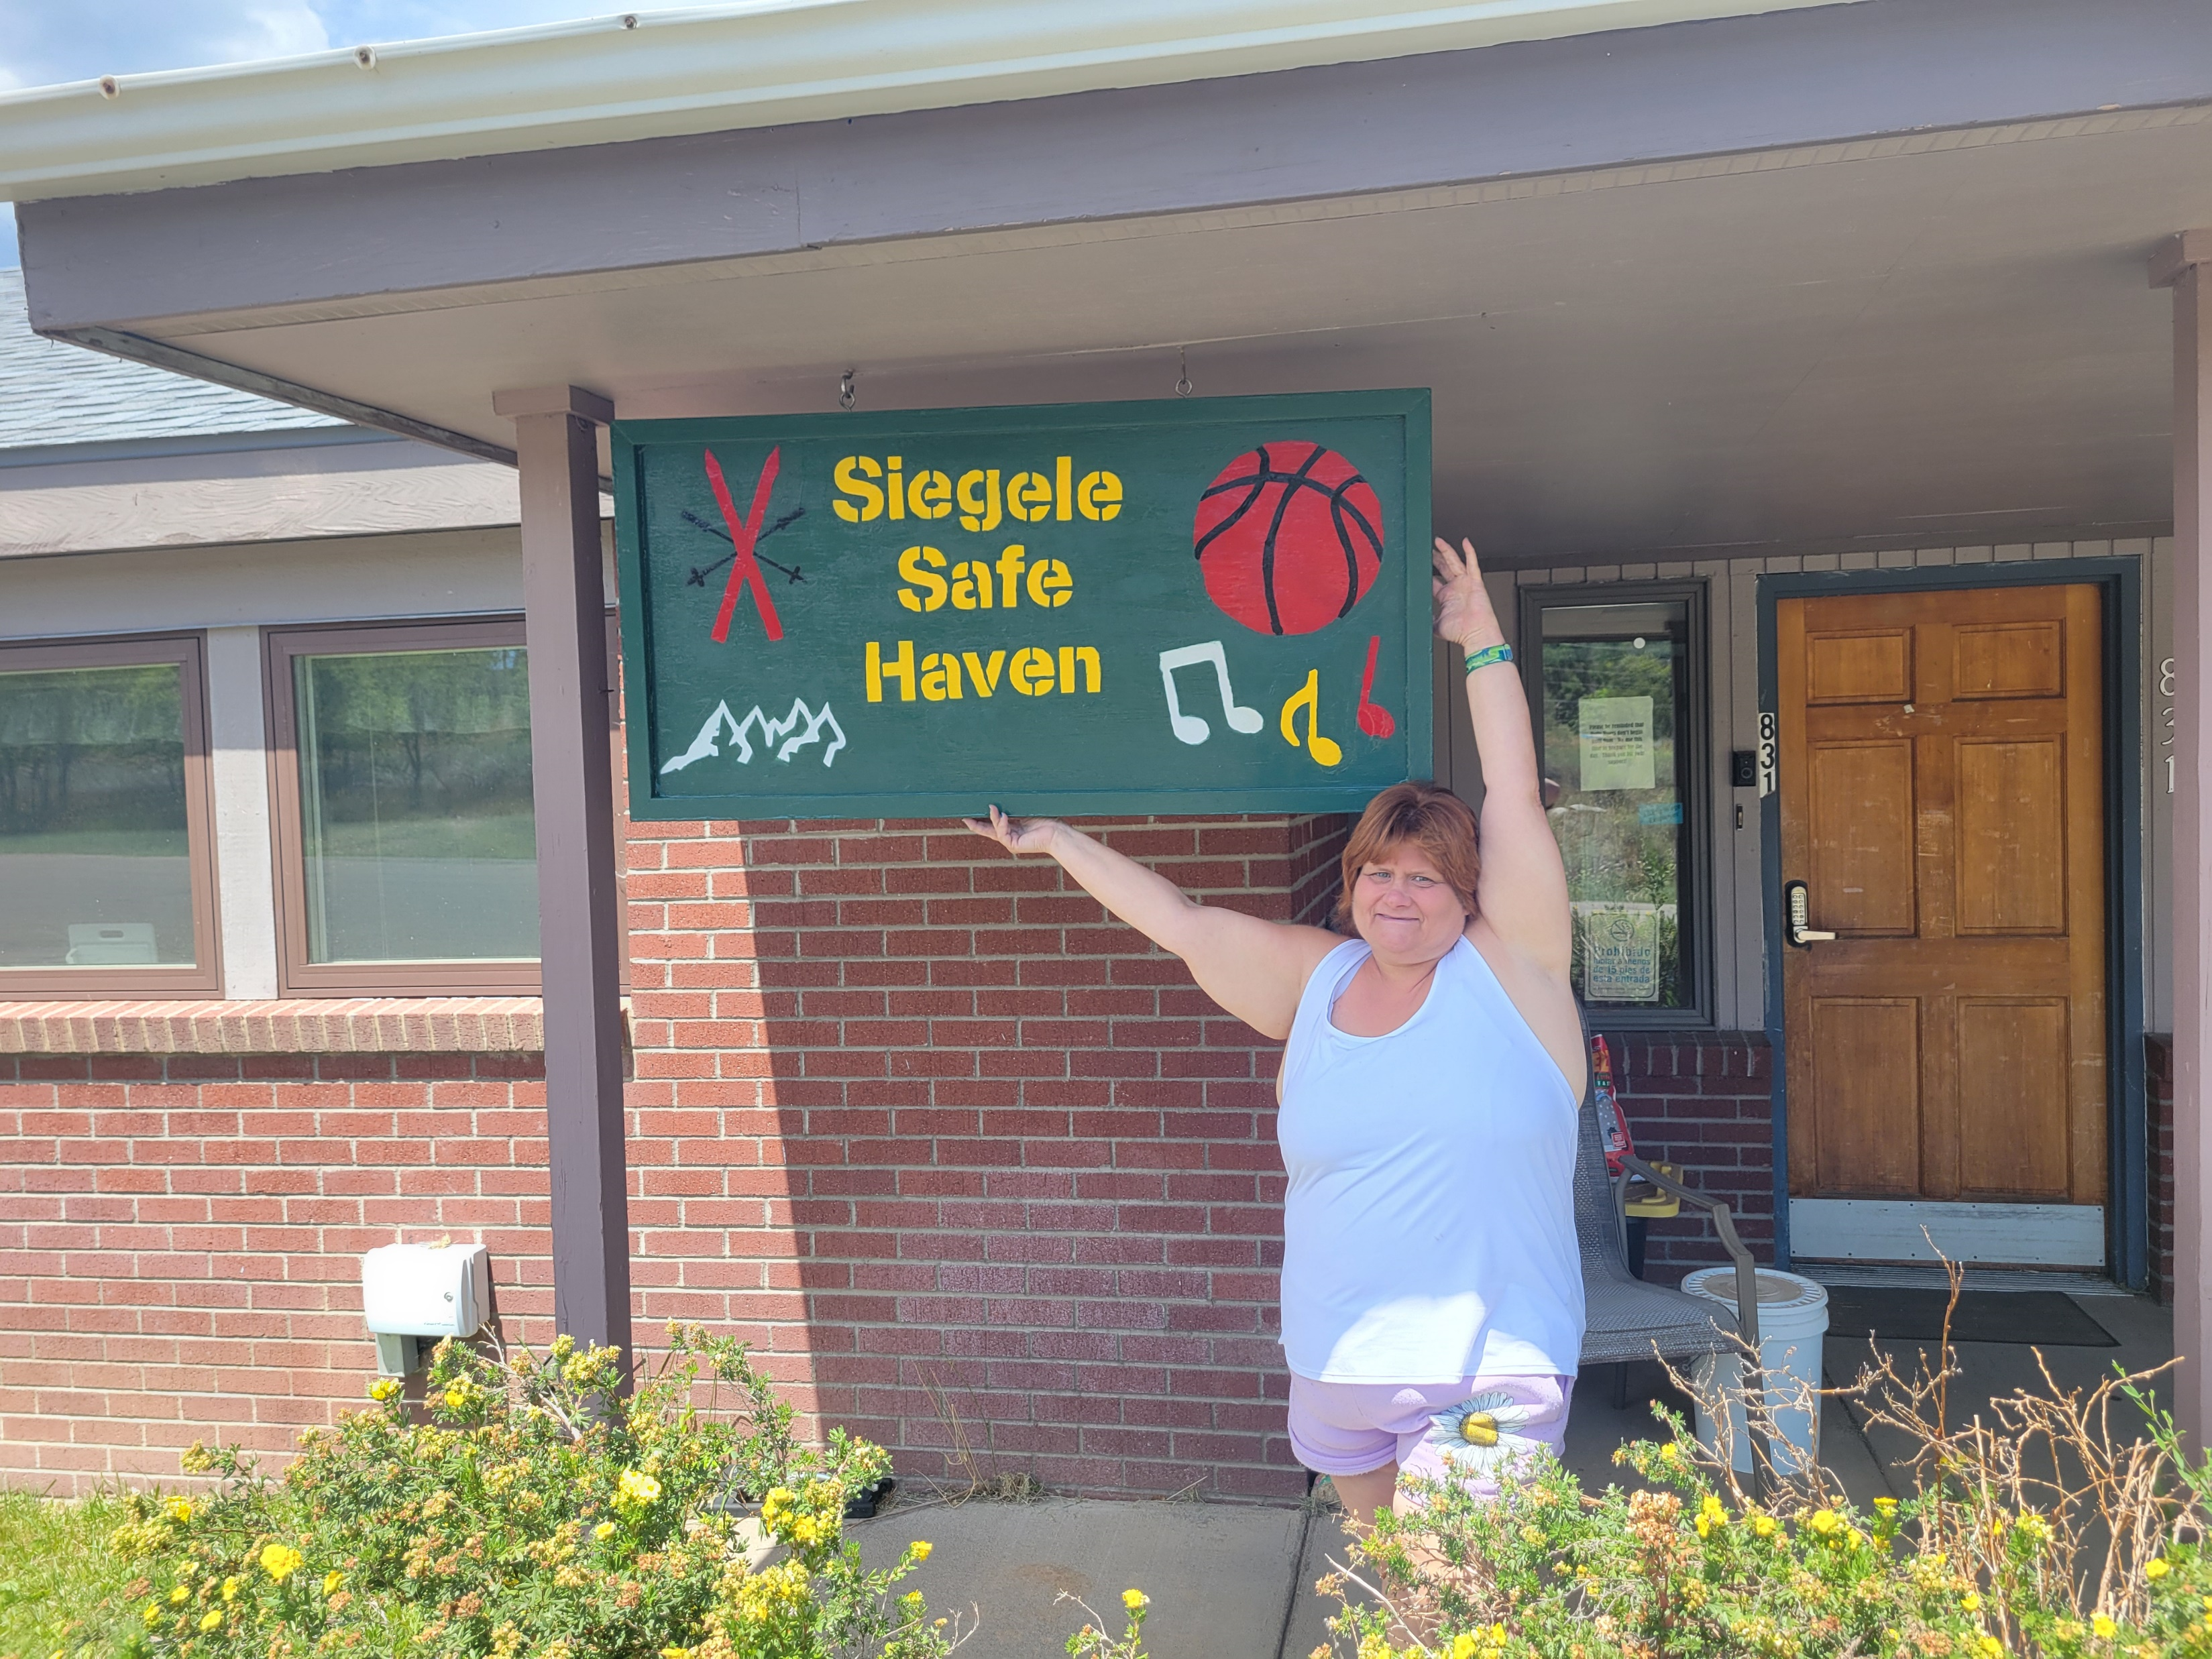
Richard’s Impact
Notes:
Cathy talks about renaming Holly House for Siegele Safe Haven and explains th meaning ofthat name.
The safe haven name was chosen because this is how Richard made people feel- safe and welcomed.

Slide 7
Richard’s Impact
A tremendous advocate, leader, and friend.
Community Connections Board and CLC member.
Wanted everyone to feel accepted, welcomed, safe.
Passed away in 2022.
Many of his values became core values of Our Own Lives.
Notes:
Cathy talks about Richard’s impact

Slide 8
What Do You Want? Takeaways:
We should be centered in leading our disability community and this organization.
We are viewed as people in need of help and not given opportunities to help each other.
Empowerment, Autonomy, and Respect for Rights most important in day-to-day services.
DSPs and Program Managers are not the masters of the universe and the sole solutions to every problem.
Connect us with disabled community mentors that have been there, done that, gotten the t-shirt.
Save DSP resources for where it makes sense to use them.
“We are all experts in Our Own Lives.”
Notes:
Jeff presents, taks about raised fist turning into raised hand in logo.
Amanda will point out that as a DSP she doesn’t know things that Cathy knows and it would make more sense to connect people with Cathy for affordable housing questions.

Slide 9
Mission and Vision
Our Mission
The mission of Our Own Lives is to provide quality support on our own terms, for us to be free to be ourselves. We center the disabled community to be heard, and we build each other up to change our world. We are all experts in our own lives.
Our Vision
We envision a world where people with disabilities are included and accepted for who we are, and we are valued for the contributions we make.
Notes:
Amanda presents- note that this is in the voice of the community because the feedback was “this is about us!”

Slide 10
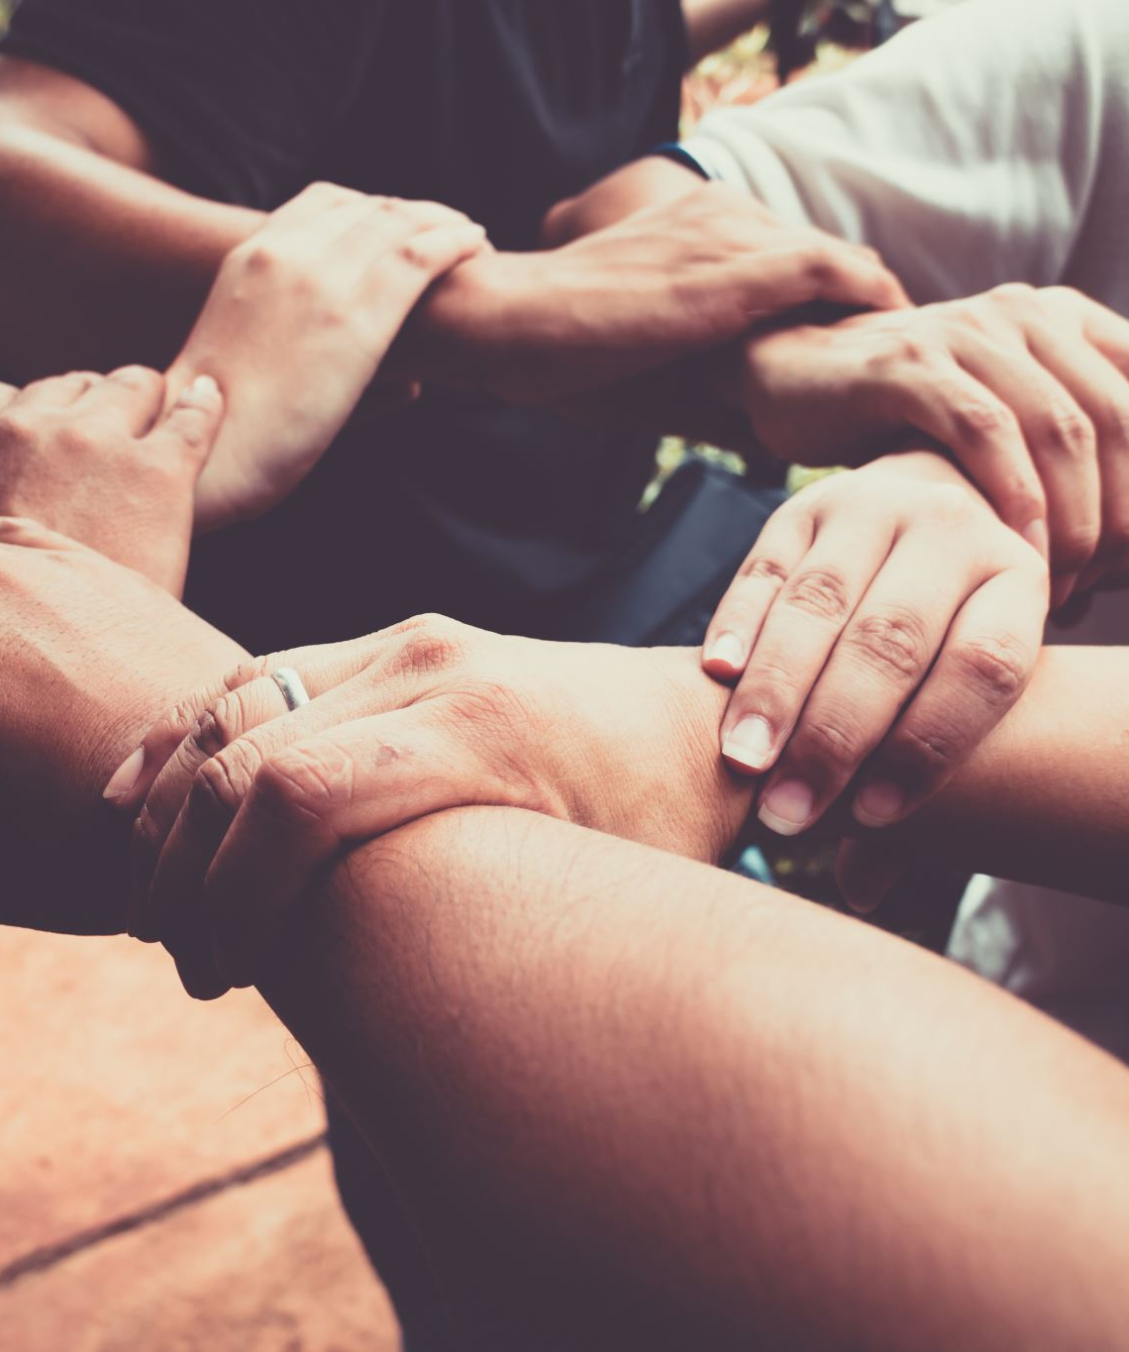
Our Values
Our Core Values
At Our Own Lives:
You are the expert, and in charge of your own choices.
And Together:
We create communities where everyone belongs.
We support and advocate for each other.
We are creative and embrace change.
We help each other, work together, and leave nobody behind.
Notes:
Jeff’s slide

Slide 11
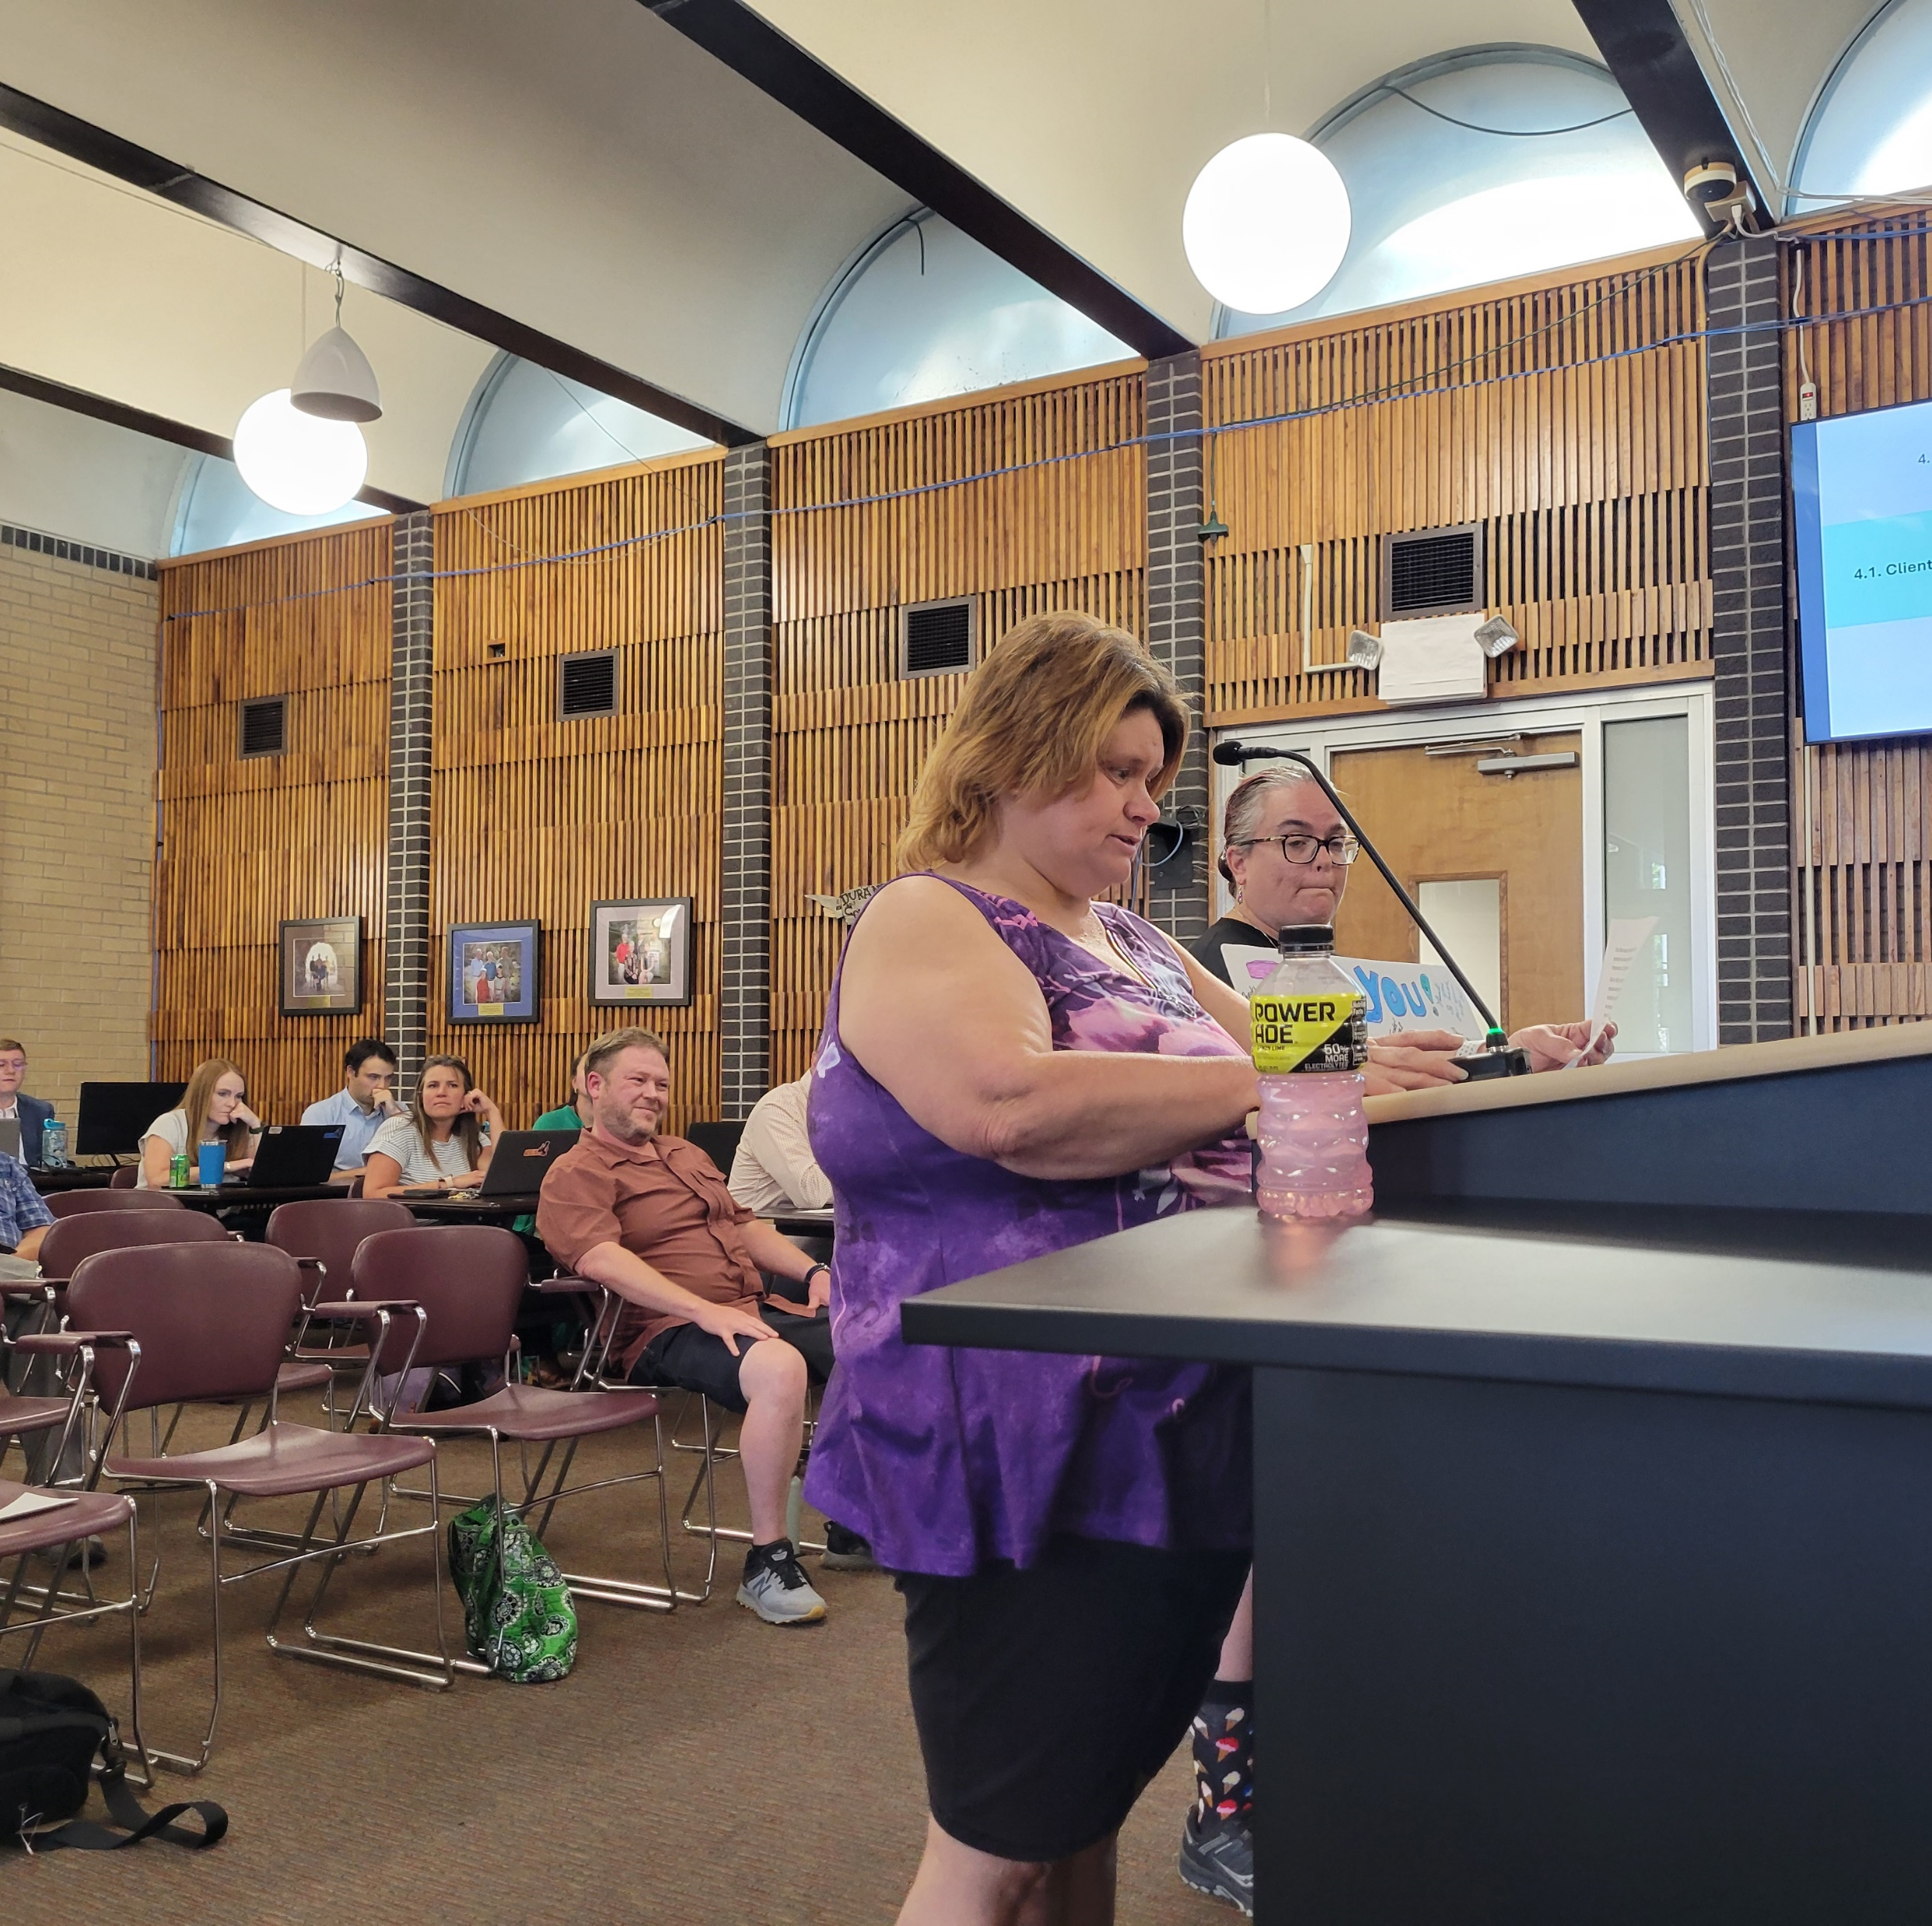
Client leadership Council
Formed as part of Community Connections in 2021.
Council members representatives elected by other people in services.
Serve 2 year terms
Provides hands on experience for leadership and board of director roles
Gives guidance and input on agency policy, activities, and direction.
Reports to the Our Own Lives Board of Directors.
Notes:
Jeff’ talks about formation of the council/

Slide 12
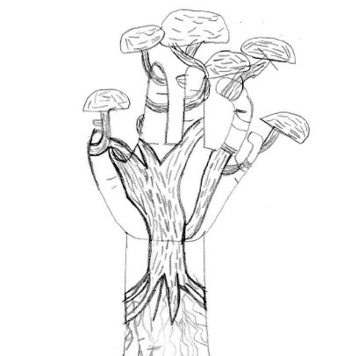
CLC Projects
Renaming of our Community Center to Siegele Safe Haven
CEO selection
Logo Selection
Part of the job interview team
Memorial Trees
Start Community Garden and revamp Community Center grounds to increase access
More whole-organization get togethers
Notes:
Cathy’s slide

Slide 13
Hiring and staffing
Only 5 of 581 ANCOR respondents reported no staffing challenges in the past year.
95.4% of agencies reported moderate (28.5%) or severe (66.8%) staffing challenges.
Source: The State of America’s Direct Support Workforce Crisis 2023, ANCOR
Notes:
Jeff’s slide.

Slide 14
Staffing Our Own Lives
Disability Hiring Preference
Universal Reasonable Accommodations Policy
Guaranteed Interviews for DVR, CILC, Transition services referrals.
Training and developing people in services to work as DSPs.
You can’t train lived experience
Subject matter experts and know our system
Far more credible as mentors- “I did this, you can too!”
Notes:
Amanda’s slide

Slide 15
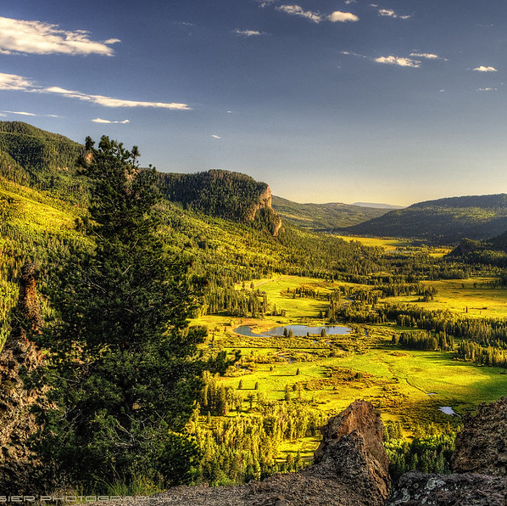
Inclusive services
You are free to be!
You know best what you need to be happy, what you want to accomplish, and good ways to support you- you are the expert in your own life.
You are welcomed and accepted for who you are
Not the theoretical “fixed” version of you
Notes:
Cathy’s slide

Slide 16
Behavior Support
We don’t “behavior plan” you.
Having behavior support needs doesn’t mean you lose autonomy.
We bring concerns to you and you decide how to handle it and what support you need.
Notes:
Jeff’s slide

Slide 17
Behavior/ABA Services
Consent/Assent based
You own and helped create your plan, it doesn’t just get “run” on you.
You are in control of who, what, where, when and why.
Notes:
Jeff’s

Slide 18
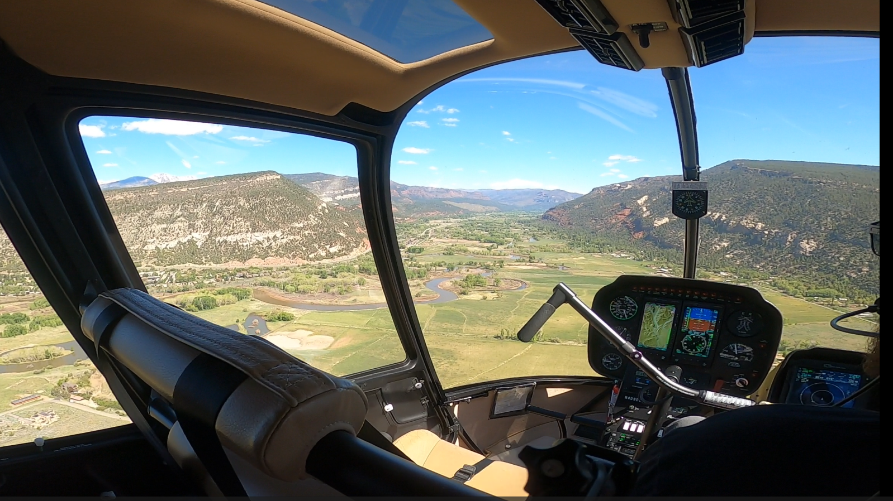
Outcomes
We are fully staffed
Meaningful, non-tokenized disabled and IDD representation at all levels of the organization- Board of Directors, Executive Leadership, Managers and Staff
Building a career ladder
High staff morale
“If you build it, they will come”
Lots of excitement!
Notes:
We will all take this slide bullet by bullet

Slide 19
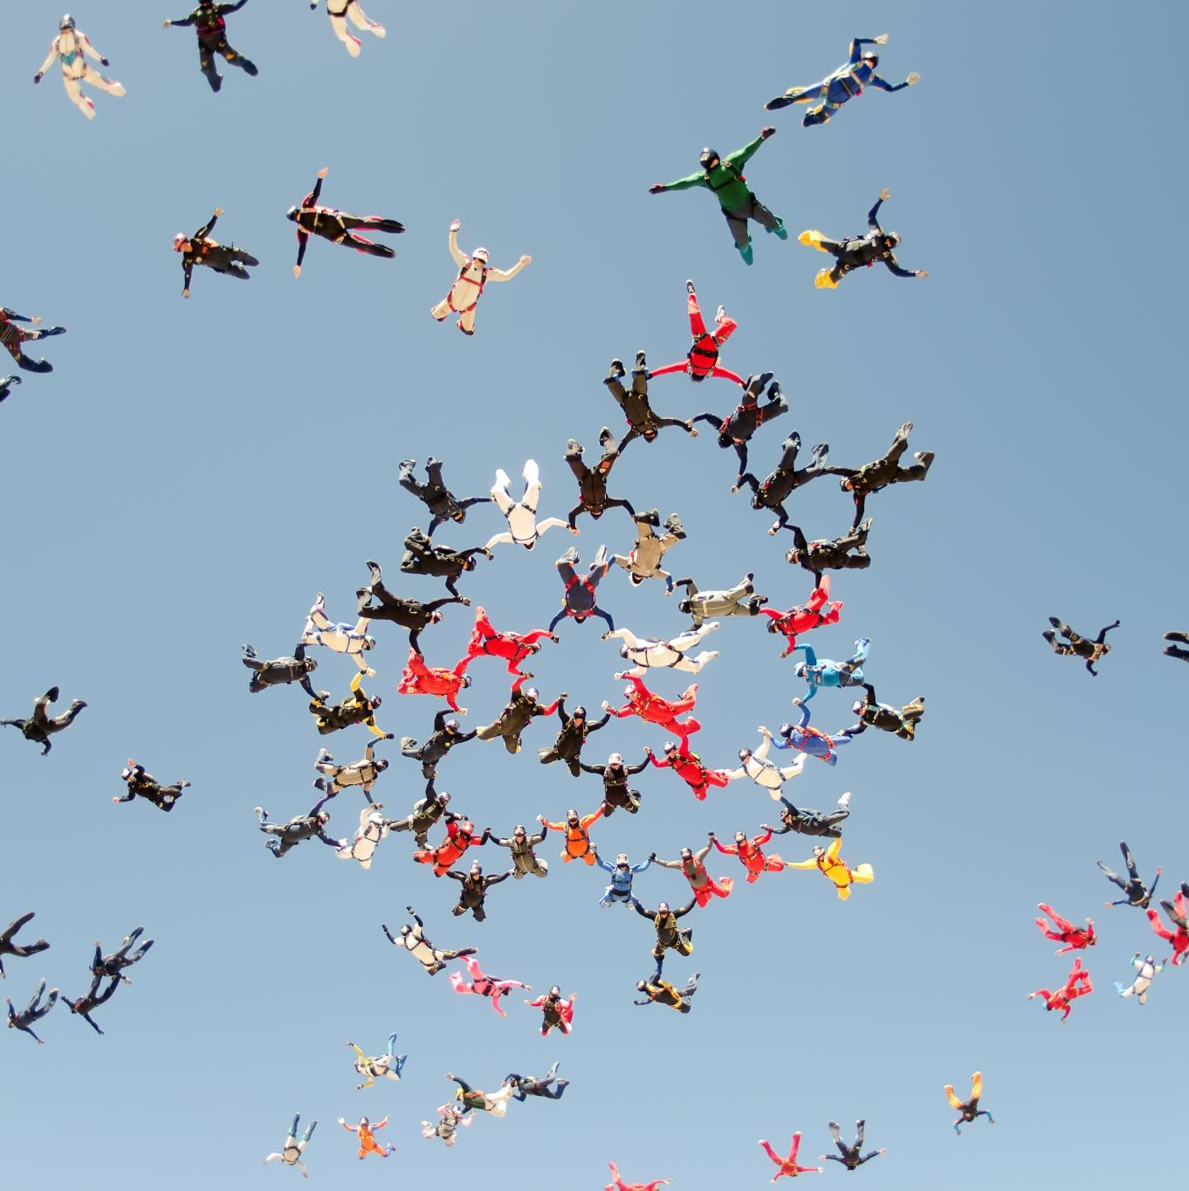
What we are Still Working on:
Accessible Board Meetings
Need to have time to absorb and process information to make an informed decision about it!
Making sure people in services serving on board not feeling railroaded.
Setting expectations about the role of DSPs that are also receiving services.
“Why doesn’t this DSP drive?“
Making sure we are matching DSP roles to skillsets.
Still working through CFCM transition.
We have no roadmap!
Notes:
Cathy will talk about board meetings
Jeff will talk about DSPs and no roadmap.

