Slide 1


National Core Indicators:
Quality information at the state and population level
Alixe Bonardi
NCI Project Director for HSRI
abonardi@hsri.org

Slide 2

What Are the National Core Indicators?: Evolution of a National Survey of Quality of Life Outcomes

Slide 3
What is NATIONAL CORE INDICATORS (NCI)?
NASDDDS, HSRI & State DD Directors
  Multi-state collaboration
  Launched in 1997 in 13 participating states – now in 45 states (including DC) and 22 sub-state areas
Goal: Measure performance of public systems for people with intellectual and developmental disabilities by looking at outcomes
    What are outcomes?
    Instead of measuring the number of people in a program/receiving funding, measuring the consequences/results of that program.
    DOMAINS: employment, community inclusion, choice, rights, health, safety, relationships, service satisfaction etc.
National Core Indicators (NCI)

Slide 4

Why was NCI developed?
NASDDDS, HSRI and State Directors
6 participating states
15 state steering committee
Needed tool to measure the outcomes of state DD services from the perspective of the individual receiving supports
Fear that tools were being developed that did not take into account needs of people with ID/DD
WAY BACK IN 1997....

Slide 5

National Core Indicators State Participation
2016-2017
WA
VT
NH
ME
MT
ND
MA
OR
MN
WI
NY
RI
ID
SD
MI
CT
WY
PA
NJ
NE
IA
OH*
DE
NV
IL
IN
MD
UT
CO
WV
VA
Wash DC
CA*
KS
MO
KY
NC
OK
TN
SC
AZ
NM
AR
MS
AL
GA
TX
LA
46 states, the District of Columbia and 22 sub-state regions
AK
FL
HI
Please note: not all NCI participating states participate in all NCI surveys each year.

Slide 6

How are performance measures collected?
NCI information comes from people who receive services and their families
Adult Consumer Survey (ACS)
(in-person)
Family Surveys
(AFS, FGS, CFS) (mail)
Notes:
DLH
Adult Consumer Survey
In-person conversation with a sample of adults receiving services to gather information about their experiences
Keyed to important person-centered outcomes that measure system-level indicators related to: employment, choice, relationships, case management, inclusion, health, etc.
Adult Family, Child Family, and Family/Guardian Surveys Mail surveys – separate sample from Adult Consumer Survey
Other NCI state level data: Staff Stability
[ HOW MANY STATES PARTICIPATED IN STAFF STBILITY]
NCI is a person-centered tool that provides information on….
Individual characteristics of people receiving services
The locations where people live
The activities they engage in during the day including whether they are working
The nature of their experiences with the supports that they receive (e.g., with case managers, ability to make choices, self-direction)
The context of their lives – friends, community involvement, safety
Health and well-being, access to healthcare

Slide 7

Family Surveys
Adult Family Survey (AFS):
  Mailed to families with an adult with
  IDD (and receiving services) who lives in the home with them
Family Guardian Survey (FGS):
  Mailed to families with an adult with IDD (and receiving services) who lives OUTSIDE of the family home
Child Family Survey (CFS):
  Mailed to families with a child with IDD (and receiving services) who lives in the home with them

Slide 8
How is the Adult Consumer Survey (ACS) Administered?
Standardized, face-to-face interview with a sample of individuals receiving services
  Background Information
  Section I (no proxies allowed)
  Section II (proxies allowed)
No pre-screening procedures
Conducted with adults only (18 and over) receiving at least one service in addition to case management
Section I and Section II together take 50 minutes (on average)
National Core Indicators (NCI)

Slide 9


National and State Reports

Slide 10
NCI data are used for monitoring and to improve services
  Benchmarking system performance
  Compare system performance with other states and to NCI average
  Identify priority areas
  CMS assurances/ systemic compliance
  HCBS settings rule transition plans
  Advocacy

Slide 11
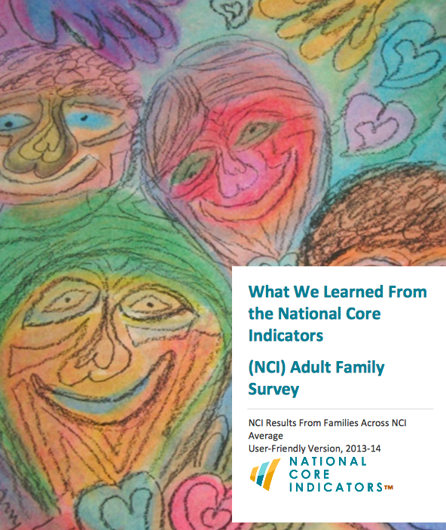
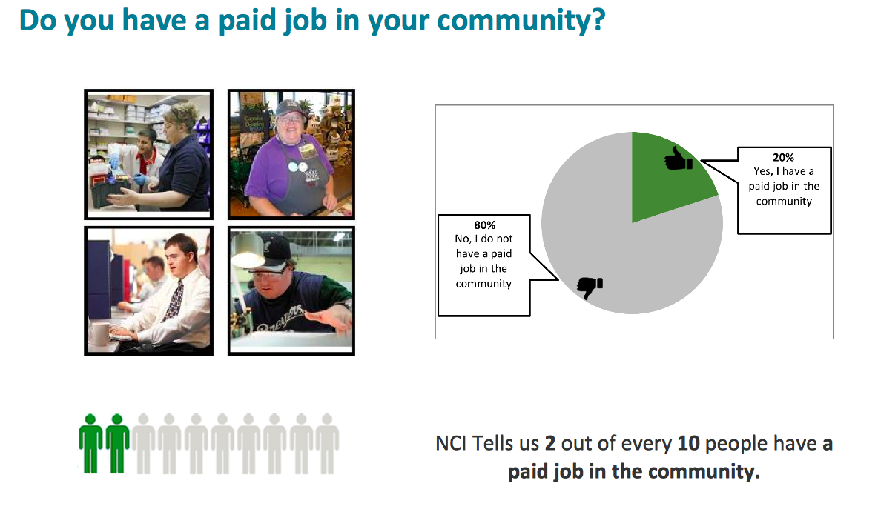
User-friendly reports

Slide 12
National Core Indicators Design
Valid
Measure what is intended to be measured
Reliable
Provide consistent results over time and interviewers
Risk Adjusted
Provides multiple state comparisons
Notes:
PA Reliability study has been completed. (Kappa scores generally .88 – .90 for interrater reliability)
Validity of study - data is examined through agreement with administrative datasets.

Slide 13
Possibility of using data for special projects
NCI sample minimum 400 people* for the face to face surveys.
States may expand sample to:
Track a particular population
Compare systems within the state (e.g. MCOs)
* Based on population served: 95%CL, 5%MoE
States may add additional questions.
Notes:
Usually requires 400 population for 95% confidence level and 5% margin of error based on the total population served by the state.

Slide 14

National Core Indicators offer a unique view
Person-centered
Individual characteristics of people receiving services
Reporting by locations where people live
Activities people engage in during the day including whether they are working
Experience with planning and the supports that
people receive (e.g., with case managers,
ability to make choices, self-direction)
Context of people’s lives – friends,
community involvement, safety
Health and well-being, access to healthcare

Slide 15
How Are States Using NCI Data?

Slide 16
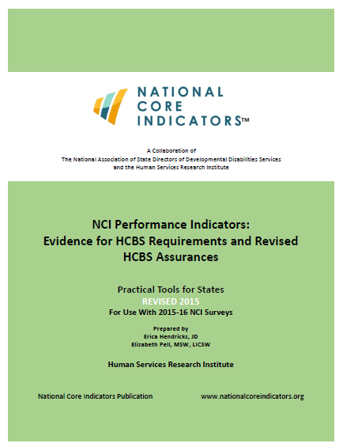
Use of NCI with Federal Regulations

Slide 17
NCI: Strengthening Service Delivery and Quality System-Wide
  Providing NCI survey findings to state and regional quality councils for review, analysis and feedback
  Identifying quality concerns and prioritizing service improvement activities
  Comparing the state’s performance against that of other states
  Targeting areas for remediation and improvement at the state and system levels in line with CMS requirements

Slide 18

How States Use NCI Data
New York
Publishes comparison data against other states
Targeted campaigns to decrease obesity rates
Ohio Council of Governments
Tracks person centered practices and changed the terminology of their planning process
Kentucky
Issues formal report on service quality and community participation
Massachusetts
Tracks and acts on health and wellness and safety data

Slide 19

What do NCI data show?
2015-16 NCI data

Slide 20
NCI Consumer Survey Data 15-16
Residence type | CO | NCI
Institutional settings | 0% | 5%
Group home | 19% | 33%
Independent home | 19% | 20%
Relative’s home | 32% | 35%
Foster care | 30% | 7%
17,682 respondents from 35 states and DC:
401 respondents from CO
Avg. age: 43
CO Avg. age: 44
NCI: 58% Male
CO: 62% Male
Notes:
ICFs, nursing home and other institutional settings
17,682 respondents from 35 states and DC:
401 respondents from CO
Avg. age: 43
CO Avg. age: 44
NCI: 58% Male
CO: 62% Male

Slide 21


Exercising Choice
 | CO Average | NCI Average
Choice – Made decision or had some input into decision
Home | 65% | 57%
House mates | 58% | 47%
Staff (day & residential) | 78% | 70%
Daily schedule | 88% | 84%
What to buy | 89% | 88%
Source: NCI-DD Adult Consumer Survey data 2015-16
Notes:
People who have guardians make fewer choices including who they live with and what they do with their time (NCI Data Brief: What NCI Data Reveal About Service Delivery and the Respect Given to the Rights of People With I/DD, 2015)
Home: N=9,719
No 61.6%
LG 45.7%
FG 41.3%
Roommates N= 9,687
No 54.0%
LG 42.0%
FG 34.8%
Staff (day & residential) N = 13,874
No 68.8%
LG 63.7%
FG 60.4%
Daily schedule N = 14,927
No 89.5%
LG 79.3%
FG 76.8%
What to buy N = 14,893
No 93.1%
LG 83.0%
FG 80.7%

Slide 22
Employment: NCI Average
Yes
19.1%
Yes
53.3%
No
80.9%
No
46.7%
Yes
41.1%
No
58.9%
Notes:
Of the valid responses to NCI Adult survey whether the person has a job in the community, 19.1% do have a job in the community.
Of those without a job, 53.3% said they would LIKE a job in the community.
Of those who said they would LIKE a job in the community, only 41.1% have a goal related to employment in their service plan.

Slide 23
Employment: CO Average
Yes
15.0 %
Yes
40.0%
No
85.0%
No
60.0%
Yes
34.5%
No
65.5%

Slide 24
Putting it another way:
Do you have a job in the community?
15% said yes.
Would you like a job?
40% said yes.
But only 34.5 percent of these people have employment as a goal in their plan for supports.

Slide 25



Relationships
Notes:
Has friends that are not family or staff

Slide 26
Service Coordination

Slide 27
Access
Notes:
Are you able to get places when you want to do something outside your home, like going out to see friends, entertainment or to do something fun?

Slide 28






https://www.youtube.com/watch?v=xJi89H2oyAY&feature=youtu.be
Notes:
Find out what we are doing better
Make sure people get the services they need
Understand how people are doing
Find out how services are doing

Slide 29
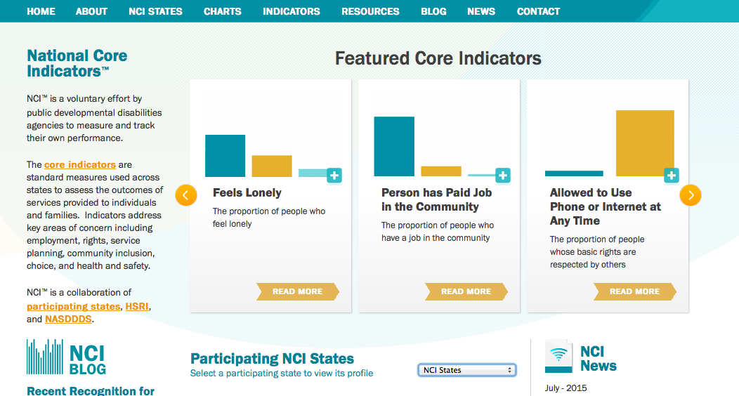
www.nationalcoreindicators.org

Slide 30

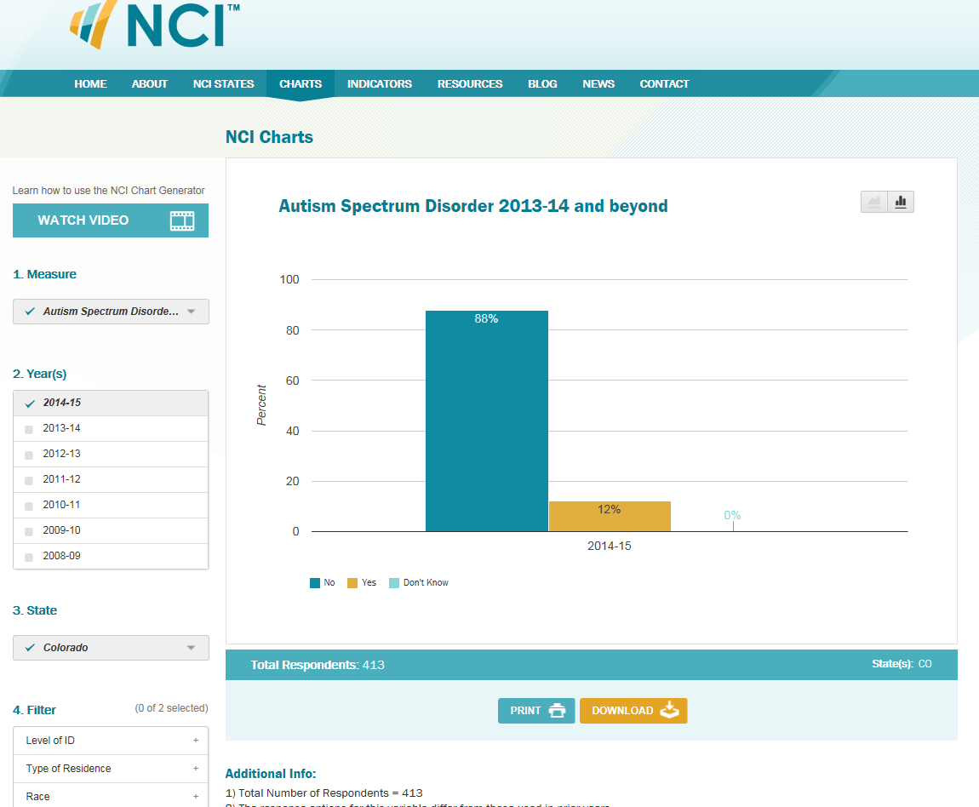
NCI Chart Generator

Slide 31


Contacts
HSRI
  Alixe Bonardi: abonardi@hsri.org
NASDDDS
  Mary Lou Bourne: mlbourne@nasddds.org
NCI website: www.nationalcoreindicators.org

