Slide 1
Randall Wilson, PhD
Jobs for the Future | June 22, 2017
2017 Alliance Summit
Strengthening the direct support Workforce:
Better jobs, Skills, and Career advancement

Slide 2

ABOUT JOBS FOR THE FUTURE
OUR MISSION
JFF works to ensure that all young people and workers have the skills and credentials needed to succeed in our economy.
OUR VISION
The promise of education and economic mobility in America is achieved for everyone.

Slide 3

Need for Solutions is Urgent
Emerging Vision of Good Practices
Models and Lessons from Employers and Workforce Initiatives
Your Thoughts and Next Steps

Slide 4
CAREGIVING: A PERSONAL VIEW

Slide 5
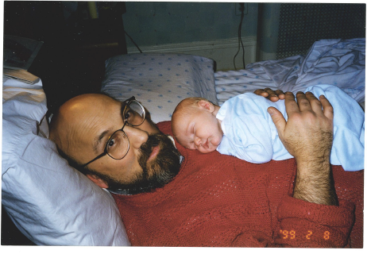
Caregiving at day 10

Slide 6
Caregiving: year 80

Slide 7
Urgent need for solutions
Shift to home/community-based service; rise in aging population, persons with disabilities
Low unemployment, competition from other employers
Need to stabilize, strengthen workforce to ensure care
Need for higher skills to meet employer and consumer performance standards
Need for better jobs with career and educational opportunities – increase retention and engagement

Slide 8
HEALTHCARE and human service SUPPORT OCCUPATIONS
Essential to transforming healthcare and service delivery
Often underpaid, under-recognized and underutilized
May lack formal credentials and job definitions
Inconsistent level of skill and training
Roles and job definitions in flux, like healthcare itself

Slide 9
Who are direct care workers?

Slide 10
Direct care workers by occupation
Occupation | 2014 Employment | Median Hourly Wage
Nursing Assistants | 1,545,200 | $12.78
Home Health Aides | 913,500 | $10.87
Personal Care Aides | 1,768,400 | $10.54

Slide 11
Who are direct care workers?
Nine in ten are female
One-half are high school-educated or less
One in five is a single parent
Almost a quarter (24%) are immigrants
More than half (57%) depend on public assistance

Slide 12
The problem is widespread
Direct care worker shortage looming in Iowa (Telegraph Herald, Dubuque, Iowa. 6/4/15)
Severe shortage of home health workers robs thousands of proper care (Kaiser Health News, 4/26/17)
Low wages to blame for shortage of caregivers for people with disabilities (KQWC TV-6, Illinois)
Elder Care Is a Looming Crisis. Hawaii Is Facing It Head-On. (Slate, 6/5/17)

Slide 13
High demand for caregivers . . .

Slide 14
. . . But retention is a challenge
Retention is an issue for 83% of US ID/DD agencies
DSP turnover rate = 50% (residential), 65% (in-home)
  CO: 38%, ranging to 81%
Key causes:
  Inadequate pay/benefits
  Work stress
  Lack of advancement opportunities
  Lack of supervisory support
Key costs: recruitment, training, lost productivity, service gaps
(Source: Medisked 2016; PHI 2011; Alliance CO)

Slide 15
Earnings fall below a living wage
(Source: Colorado Department of Labor and Employment n.d.; livingwage.mit.edu/states/08)

Slide 16
PCA Training and skill levels vary
Lack of federal standards for Personal Care Aide training
Wide variation across states in minimum training required
Inconsistent training across programs within states
  Just 4 states have uniform standards
22% of states lack any training requirements
45% of states have at least one program w/no required training
Contributes to substandard care and low job satisfaction, retention
(Source: Chapman and Marquand 2014)

Slide 17
Transforming health care support roles for better care
CHANGING ROLES
OCCUPATIONAL EXAMPLES
New roles, tasks, and skills
Shifting roles and tasks
New settings
Emerging occupations
Direct Care Workers (CNAs, HHAs, PCAs, DSPs)
Medical Assistants
Peer Recovery Specialists
Community Paramedics
Community Health Workers/Patient Navigators

Slide 18
Elements of a quality job
Family-sustaining wages and benefits
Competencies and training
Careful assessment and screening
Supportive and qualified supervision
Opportunities for skill and career development
Respect!

Slide 19
Professionalizing care work
STRATEGIES
EXAMPLES
Creating core competencies
Establishing certifications
Building membership organizations
Iowa “Prepare to Care”
RI Community Health Worker certification

Slide 20
IOWA: “PREPARE TO CARE” CURRICULA

Slide 21

Adding rungs to the ladder
Advanced Aide Roles
NYC Care Connections
North Carolina Personal and Home Care Aide State Training Program (PHCAST)
Washington Advanced Home Care Aide Registered Apprenticeship

Slide 22
Advanced Aides: NC PHCAST

Slide 23
Career lattices: MA PHCAST

Slide 24
ELEMENTS OF EFFECTIVE TRAINING and pathways
Adult learner-centered—building from individual’s knowledge
Competency-based
Work readiness – “21st Century Skills”
Work-based learning
Contextualized
Technology-enhanced
Stackable credentials, multiple entry and exit points

Slide 25
Emerging vision of good practices
Inclusive hiring
Accessible learning
Career advancement opportunities
Engaging leadership
Capacity for workforce development
Leveraging resources

Slide 26
Good practice Model: Homebridge
San Francisco-based home care agency (formerly In-Home Supportive Services Consortium)
Homebridge Training provides structured on-boarding of hires—including work readiness, cultural training and mentoring
Intensive basic and specialized training in 3 languages; competency-based with formal assessments
On-staff peer mentor and Retention/Success Coordinator
Turnover rate well below national average

Slide 27
Good practice model: holy angels
Shreveport, LA provider to intellectual/developmental disabled community–paying $3 over area average wage
”Angels University:” training partnership with higher ed, public workforce system
Onsite training with ladders: Certified Medication Aide, Advanced Behavioral Analysis Tech; foundational and life skills
82% retention rate for CMA trainees; voluntary separations down sharply

Slide 28
Good practice model: Inglis Foundation
Philadelphia, PA: persons with disabilities (residential and community-based services)
Customized CNA training and extended support for new hires; created assessment center to screen, interview
Collaboration with labor/management and industry partnerships
Turnover down from 69 to 22%

Slide 29
Resource for workforce development: Career sTAT

Slide 30
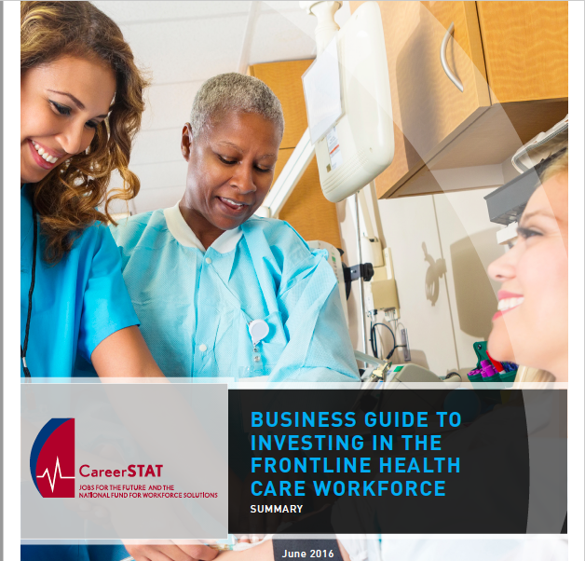
Resource for workforce development: Career sTAT

Slide 31
Areas of strategic business impact
Workforce Availability
Employee Competency
and Advancement
Employee Engagement

Slide 32
Areas of strategic business impact
Consumer Experience
Community Impact
Quality & Safety

Slide 33
takeaways
Promote recognitions, rewards, and career and educational development
Formalize professional roles with competencies and industry-recognized certifications
Measure your impact--integrate measures into design of workforce programs
Network! Learn from other providers—promote adoption of good practice
Create partnerships with higher ed, CBOs, workforce system, other agencies

Slide 34
resources
FOR MORE INFORMATION:
www.jff.org
https://nationalfund.org/initiatives/careerstat/
https://phinational.org

Slide 35

QUESTIONS AND DISCUSSION
Photo courtesy of:

Slide 36

Randall Wilson, Phd
rwilson@jff.org
TEL 617.728.4446 FAX 617.728.4857 info@jff.org
88 Broad Street, 8th Floor, Boston, MA 02110 (HQ)
122 C Street, NW, Suite 650, Washington, DC 20001
505 14th Street, Suite 340, Oakland, CA 94612
WWW.JFF.ORG

