Slide 1
Marketing Au Naturel
Gayle Gross
Community Relations Manager, Mosaic in Colorado Springs
Josh Thomas
Quality Assurance Coordinator, Mosaic in Colorado Springs
Notes:
My name is Gayle Gross and I’d like to talk with you about making your business the one that people remember. Face it, there are many businesses that do what you do. There are three principles we learn at an early age. They are respect, maintaining a positive focus and clear communication. You may remember them as:
1 ) do unto others as you would have them do unto you;
2 ) look on the bright side:
3 ) and never talk with your mouth full.
Before we dig deeper into this subject I’d like to introduce you to Josh Thomas, he is Mosaic in Colorado Springs’ Quality Assurance Coordinator. We go down this path with respect – introducing Josh to you, A positive focus – how many of you know you’ll walk out of here learning more about Josh and I (everyone raises their hand). Do you know more about me? Not yet, but Josh will reciprocate….Gayle Gross is the Community Relations Manager in Colorado Springs.
When we focus on respect, the positive side of things and clear communication, we move success to a new level. To put this into perspective, if you learned the value of creating relationships at an early age you were never the last one picked in gym class even though you were the worst player. Right?
What would you do if you walked into work on Monday morning to find your office door locked and your key not working? I am going to suggest three solutions, please raise your hand for the one, which best fits you.
• How many of you would turn the knob on the door, shake your head because it’s locked and then go home...realizing it’s Sunday?
• How many of you would contact your boss via text or email on your smartphone?(text) Hey man what’s going on? I can’t get into my office.
• If you haven’t already raised you hand this is the last option. Are you ready? It’s the one you have to do…and I’m going to respect you for it. I’m going to put a positive spin on it. The door is locked so you decide to bust the door down because you’re wearing your vintage sweater with shoulder pads. Nice, right?
I am obviously joking about the three options but in truth, what you decide to do will depend a lot on what happened to you before you even reached your office door.
• It’s the relationship with your family...as you said good bye to your spouse and children that morning,
• the drive to work…and the guy in the black Mercedes who pulled out in front of you, cut you off, and then drove as slow as molasses in wintertime.
• It’s the communication that happens before, during, and after an incident that makes a difference. What you do about the locked door depends on previous relationships/experiences and how you handled them.
Do you believe me? Relationships make a difference. They make a huge difference when it comes to marketing.
• For those of you who raised your hand and went back home because you realized it’s Sunday…praise the Lord, you’re working too hard. Thou shalt have a day off.
• For those of you who raised your hand because you’ll connect with your boss via text or email…make sure you look up at the nameplate on the door…to be sure the office your breaking into really is yours before you push send?
• For those of you who are getting ready to break the barrier, in this case – the door, it’s a little aggressive but it does get you inside. And, since I communicated it was the final option and you had to take it, your choice to respect my decision will probably determine if I help you pay to get the door fixed. Chances are I am going to like you for going the extra mile. I will trust you to get the tough jobs done. And, I am going to know you a little better, like, you have a great wardrobe of vintage sweaters that I may want to borrow.

Slide 2
Natural
One of the best ways to market a product is to advertise it as natural.
The FDA has not developed a definition for the use of the term.
The only thing
100% Natural for you
is YOU.
The Natural Effect – by adding natural to your package
RespectF.O.R.M. – Family, Occupation, Recreation, Message
Notes:
Did you know that listing something as natural is the best way to market a product?
The FDA has not developed a definition for “natural” but believe believe it means things are of the earth, organic, good for you. You could label your product as natural and get away with it.
The only thing 100% natural is you. SO – BE YOU. Let people know you. Make marketing about the relationships you build. They are so important to the process because people do business with people they know, like and trust.

Slide 3
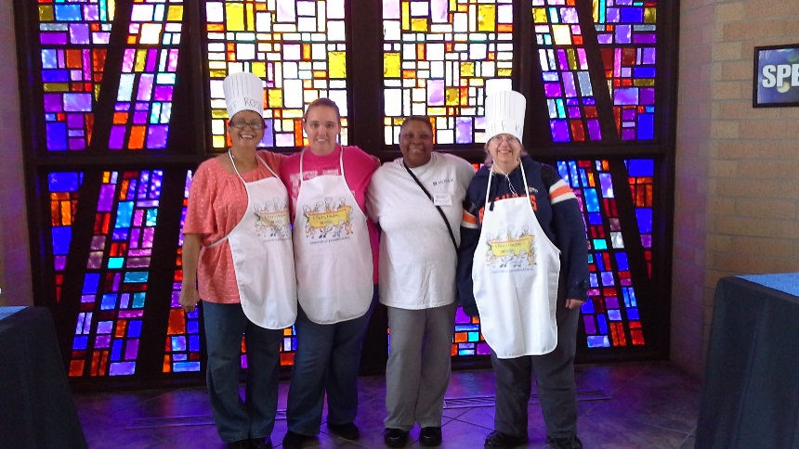
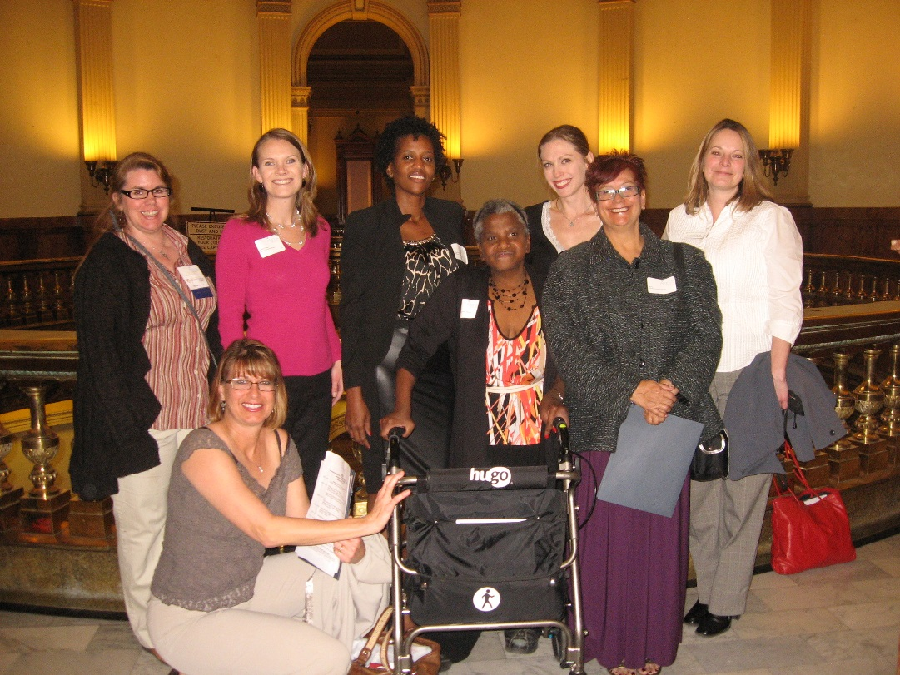
Use F.O.R.M
What does it mean?
F.) _______________________________
O.) _______________________________
R.) _______________________________
M.) _______________________________
RespectF.O.R.M. – Family, Occupation, Recreation, Message
Notes:
Have you heard of FORM?
You can use FORM to build relationships.
F – stands for family
O – stands for occupation
R – stands for recreation
M – stands for message
Before you ever get to the message at hand…get to know the person you’re with. Ask about their family, occupation, and recreation.
Gayle and Josh role play this process.

Slide 4
Values
What do you value?
1.) _______________________________
2.) _______________________________
3.) _______________________________
4.) _______________________________
Establishing and Understanding
RESPECT
Notes:
Pass out copies of values and the challenge slides.
When you know and understand your values you can also understand what values you like in another person. It’s easy to find the values that overlap when you go through the FORM process. It is important to interact in conversations. Reciprocate when a person asks you a question. (role played)
Give 2 – 3 minutes for people to list their values.

Slide 5
Challenges/oppportunities
What challenges are there in your market?
1.) _______________________________
2.) _______________________________
3.) _______________________________
4.) _______________________________
What is the opportunity associated with the challenge
1.) _______________________________
2.) _______________________________
3.) _______________________________
4.) _______________________________
Establishing and Understanding Positive Attitude
Notes:
Every organization has some challenges they feel are a burden when it comes to marketing themselves in their community. What do you feel yours are?
Example: Colorado Springs has over 2000 non-profits. When it comes to recognition and fundraising we are up against the others. That would be a challenge for Mosaic in Colorado Springs.
Give 3 - 4 minutes for writing down challenges.
Explanation of how follow up makes or breaks a relationship. Usually three contacts within one week is good. Could be email, followed up with phone call, followed by note or personal visit.
Each person finds a partner they do not know. Go through FORM to learn about each other (5 minutes). Collect each other’s contact information.
Explain about Gayle and Josh follow up with individuals within 7 to 10 days. Then follow up to whole group within two to three weeks for analysis of how the relationship building exercise worked.
Each team (partners of two) help each other list a positive solution to their challenges. Agree to follow up with each other.
Bring group’s attention together by listing values on the flip chart. This is so each person knew where others (partner in exercise) find value. Creating common ground.

Slide 6
Values How to Share your Values Follow up Plans
Thank YOU - Naturally
Establishing and Understanding
Clear Communication
Notes:
Wrap up by reiterating how respect, positive attitude and clear communication has helped the group in the room come together. Great networking as you learned more about your partner. Encourage connecting after the session. Remind of follow up by Gayle and Josh.
Questions?

