Slide 1
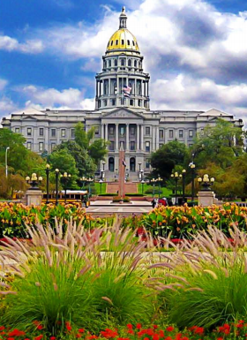
2015 Legislative Session Review & UNDERSTANDING THE BIG 3: Tabor, The Negative Factor, & Marijuana Revenue

Slide 2
Government Relations Committee
THE QUICK FACTS
Committee Chair: Randy Brodersen, North Metro Community Services
There are about 20-25 active Alliance members who participate in Government Relations Committee
Committee meets once per month for two hours to discuss relevant legislative bills and budget updates
Alliance hosts a weekly Tuesday morning call during Session to keep the Committee and other members apprised of any changes
Committee makes critical decisions about Alliance positions on bills as well as assists with our strategic lobbying approach on a range of issues
Committee engages in grassroots efforts to build relationships with legislators including Capitol meet & greets and agency tours
This committee is open to all members!

Slide 3
The Colorado Budget Cycle
July 1: Initial Dept. Request Due to OSPB
Sept. 1: Full Dept. Request Due to OSPB
Nov. 1: Governor’s Budget Due to JBC
Nov.-Dec.: JBC Budget Briefings and Hearings
January: (Legislature in Session) Midyear Supplementals
Feb./March: Figure Setting
March/April: Long Bill
Notes:
Colorado’s Fiscal Year starts July 1st, and so does it’s budget cycle. Understanding the Colorado budgeting process can give you an advantage when attempting to secure state funds or make policy changes at the state level. Here is a quick overview of the process:
July 1st: The governor’s departments begin to review any changes they would like to make to the budget. They can propose new initiates or change old ones. All of these requests will be sent to the governor's Office of State Planning and Budgeting (OSPB) at the Capitol.
September 1st: all department requests are due and OSPB staff will create a budget request on behalf of the governor.
November 1st: The governor submits his request to the JBC and the legislature.
November- December: The JBC holds staff briefings and department hearings to examine every budget request from the governor.
In January, the 120 day legislative session begins. The legislature holds hearings called “Supplemental Hearings” to make sure the budget is still balanced. Sometimes amendments to the current year’s budget are required to keep the budget in balance.
February and March: The JBC builds the budget through a process called “Figure Setting.” At this time the JBC can chose to use all or part of the governor’s request or they can start over with a new budget.
Finally in March and April, the General Assembly drafts and amends the Long Bill, holds public hearings and committee debates, passes the Long Bill and sends it to the governor for his signature.
(Ziegler, 2013)

Slide 4
JBC Successes
$40 million increase to IDD line
1.7% Provider Rate Increase
Ended the autism waitlist
Also expanded the age limit and years of service
Continued to draw down the IDD Comp wait list
Fully funded the SLS/CES waiver services to continue elimination of wait lists
Fully funded the EI growth and increased funding for EI service coordination
$1M Respite Services from IDD Cash Fund
$500,000 Person Centered Thinking Training
Funded crisis pilot programs for people with co-occurring mental health issues and IDD

Slide 5
Summary of 2015 IDD Bills
46 bills identified with possible IDD system impact
32 out of 46 total bills were passed
Alliance ‘supported’ or ‘actively supported’ 12 bills
All bills that Alliance ‘supported’ or ‘actively supported’ passed through the General Assembly
One exception: HB15-1314 relating to Endowment or Institutional Fund Gift Tax Credits
No bills were passed that Alliance formally ‘opposed’ or ‘actively opposed’

Slide 6
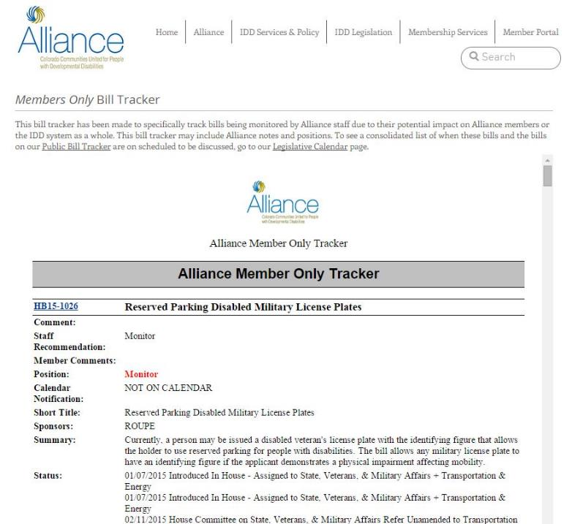
RESOURCE: Member Bill Tracker

Slide 7
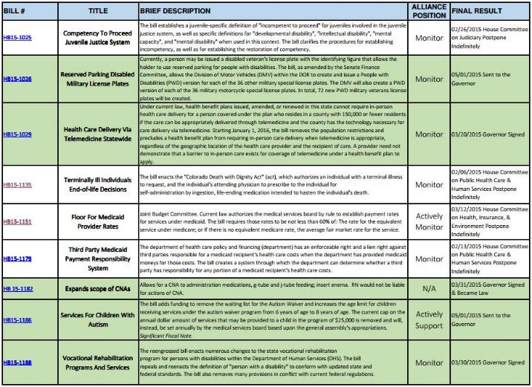
RESOURCE: 2015 Bills in Review

Slide 8
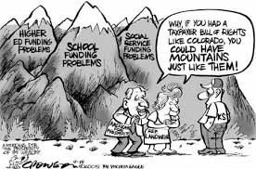
What’s to Come in 2016: THE BIG THREE

Slide 9
What is TABOR?
TABOR
Prohibits tax increase without the vote of the people
Strict limits on how much money the state can keep and spend
Any revenue collected in excess of TABOR’s limits must be refunded to the taxpayers
TABOR Formula: Inflation plus annual change in population
In 1992, Colorado voters approved a measure which amended the Colorado Constitution that restricts revenues for all levels of government (state, local, and schools).^{[2]}
Under TABOR “Taxpayer Bill of Rights”, state and local governments cannot raise tax rates without voter approval and cannot spend revenues collected under existing tax rates without voter approval if revenues grow faster than the rate of inflation and population growth.^{[2]}
Revenue in excess of the TABOR limit, commonly referred to as the "TABOR surplus", must be refunded to taxpayers, unless voters approve a revenue change as an offset in a referendum

Slide 10
What is the Negative Factor?
1994: School Finance Act
Each school district receives base per pupil funding
The base amount is then adjusted by ‘factors,’ which account for unique local circumstances such as size, at-risk students in the district, cost of living and personnel costs.
2000: Amendment 23
Amendment 23 required K-12 funding to increase each year by the inflation rate plus 1 percent until 2011, and thereafter by inflation
2009: The Negative Factor
In response to the recession, the legislature changed its interpretation of Amendment 23 and declared that Amendment 23 only required the state to increase the base funding each year.
The intention was to provide stable and predictable funding increases for Colorado school districts and to bring the total per-pupil funding amount in Colorado back to 1989 levels when adjusted for inflation.
Funding for the ‘factors’ could be cut by the legislature.
The legislature proceeded to add a new “negative factor” to the school finance funding formula as a mechanism to enact across-the-board cuts to school finance funding each year.
Notes:
You might want to change this video to a you tube….

Slide 11
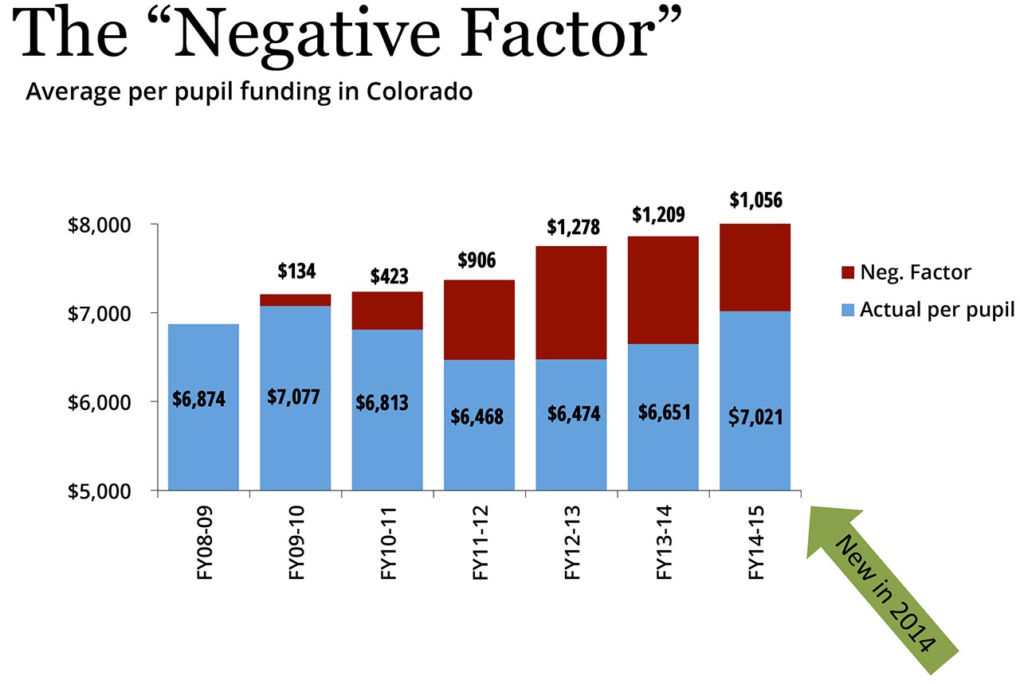
Budget Consequences
Money spent on K-12 adds to the school funding “base,” which then has to grow by inflation each year according to Amendment 23. If the state puts too much extra money into the base this year it could create budget pressure next year, which would result in either taking money away from other programs funded out of the general fund or requiring cuts to education again.

Slide 12
Marijuana Money: Refund Madness
What’s the Problem?
Due to legal fine print in TABOR, Colorado is looking at having to refund $58 million in marijuana tax revenue back to Colorado taxpayers.
What Colorado is Doing to Fix the Problem?
HB15-1318- which passed this Legislative Session, would put forth a measure on the ballot to ask Colorado taxpayers to keep the $58 million.
Under TABOR, all new taxes must not only be approved by voters but it must also include an estimate of the revenue those taxes would raise.
If that estimate is wrong, the state must refund all new revenue from the tax.
Overall revenue estimates ended up being too low when the marijuana tax question was put to voters- triggering a refund.
It included a refund model if taxpayers choose to not allow the State to keep the money.

Slide 13
Where Are We Now?
According to the Office of State Planning and Budgeting’s (OSPB) March revenue forecast, TABOR revenue is projected to exceed the cap. This means that a refund to taxpayers will occur unless voters allow the State to retain the revenue.
No matter how well Colorado’s economy does, every additional dollar that comes in to the state’s General Fund will go back out to taxpayers.
Legislators introduced a bill during the last week of session to take the Hospital Provider Fee out of the General Fund and make it what is known as an “enterprise fund”. The fee is estimated to bring in $532.3 million in 2014-15 and $688.5 million in 2015-16. Thus, shifting it out from under the General Fund/TABOR limits would eliminate the need for taxpayer refunds. However, the bill was killed in the last days of the session.
*According to OSPB March Revenue Forecast

Slide 14
What’s to Come in 2016?
Due to a change in the way K-12 education is funded (referred to as the “K-12 negative factor”), $3 out of every $4 in the state budget will go toward K-12 education. That leaves only one-quarter of the budget to support every other state priority
We have heard that any program/line item that doesn’t use all of their funding this year cannot expect to have that funding redirected for other purposes within their program/line item next year. Those monies will be directed toward filling the state budget gap instead.

Slide 15
Join Government Relations Committee for 2016
Be part of the solution!
Everyone is welcome to attend our August Government Relations Strategy Meeting on August 11th from 10-2pm at Developmental Pathways

