Slide 2
Presenters…
Mary Hoefler, Office of behavioral health, Manager Crisis Services
Bev Marquez & Cheri Skelding, Rocky Mountain Crisis Partners, CRISISline
Deanna Ryerson, Northeast Behavioral Health, Northeast REGION
Dale Wright, West Slope Casa, West Slope Region
Lori Banks, CCC: Denver Metro Region
Jason DeaBueno, Aspen Pointe, Southern Region

Slide 3
Office of behavioral Health (OBH)
SB 13-266
Continuum of care; “No wrong Door”
Multiple components: Hotline / Warmline; Walk-in Crisis Services / Crisis Stabilization Units; Residential and in-home Respite Services; Mobile Assessment
Trauma-informed care
Regardless of ability to pay (no authorization for crisis stabilization services)
Presentation vs Diagnoses
Notes:
Crisis Respite vs. IDD Respite – differences in language…

Slide 4
Rocky Mountain Crisis Partners
1-844-493-8255 (TALK)
Support Line
Crisis Line
9a – 11p 7 days a week
Peer Specialists with lived experience with behavioral health challenges = Power of shared experience
Provide in the moment or ongoing support
Promote recovery and wellness
Triage to Crisis Line as appropriate
Follow up calls
Referral and resource linkage
Immediate crisis support and in the moment consultation
Telephonic assessment for wide scope of mental health and substance use issues
Suicide/safety assessments, substance use screenings
Triage to other components of the Colorado Crisis Services
Referral and resource linkage
3rd party consultation (friends, family, other professionals)
Telephonic case management, continuity of care activities
Follow up calls

Slide 5
Crisis & IDD
Crisis Services are available to individuals with an Intellectual and Developmental Disability (IDD) who are in a behavioral health crisis; regardless of etiology or primary diagnosis, individuals will be served.
Payment of services is regardless of ability to pay, though individuals with a covered benefit will be asked to provide proof of insurance and services may be billed if covered.
Community partnership and warm-handoff from crisis is our goal. Expect collaboration and joint discharge planning with CCBs and crisis services whenever possible.
We recognize that service limitations (up to 5 days CSU; up to 14 days Respite) can be challenging at times so we hope to enlist your help in locating appropriate disposition resources.

Slide 6
State-wide CONTACT INFORMATION
Office of Behavioral Health
Mary Hoefler, LCSW
Manager, Crisis Services
Colorado Office of Behavioral Health
3824 West Princeton Circle, Denver, CO 80236
mary.hoefler@state.co.us
O: 303-866-7518
Crisis Website: www.coloradocrisisservices.org
Crisis Line & Support Warm Line
Cheri Skelding, LCSW
Clinical Director
Rocky Mountain Crisis Partners
cskelding@rmcrisispartners.org
O: 303-928-7117
Website: www.RMCrisisPartners.org
Dashboard: http://www.metrocrisisservices.org/6-about-rmcp/what-we-do/ccsdashboard

Slide 7
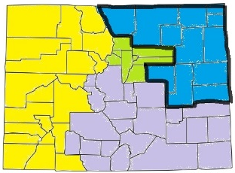
Northeast Region
12-counties: Larimer, Weld, Morgan, Yuma, Washington, Logan, Phillips, Sedgwick, Kit Carson, Elbert, Cheyenne & Lincoln
24/7 Front-Door Services:
Referral-Based Services:
HOTLINE / WARMLINE
1-844-493-TALK (8255)
A program of Rocky Mountain Crisis Partners
Mobile Unit Response
Crisis Walk-In Centers
1) 928 12th St. Greeley
2) 525 W. Oak St, Ft Collins
(moving to Riverside in Summer)
Crisis Residential Respite
Greeley Respite
Sterling Respite
Crisis Stabilization Units
Greeley ATU/Detox
Ft Collins Riverside (opening in Summer)

Slide 8
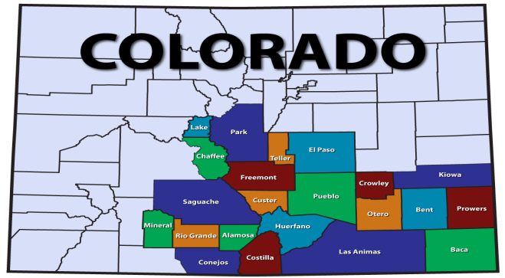
Southern Region
22 counties served – El Paso, Pueblo, Park, Teller, Lake, Chaffee, Fremont, Saguache, Mineral, Rio Grande, Alamosa, Conejos, Costilla, Huerfano, Las Animas, Custer, Crowley, Otero, Bent, Kiowa, Prowers, Baca
Access to Services Available 24/7/365
Referral Based Services
HOTLINE / WARMLINE
1-844-493-TALK (8255)
A program of Rocky Mountain Crisis Partners
Mobile Unit Response
Crisis Residential Respite
1) Alano House
2) Special Kids Special Families
3) El Pueblo Kids
4) Grand House
Crisis Walk-In Centers
1) 115 S. Parkside Dr.
Colorado Springs, CO
2) 1310 Chinook Ln Pueblo, CO
Crisis Stabilization Units
1) 115 S. Parkside Dr. Colorado Springs, CO
2) 1302 Chinook Ln Pueblo, CO

Slide 9
West slope Casa region
21-counties: Archeleta, Delta, Dolores, Eagle, Garfield, Grand, Gunnison, Hinsdale, Jackson, La Plata, Mesa, Moffett, Montezuma, Montrose, Ouray, Pitkin, Rio Blanco, Routt, San Juan, San Miguel, Summit
24/7 Front-Door Services:
Referral-Based Services:
Three Regional Crisis Numbers
HOTLINE / WARMLINE
1-844-493-TALK (8255)
A program of Rocky Mountain Crisis Partners
Mobile Unit Response
Crisis Walk-In Center:
515 28 ¾ Road
Grand Junction
Crisis Residential Respite (7)
Grand Junction, Gunnison, Aspen, Glenwood Springs, Frisco, Steamboat, Eagle.
Crisis Stabilization Unit:
Grand Junction

Slide 10
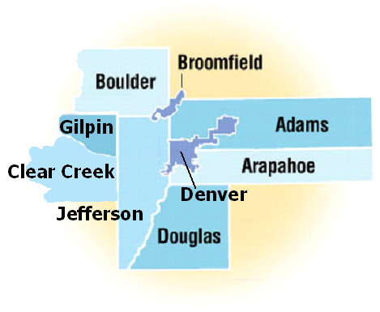
Denver metro region
Community Crisis Connection is a partnership of six community mental health centers serving the metro Denver/Boulder region for CCS.
Mental Health Partners (serving Boulder and Broomfield Counties)
Jefferson Center for Mental Health (serving Jefferson, Gilpin and Clear Creek Counties)
Community Reach Center (serving Adams County)
Mental Health Center of Denver (serving the City and County of Denver)
Aurora Mental Health Center (serving the City of Aurora)
Arapahoe/Douglas Mental Health Network (serving Arapahoe and Douglas Counties)
Community Crisis Connection provides crisis services through the Crisis Support Line, (7) Walk-in Crisis Centers, (5) Crisis Stabilization Units, (6) Mobile Crisis and Respite

Slide 11
Regional CONTACT INFORMATION
Northeast
Deanna Ryerson, PhD
Director of Crisis Response
Northeast Behavioral Health
1300 N. 17th Ave, Greeley, CO 80631
deanna.ryerson@northeastbho.org
O: 970-347-1308 / C: 970-342-6817
Website: www.northeastbhs.org
Southern
Jason DeaBueno
Southern Colorado Crisis Connection
Vice President Health Services
115 S Parkside Dr
Colorado Springs, CO 80906
Jason.DeaBueno@aspenpointe.org
O: 719-572-6366
Website: http://csu.aspenpointe.org/Dashboard.aspx
West Slope
Dale Wright, LPC
West Slope Casa Crisis Clinical Care Coordinator
515 28 ¾ Road Building A
Grand Junction, CO 81501
dwright@mindspringshealth.org
O: 970-683-7051 / C: 970-261-2458
Website: www.westslopecasa.org
Central (Denver) Region
Lori Banks, LCSW
Community Crisis Connection
Chief Operating Officer
791 North Chambers Road
Aurora, Colorado 80011
LoriBanks@aumhc.org
O: 303-923-6513
Website: www.CommunityCrisisConnection.org

Slide 12
Thank you!

