Slide 1
Working together to improve health of shared clients: RCCOs, CCBs and care coordination
2015 Alliance June Summit
June 18, 2015

Slide 2
The Accountable care collaborative (ACC)
Transforming our systems from a medical model to a health model.
Moving toward person-centered, integrated and coordinated supports and services.
Leveraging efficiencies to provide better quality care at lower costs to more people.
Notes:
Predates ACA, although some parts of the ACC program are enhanced by ACA
Purpose to meet the Triple Aim-quality, health outcomes, cost

Slide 3
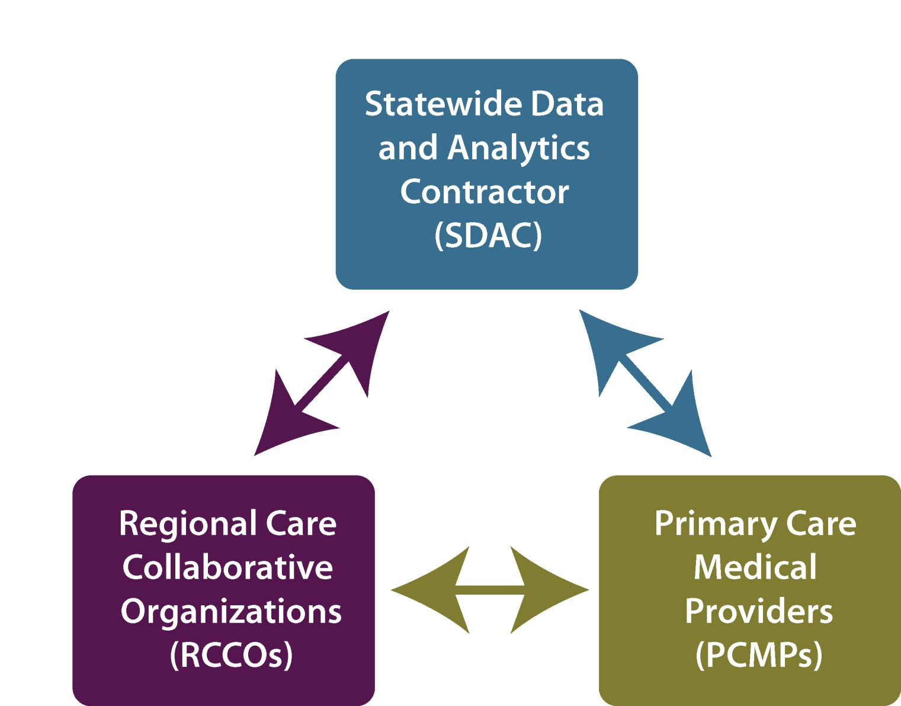
Colorado’s ACC Model
Notes:
550,000 members statewide– about half of all Medicaid clients.
This is the vehicle of the Medicaid delivery going forward
mFFS
Role of data, role of PCMPs, role of RCCO– and patient at the center

Slide 5
Geographic Regions in the ACC
Notes:
How divided and what‘s different about each region

Slide 6
ACC: Medicare-Medicaid Program

Slide 7
Program Background
10 million people nationwide rely on Medicare and Medicaid
Fragmented fee-for-service (FFS) delivery system
Affordable Care Act authorization of state-led demonstration programs to integrate care
Colorado is one of 15 participating states
32,000 eligible clients statewide
Notes:
For those of you who attended a previous webinar, some of this information will be familiar…
Nationwide, around 10 million people rely on Medicare and Medicaid for most all their healthcare needs.
A large majority of these individuals have received their care from a fragmented fee-for-service delivery system.
To address the problems associated with fee-for-service delivery systems, and to coordinate the two largest payers of healthcare in the united states:
The Affordable Care Act authorized the Federal DHS to support state-led programs (demonstrations) to integrate care for people who receive both Medicare and Medicaid benefits.
Co is One of only 12 states participating, only 2nd FFS state with largest FFS population
~ 50,000 clients will be enrolled across the state over a period of 7 months, beginning September 1st
7,500 clients per month, passively enrolled based on RCCO geographic area and existing beneficiary-provider relationships
Allows existing infrastructure optimization
Monthly categorization of potential enrollees in RCCO/county/delivery system/provider-type matrix
Intended to coordinate services across Medicare/Medicaid and achieve cost-savings for Fed/State governments through improvements in quality of care and reductions in unnecessary expenditures

Slide 8
ACC: Medicare-Medicaid Program Goals
Improve MME health outcomes
Decrease unnecessary and duplicative services
Promote person-centered planning
Improve client experience through enhanced coordination and quality of care
Notes:
The Accountable Care Collaborative (ACC) is…

Slide 9
New System for MME’s
Coordination of Primary Care, Acute, Sub-Acute, and Specialty Care
RCCO Coordinates both acute and community-based services for ALL enrolled clients
Service Coordination
Plan
Clients receiving LTSS:
Existing Long-Term Care (LTC) “Service Plans” and other assessments largely inform the SCP
Acute Care and Hospital services
Community-Based Services and Supports

Slide 10
Care Coordination Requirements
Centers for Medicare and Medicaid Services (CMS) requires:
“Plan of care” for each enrollee
Colorado’s plan of care is Service Coordination Plan (SCP)
Enrollees determined “high risk” to have SCP completed within 90 days
All other enrollees 120 days
SCPs must be updated every six months or as needed to ensure client is on track and achieving health care goals
Process for Provider Communication and Collaboration to complete SCP = Provider Protocols
Notes:
Care coordination is the backbone of Colorado’s proposal to CMS on how to improve outcomes for MME clients and help them achieve their goals.
To coordinate Medicare and Medicaid services more effectively, CMS is requiring each demonstration state to develop a “care plan”.
To support beneficiaries in implementing their care plan, RCCOs will offer care coordination, either thru RCCO staff or arrangements with local providers.
We worked with the RCCOs to develop Colorado’s care plan, called the Service Coordination Plan (or “skip”). There was a workgroup that developed the tool; clients of the workgroup included: RCCO contract managers and care coordinators; HCPF (quality and program offices); and FBMME subcommittee review (advocates). The SCP is based off of the recommendations from the project proposal (which was created in concert with the FBMME subcommittee).

Slide 11
Service Coordination Plan
Promotes proactive, person-centered, strength-based coordination of services and supports, including:
Coordinating physical, behavioral and social health needs for clients w/complex conditions
System-level oversight and support for people w/multiple case managers
Promoting patient activation

Slide 12
Protocol Network
RCCO
SEPs
CCBs
Home Health
Hospitals
SNFs
Hospice
Disability Orgs
BHOs
Notes:
Protocols describe the process for identifying and working with beneficiaries, fulfilling existing responsibilities, and mutually agreed upon support functions and establishing regular contact and communication.
The protocols were developed in collaboration with the RCCOs.
These protocols will be emailed out to you after this webinar. You can also find them on our website (?).
(Define Acronyms)

Slide 13
Region 1: Rocky Mountain Health Plans

Slide 14
Community Care Teams
Locally employed, live within the counties served
Integrated physical and behavioral health
Multidisciplinary teams
Provide support to PCMPs
Provide ancillary support to others working with our Members
Coordinating the coordination
Provide clinical/medical support, address psych-social needs, connect community resources, Medicaid navigation, conduct home visits, help with referrals, get Members from point A to B.

Slide 15
Community Care Teams
Area Served | Led by | Partners
Fort Collins | Poudre Valley Health | Touchstone, Health District of NoLaCo
Loveland | Sunrise Comm Clinic | North CO Health District, Touchstone, Banner
Routt, Moffat, Grand, Jackson, Rio Blanco | NW CO Comm Health Partnership | NWCOVNA, Mind Springs, Grand Cty Rural Health Network
Eagle, Garfield, Pitkin | Mountain Family Health Centers | MFHC, Mind Springs, WMRHA
La Plata, Archuleta, San Juan | San Juan Basin Health Dept | Axis Health Systems, Mercy, SWAHEC, CO Ctr for Excellence in Care Coordination

Slide 16
Care Coordination-Expansion
Medicaid Expansion-RCCO 1 membership doubled in six months
RMHP hired and trained additional care coordination staff to serve as extension of community care teams.
Greater Larimer County
Montezuma, Dolores, Ouray, Hinsdale, San Miguel
Summit, Garfield, Pitkin, Eagle
Mesa, Montrose, Delta, Gunnison
RMHP staff live in the regions they serve and provide in-person CC support.
Clients with low levels of need are supported by RMHP Care Management telephonic team.

Slide 17
Region 4: Integrated Community Health Partners (ICHP)

Slide 18
Innovative Integrated Leadership Our Board

Slide 19
ICHP Demographics
105,680 enrollees as of May 2015
Approximately 6,471 new Medicare-Medicaid
enrollees
252 individual practitioners
95 practices
10 community care teams

Slide 20
ICHP and the Care Coordination process:
Case management and care coordination integration among PCMP, BH and local resources
Identification of high cost/utilization Members
Implementation of Tier System with Member care protocols
Use of Health Risk Assessments and algorithms
Chronic disease management programs
Patient education and support
Establish policies and processes for consistent delivery of CC efforts
Reporting and tracking of process improvement efforts to enhance the on-going delivery of care to Members
Practice Transformation around Care Coordination

Slide 21
Region 7: Community Care of Central Colorado

Slide 22
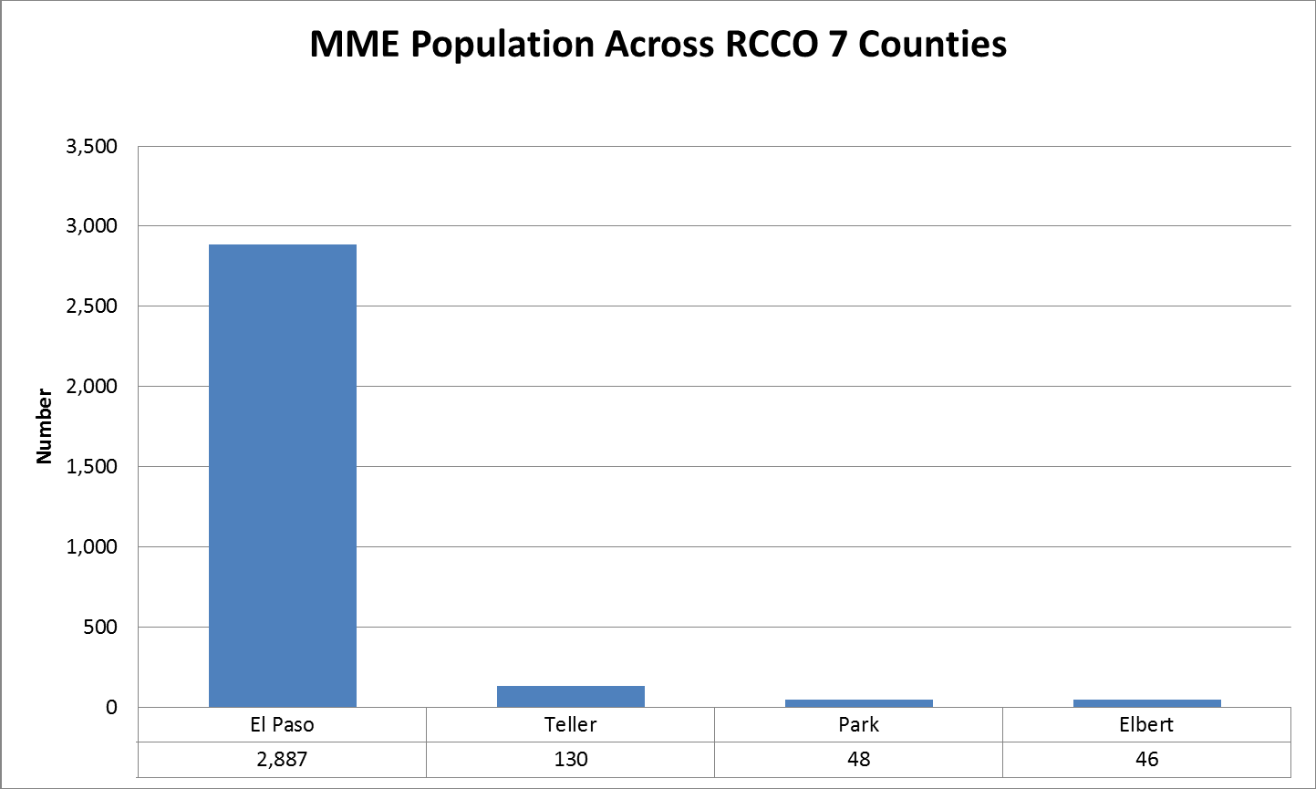
Demographics

Slide 23
MMP Care Coordination Partnerships
Developmental Disabilities Health Center—PVCHC and TRE
SCP Completion
Advanced Illness Counseling
Recuperative Care for Homeless/At-Risk
The Independence Center

Slide 24
Thank you
Jenny Nate
Rocky Mountain Health Plans (RCCO 1)
720-934-4293/Jenny.Nate@rmhpcommunity.org
Lori Roberts
Integrated Community Health Partners (RCCO 4)
719-244-9721/Lora.Roberts@valueoptions.com
Kelley Vivian
Community Care of Central Colorado (RCCO 7)
719-632-5094/Kelley@ppchp.org

