Slide 1
Shaping policy • Sharing solutions • Strengthening communities

Slide 2
Federal Update June 2015
Esmé Grant Grewal, Esq.
ANCOR Senior Director of Government Relations
egrant@ancor.org

Slide 3
AGENDA
About ANCOR and GR Department
What’s Happening in DC?
Executive – Obama Administration
President’s FY16 Budget
Regulatory
DOL and DOE: WIOA, FLSA
HHS/CMS: HCBS, Managed Care
Legislative - Congress
Congressional FY16 Budget
Proposed Legislation: Grassley Demo, CIA, DSP, Min Wage, SSDI
Caucus Work: Assisting Caregivers Today (ACT)
Judicial – U.S. Supreme and Federal Courts
USSC: Rate Setting
Federal: Companionship Exemption
Olmstead

Slide 4
ANCOR is… A national nonprofit trade association advocating and supporting
Over 880 private providers of services and supports to
Over 500,000 people with disabilities and their families
And employing a workforce of over 400,000 direct support professionals (DSPs) and other staff

Slide 5
Government Relations and Federal Representation
We are your voice in Washington!
We directly lobby key policymakers, including key House and Senate committee leaders
We have formed and maintain good working relationships with HHS/CMS, DOL, HUD and other Federal agencies
We work closely with other national disability organizations to collaborate on policy and advance common goals
We provide advocacy training and tools to empower our members to effectively engage at all levels of government
We sponsor Hill days and DSPs to DC

Slide 6
2015 ANCOR Government Relations Priorities
REFORM SERVICE SYSTEM: Advance rational, sustainable service system reform
EXPAND COMMUNITY SERVICES: Expand options for HCBS Medicaid funding opportunities
ADVANCE TECHNOLOGY SOLUTIONS: Advance innovative technologies
PROTECT AND PROMOTE QUALITY OF SERVICE: Protect and promote quality services
INCREASE HOUSING OPTIONS: Protect and increase policies to ensure an array of safe, affordable, stable, and accessible housing options for people with disabilities

Slide 7
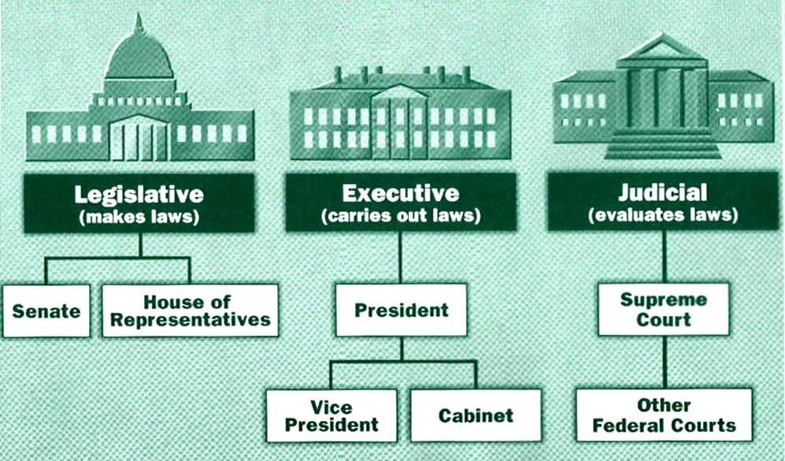

Slide 8
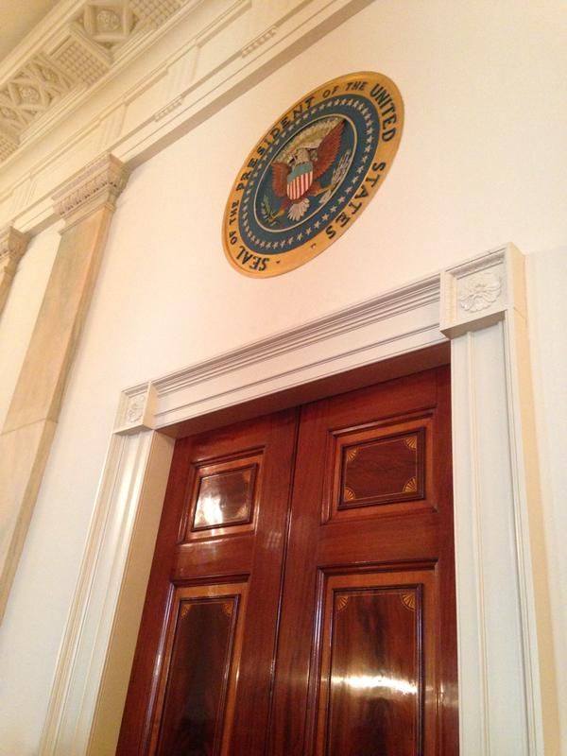
Executive Branch

Slide 9
President’s FY16 Budget
Highlights
HHS: $356.8 billion in grants to states for Medicaid, (increase of $18.7 billion) and $4.3 million, (increase of $2.8 million) to assist with CMS implementation, education, and technical assistance around the new HCBS rule
DOL: $9 million for the Disability Employment Initiative and $38 million for the Office of Disability Employment Policy to increase the number of quality of employment opportunities for people with disabilities and $2 billion allocated towards the Apprenticeship Training Fund (the DSP Registered Apprenticeship Program was approved by DOL in 2010)
HUD: $177 million to continue current assistance through Section 811 Supportive Housing for Persons with Disabilities project rental assistance program (increase of $25 million to fund 700 units of integrated, supportive housing)
SSA: The Budget proposes rebalancing of Social Security’s trust funds, to put both on sound footing until 2033 and avoid cuts to SSDI payouts in 2016

Slide 10
DOL and DOE: Workforce Innovation and Opportunity Act (WIOA) Proposed Regulations

Slide 11
WIOA Proposed Regulations
Five Notices of Proposed Rulemaking (NPRMs) were published in the Federal Register on April 16, 2015. Comments were due and submitted by ANCOR June 15, 2015.
Issuing Agency | Citation | Sections Impacted
Department of Labor & Department of Education | 2015-05528 | Unified and Combined State Plans, Performance Accountability, and the One-Stop System Joint Provision
Department of Labor | 2015-05530 | Titles I and II of WIOA
Department of Education | 2015-05535 | Miscellaneous Program Changes
Department of Education | 2015-05538 | State VR Services Program; State Supported Employment Services Program; Limitations on Use of Subminimum Wage
Department of Education | 2015-05540 | Adult Education and Family Literacy Act (AEFLA)

Slide 12
What’s in WIOA?
Signed into law on July 22, 2014
Contains strong presumption of non-sheltered employment
Requires appropriate youth transitioning services
Requires access to employment training and supports
Retains 14(c) special wage certificates, but requires additional review to ensure appropriateness
WIOA Advisory committee on competitive, integrated employment convened for the first time in January 2015

Slide 13
What’s in WIOA?
Requires states to reserve 15% of VR allotment to provide pre-employment transition services to students with disabilities.
Requires states to reserve 50% of their supported employment program allotment for the provision of supported employment services to youth with the most significant disabilities.
Section 511 (effective July 22, 2016) requires that transitioning youths and others have access to job training and other resources prior to moving to sheltered work. Once in sheltered work, the individual’s plan must be reviewed regularly and documentation made whether it remains an appropriate placement.

Slide 14
WIOA Proposed Regulations
Purpose and Goals of the Proposed Rules (2015-05530):
Foster regional collaboration by having local areas plan and coordinate service delivery within a region Emphasize the use of career pathways and sector partnerships to promote employment in in-demand industries and occupations
Promote work-based training by authorizing local areas to provide incumbent worker training and transitional jobs, increasing the reimbursement to employers for on-the-job training and customized training and by increasing linkages with Registered Apprentices Our comments:
Refocus the youth formula program to serve disconnected youth by requiring a minimum of 75 percent of funds to be used for out-of-school youth compared to 30 percent under WIA

Slide 15
WIOA Proposed Regulations
Purpose and Goals of the Proposed Rules (2015-05538):
Ensure that federal core program services are coordinated by requiring a single, 4-year Strategic State Plan for achieving the workforce goals of the State. States may include collaborative planning with other Federal education and training programs specified in WIOA (generally, the One-Stop partners that are in addition to the core programs) to develop Combined State plans;
Ensure that federal investments in programs are evidence-based, data-driven, and accountable to participants and taxpayers by establishing a common performance accountability system for the core programs, requiring other authorized programs to report on the common performance indicators, and providing easy-to-understand information to consumers and the public about training provider and program performance; and
Enhance services provided to all job seekers and employers through the American Job Center; providing for State-established certification to ensure high-quality American Job Centers; requiring partners to dedicate funding for allowable infrastructure and other shared costs; and promoting the development of integrated intake, case management, and reporting systems.

Slide 16
Summary of ANCOR Comments on WIOA Regulations
Mandatory inclusion of disability service providers, direct support professionals, and people with disabilities on local and state workforce boards
Continuation of efforts to improve disability access of One Stop shops
Increased focus of Rehab Act of 1973 in state workforce programs
Inclusion of tracking of DSP turnover and wages in labor market data required for collection by states
Mandated attention on training/retention programs for DSPs
Inclusion of services for individuals with significant I/DD in all WIOA programs

Slide 17
WIOA Advisory Committee Testimony
Advisory Committee on Increasing Competitive
Integrated Employment for Individuals with Disabilities
Themes of ANCOR Testimony
Emphasize expertise of membership
Support transition but with focus on realistic outcomes
Include provider perspective
Address issues of direct support professionals role in job support
Support technology recommendations

Slide 18
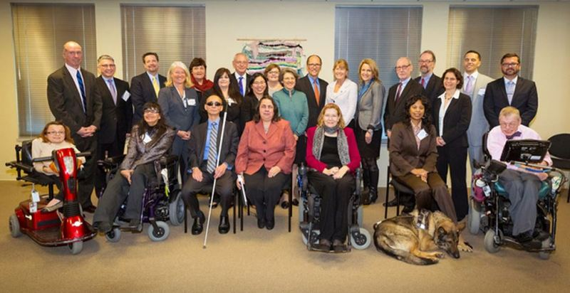
WIOA Advisory Committee

Slide 19
Department of Labor: FLSA
Companionship Exemption
Overtime Rules
14c certificates
Independent Contractor

Slide 20
Department of Health & Human Services CMS HCBS Settings Rule

Slide 21
CMS: Home and Community-Based Settings Rule
Major Provisions
Released 1/10/2014, effective date of 3/17/2014, compliance date 2019.
Defines and describes HCB settings under section 1915(c) waivers and section 1915(i)/1915(k) state plan options.
Sets forth requirements for person-centered planning process and person-centered service plan.
Lays out transition timeframe and requirements.

Slide 22
CMS: Home and Community-Based Settings Rule
Settings Requirements
All HCBS settings must:
Be integrated in the community
Be selected by the individual among setting options
Respect privacy rights
Ensure coercion and restraint are not used
Optimize independence and autonomy
If provider-controlled, residential settings also:
Written lease or residency agreement
Additional privacy requirements (door locks, roommates, decorating)
Individual control of schedules, access to food, and visitors
Must be physically accessible
Modification only with specific assessed need justified in person-centered plan

Slide 23
CMS: Home and Community-Based Services Rule
Non-Residential/Day Settings
The same criteria for residential HCBS settings apply
Most recent guidance out of CMS focuses on outcomes and the nature and quality of individuals’ experiences
Individuals must have opportunities to seek competitive, integrated employment
Must have options available that are non disability-specific
HCBS funding for non-residential and other day programs is available
ONLY to individuals that reside in settings that are compliant with
the rule’s residential requirements
States have until 2019 to fully transition all HCBS settings

Slide 24
Person-Centered Planning Process
CMS: Home and Community-Based Settings Rule
The State must develop a written service plan jointly with the individual using a process driven by the individual. The process must:
Be person-centered

Slide 25
CMS: Home and Community-Based Settings Rule
Transition Plans and Guidance
All states that operate HCBS under 1915(c) or 1915(i) should have submitted statewide transition plan by 3/17/15 (or sooner, as required).
Initial guidance focused on residential settings, including settings that tend to isolate.
Guidance issued in December on non-residential settings.
CMS has now issued review standards.

Slide 26
CMS: Home and Community-Based Settings Rule
5 Steps for Transition Plan
Assessing Current Services & Settings
Step 1: Settings that are NOT HCBS
Step 2: Settings PRESUMED not to be HCBS
Step 3: Determine if state’s services meet person-centered planning requirements
Step 4: Determine if state’s settings/services meet new regulatory requirements for HCBS
Step 5: Determine if the state’s provider owned/controlled settings meet the new regulatory requirements for HCBS

Slide 27
CMS: Home and Community-Based Settings Rule
STEP 1: Determine if the state has appropriately identified settings that are NOT a home and community-based as determined by the HCBS rule
Is the setting
A nursing facility
An institution for mental disease
An intermediate care facility for individuals with I/DD
A hospital
Finding: The rule prohibits 1915(c), 1915(i), and 1915(k) funding from going to any of the above settings

Slide 28
CMS: Home and Community-Based Settings Rule
STEP 2: Determine if the state has appropriately identified settings that are PRESUMED to have the qualities of an institution and are not home and community-based
Does the setting:
Have the effect of isolating individuals with disabilities
Put individuals receiving Medicaid in further isolation than those who do not receive it
Qualify as a farmstead, gated community, or disability-specific residential school?
Operate in abuilding that also provides inpatient institutional treament?
Finding: A presumption of an institutional setting has to overcome heightened scruitiny by the Secretary of HHS in order to receive 1915c, 1915i, or 1915k funding

Slide 29
CMS: Home and Community-Based Services Rule
STEP 3: Determine if the state’s services are administered in accordance with the new HCBS rule requirements for the person-centered planning process (also called plan of care)
Note: Important update from CMS
Considerations include:
Process is in language easily understood by individual
Provides necessary information and support to ensure individual can make their own choices
Includes people chosen by the individual to be there
Offers a method for the individual to request updates to the plan as needed
Records the alternative HCBS settings considered by the individual
Finding: If weaknesses in the process, state should propose improvements in the transition plan

Slide 30
CMS: Home and Community-Based Settings Rule
STEP 4: Determine if the state’s settings and services meets the new regulatory requirements for HCBS
Considerations include:
Does the individual come and go at anytime?
Can the individual eat whenever they choose?
Does the individual decorate their own room?
Does the individual have choice of roommate and options regarding where to live and receive services?
Does the individual participate in meaningful non-work activities in an integrated setting?
Finding: If NO to any of the above questions, the state’s transition plan needs to propose improvements or changes and timelines.

Slide 31
CMS: Home and Community-Based Settings Rule
STEP 5: Determine if the state’s provider owned or controlled settings meet the new regulatory requirements for HCBS
Considerations include:
Does the individual have a lease or a written tenancy agreement?
Does the individual have a private cell phone, computer, or other personal communication device?
Is privacy afforded to the individual (no camera in dressing areas, staff knocks before entering, lock on bedroom doors)
Do individuals have visitors of their choice and come and go as they wish?
Finding: If NO to any of the above questions, the state’s transition plan needs to propose improvements or changes and timelines.

Slide 32
CMS: Home and Community-Based Services Rule
What We Know Now
•All but 3 states have now submitted their state transition plans
•The Administration on Community Living and Department of Justice have joined CMS in their review of the plans (and NORC)
•Most state transition plans submitted are "plans to plan" that indicate a time frame and process for assessment for the future. NONE of the statewide transition plans have yet been approved, but we will likely begin to see approvals in June
•CMS is still aiming for states to reach compliance in 2019. Once state transition plans are approved, CMS will move into framing state-specific plans for ongoing monitoring and oversight
•CMS is getting close to issuing their guidance on how they will apply the "heightened scrutiny process" - only a few states have mentioned the process or identified the need for the process in their plans (AK, ME, SD, WA, ND - only ND and WA submitted evidence to overcome it)

Slide 33
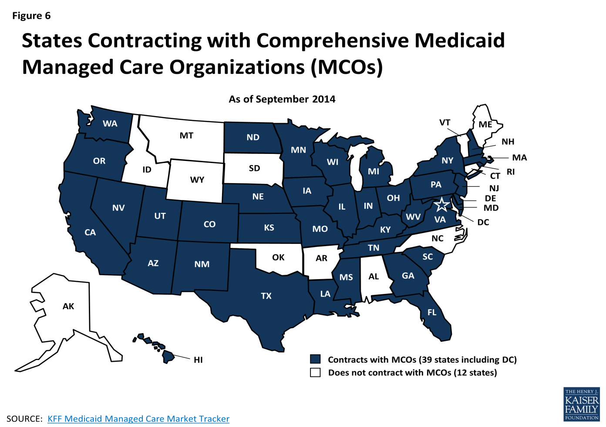
Managed Care

Slide 34
HHS/CMS: Managed Care
On June 1, 2015, the Centers for Medicare and Medicaid Services (CMS) published a new notice of proposed rulemaking (NPRM) (RIN 0938–AS25) in the Federal Register that makes changes to the regulations governing managed care programs under Medicaid.
According to CMS, there has not been a major update to Medicaid or the Children's Health Insurance Program (CHIP) for over a decade, and the current regulations require modernization given the increased use and expansion of managed care programs within Medicaid.
Public comments on the NPRM are due on July 27, 2015. ANCOR will submit comments with input from members.
The proposed rule is 80 Fed. Reg. 31097a and is available at http://www.gpo.gov/fdsys/pkg/FR-2015-06-01/pdf/2015-12965.pdf.

Slide 35
HHS/CMS: Managed Care Proposed Rule
Specifically, the proposed regulation seeks to:
Ensure that states engage in a thoughtful and deliberative state planning process, including standards for the state’s readiness reviews of managed care plans and specific information to beneficiaries being transitioned from fee-for-service to managed care;
Create a structure to engage stakeholders regularly in the ongoing monitoring and oversight of the MLTSS program;
Provide that MLTSS programs are consistent with federal laws, including the Americans with Disabilities Act (ADA) and Olmstead
Encourage payment methodologies that will support the goals of MLTSS programs to improve the health of populations, support the beneficiary’s experience of care, support community integration of enrollees, and control costs;

Slide 36
HHS/CMS: Managed Care Proposed Rule
Provide support, education, and a central contact for complaints or concerns for beneficiaries, including assistance with enrollment, disenrollment, and the appeals process;
Establish standards for coordination and referral by the managed care plan when services are divided between contracts or delivery systems to ensure that the beneficiary’s service plan is comprehensive;
Set standards to evaluate the adequacy of the network for MLTSS programs, the qualifications and credentialing of providers, and the accessibility of providers to meet the needs of MLTSS enrollees;
Prevent, detect, and report critical incidents that adversely impact enrollee health and welfare; and
Incorporate MLTSS -specific elements into the state’s comprehensive quality strategy.

Slide 37
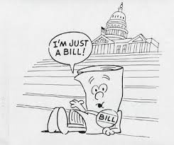
Legislative
Branch

Slide 38
Overview of Congress in 114th
The House of Representatives has 245 Republicans (including one Delegate), 193 Democrats (including four Delegates and the Resident Commissioner of Puerto Rico), and three vacancies (IL, NY, MS)
The Senate has 54 Republicans, 44 Democrats, and 2 Independents, who both caucus with the Democrats
The average age of Members of the House at the beginning of the 114th Congress was 57 years; of Senators, 61 years

Slide 40
Key Committees
SENATE
Appropriations
Finance
Health, Education, Labor & Pensions (HELP)
HOUSE
Appropriations
Energy & Commerce
Ways & Means
Education & the Workforce

Slide 41
Senate Finance Committee Members
REPUBLICAN DEMOCRAT
Orrin Hatch (UT), Chairman Ron Wyden (OR), Ranking
Chuck Grassley (IA) Chuck Schumer (NY)
Mike Crapo (ID) Debbie Stabenow (MI)
Pat Roberts (KS) Maria Cantwell (WA)
Mike Enzi (WY) Bill Nelson (FL)
John Cornyn (TX) Bob Menendez (NJ)
John Thune (SD) Tom Carper (DE)
Richard Burr (NC) Ben Cardin (MD)
Johnny Isakson (GA) Sherrod Brown (OH)
Rob Portman (OH) Michael Bennet (CO)
Pat Toomey (PA) Bob Casey (PA)
Dan Coats (IN) Mark Warner (VA)
Dean Heller (NV)
Tim Scott (SC)

Slide 42
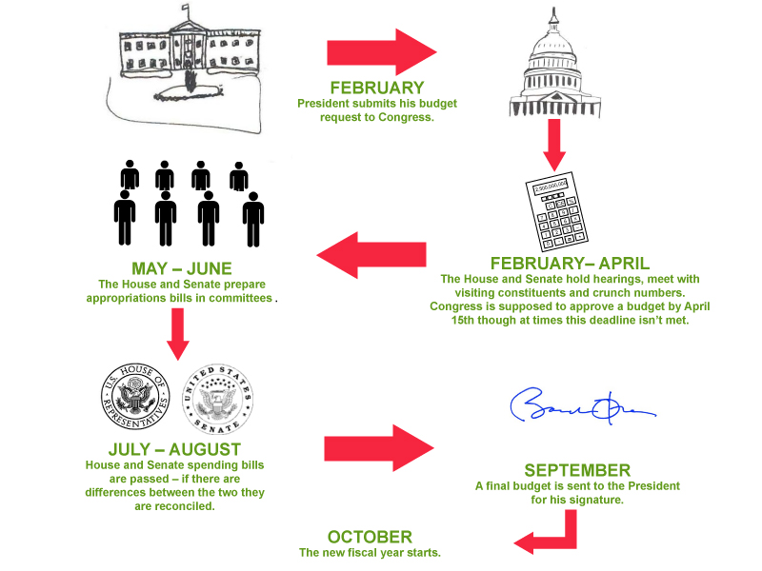

Slide 43
Budget
House and Senate Concurrent Budget Resolution
Revealed April 30, passed by House and Senate with simple majority
Require that the House Energy and Commerce Committee and the Senate Finance Committee find at least $1 billion in savings in programs under their jurisdiction (reconciliation)
The numbers on Medicaid: Takes growth of 6.3% in 2006-2015 183 billion to 355 billion to a reduced growth of 5.8% over the next ten years with 360 billion for FY16 and ending with 588 billion in 2025.
References block grants and per capita caps
“ State flexibility” and “State innovation” = block grants
“Stable and predictable funding” = per capita caps

Slide 44
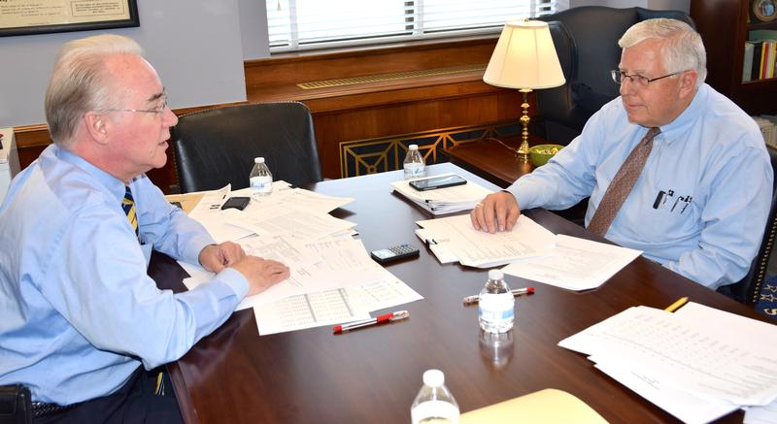
Budget Language on Medicaid Reform
Reform should return authority to States wherever possible to make the system more responsive to patients and their needs. Instead of tying States’ hands with Federal requirements for their Medicaid programs, the Federal Government should return control of this program to the States. Not only does the current Medicaid program drive up Federal debt and threaten to bankrupt State budgets, but States are better positioned to provide quality, affordable care to those who are eligible for the program and to track down and weed out waste, fraud and abuse.

Slide 45
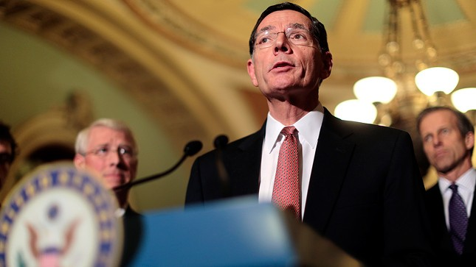
Budget and the ACA
Quick note on ACA and King v. Burwell
Congress would like to use “reconciliation” during budget process to overturn the Affordable Care Act by simply majority vote if possible, however they are also waiting to see what happens with Supreme Court decision on King v. Burwell.
Issue of King v. Burwell: Whether the Internal Revenue Service may permissibly promulgate regulations to extend tax-credit subsidies to coverage purchased through exchanges established by the federal government under Section 1321 of the Patient Protection and Affordable Care Act. (Impacts 34 states with no state exchange)
GOP has released several proposals to address an overturned ACA which include temporary relief to those that would lose subsidies. Democrats have offered fixes to the law itself to fix the text.

Slide 46
Grassley Medicaid Demo Proposal
Senator Grassley (R-IA) is introducing legislation that would offer a Medicaid demo to 10 Medicaid Buy-In states who would receive bonus federal payments for achieving benchmarks and achievements in placement of integrated employment.
The bill will:
Include a requirement of stakeholder advisory committee to include people with disabilities and providers
Encourage and promote interagency collaboration of VR, education, and Medicaid programs within a state
Create a benchmark for states to create a utilization goal of 7% of the state workforce as people with disabilities
Encourages states to increase Medicaid payments for support employment providers to ensure an adequately supported employment network

Slide 47
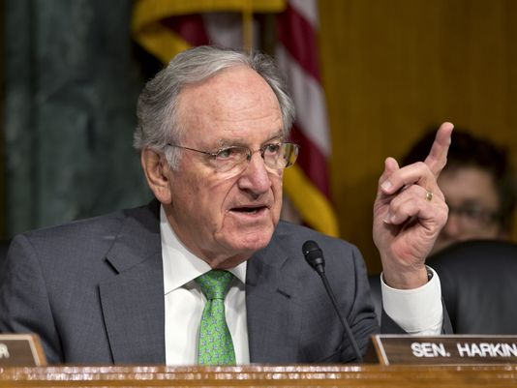
Community Integration Act
Eliminate the Nursing Home Bias in Medicaid by clearly allowing the provision of similar care or services in home and community based settings.
Prohibit states from making anyone ineligible for HCBS based on a particular disability.
Require states that have found an individual to be eligible for nursing or institutional care to similarly find those same individuals to be eligible for care in home and community-based settings.
Set clear requirements for states regarding the provision of services in home and community based settings.
Require annual reporting by states about the number of individuals with disabilities in institutional settings and the number that have been transitioned to home- and community-based settings
To be introduced again this year

Slide 48
DSP Recognition Week Senate Resolution
Background/Talking Points (for Senate Only)
DSP Recognition Week for 2015 will be September 13 - 19
As in years past, we are working to get as many co-sponsors as possible. Senators Susan Collins (R-ME) and Ben Cardin (D-MD) will be the lead co-sponsors
Ask your Senator to sign on as a co-sponsor of DSP Recognition Week 2015!
Photo credit: Dungarvin

Slide 49
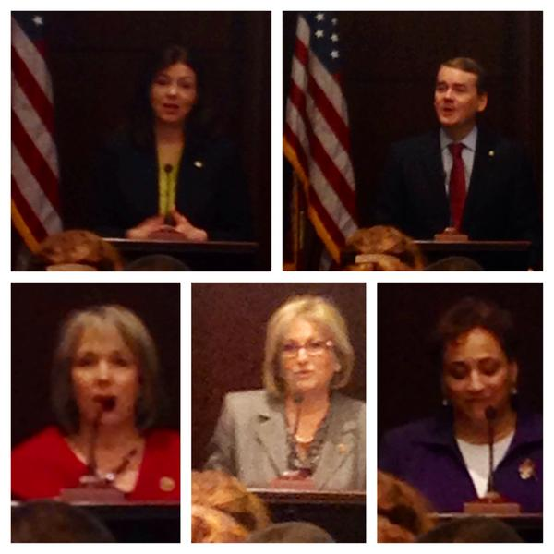
Assisting Caregivers Today Caucus
Congressional Leads
Senator Ayotte (R-NH)
Senator Bennet (D-CO)
Rep. Lujan Grisham (D-DM)
Rep. Black (R-TN)

Slide 50
Minimum Wage
In February 2014, President Obama signed Executive Order increasing minimum wage for federal contractors to $10.10/hr.
38 states introduced minimum wage bills during the 2014 session; 34 states considered increases to the state minimum wage.
11 states enacted increases in 2014.
In 2015, Senator Patty Murray (D-WA) and Congressman Robert C. “Bobby” Scott (D-VA) introduced the Raise the Wage Act, legislation that would increase the minimum wage to $12 by 2020

Slide 51
Social Security Disability Insurance
SSDI pays modest benefits, averaging just $1,140 per month, less than most workers make before they qualify for the program
For 80% of beneficiaries, SSDI is the primary or only source of income
Without reallocation or other solution , after 2016 beneficiaries can expect a 20% reduction in benefits
ANCOR has been asked to weigh in on SSDI proposals in Congress

Slide 52
Judicial
Branch

Slide 53
Armstrong v. Exceptional Child, Inc.
Facts: Idaho’s state legislature passed a law requiring a new rate methodology and it was approved by CMS but the new rates were never implemented because the state failed to appropriate sufficient funding. Idaho providers sued wanting the federal courts to rule that Idaho’s failure to implement the new rates violates the equal access provision of the federal Medicaid Act.
Decision: The majority opinion was written by Justice Scalia. Chief Justice Roberts, Justice Thomas, and Justice Alito concurred in the entire opinion. Justice Breyer concurred in the result and in parts one through three of the majority opinion. The decision ultimately advised providers (and, by implication, beneficiaries as well) to turn to HHS, not the courts, for help in requiring that states live up to the minimum legal terms of the Medicaid statute.

Slide 54
Armstrong v. Exceptional Child, Inc.
NEXT STEPS
Options moving forward
Engage HHS on updating and changes rules/policies
Work with Congress to create private right of action
Assess state laws and regs that may permit Medicaid rate suits
Work with stakeholders to consider litigation against HHS
Note: Provider tax has come up in discussions!
Letter from CMS (Vikki Wachino) to Florida Medicaid Director on Low Income Pool:
“Provider payment rates must be sufficient to promote provider participation and access, and should support plans in managing and coordinating care”

Slide 55
Armstrong v. Exceptional Child, Inc.
Latest letter April 28 from America’s Essential Hospitals to CMS requesting following action:
Revise and finalize the proposed equal access rule in a manner that will enforce the requirement that the states pay rates that provide Medicaid beneficiaries with access to care that is at least equal to that of the general population
Vigorously exercise its authority and responsibility as the sole arbiter of the quality and access as well as efficiency and economy to review and disapprove rates that are insufficient to meet the statutory standard
Allow stakeholders to have meaningful and direct input into CMS’ review of state rate proposals
Eliminate the regulatory prohibition on direct payments to providers for services provided through Medicaid managed care.

Slide 56
Armstrong v. Exceptional Child, Inc.
Latest letter April 28 from America’s Essential Hospitals to CMS requesting following action:
Permit states to offer direct support for uncompensated care incurred by essential provides through Section 1115 waivers
Recognize the legitimacy and historical basis for the use of local funding sources in the Medicaid Program and do not disfavor payments based on the source of nonfederal share.
Continue to support the development of Delivery System Reform Incentive Payments (DSRIPs) through Section 1115
Reject attempts to use DSRIPs as a replacement for supplemental payments for services (including uncompensated payments)

Slide 57
Department of Labor: Home Care Rule
Final rule issued September 17, 2013
Effective date January 1, 2015 (Federal enforcement delayed)
Narrows use of companionship exemption under the Fair Labor Standards Act
Imposes new recordkeeping requirements on employers
Clarifies circumstances that create employment relationships
DOL Home Care Rule: http://www.dol.gov/whd/homecare/

Slide 58
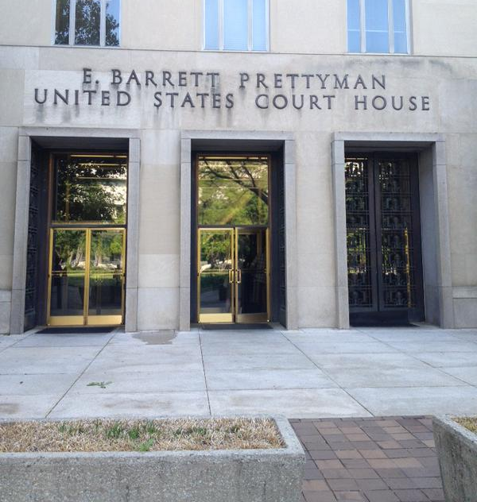
Department of Labor: Home Care Rule
Home Care Association of America v. Weil
U.S. District Court for D.C. struck down third-party prohibition for companionship in a ruling on December 22, 2014
The court vacated the narrowed definition of “companionship services” in a second ruling on January 14, 2015
DOL has appealed the case and we now await the final decision…

Slide 59
Olmstead
June 22, 1999
Under the Americans with Disabilities Act of 1990, states must provide community-based treatment to persons with intellectual and developmental disabilities when
such services are deemed appropriate;
(2) the affected persons do not oppose community-based treatment; and
(3) community-based treatment can be reasonably accommodated, taking into account the resources available to the state and the needs of others with intellectual and developmental disabilities;

Slide 60
AMPLIFY Resources
Make sure to bookmark amplifier.ancor.org for quick access to all of this year’s information sheets, talking points, Hill training videos and leave behinds.
LOOK FOR ACTION ALERT IN JULY FOR PROTECTING MEDICAID DOLLARS IN CONGRESSIONAL BUDGET PROCESS

Slide 61
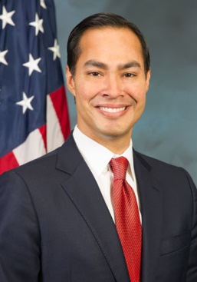
Mark your calendar!
Washington, DC
Invited Speakers Include:

Slide 62
ANCOR Government Relations Team
Esmé Grant Grewal, Esq.
Senior Director of Government Relations
egrant@ancor.org
(703) 535-7850, ext. 105
Katherine Berland, Esq.
Director of Public Policy
kberland@ancor.org
(703) 535-7850, ext. 104

