Slide 1
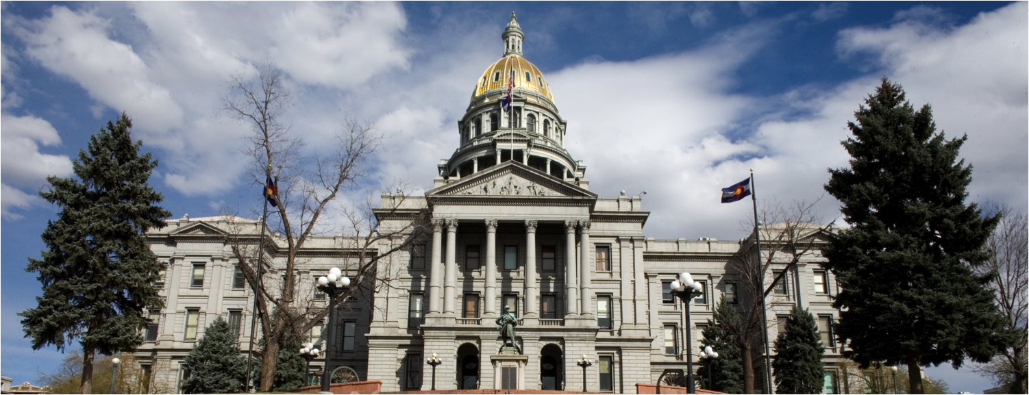
2014 Session In Review

Slide 2
A Colorado Budget Overview
2014

Slide 3
Colorado General Fund Revenue Breakdown

Slide 4
Budget Overview
The Colorado economy is still strong and is expected to grow even stronger in 2015.
Colorado now has a 6.5% Reserve ($431.7 million)
OSPB FY15-16 GF Estimate: $7, 823.8 million
In excess of the GF Reserve: $1.041 billion
Leg Council FY 15-16 GF Estimate: $7,906.5 million
In excess of the GF Reserve: $1.390 billion
Taken from the OSPB and Leg Council’s March Revenue Forecast
Some of these estimates have changed now that the FY2014-15 Long Bill is law

Slide 5
CO Budget Cycle
Notes:
Colorado’s Fiscal Year starts July 1st, and so does it’s budget cycle. Understanding the Colorado budgeting process can give you an advantage when attempting to secure state funds or make policy changes at the state level. Here is a quick overview of the process:
July 1st: The governor’s departments begin to review any changes they would like to make to the budget. They can propose new initiates or change old ones. All of these requests will be sent to the governor's Office of State Planning and Budgeting (OSPB) at the Capitol.
September 1st: all department requests are due and OSPB staff will create a budget request on behalf of the governor.
November 1st: The governor submits his request to the JBC and the legislature.
November- December: The JBC holds staff briefings and department hearings to examine every budget request from the governor.
In January, the 120 day legislative session begins. The legislature holds hearings called “Supplemental Hearings” to make sure the budget is still balanced. Sometimes amendments to the current year’s budget are required to keep the budget in balance.
February and March: The JBC builds the budget through a process called “Figure Setting.” At this time the JBC can chose to use all or part of the governor’s request or they can start over with a new budget.
Finally in March and April, the General Assembly drafts and amends the Long Bill, holds public hearings and committee debates, passes the Long Bill and sends it to the governor for his signature.
(Ziegler, 2013)

Slide 6
Alliance Successes at the legislature
2014

Slide 7
IDD Long Bill Increases
Provider rate increase: The bill provides: funding for a 2.5 percent increase in rates paid to providers that receive payments through the intellectual and developmental disabilities waiver programs ($15.5 million total)
Benefit changes:
IDD Supported living services - provides funding for 2,040 enrollments for individuals waiting for supported living services that become available as soon as possible.
Family support services - provides funding to double the amount of funds available to families for support services.

Slide 8
IDD Long Bill Increases
IDD Increase funded FPE – provides funding for the following:
55 comprehensive enrollments for youth who are turning 21 during FY 2014-15 to transition from the child welfare system to the comprehensive waiver;
40 comprehensive enrollments for adults who experience emergencies or crisis situations and require comprehensive services;
30 comprehensive enrollments to transition individuals who no longer require institutional level care from the Regional Centers and Mental Health Institutes;
61 supported living enrollments for youth turning 18 during FY 2014-15 who will transition from the children's extensive support services to adult supported living services.

Slide 9
IDD Bills
HB 1051: Dev. Disability Services Strategic Plan (PASSED)
requires HCPF by November 1, 2014, to develop a strategic plan to enroll eligible persons with IDD in home- and community-based programs, services, and supports.
HB 1338: (JBC bill) Regional Center Task Force (PASSED)
Requires a task force to study matters relating to the state’s regional centers for people with IDD.
1360: (Young/Aguilar) Home Care Sunset (PASSED)
Concerning regulations of home care agencies by CDPHE

Slide 10
Next Year’s Budget Priorities
Address Waitlists for Services
Create Viable Community Rate Structures
Annual Budget Requests:
Emergency Services
Early Intervention
Children Aging out of Foster Care
Children Aging Out of Children’s Extensive Support

Slide 11
Special Thanks
2014

Slide 12
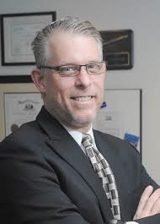
Thanks!!!
Everyone that laid the Foundation
Government Relations
A few Alliance Members to thank…
Leslie Rothman (Imagine!)
Jodie Walters (Imagine!)
David Ervin (The Resource Exchange)

Slide 13
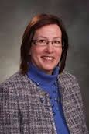
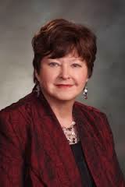
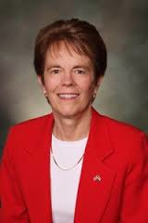
Legislators to Thank
Alliance Legislator of the Year Rep. May (D-Aurora)
Alliance Waitlist Champaign Rep. Landgraf (R- Fountain)
Alliance Waitlist Champaign
Rep. Shafer (D-Wheat Ridge)

Slide 14
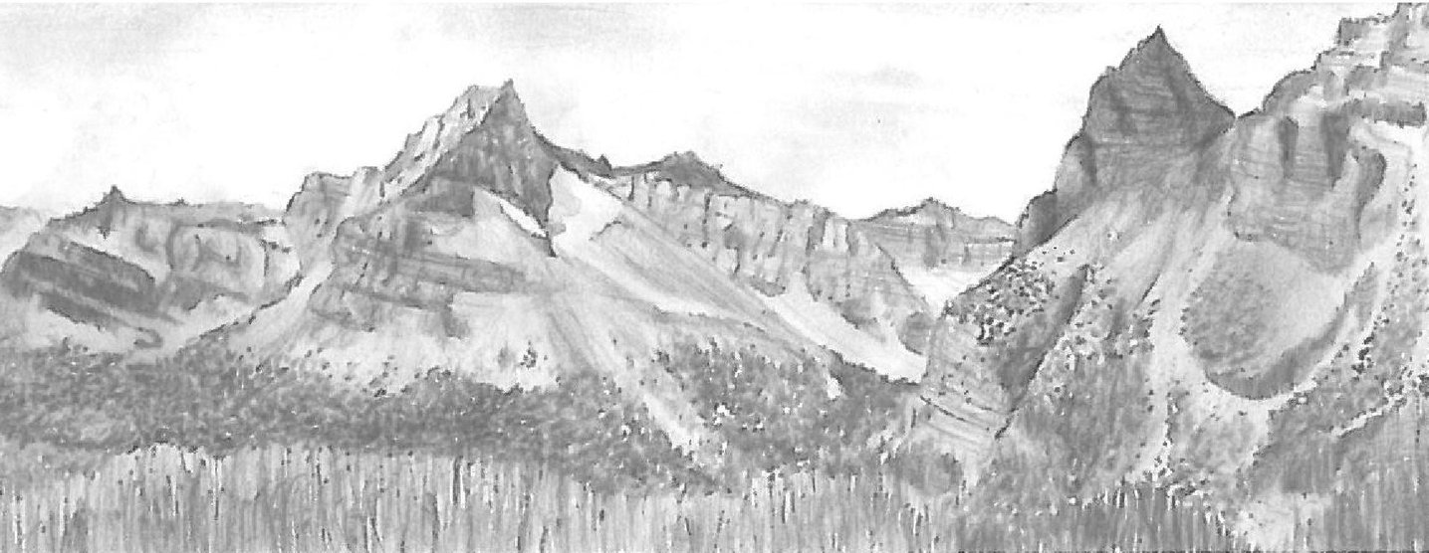
Political Landscape
What it looked like in 2014 and how it might change…

Slide 15
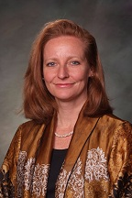
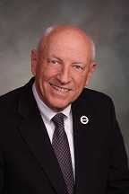
CO Senate Leadership
Majority Leader: Rollie Heath
(D- Boulder)
Minority Leader: Bill Cadman
(R- El Paso Co)
President of the Senate:
Morgan Carroll (D-Aurora)
Assist. Maj. Leader: Irene Aguilar
(D-Denver)
Assist Minority Leader: Senator Mark Scheffel
(R-Parker)
Majority Caucus Chair: Jeanne Nicholson
(D- Gilpin/Denver County)
President Pro Tem: Lucia Guzman (D-Denver)
Min. Rep Caucus Chair: Scott Renfroe (R- Weld Co)

Slide 16
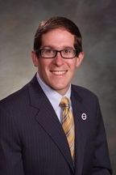
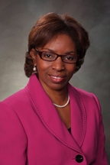
CO House Leadership
Majority Leader: Dickey Lee Hullinghorst
(D-Boulder)
Minority Leader: Brian DelGrosso
(R- Loveland)
Speaker: Mark Ferrandino
(D-Denver)
Assist. Maj. Leader: Dan Pabon
(D-Denver)
Assist Min. Leader: Libby Szabo
(R-Arvada)
Majority Caucus Chair: Lois Court (D-Denver)
Speaker Pro Tem:
Rhonda Fields (D- Aurora)
Min. Caucus Chair: Kathleen Conti
(R-Littleton)

Slide 17
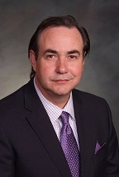
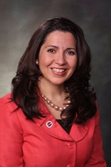
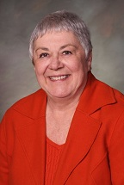
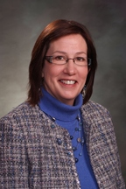
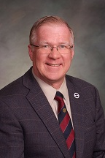
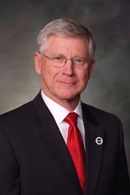
Joint Budget Committee -2014 4 Democrats – 2 Republicans
Senate
Vice-chair Sen. Steadman (D- Denver)
Sen. Hodge (She will likely leave to chair the agricultural committee)
(D-Brighton)
Sen. Lambert
(R- El Paso County)
House
Chair Rep. Duran (D-Denver)
Rep. May (D- Aurora)
NEW: Rep. Rankin
(R- Glenwood Springs)

Slide 18
A look ahead Election 2014…

Slide 19
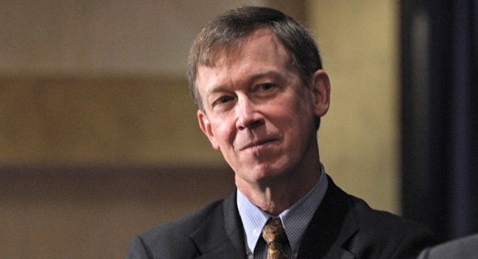
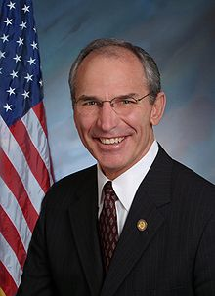
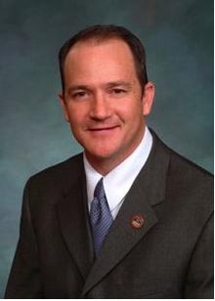
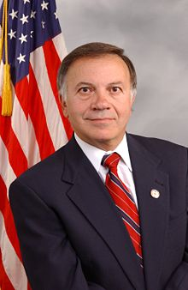
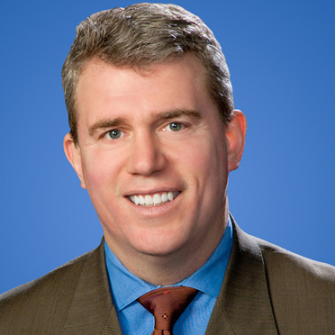
Governor’s Race 2014
Colorado Primary: June 24th
Governor Hickenlooper
(D-Denver)
Elected 2010
Rep. Bob Beauprez
(R- Former U.S. Rep)
Sen. Mike Kopp
(R- Former State Sen.)
Rep. Tom Tancredo
(R- Former U.S. Rep.)
Sec. Scott Gessler
(R-Secretary of State)

Slide 20
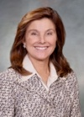
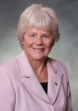
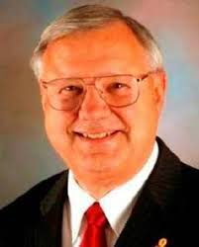
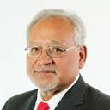
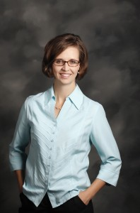
2014 Senate Races to Watch
SD 20: (Jahn-D) Wheatridge
Performance: .7 % Dem.
(Reg: 32.40D, 35.15R, 31.78U)
SD 5: (Schwartz- Term limited) Snowmass
Performance: 3.12 % Repb.
(Reg: 34.68D, 30.66R, 34.87U)
SD 24: (Tochtrop-D Term limited) Thornton
Performance: .94 % Dem.
(Reg: 34.27D, 31.06R, 34.01U)
SD 11: (Hurpin-R) CO Springs
Performance: 7.52 % Dem.
(Reg: 34.68D, 30.66R, 33.76U)
SD 22: (A.Kerr-D) Lakewood
Performance: 1.76 % Dem.
(Reg: 34.94D, 33.81R, 30.74U)
SD 3: (Rivera-R) Pueblo
(Reg: 49%D, 24%R, 25%U)
SD 16: (Nicholson-D) JeffCo/Gilpin/Clear Creek/Denver
Performance: 2.24 % Repb.
(Reg: 31.04D, 35.63R, 32.57U)
*SD 19: (Zeninger-D) Arvada
5 Vote democrat advantage
(Reg: 32%D, 33%R, 32%U)

Slide 21
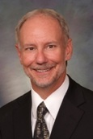
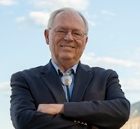
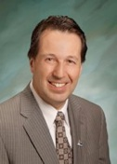
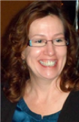
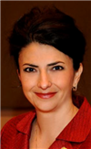
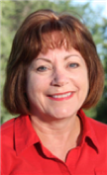
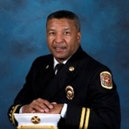
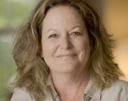
2014 House Races to Watch
HD50: (Young-D) Greeley
Performance: 1.64 % Dem.
(Reg: 31.28D, 32.05R, 35.84U)
HD59: (McLachlan-D) Durango
Performance: 3.78 % Repub.
(Reg: 32.40D, 35.15R, 31.78U)
HD3: (Kagan-D) Cherry Hills
Performance: .7 % Dem.
(Reg: 34.05D, 35.04R, 30.18U)
HD30: (May-D) Aurora
Performance: 4.02 % Dem.
(Reg: 37.96D, 27.91R, 33.36U)
HD47: (Navarro-R) Pueblo
Performance: 3.64 % Repub.
(Reg: 39.31D, 34.04R, 26.17U)
HD33 (Primivera-D) Broomfield
Performance: .7 % Dem.
(Reg: 32.40D, 35.15R, 31.78U)
HD17: (Exum-D) CO Springs
Performance: 3.72 % Repub.
(Reg: 34.37D, 31.79R, 26.17U)
HD29(Kraft-Tharp-D)Arvada
Performance: 4.98 % Dem.
(Reg: 34.47D, 31.08R, 33.70U)

