Slide 1

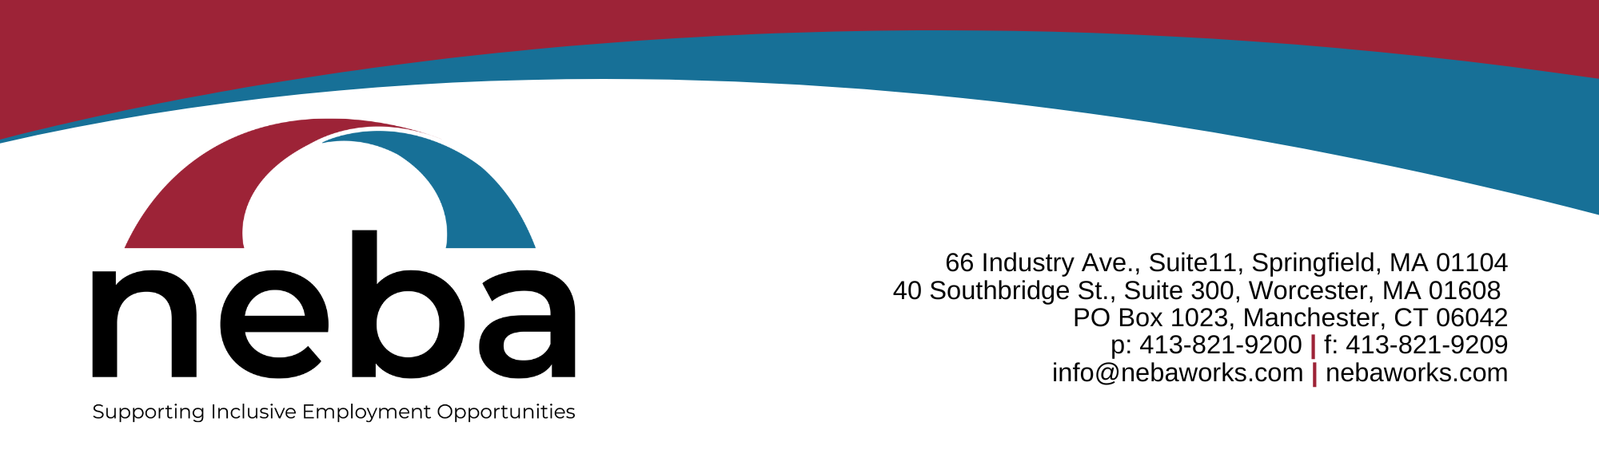
Meaningful Lives
How do we help people with I/DD to become active, contributing members of our communities?
Alliance Colorado – May 24,2023

Slide 2
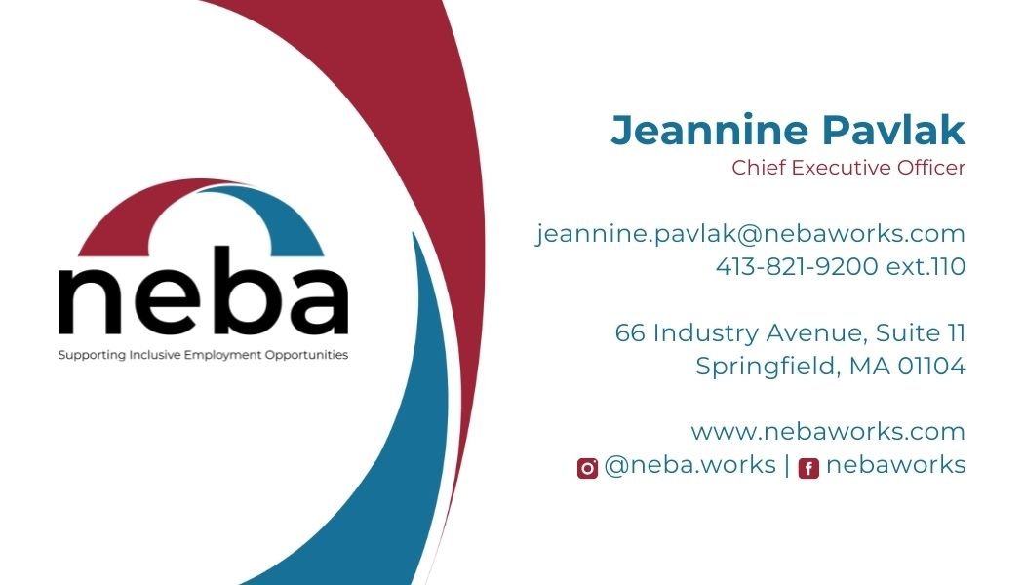
A good life can be described as a life that is self-satisfying and self-fulfilling. It is characterized by personal joy, fulfillment, and enjoyment of the small pleasures of life. When someone says their life is good, it means that they can access the basic things that give them comfort and pleasure

Slide 3

The Three Things
We All Need for a Happy Life
Someone to love
Something to do
Something to look forward to

Slide 4


What Makes Your Life
Feel Satisfying and Self-Fulfilling?

Slide 5

A Good Life Typically Includes:
A sense of purpose
A positive Social Role
Friends
Family
Intimate Relationships
Choice of where to live, what to do that is meaningful, and who to share time with
Opportunities for continual growth and exploration
A way to contribute

Slide 6
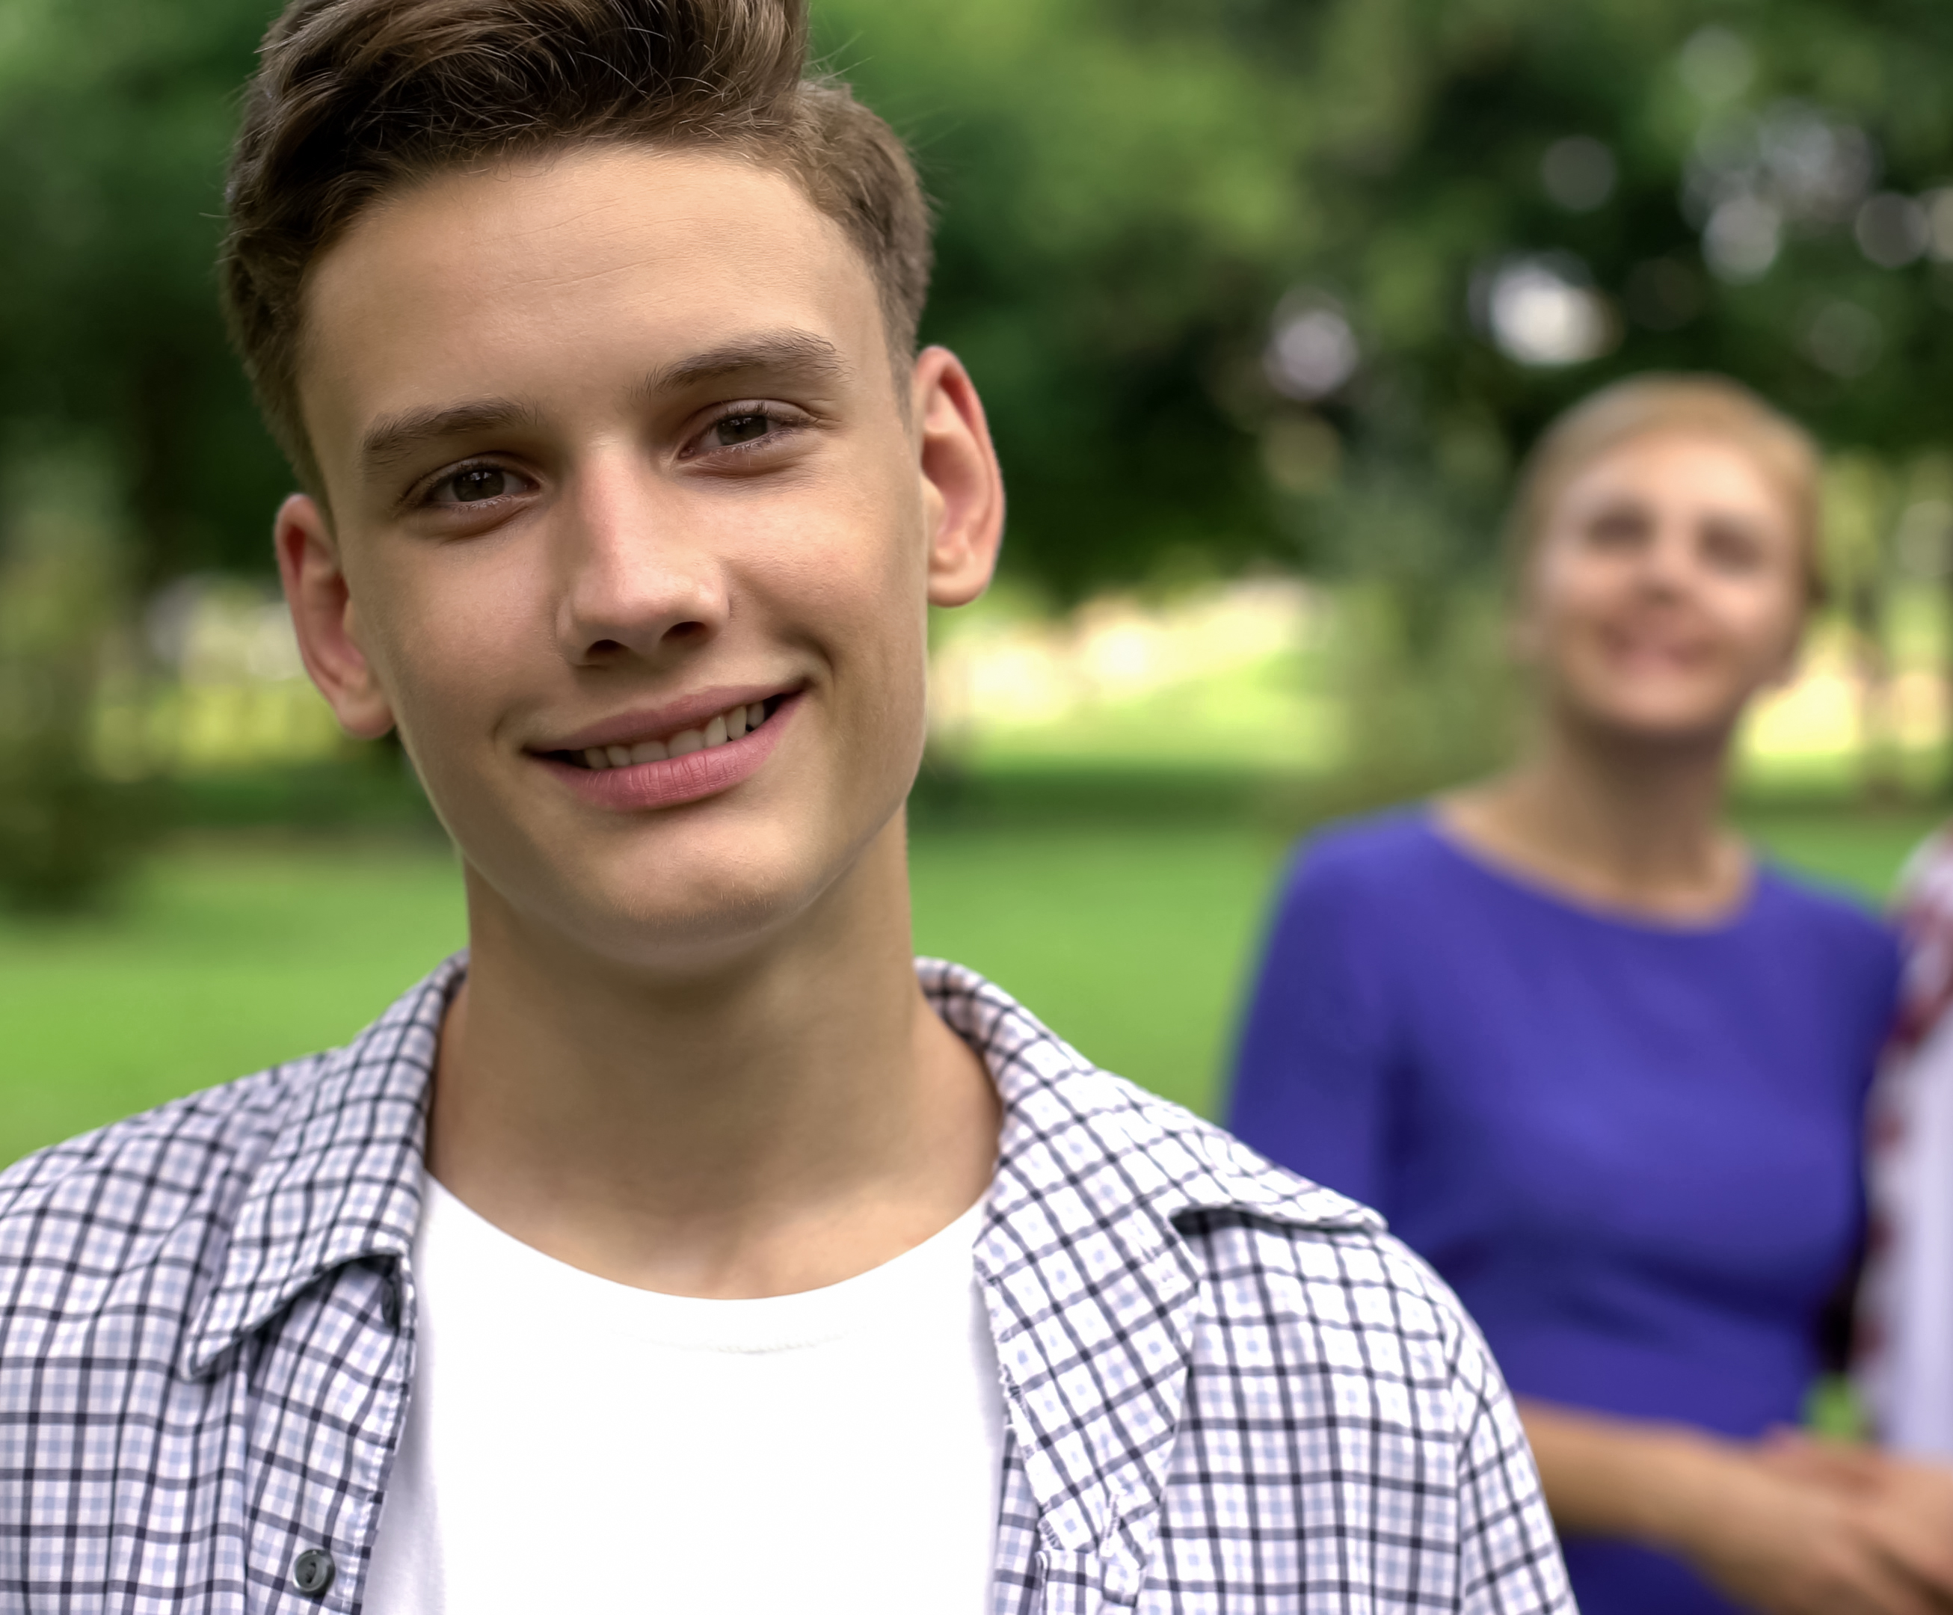

W
Dreams for the Future

Slide 7

Services and supports center around deficits – treatment, get fixed.
Risk management =
better safe then in a lawsuit.
No real choice – pick a service box.
Practice until perfect…

Slide 8
Our Disability Service System
Disjointed, compartmentalized programs;
Programs are built around funding, not people;
Referrals are made upon openings, vacancies;
Programs are funded based on attendance, not personal goals;
Programs/supports don’t encourage independence.

Slide 9
Decades in the Making
Olmstead Decision and Department of Justice Rulings
Home and Community Based Services Settings Rule
Employment First
Workforce Innovation and Opportunity Act (WIOA)
Personal experiences and outcomes

Slide 10
The New Regulatory Environment – Mandates and Opportunities
Employment Landscape is Changing
WIOA
CMS Final
Rule and Priorities
HCBS settings must be integrated in and support full access to greater community including opportunities to seek employment and work in competitive integrated settings
Funding mandates – 15% of VR Title I dollars for youth with disabilities
(OFCCP Section 503 Regulations) Federal Contractor Requirements
7% hiring goal for individuals with disabilities
Potential new HCBS funding opportunities to support employment outcomes
Restrictions on youth entry into non-integrated work settings
Definition of competitive integrated employment

Slide 11

For many disabled people, getting services or getting some kind of help often is only achieved by accepting that you’re going to be segregated away from ordinary communities. This is one of the worst features of the service system that disabled people have to put up with.
You can’t live a decent life inside a service. The good things of life don’t happen inside services. The good things in life happen in the community.” -Simon Duffy
This Photo by Unknown Author is licensed under CC BY

Slide 12
Time for a Change

Slide 13
“The only thing that stays the same is change”
– Sage Francis
Old Way (back pocket approach)
What we have to offer
What you will settle with
New Way (build your britches approach)
Start with the person using a strength-based approach
Enable them to be an agent of change in THEIR life
Identify areas of interest (through experience)
Using a team approach, expand the horizons of opportunity
Identify and plan towards overcoming barriers (action steps)
Involve the person in the process (pre/during/post/repeat)
Program vs People

Slide 14
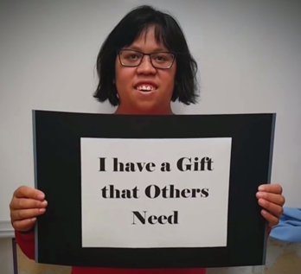
Valued Social Roles Matter
When people have valued social roles they have more opportunities to live “the good life.”
Normalization = authentic, typical life experiences in ordinary, typical places…not practice, simulations, or separate places.
Disability Systems have wounded people:
  Loss of individualism dealing with bureaucratic systems
  Inauthentic experiences and relationships
  Always helped, never a helper
  Loss of control over life’s choices
  Marginalization, separation and segregation
Takes a major systems change to support “the good life.”

Slide 15
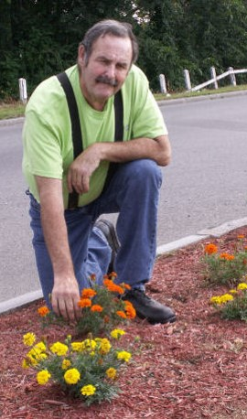
Person-centered, Person-driven
Built around the individual:
  What do they want to do/learn?
  What do they need to learn to be successful?
  Dreams and 3 yr.-goals- what is the plan to get there?
  Home-based, in my neighborhood

Slide 16
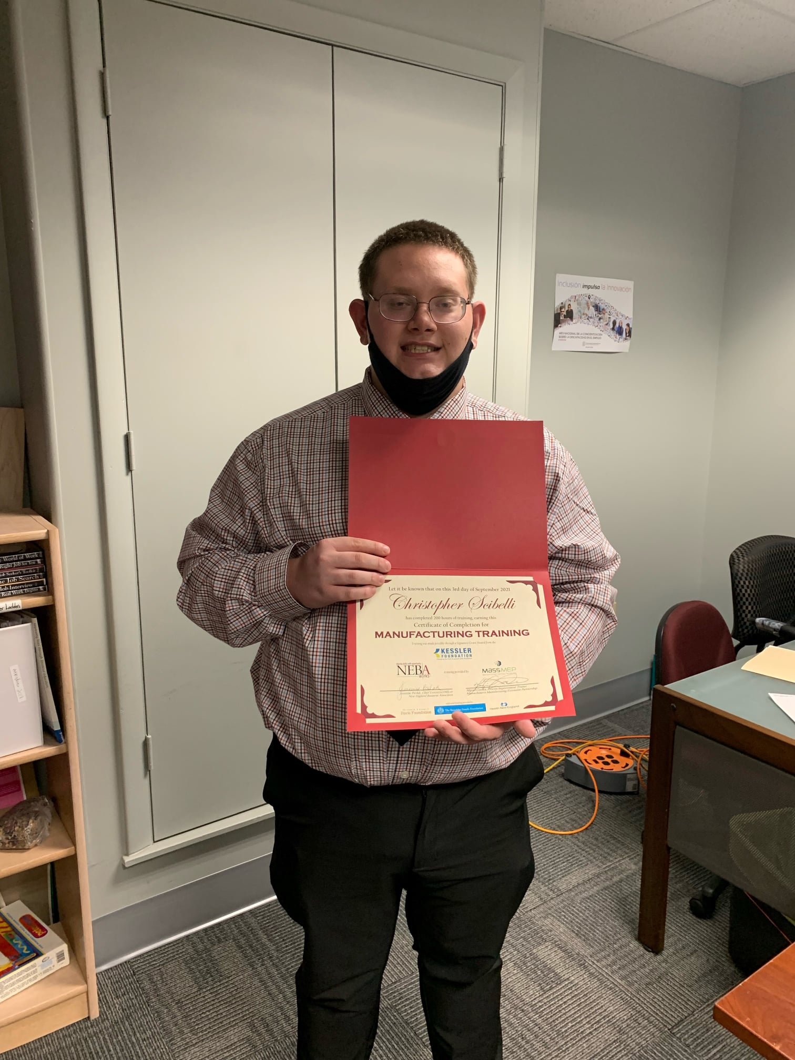
Strength-based profile building
Person-Centered approach
Draws from whole life experiences
Encourages positive input and participation from varying sources
Focuses on strengths, with consideration of support needs/strategies
Prepares people for portfolio building and resume development
Notes:
Kie
Two golden rules to profile building: ANYONE can add to it, NO ONE can remove information!

Slide 17

Changing How We Do Business
Aiming for 100% Community-Based
Finding what is meaningful: no programs, outings, “going into the community,” day wasting, or supported loitering
Guide on the side. Connector. Building services designed to fade - when and as much as possible as independence increases
Creating a pathways to employment by learning, exploring, connecting and contributing
Supporting more people, possibly for fewer hours each day, in a variety of ways - breaking the 9am to 3pm service mold
Impacts on residential services
Tapping into transportation options – bus and taxi training, ride share, walking and biking, community meeting up hubs, etc.
Notes:
Jeannine provide examples of how they do some of these things – conversations with residential providers (set aside roles and hours to work together to support people)

Slide 18
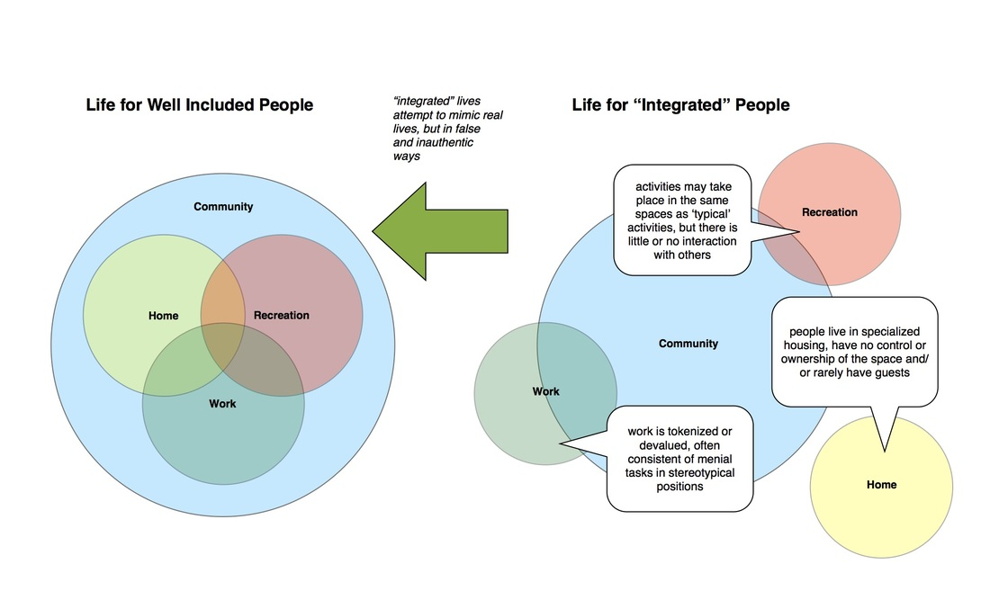
Graphic from: Steps Forward B.C. Initiative for Inclusive Access to Post Secondary Education
Notes:
Jeannine – examples of intentional changes to services to ensure people are well included in community life

Slide 19


Ambivalence is an opportunity.
Culture of low expectations
Deficit-based thinking
Limited life experiences
Fears
Exposure precedes interest. Interest precedes motivation.
Notes:
Told they can’t work, never asked or expected to. Acceptance, safety, fears of losing services - Jeannine add a story

Slide 20
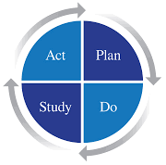
Where to Start?
Develop a Pilot
Identify interests (arts/crafts, fitness, politics, cooking, etc.)
Think in themes and explore: “Let’s find everything in our town about __________.”
Get to know your community/Public Works tour (Fire Dept, Police Dept, library, Job Center, Rec Center, Town Hall/Municipal building bus depot, museums, airport, powerplant, colleges)
Try Volunteer tasters
Take Business Tours
How to Get Involved in Your Community: https://www.youtube.com/watch?v=MtOXxlUE2Zg&t=1s
Notes:
Jeannine add agency perspective

Slide 21
Look at Interests…
Don’t get stuck on Deficits.
What Jeff’s File said:
Down’s Syndrome
Can only read/write simple words
2nd grade math
Difficult to understand, stutters
Endocardial cushion deficit
Stubborn
Unemployable
What we discovered:
Sports/fitness fanatic
Loves musicals, singing dancing & playing his guitar
Gregarious, outgoing, great sense of humor
Takes pride in his Jewish heritage
Loves to help others
Cancer survivor

Slide 22
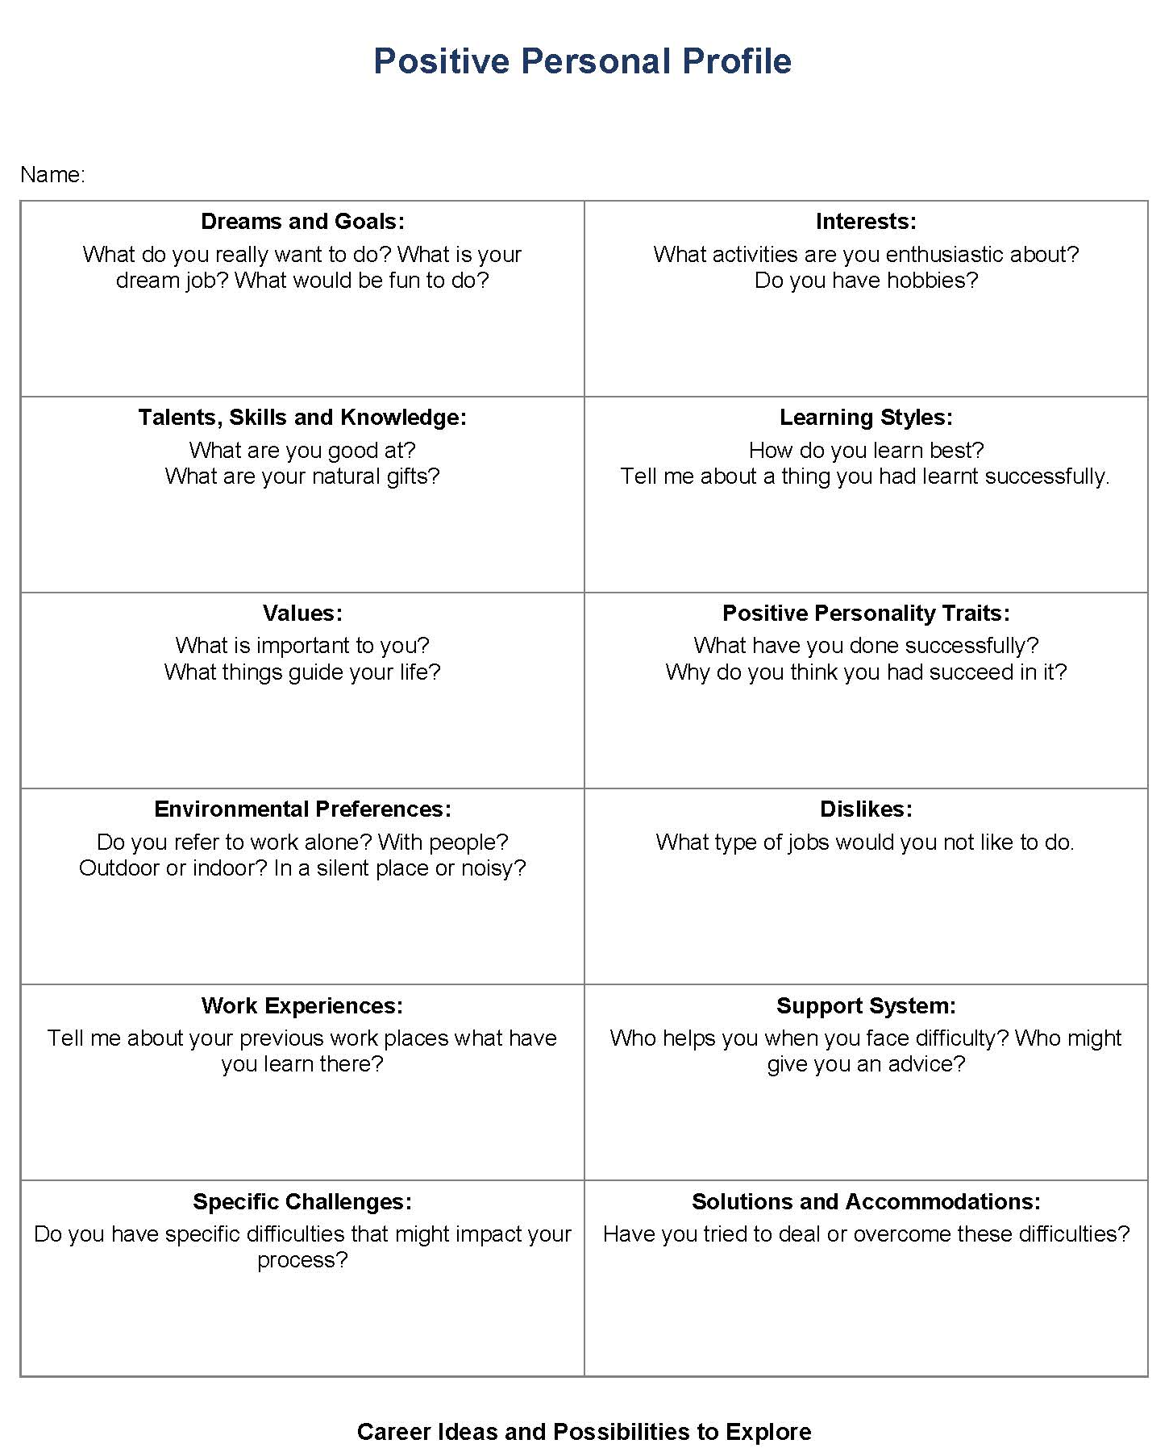
Positive Person Profile:
Let’s give this a whirl
Take a minute to profile yourself.
Then take a look at your current life…
Is it meaningful? Why (or why not)?

Slide 23
Mapping People, Places, and Associations
Volunteering and Contributing
Learning and Personal Growth
Special Interests Groups
Membership and Belonging
Community Asset Mapping Workbook: https://naaee.org/sites/default/files/assetmappingworkbook2013.pdf
Relationship Maps Searchable Databases Kanban Boards Google Maps
Notes:
Add Community Asset Mapping Workbook

Slide 24
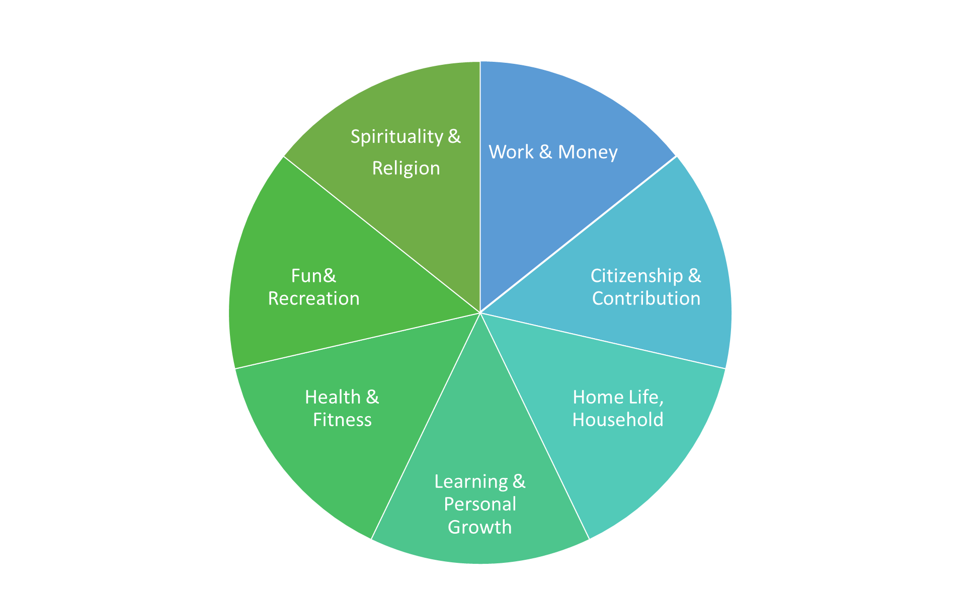
Meaningful Day “Tools”
Community & Relationship Mapping: general mapping and person specific.
Positive Personal Profile: completed through exploration, discovery and reflection. Updated on a rolling basis. Individual Service Design Sessions.
Partnership documentation. “Nothing about me without me.”
Skills Assessment (For Independence or Self-Reliance): updated every 3-6 months
2-3 SMART goals based on “What do you want to do? What do you need to learn?”
30 day plans with specific goals and who is responsible.
Regular team meetings: strengths-based and person-centered. Person leads meetings whenever possible. 30 day plans help with accountability
Scatter Plotting to show progress: 1) experiences related to employment (which is one of the most valued social roles) and 2) skills assessment score.
Notes:
Jeannine replace with the tools and planning processes they use

Slide 25
Funding Considerations
Braided, hourly services: Employment and Community Supports Services
Integrated, 100% community-based services
Services start and end at HOME
Focused on pathways to CIE and building skills
Individualized, customized, person-driven
  1:1 services and/or small group ratios, 1:3- 1:4
  Heterogeneous enrollment - 1/3, 1/3 & 1/3
  All services must be Meaningful
Customized Employment placement methods
Services, not programs. Expectation is that services will fade as independence and confidence grows

Slide 26
Benefits of a Braided, Hourly Supports
  Built to Order (tailored & individualized service plans)
  Addresses service gaps
  Makes Employment more manageable and viable for people with complex needs
Services can be more flexible and responsive:
  Adjust to changing lives & circumstances
  Fade as person gains confidence and skills
Encourages collaboration and maximizes use of our limited resources
  Making stone soup

Slide 27
Improves
Employment
Outcomes
  Use Waiver Services to explore interests, employment ideas and build confidence in community settings & employability skills
  Open VR/Supported Employment case only when vocational goals and skills are identified (1:1 service)
Can address barriers or skill deficits prior to placement
Unpredictability of placements was difficult to manage, budget and staff
Creates a “specialties” within teams
Don’t have to scramble group services to support job placements.

Slide 28
Meaningful (adj.): full of meaning, significance, purpose, or value; purposeful; significant: a meaningful wink; a meaningful choice
- Dictionary.com

Slide 29
Historically, Community
Activities and Day Services were:
An alternative for people not interested (or “able”) to work
Seen as “outings” or field trips in large groups
Activities to fill “down” time (no contracts)
Special events
Recreational opportunities or a chance to socialize with friends
Planned and directed by staff

Slide 30
Purpose of Community Supports
Exploration and discovery
Build new skills
Develop social and professional connections
Foster inclusion - engage in community a meaningful ways
Gain independence, self-confidence in community settings
Augment part-time work schedules with meaningful non-work activities
Encourage the idea of working and create a pathway to Community Integrated Employment

Slide 31
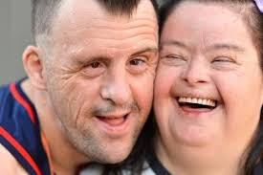
It is about
Teaching Skills
Not “Outings” or “Field Trips”
Person-centered, individual schedules
Goal-oriented: what does the individual want to learn? And need to learn?
Routine, pre-planned weekly schedules
Multiple visits, an opportunity to practice and make friends
Systematic instruction
Data collected/progress measured

Slide 32

Inclusion vs. Integration
More than just buying a cup of coffee at Starbucks
Requires routine opportunities to engage with others in meaningful ways
Must “give back”
Work, Volunteer, Help
Inclusion is not just physical proximity to others.
It means being accepted, respected, valued --- and missed

Slide 33
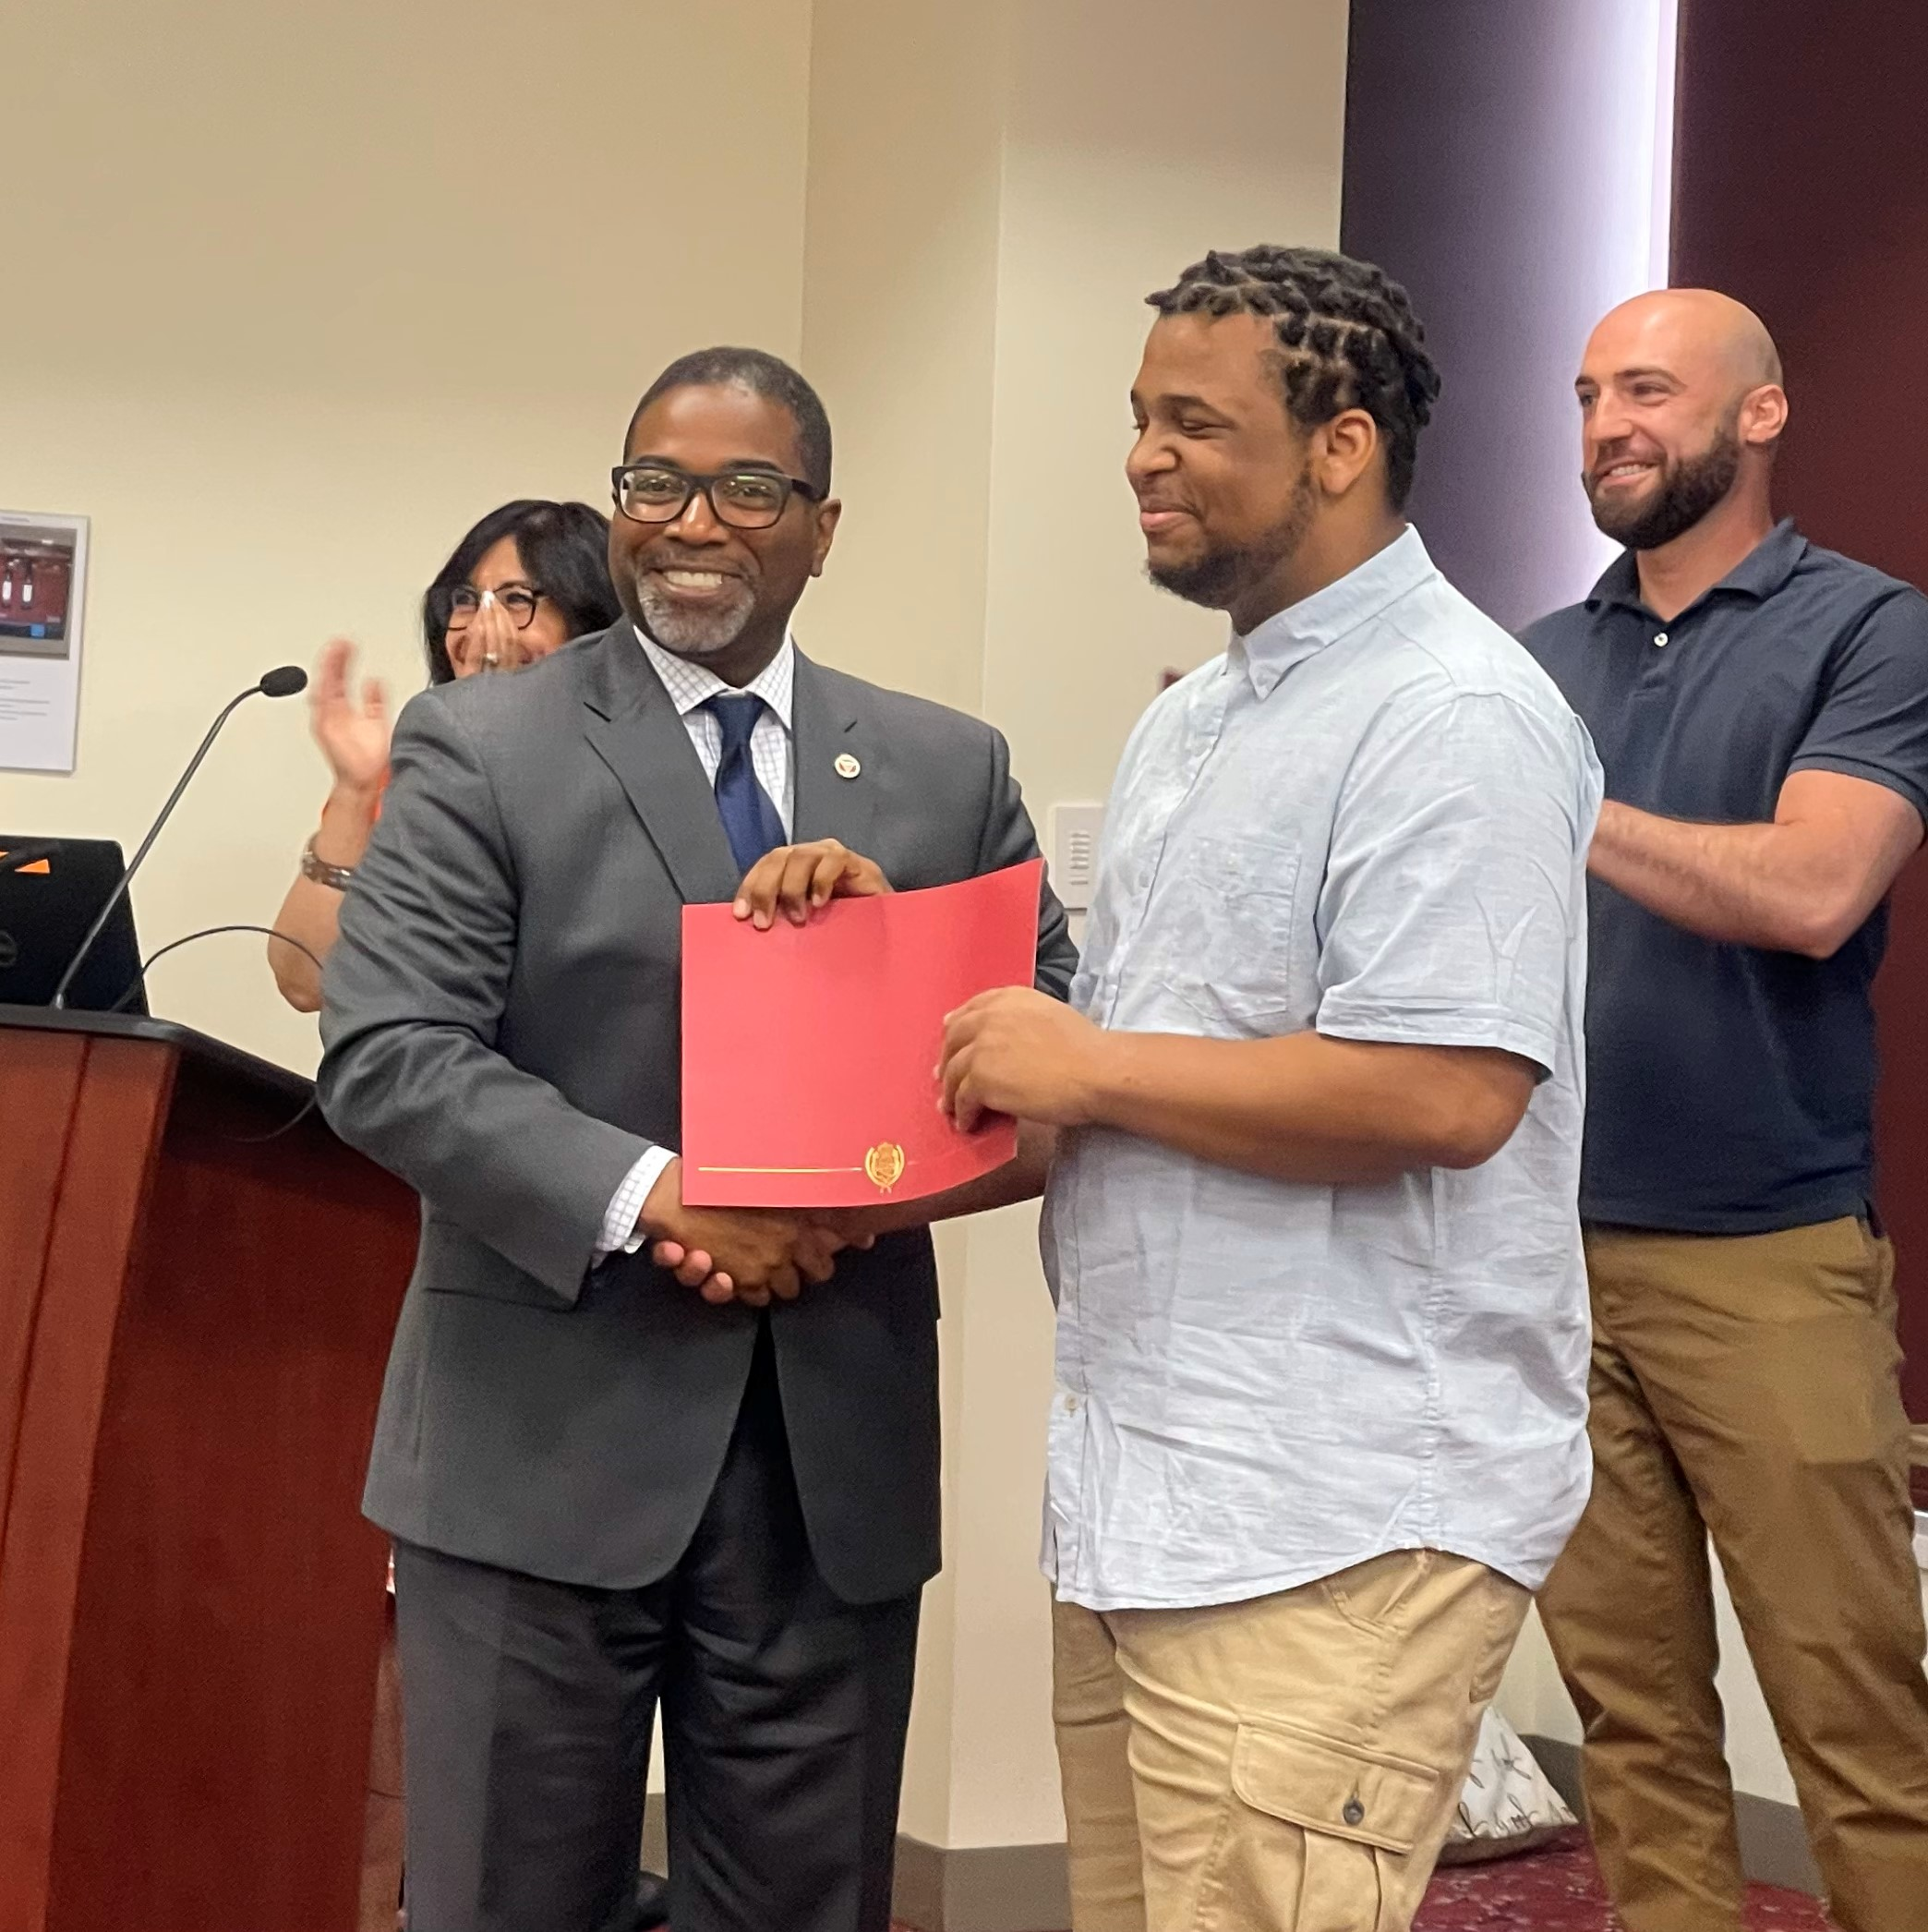

Building Confidence in the Community and Encouraging Independence
Teaching “social self-sufficiency”
Building stamina & endurance
Safety skills

Slide 34

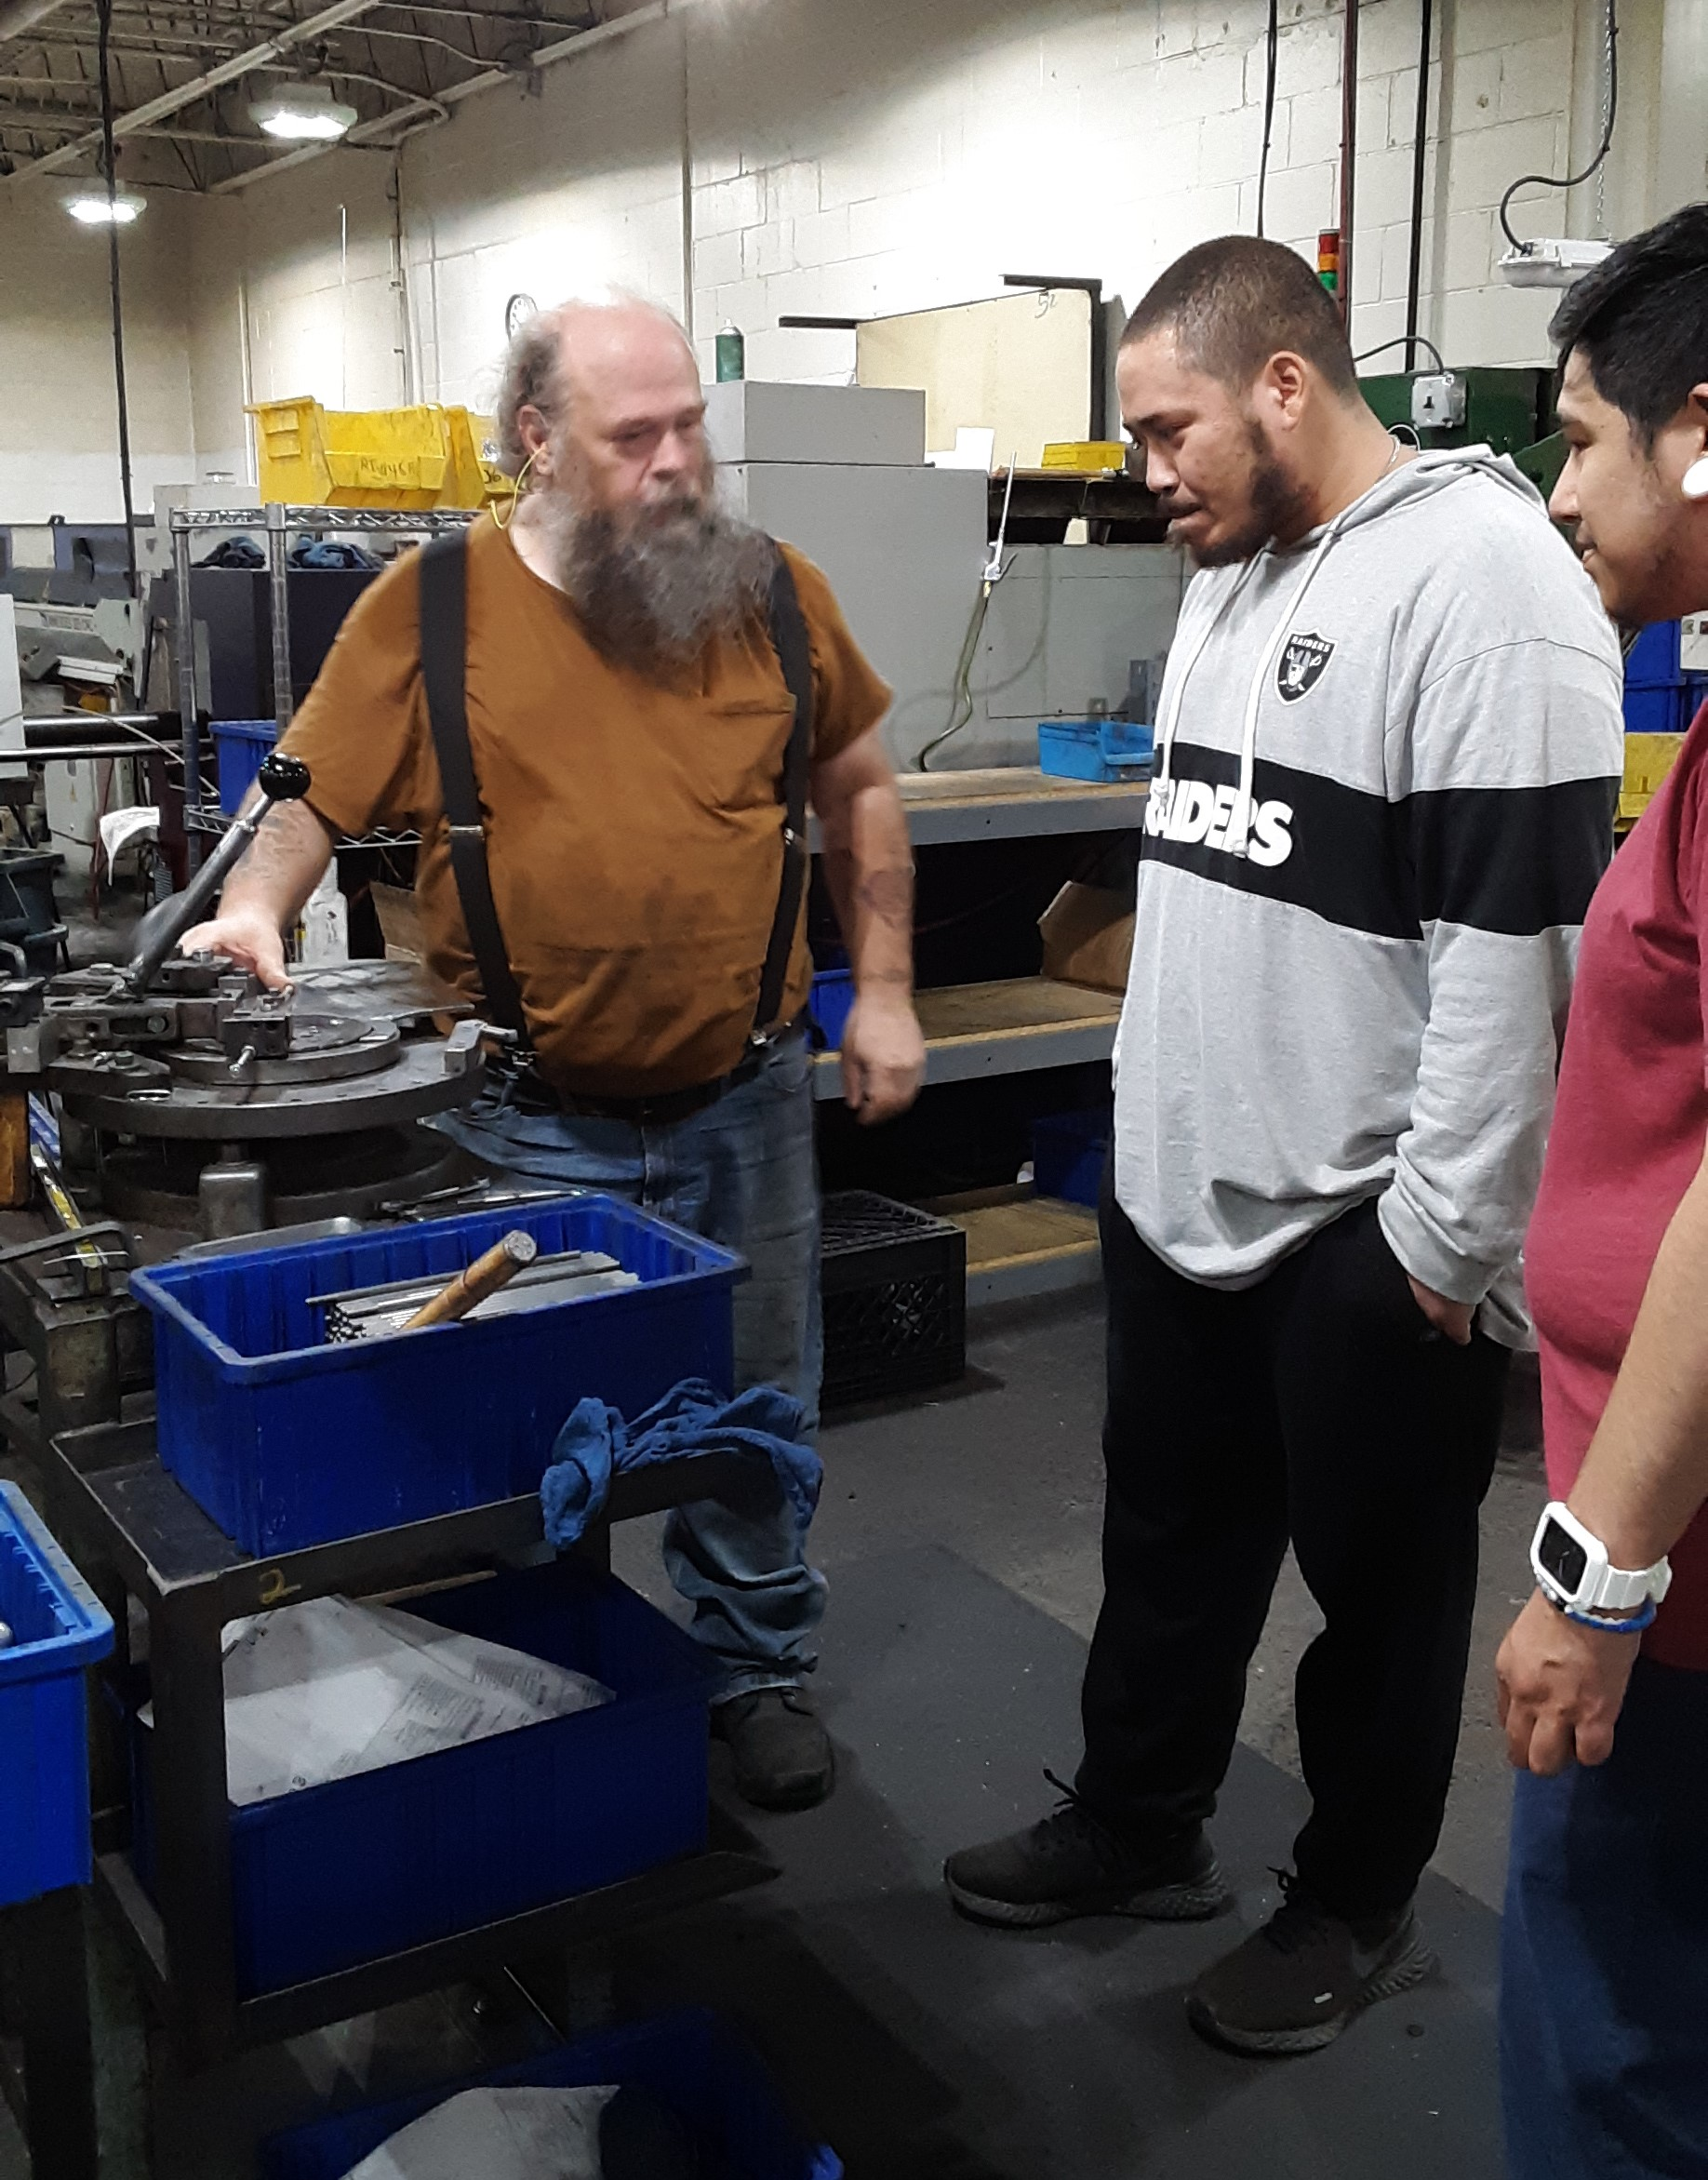
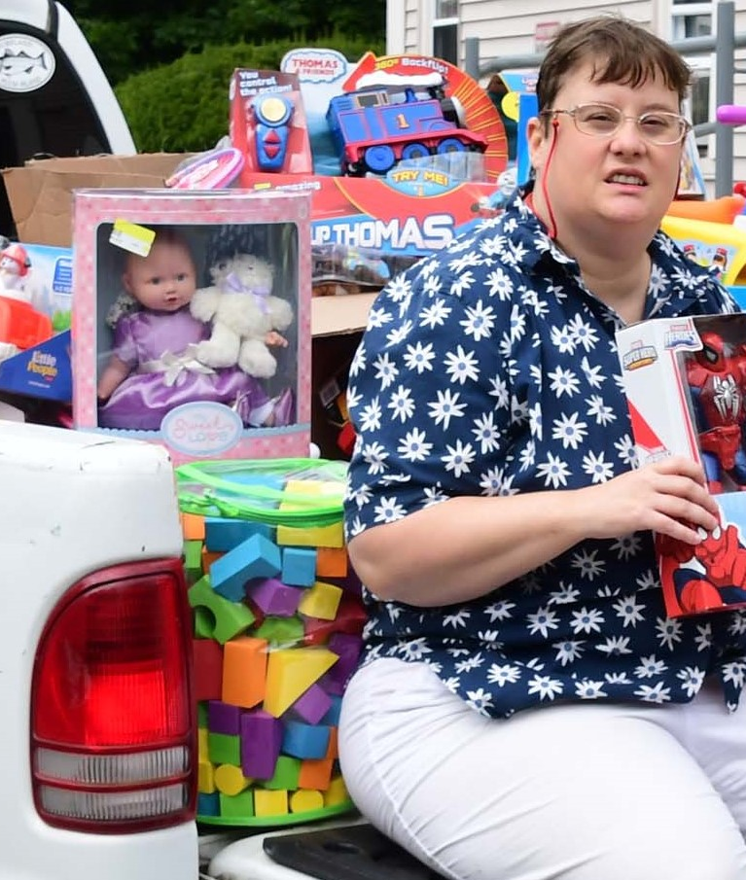
Community-Based Instruction
Real world: real people, real tools, “teachable moments”
HOME BASE IS BEST: home to sites, focus on neighborhoods
What is the skill we are trying to teach? Where does this happen in the real world?
Repetition and multiple visits: practice/learn skills, make friends, gain confidence

Slide 35
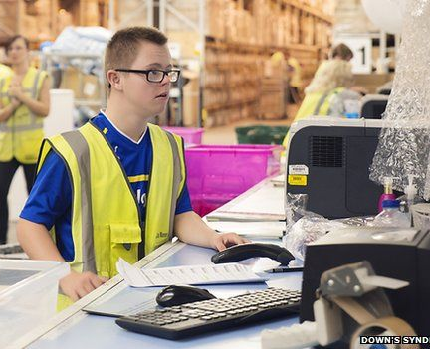
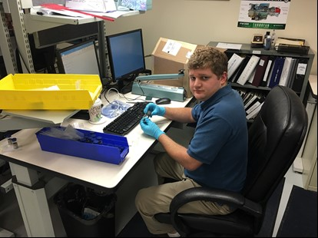
As Confidence and Skills Increase- Services Decrease
Listen, not lead
Facilitate, not control
Look for ways to fade
Consider technology
Be intentional

Slide 36
Individualized Services vs. Programs
Services are integrated within the person’s network of supports.
Schedules designed around real life, not a M-F, 9 to 3 program day.
Hourly rates: Flexible supports that wrap around a job.
Service provided based on what is meaningful for that individual, not focused on what is broken.
Individualized, but not necessarily 1:1
Activities (and groups) are based on a mutual interest or building a critical skill, not pre-determined classes, set by the program staff or a curriculum.
Notes:
Supports similar to “job coaching” – teach, get out of the way.

Slide 37
Charting the LifeCourse™
University of Missouri/KC UCEDD
Sees the person within the context of family & community
Looks at Life Stages and Life Domains.
Integrated supports: personal strengths, relationships, community resources, eligibility specific resources, technology
Creates connections and partnerships to support an individual’s goals and life

Slide 38
Traditional Program Supports and Services
Before:
Personal Strengths (independent)
Community-based, Public resources
→ Eligibility Specific Services
→ Relationships
Technology
Schedule courtesy of LifeCourse™

Slide 39
Goal: Integrated,
Normalized Lives and Normalized Supports/Services
After:
Personal Strengths (independent)
Community-based, Public resources
Eligibility Specific Services
Relationships
Technology
Schedule courtesy of LifeCourse™

Slide 40
For further inquires, please contact
Jeannine Pavlak, CEO jeannine.pavlak@nebaworks.com

