Slide 1

Employment is Everyone’s Job
Breaking Down the silos

Slide 2

Time to Act
WIOA Funding Mandates – 15% of VR Title I dollars for youth with disabilities; Restrictions on youth entry into non-integrated work settings; Definition of competitive integrated employment
CMS Final Rule- HCBS settings must be integrated in and support full access to greater community including opportunities to seek employment and work in competitive integrated settings.
Phase out of 14c
Employment First

Slide 3
Despite this the majority of individuals with IDD remain unemployed, isolated and impoverished. Recurring referrals to other services and supports vs employment supports

Slide 4

“The Great Resignation”
More jobs openings then ever.
Employers becoming more open to customized jobs.
Employers are more interested in partnering.

Slide 5
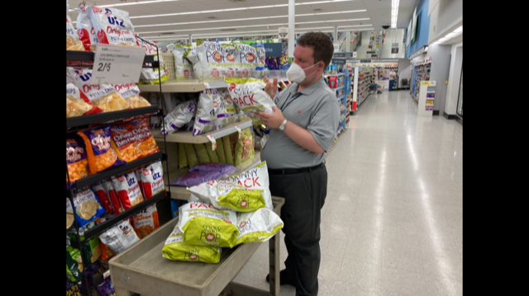
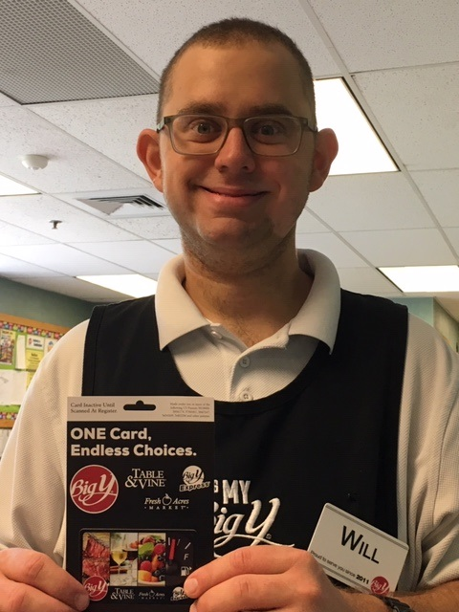
In a Society of Workers, Employment is the Way to True Integration

Slide 6

Get Stuck in Excuses
Safety Concerns
Fear of Rejection
“Not quite ready” - Fear of Failure
Staffing
Transportation
Sustainability
Unconscious low expectations
……………………………………

Slide 7

If we wait until we’re ready,
we’ll be waiting for the rest of our lives

Slide 8
Good Intentions Does Not Necessarily =
Good Service Delivery
Road to Hell: People often mean well but do bad things (institutions, segregation)
On the surface this simply means that you don’t succeed in doing the good things you intended
People who believe they are doing good can end up doing bad ( the law of unintended consequences) There is no value in simply planning to be good if you don’t actually do it!

Slide 9
A program is a set of structured activities while service is an event in which an entity takes the responsibility that something desirable happens on the behalf of another entity.
Difference between
Programs and Services
Program = Set of Activities
Services = Events that make something desirable happen.

Slide 10
Silos – Separate processes, requirements, job descriptions and expectations.
Group Day
Residential
Staff
Employment
CPS
Staff
Community Based Pre-Voc
Facility Based Pre-Voc
Staff

Slide 11

Look to Peel Away the Layers
What practices and processes are getting in the way?
How have we communicated the importance of employment to all staff?
Do we make time to discuss goals and progress made?
Do we make a habit of recognizing good work?

Slide 12


Slide 13

Seeing Through Different Lenses
Typically Centered on Deficits

Slide 14
“Disability is a matter of perception. If you can do just one thing well, you’re needed by someone.”
-Martina Navratilova

Slide 15
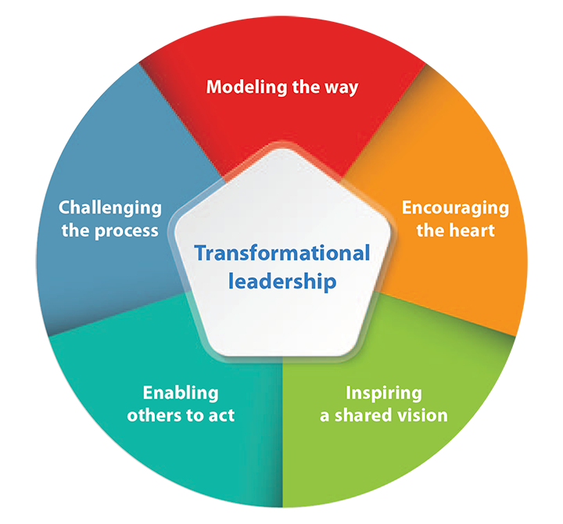
Begins with Leadership

Slide 16
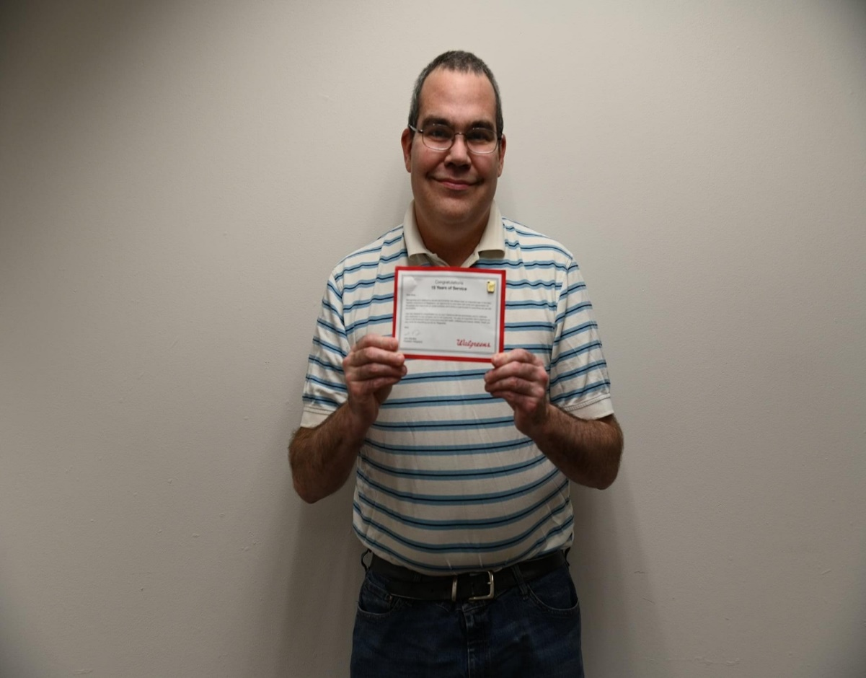
What are we Intending to Do?
Real community integration
and real work
for real pay

Slide 17
Clear consistent messaging – what direction are we going in?
Accountability for outcomes, or lack thereof.
Revised job descriptions focused on identifying natural talents and interests of the individuals we serve. (Move away from focus on documentation and safety.)
Hiring with intention.

Slide 18
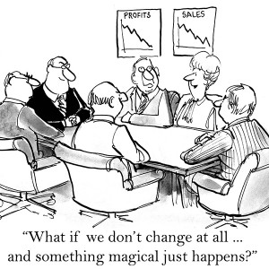
Resistance to Change is Inevitable
Set the strategy for change
Provide consistent, clear communication
Experiment and take risks
Let people know why to change and how to change
Act on things already in your control
Focus and make visible the BIG picture
Make change synonymous with continuous improvement

Slide 19

Pick the Right People/Departments
The majority fall in the middle of the curve
The Nay Sayers fall on the right of the curve
The excited to change fall on the left of the curve
Let’s go
Waiting it out
Not on my watch

Slide 20
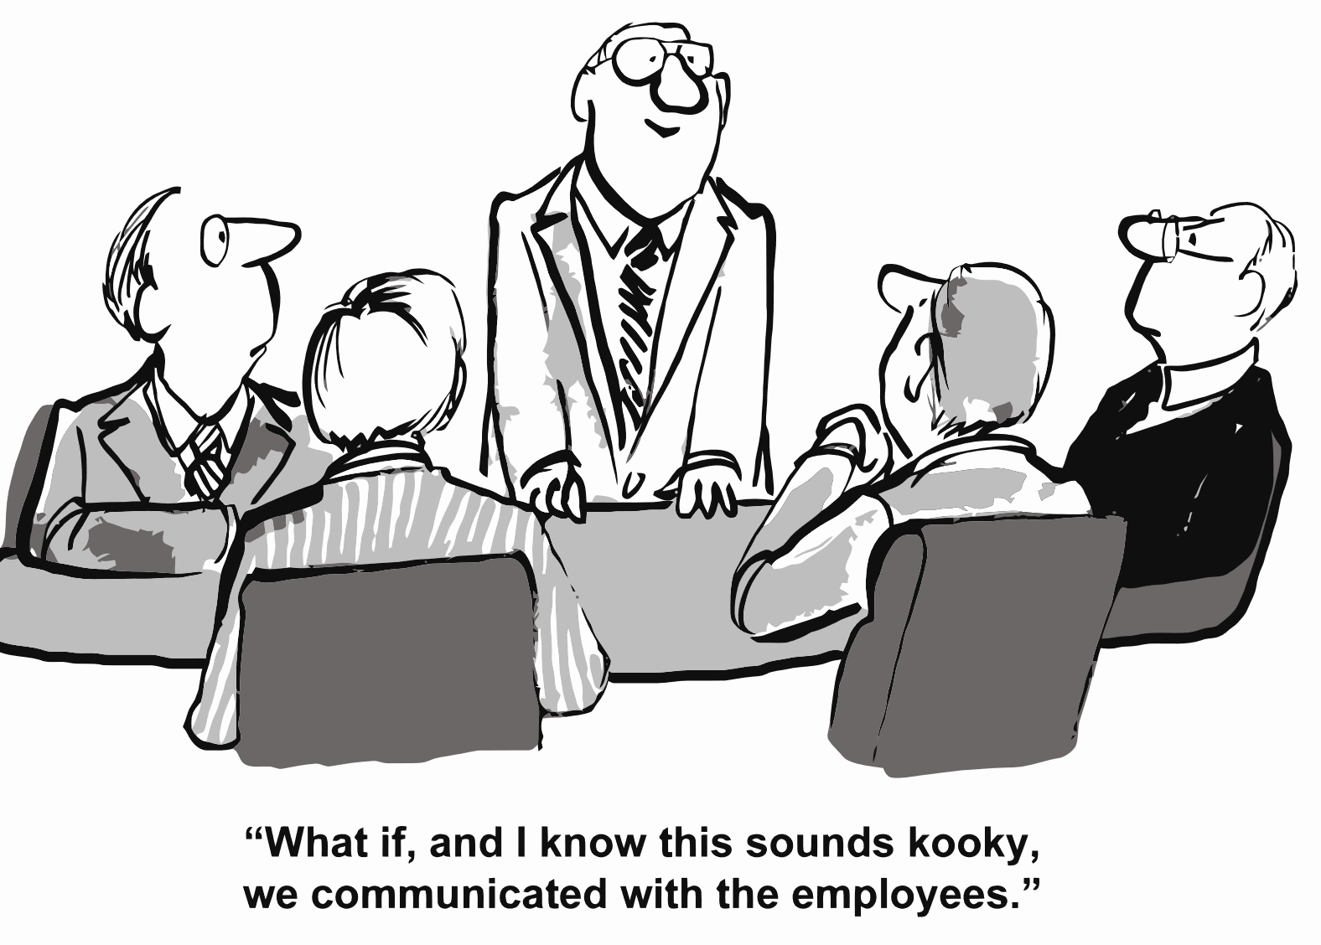
You Can’t Over Communicate

Slide 21
Home- Identifying interests and natural talents, skill building vs. doing for instead.
Home
Employment
Community
Day – Discovery, individualized schedules, expand networks
Facility Based – Explore through technology. Identify skills.

Slide 22
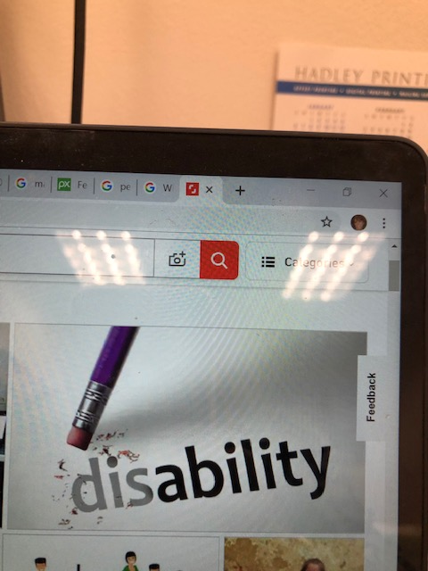
Keep in Mind
What are we teaching?
What is the reason behind the why?
Where do people learn best?
What is typical?
Introduce individuals in the most positive way.

Slide 23
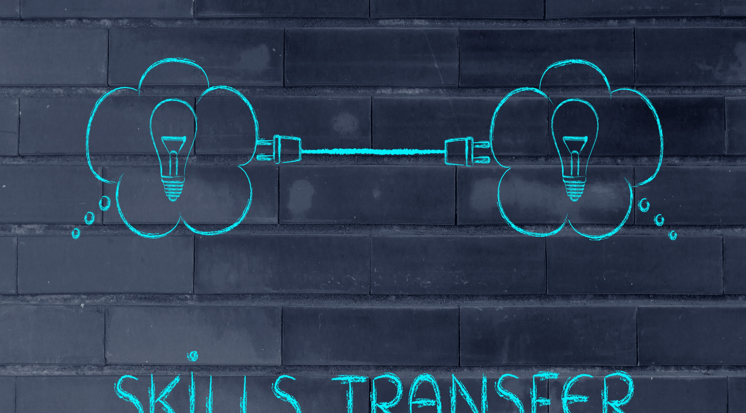

Slide 24
“It’s the repetition of affirmations that leads to belief. And once that belief becomes a deep conviction, things begin to happen.”
–Muhammad Ali

Slide 25
Basic Building Blocks
Voc Rehab
HCBS Waiver
TTW
Foundation
Private Funding
Local, State and School Districts

Slide 26
Braiding Funding
HCBS Waiver community based services for discovery and community Integration
VR funding for job development and intensive job coaching
HCBS Waiver funding for long term job coaching and wrap around supports

Slide 27
Medicaid HCBS Waivers to Promote Employment
Discovery and Person Centered Planning
Job Development and Support
Wrap around services, community participation
Community Habilitation and Community Participation Supports
Supported Employment Services
Residential
Job Finding
Job coaching support
Community Habilitation
Community Participation Supports

Slide 28
Pilot
Start small and work through the kinks and bring to scale.
Track progress
Celebrate along the way
Don’t give up
Be willing to redirect as necessary
No one ever said this work was easy

Slide 29
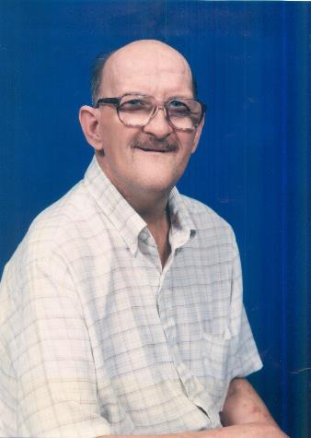
John Patrick…
John grew up at Belchertown State School and moved to Northampton in the early ‘90’s.
He worked as an advocate and public speaker for 10 years.
His work, along with his relationships in the community, saved his life.

Slide 30
Jeannine Pavlak
Jeannine.Pavlak@nebaworks.com
(413) 821-9200

