Slide 1
Meaningful Lives
A Deeper Dive
Alliance Colorado – June 5,2023

Slide 2
Changing How We Do Business
Aiming for 100% Community-Based
Finding what is meaningful: not about the program, it is about the people. Fully participating with purpose
Guide on the side. Connector. Building services designed to fade - when and as much as possible as independence increases
Creating a pathway to employment by learning, exploring, connecting and contributing
Supporting more people, possibly for fewer hours each day, in a variety of ways - breaking the 9am to 3pm service mold
Include and set aside time to talk with residential staff
Tapping into transportation options – bus and taxi training, ride share, walking and biking, community meeting up hubs, etc.
Notes:
Jeannine provide examples of how they do some of these things – conversations with residential providers (set aside roles and hours to work together to support people)

Slide 3
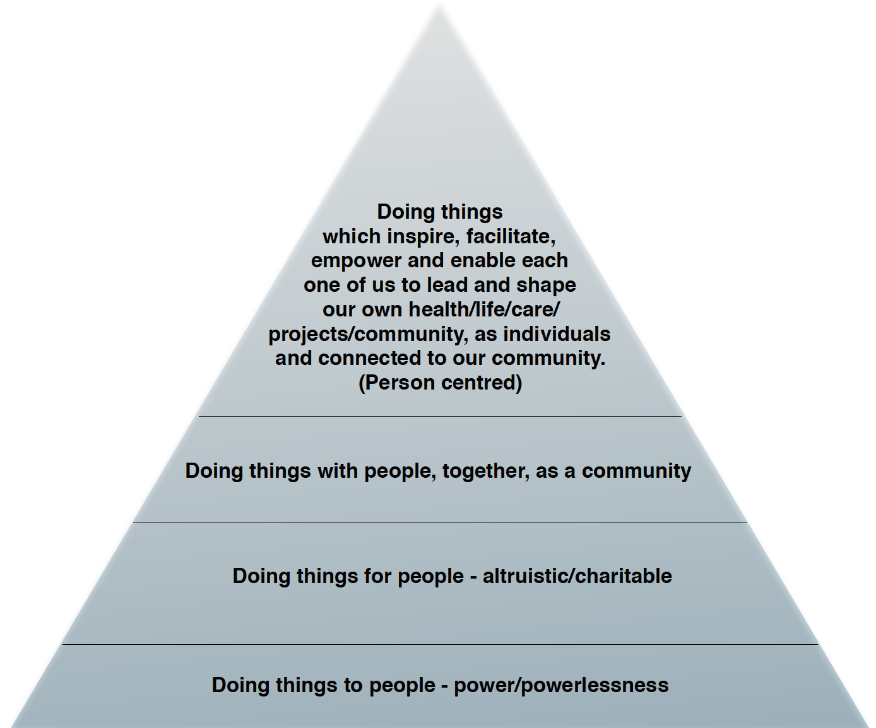
Hierarchy of Best Practices

Slide 4
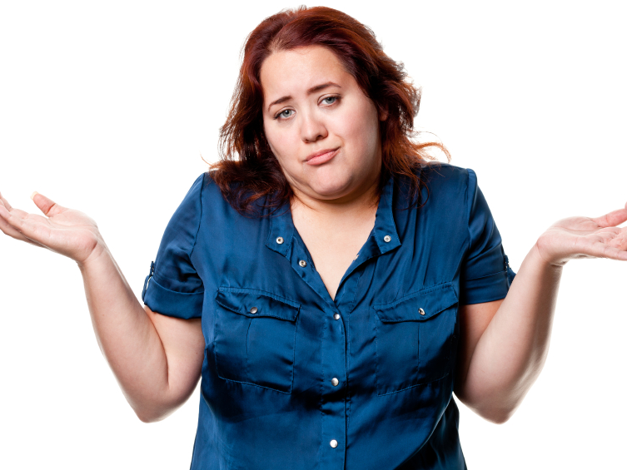
Ambivalence is an opportunity.
Culture of low expectations
Deficit-based thinking
Limited life experiences
Fears
Exposure precedes interest.
Interest precedes motivation.
Notes:
Told they can’t work, never asked or expected to. Acceptance, safety, fears of losing services - Jeannine add a story

Slide 5
About Me
What am I good at?
Where am I happiest?
What do I want to Learn?

Slide 6
Positive Person Profile:
Take a minute to profile yourself.
Then take a look at your current life…
Is it meaningful? Why (or why not)?

Slide 7
Start with Interests… Don’t get stuck on Deficits.
What Shane’s File said:
Autism diagnosis
Non- Verbal
Can’t sit still
Self injurious behaviors
Flight Risk
Stubborn
Unemployable

Slide 8
Start with Interests… Don’t get stuck on Deficits.
What we discovered:
Likes hiking, boating and fishing
Movement and exercise help him manage his anxiety
He is fascinated by windows and doors
Father is a carpenter and makes shims
Likes art and drawing

Slide 9
Start with Interests… Don’t get stuck on Deficits.
What Shane’s File said:
Autism diagnosis
Non- Verbal
Can’t sit still
Self injurious behaviors
Flight Risk
Stubborn
Unemployable
What we discovered:
Likes hiking, boating and fishing
Movement and exercise help him manage his anxiety
He is fascinated by windows and doors
Father is a carpenter and makes shims
Likes art and drawing

Slide 10
Community Mapping

Slide 11
Community Mapping
As close to home as possible
Where do people go with same/similar interests
Widen the circle as necessary
Make sure to include smaller, artisan places

Slide 12
Likes hiking, boating and fishing
Movement and exercise help him manage his anxiety
He is fascinated by windows and doors
Father is a carpenter and makes shims
Likes art and drawing

Slide 13
Parks
Recreation Center
Health Club
Rowing Club
Museum
Art Classes
College Campuses
Local Carpenters
Hardware Stores
Home Depot
IKEA
W
Community Map

Slide 14
Community Mapping Exercise

Slide 15
Getting Started:
Start from home base when possible
List all places that people go to who have same/similar interests
Use Google Maps to see what is around
Familiar places – where do they go with family
Calendar of Community Events
Think in Themes
Opportunities for continual growth and exploration
Purposeful participation

Slide 16
“Loneliness is the only real disability.” - David Pitonyak
Lack of social capital severely impacts any individual’s ability to be successful.
Do we need to address how we support people in order to help them to develop their own social capital? Yes, ABSOLUTLEY!

Slide 17
Relationships - Social Capital.
Relationships are what keep us happy, healthy, and safe.
Relationships make the world go round.
Relationships bring us opportunities- they expand our world.
Do the people we serve have diverse relationships with a wide network of people?

Slide 18
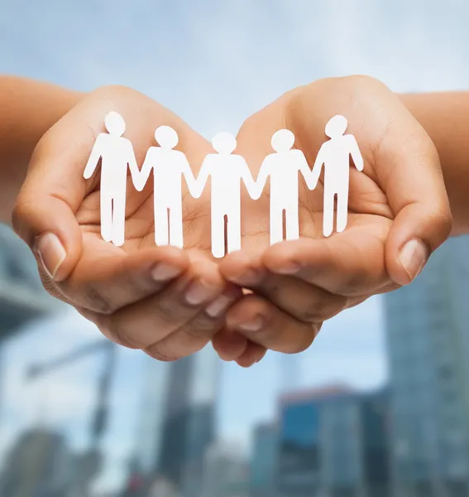
Relationship Mapping - Exercise

Slide 19
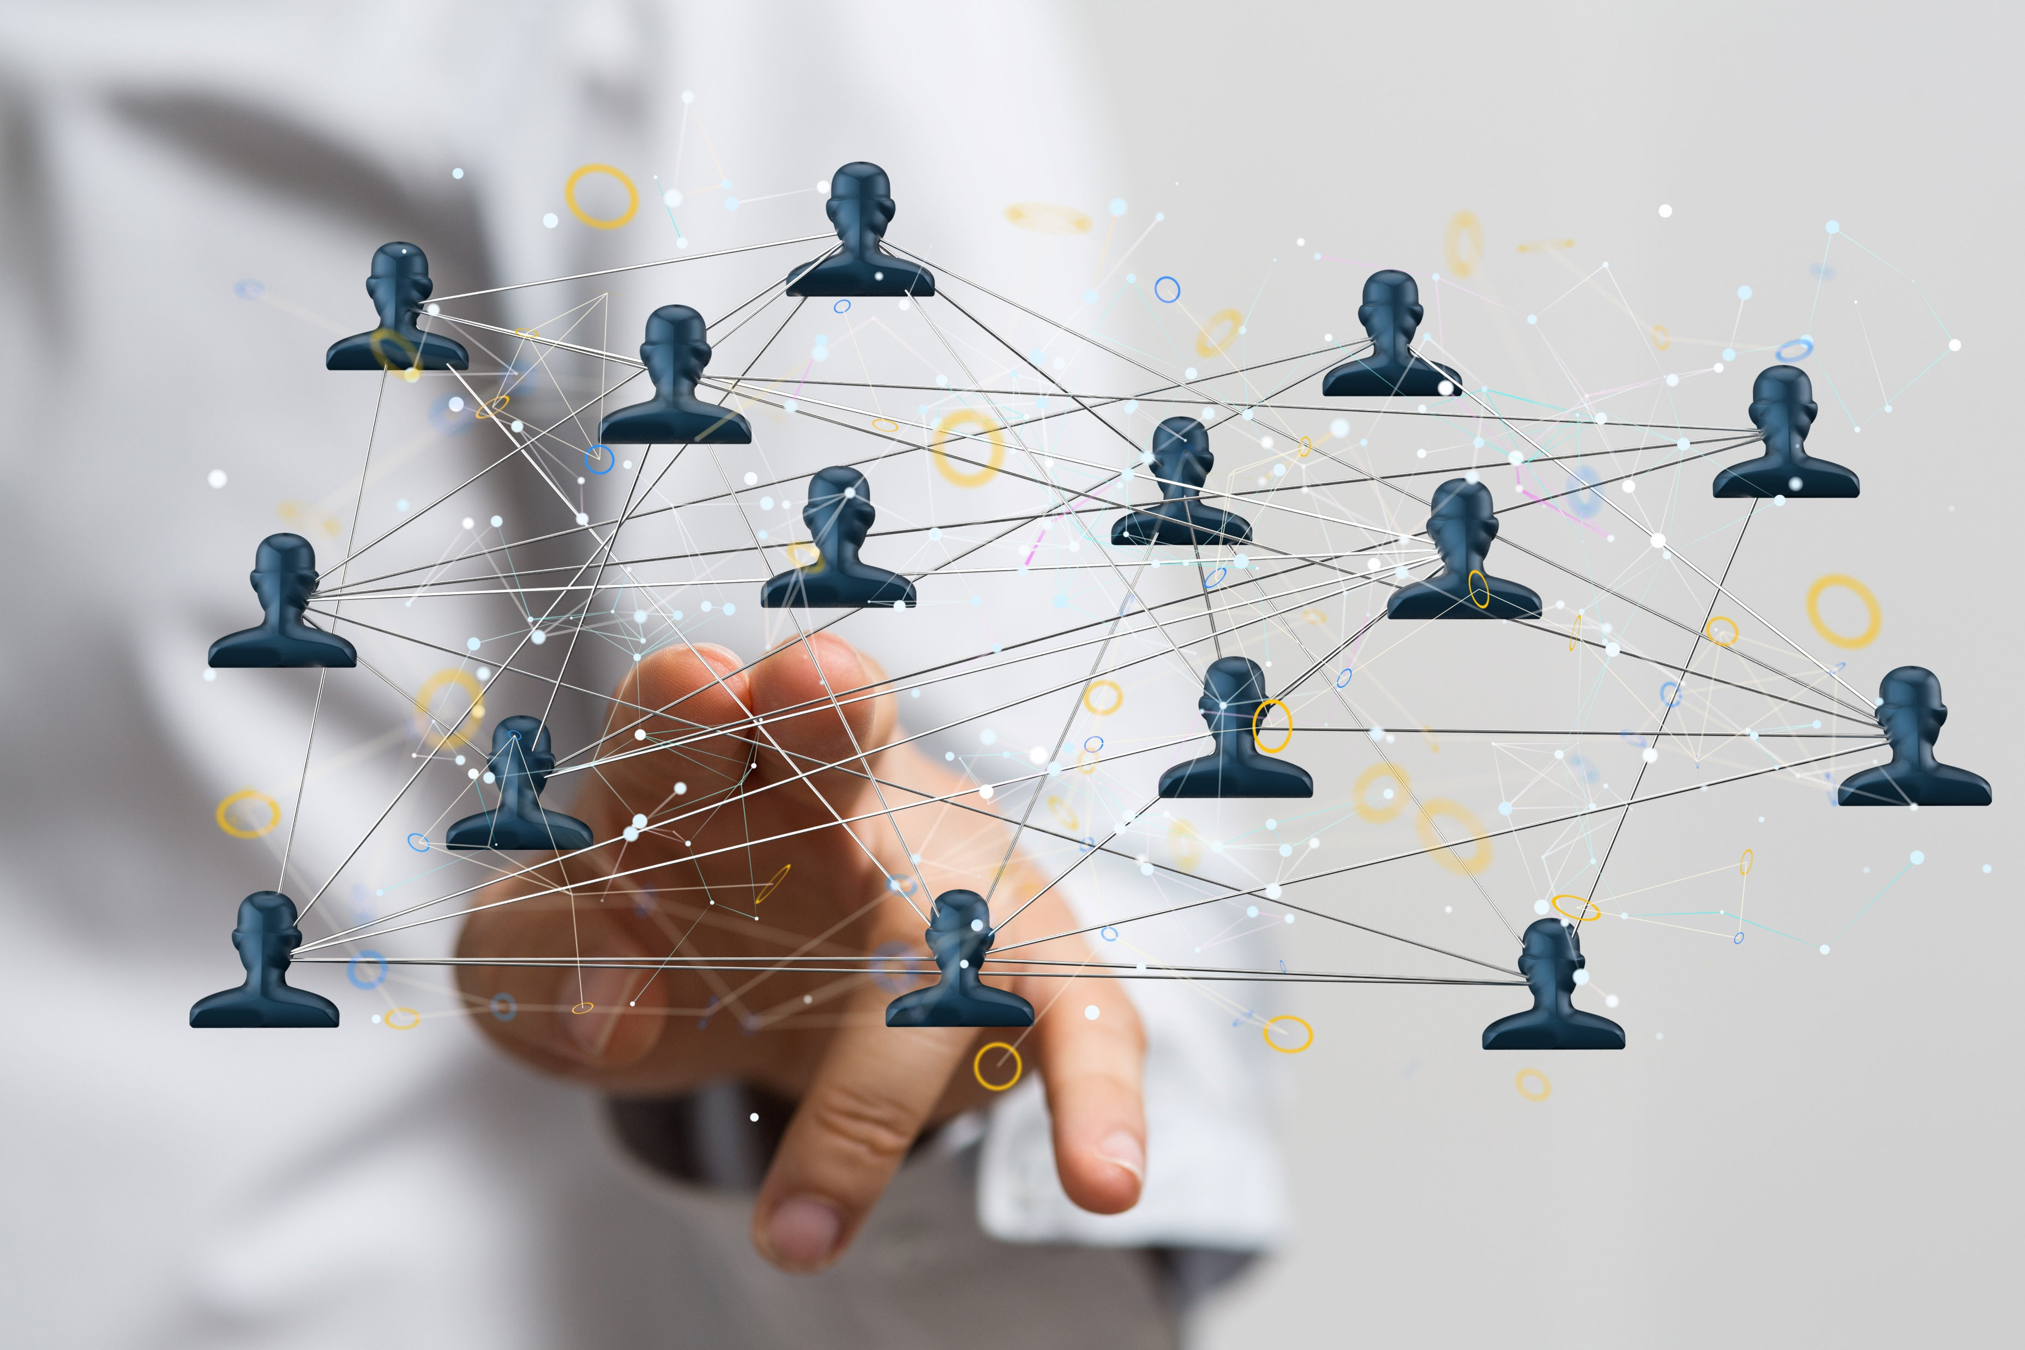
Relationship Mapping
Who do you know?
Who does the individual know?

Slide 20
Look for the social/communal hubs
Bars, restaurants, beer gardens, breweries, food halls, food truck parks
Libraries
YMCAs, gyms, sports leagues
Community gardens, community parks and recreation
Community centers, senior centers
Schools
Performing arts centers
Time Banks, Co-Ops, Non-profit organizations

Slide 21
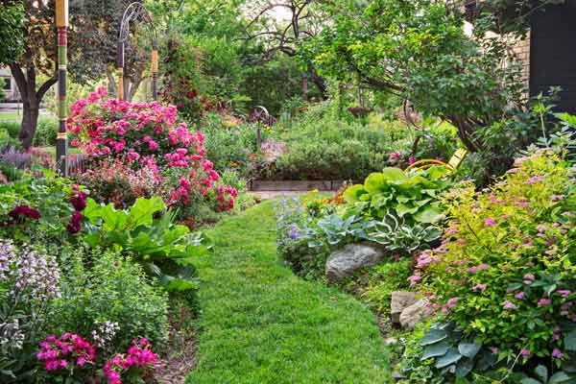
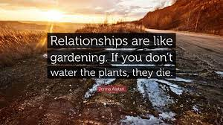
Cultivating relationships is like gardening…
You have to..
Make your garden plan
Plant your seeds
Tend, water, and weed
Tend, water, and weed some more
Gather your harvest
It’s hard work and it takes a while.

Slide 22
Although 1:1 is ideal,
it can be done in small groups based on interests

Slide 23
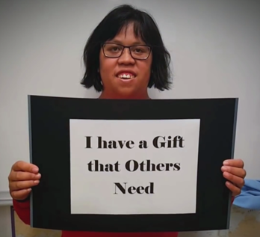
Valued Social Roles Matter
When people have valued social roles they have more opportunities to live “the good life.”
Normalization = authentic, typical life experiences in ordinary, typical places…not practice, simulations, or separate places.
Valued Social Roles: Community Member vs Client
Giving vs Taking

Slide 24
For further inquires, please contact Jeannine Pavlak, CEO jeannine.pavlak@nebaworks.com

